Slide 1
Homework 1
Install FreeBSD & WireGuard
stchang
Notes:
作業的要求很多都是業界的best practice

Slide 2
Requirements
Basic (15%)
Install FreeBSD 13.0-RELEASE or other allowed operating systems
Apply security patches (latest: patch 4)
Root on ZFS (15%)
Zpool name : zroot
Add a user and a group
User should also be in the "wheel" group
Use this user to do this homework instead of root (using sudo)
Add a user called "judge" for Online Judge
User should also be in the "wheel" group
Please Using "sh" as default shell (10%)
This user needs to run sudo without password (15%)
Notes:
Best practice
安裝freebsd 13.0的release版本 然後root 要on zfs上
要安裝更新到patch 4並重開增加使用者和群組 你的功課要用這個user來完成不能使用 root
然後再新增一個較judge的使用者給我們judge使用並且不需要密碼就能跑sudo指令

Slide 3
Requirements (Cont.)
Set your machine to current time zone and adjust current time (10%)
CST
Enable sshd (20%)
Install this public key to your /home/judge/.ssh/ for Online Judge.
$ fetch https://nasa.cs.nctu.edu.tw/sa/2021/nasakey.pub
$ cat nasakey.pub >> /home/judge/.ssh/authorized_keys
You can use Fingerprint to check "nasakey.pub"
$ ssh-keygen -l -f nasakey.pub
2048 SHA256:FKznGEAAy6gcVC4x+JpiTo34zbaHRYIc9WShzqR+yF4 no comment (RSA)
Notes:
設定你得時區在CST
打開你的sshd 把我們judge的key加入讓judge可以連上
可以用fringerprint來檢查key
nasakey.pub有包含IP設定

Slide 4
Requirements (Cont.)
Login into NASA Online Judge.
There are some information in your profile
ID
Your IP in WireGuard is 10.113.0.ID
WG_PRIVATE_KEY
Using this private key to connect WireGuard Server
WG_SERVER_PUBLIC_KEY
Using this public key to connect WireGuard Server
Notes:
登入oj會有wireguard的相關訊息在你的profile

Slide 5
Requirements (Cont.)
Install WireGuard (Installation Guide)
Server Address
nasa.nycucs.org:51821
Using this information to connect Online Judge’s WireGuard Server :
10.113.0.ID
WG_PRIVATE_KEY
WG_SERVER_PUBLIC_KEY
You can install WireGuard with pkg or port
Notes:
安裝wireguard 並且設定相關資訊

Slide 6
Requirements (Cont.)
WireGuard Config Example
[Interface]
Address = 10.113.0.ID/32
PrivateKey = [WG_PRIVATE_KEY]
[Peer]
PublicKey = [WG_SERVER_PUBLIC_KEY]
AllowedIPs = 10.113.0.0/16
Endpoint = nasa.nycucs.org:51821
PersistentKeepalive = 25
wg0.conf
Notes:
這邊有範例

Slide 7
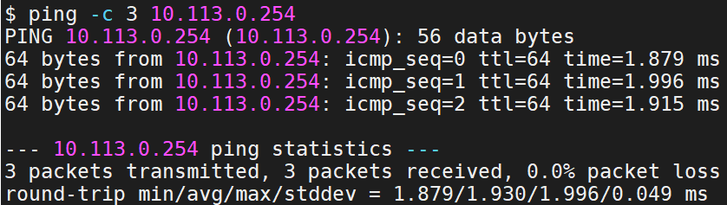
Requirements (Cont.)
You can use "ping -c 3 10.113.0.254" to test whether you have connected to WireGuard Server
Online judge server can ping your server (15%)
Notes:
可以用ping指令來測試是否ping的到oj的機器

Slide 8
Requirements (Cont.)
Online judge system is designed for FreeBSD 13.0-RELEASE and CentOS 8-Stream only
Doing your homework with other OS may not pass online judgement

Slide 9
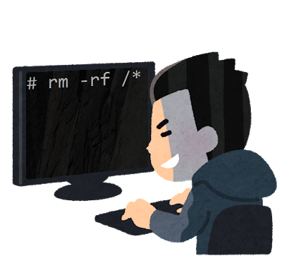
Requirements (Cont.)
BACKUP your server before judge EVERY TIME
We may do some things bad when judging.
TAs reserve the right of final explanations
Start from 9/24 12:00
Deadline 10/13 23:59
Notes:
記得所有動作都要備份，以免再judg的時候被做壞事

Slide 10
Hints
Virtual machine is good for doing homeworks
Easy to install and backup
Try to make your VM hardware configuration better
Disk controller
IDE → SATA, NVMe, …
NIC: paravirtualized net, ...

Slide 11
Sign Up CS Account

Slide 12
Requirements
CS account
Sign up your own account at CSCC account system
https://account.cs.nctu.edu.tw/
Active your account in EC320
Try to login to Git.cs using CS account
We will using Git in the next homework.
https://git.cs.nctu.edu.tw/
SIGNUP CS ACCOUNT EARLY!
We will not grade in this stage
If you aren’t major in CS, you need to get Teachers/Professor's signature to activate your CS account!
Notes:
去計中申請帳號 之後作業會有用到系上的gitlab

Slide 13
How to use Online Judge

Slide 14

Online Judge
https://nasa.nycucs.org
Notes:
學校單一入口登入的帳號密碼

Slide 15
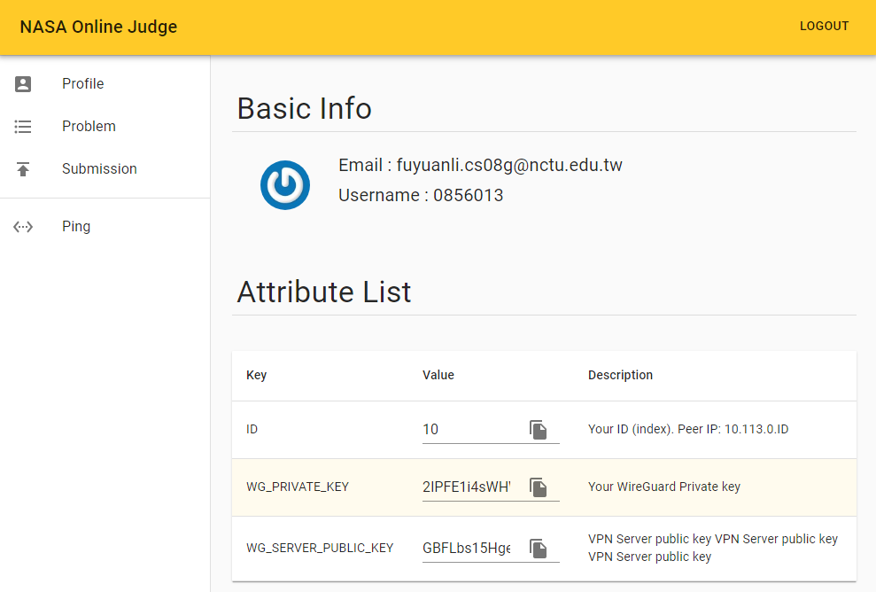
Profile
https://nasa.nycucs.org/profile

Slide 16
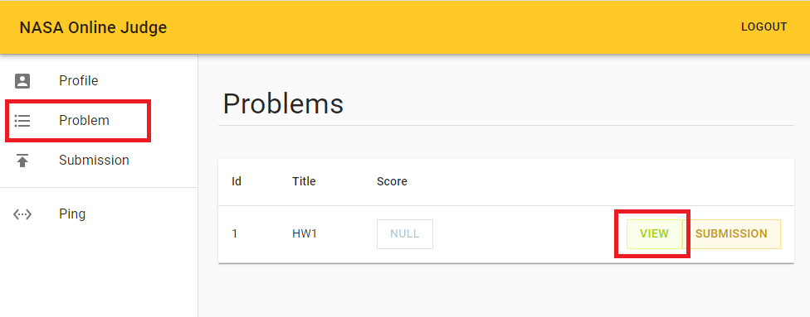
Problem
Notes:
problem看有哪些作業

Slide 17
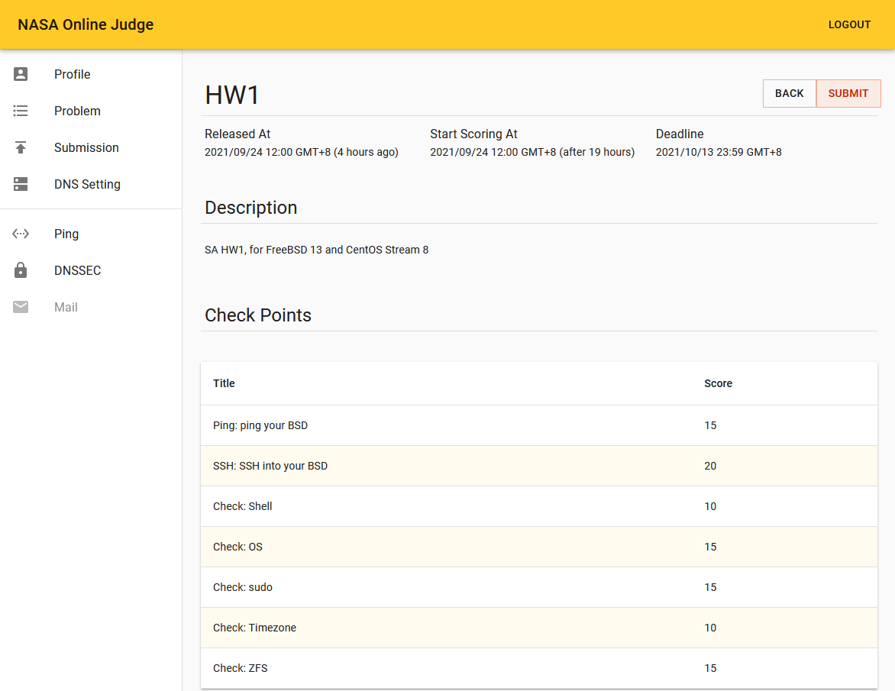
Notes:
下面有分數對照看看自己有沒有達成

Slide 18
Help!
Join NCTUNASA google group
If you have any question, you can post your problem in this group, TAs and Students will help you.
https://groups.google.com/g/nctunasa
UNIX 常見指令教學
https://cscc.cs.nctu.edu.tw/unix-basic-commands
How To Ask Questions The Smart Way
https://github.com/ryanhanwu/How-To-Ask-Questions-The-Smart-Way

