Slide 1
Homework 2 One Liner Script & System Info
hslin, cwang, xizhen

Slide 2
HW 2-1: One liner script (40%)

Slide 3
HW 2-1: One liner script (40%)
Use shell script to analyze the content of auth.log (secure) and output three files:
audit_ip.txt: List the source IPs that ssh login failed and count the number of login failed times.
audit_sudo.txt: List the commands and users who used `sudo`.
audit_user.txt: List the users who ssh login failed and count the number of login failed times. (Users who in the system)
Notes:
Best practice
安裝freebsd 13.0的release版本 然後root 要on zfs上
要安裝更新到patch 4並重開增加使用者和群組 你的功課要用這個user來完成不能使用 root
然後再新增一個較judge的使用者給我們judge使用並且不需要密碼就能跑sudo指令

Slide 4
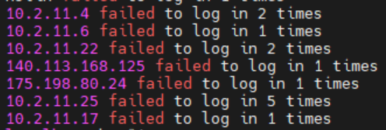
HW 2-1: One liner script (40%)
audit_ip.txt: List the source IPs that ssh login failed and count the number of login failed times. (10%)
Notes:
Best practice
安裝freebsd 13.0的release版本 然後root 要on zfs上
要安裝更新到patch 4並重開增加使用者和群組 你的功課要用這個user來完成不能使用 root
然後再新增一個較judge的使用者給我們judge使用並且不需要密碼就能跑sudo指令

Slide 5
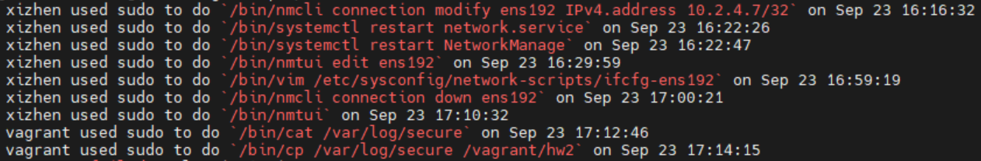
HW 2-1: One liner script (40%)
audit_sudo.txt: List the commands and users who used `sudo`. (20%)
Notes:
Best practice
安裝freebsd 13.0的release版本 然後root 要on zfs上
要安裝更新到patch 4並重開增加使用者和群組 你的功課要用這個user來完成不能使用 root
然後再新增一個較judge的使用者給我們judge使用並且不需要密碼就能跑sudo指令

Slide 6
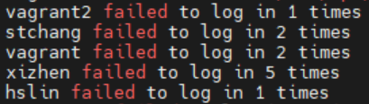
HW 2-1: One liner script (40%)
audit_user.txt: List the users who ssh login failed and count the number of login failed times. (Users who in the system) (10%)
Notes:
Best practice
安裝freebsd 13.0的release版本 然後root 要on zfs上
要安裝更新到patch 4並重開增加使用者和群組 你的功課要用這個user來完成不能使用 root
然後再新增一個較judge的使用者給我們judge使用並且不需要密碼就能跑sudo指令

Slide 7
HW 2-1: One liner script (40%)
Your script is limited to one line and outputs 3 files.
Must not use the following commands:
Subshell for grouping: ( … )
Command substitution: $(…) also spelled `…`
Process substitution: <(…) or >(…)
tee, sh, bash, csh, base64, eval
;, &&, ||
Temporary files are not allowed.
Only use > to redirect output to file once.
Notes:
Best practice
安裝freebsd 13.0的release版本 然後root 要on zfs上
要安裝更新到patch 4並重開增加使用者和群組 你的功課要用這個user來完成不能使用 root
然後再新增一個較judge的使用者給我們judge使用並且不需要密碼就能跑sudo指令

Slide 8
HW 2-1: One liner script (40%)
Must not use shell variables.
Must not call network tools (such as curl, wget...)
Must not call interpreters or compiler (such as Python, Ruby…).
Only one shell, sh, are allowed.
If you are not sure whether a tool is allowed, please ask TA on Google group.
Your script must start with
FreeBSD:
cat /var/log/auth.log |
CentOS:
cat /var/log/secure |
Notes:
Best practice
安裝freebsd 13.0的release版本 然後root 要on zfs上
要安裝更新到patch 4並重開增加使用者和群組 你的功課要用這個user來完成不能使用 root
然後再新增一個較judge的使用者給我們judge使用並且不需要密碼就能跑sudo指令

Slide 9
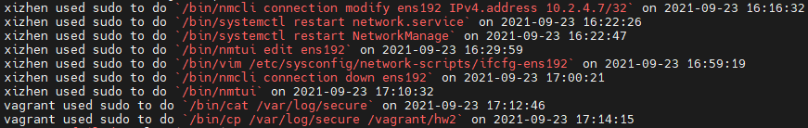
HW 2-1: One liner script (40%)
Bonus (10%):
Convert the date format of audit_sudo.txt. (5%)
Example: Sep 23 16:16:32 → 2021-09-23 16:16:32
If you can finish homework 2-1 without awk, please email ta@nasa.cs.nctu.edu.tw (5%)
Notes:
Best practice
安裝freebsd 13.0的release版本 然後root 要on zfs上
要安裝更新到patch 4並重開增加使用者和群組 你的功課要用這個user來完成不能使用 root
然後再新增一個較judge的使用者給我們judge使用並且不需要密碼就能跑sudo指令

Slide 10
HW 2-1: Sample log
FreeBSD：https://reurl.cc/vgmnak
CentOS：https://reurl.cc/0x6zvK
Notes:
Best practice
安裝freebsd 13.0的release版本 然後root 要on zfs上
要安裝更新到patch 4並重開增加使用者和群組 你的功課要用這個user來完成不能使用 root
然後再新增一個較judge的使用者給我們judge使用並且不需要密碼就能跑sudo指令

Slide 11
HW 2-2: System Info Panel (60%)

Slide 12
Freebsd: Dialog (1)
DIALOG(1) General Commands Manual DIALOG(1)
NAME
dialog - display dialog boxes from shell scripts
DESCRIPTION
Dialog is a program that will let you to present a variety of questions or display messages using dialog boxes from a shell script.
Notes:
Dialog 是可以在 Terminal 上快速建立 TUI 的工具。而 TUI 是有點像是 GUI 的玩意，不過他們不同的點是這東西是在 Terminal 上顯示ㄉ，他可以補助我們讓我們平常打的指令變成可交互話。

Slide 13
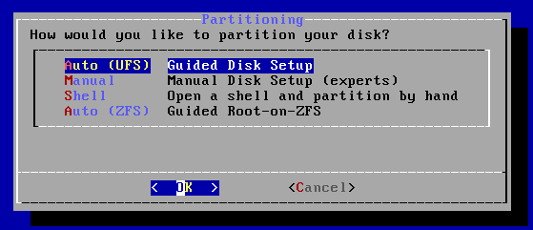
Freebsd: Dialog (1) - Example 1

Slide 14
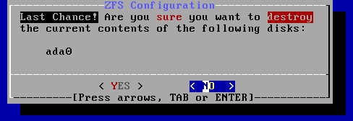
Freebsd: Dialog (1) - Example 2

Slide 15
System Info Panel
You are a System Admin
You decided to develop a text-based user interface (TUI) program to help you manage the system
It comes with several functions
After selecting one, use dialog(1) to show system information
It has to be beautiful. It has to be formatted output but raw output
Notes:
這次ㄉ作業是要讓大家來做 sys info panel
請先假設你是系統管理員而且你需要管理在主機上的 user
那這時你可以用下指令的方式來取得所有的使用者清單並對他們做一些特定的操作，不過這樣的缺點是得下很多指令
那作為管理員的你也可以選擇使用 TUI 的方式，讓整個流程變得更為人性化且易於操作 因此本次作業要讓大家使用 dialog 來實作這個工具

Slide 16
Ref.
Use flow: https://bit.ly/39HB6zu
Video: https://bit.ly/3zUwJf9
Notes:
那這邊我們先來看看這個工具是什麼樣子，讓大家有點感覺ㄅ

Slide 17
Announcement
Page - 5%
Entrance: show “Announcement” and “Users” two options.
User list: list all loginable user, and multi select.
Input message
You need make use flow here. (follow P.16)
You can send broadcast message to specify users - 5%
Hint:
/etc/passwd
Notes:
需要把流程也做出來才能拿到分數
首先我們的進入頁面要有 A U

Slide 18
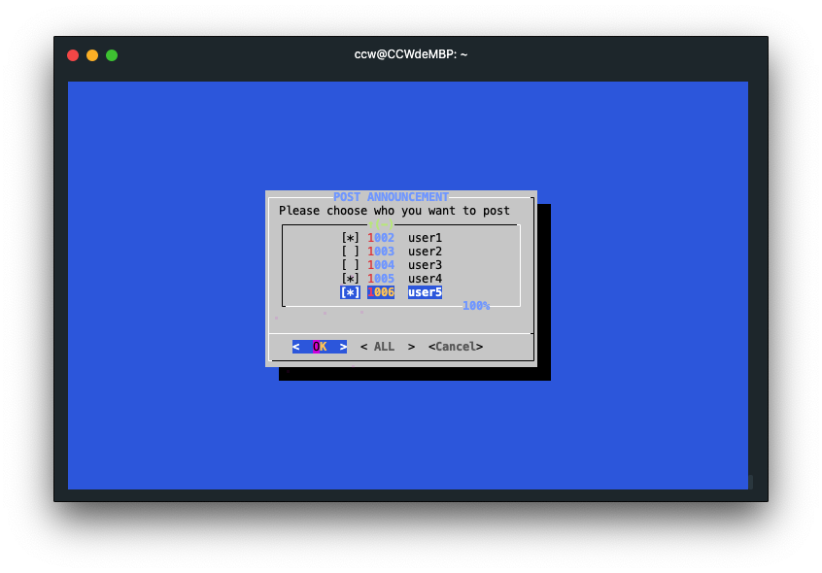
Announcement
Notes:
這邊需要多選，或是發給所有人

Slide 19
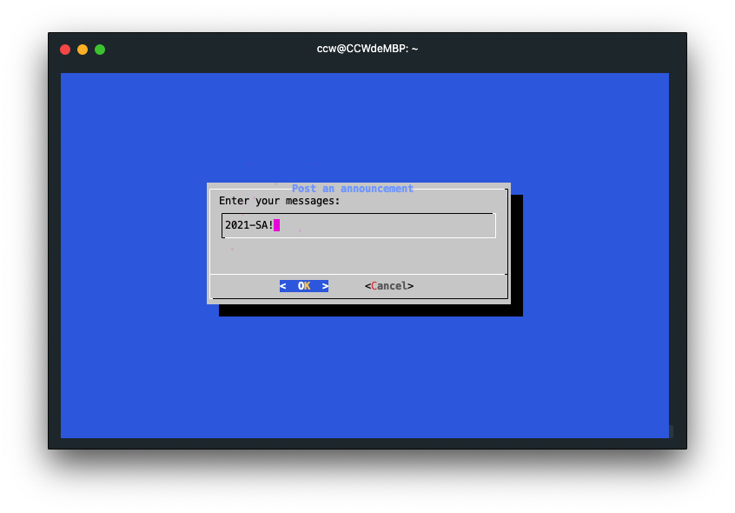
Announcement

Slide 20
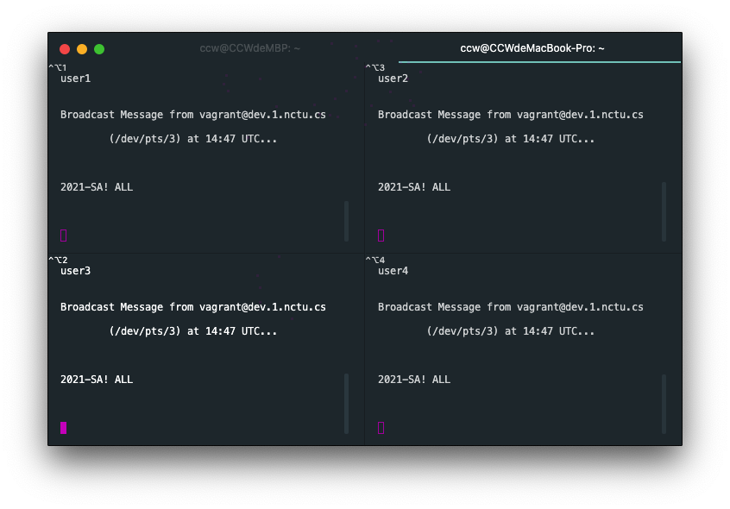
Announcement - Type Msg (Cont.)

Slide 21
Users
Page - 6%
User List: list all loginable user, and mark online user with star.
Hint: who
User Action: display groups, ports, login history, sudo log, block user, total 5 options.
Notes:
直接列出使用者會很多，這邊只需要列出「可以登入的」
可以自己新增幾個使用者測試看看

Slide 22
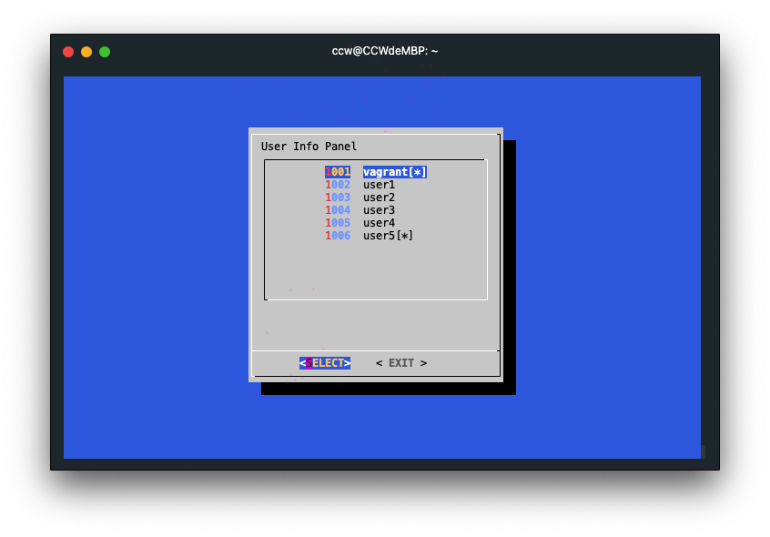
User List

Slide 23
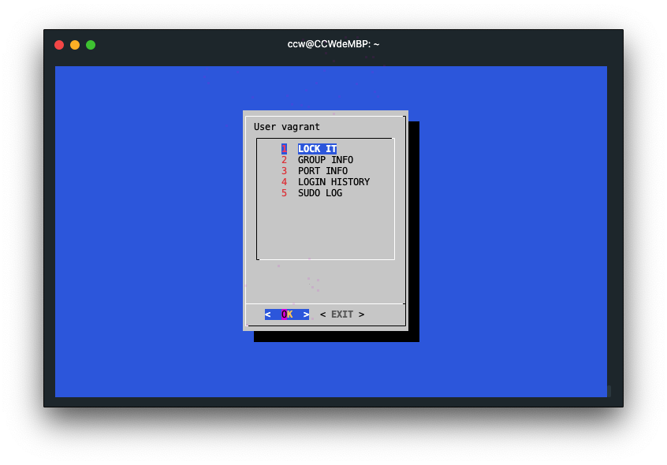
User Action

Slide 24
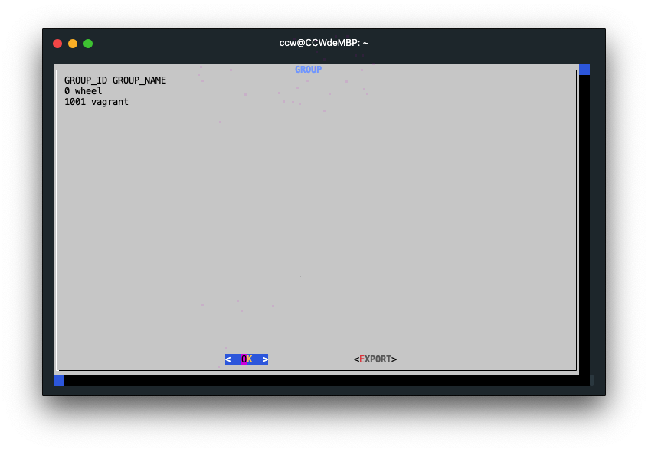
Groups (5%)
List groups that specify user belongs to.
Need group id and group name column.
Hint: groups

Slide 25
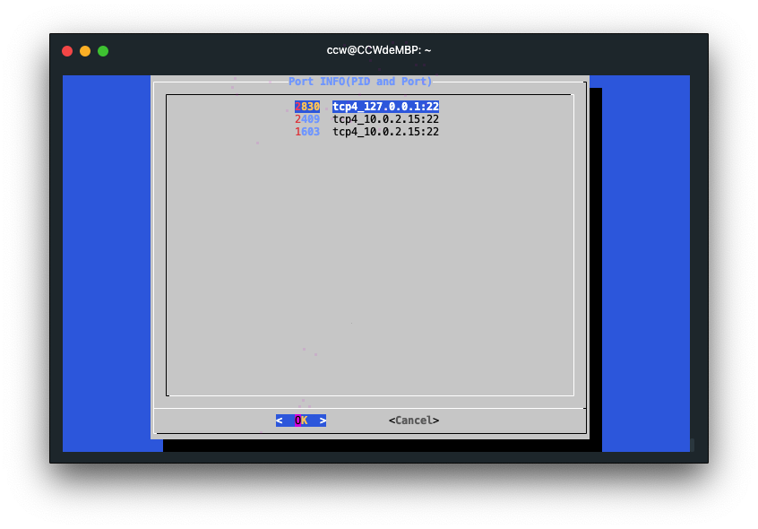
Ports (5%)
List specify user used port listening on tcp and udp
List only ipv4
Can get port detail info in next page
If the list is too long, make it scrollable
Hint: sockstat (1)
Notes:
提醒這邊可以看第二層（port -> pid detail

Slide 26
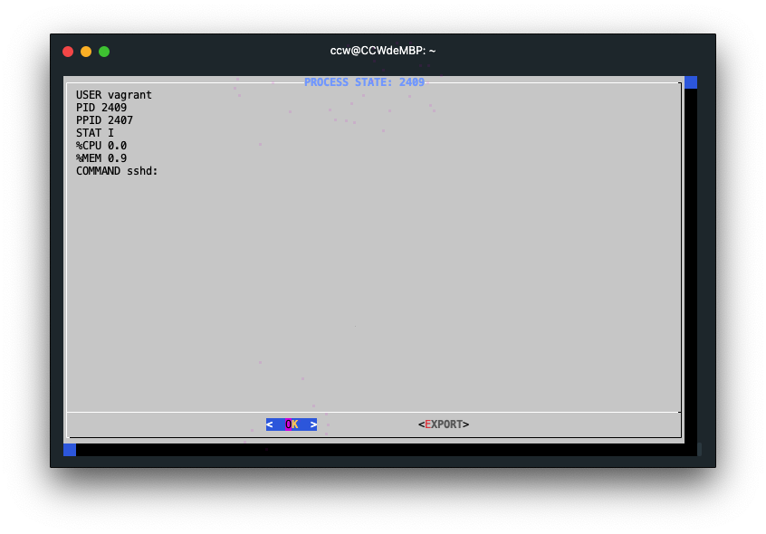
Ports
Each port is used by one process.
Get process detail that specify port used.
Hint: ps

Slide 27
Lock / Unlock (10%)
Lock (or unlock) user login.
When specify user already lock, then options in User Action page show “unlock” text.
Hint: pw

Slide 28
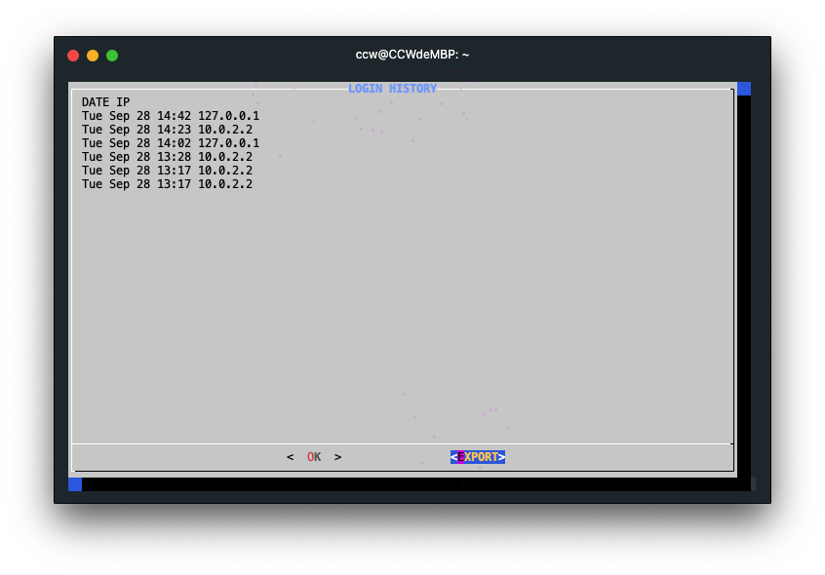
Login History (5%)
Show specify user login history
Recently 10 times login history
datetime, login ip
Hint: last(1)

Slide 29
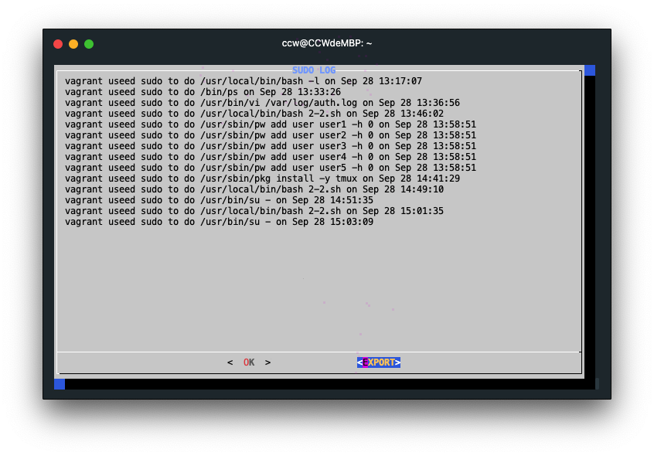
Sudo Log (5%)
Show specify user sudo command usage log.
Show recent 30 days log.
Hint: auth.log

Slide 30
Export (10%)
Export dialog text into file
Use dialog to ask user on where to save and save the output to file
User could input absolute path or relative path based on user’s home directory
e.g. res -> /u/gcs/109/309551019/res
Export button in each info page (group, port, sudo log, login history)

Slide 31
Export
Notes:
提醒 export 按鈕的位置

Slide 32
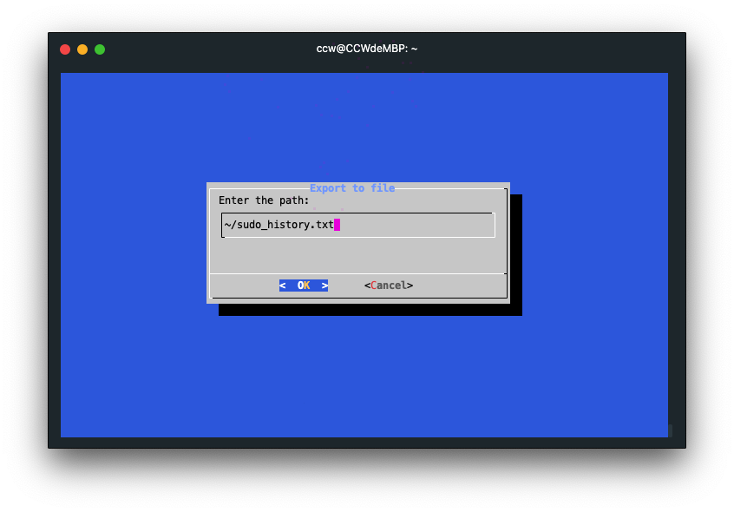
Export

Slide 33
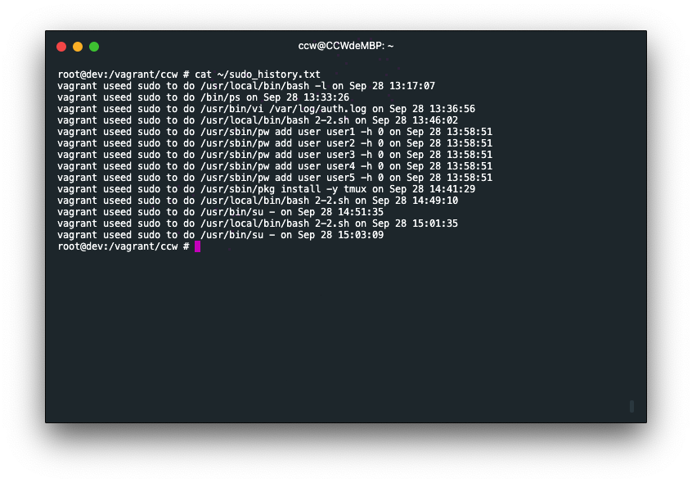
Export

Slide 34
Return Code (4%)
Program Return codes and stdout:
0 for cancel (program successfully finished)
echo Exit. to stdout
1 for Esc
echo Esc pressed. to stderr
2 for Ctrl + C
echo Ctrl + C pressed. to stdout

Slide 35
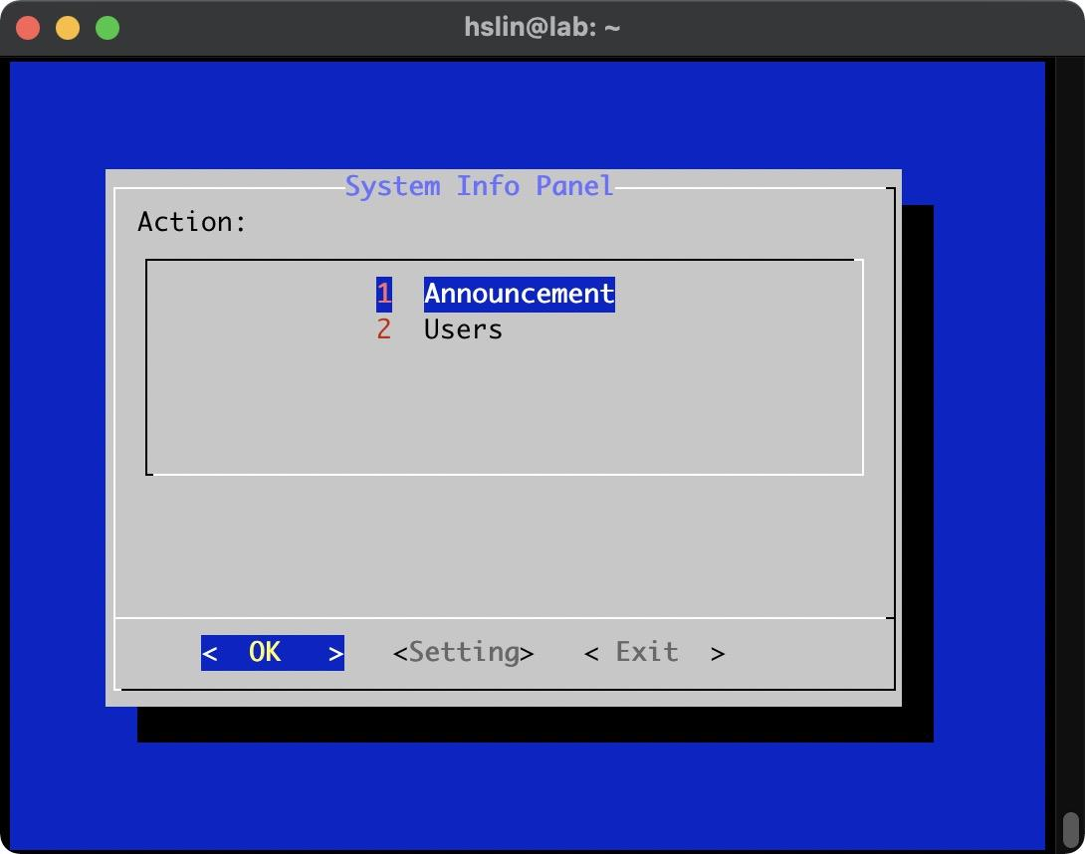
System Info Panel - Bonus (5%)
If user login fail >= 3, auto lock this user
Enable / Disable this feature in “system info panel” setting
Notes:
提醒 Setting 在下面、開放自由發揮流程

Slide 36
System Info Panel - Grading
Each page & control flow (11%) - This is required.
Post an announcement to online users (5%)
User
Get this user’s group (5%)
Query the port used by this user (5%)
And get process (used port) detail
User login history (5%)
Sudo usage log (5%)
BLOCK / UNBLOCK this user (10%)
Return Code (4%)
EXPORT the information of each page (10%)
Notes:
可以提醒「優雅的做」

Slide 37
Attention!
You are restricted to use only sh to complete your work
That is, no other shell and no other programming language.
If you’re not sure what’s allowed, contact TAs.
TAs reserve the right of final explanations. Specs are subject to change without notice.
Your output does not have to be exactly the same as mine.
You could design your own ways the information is presented in as you please.

Slide 38
How to use git.cs

Slide 39
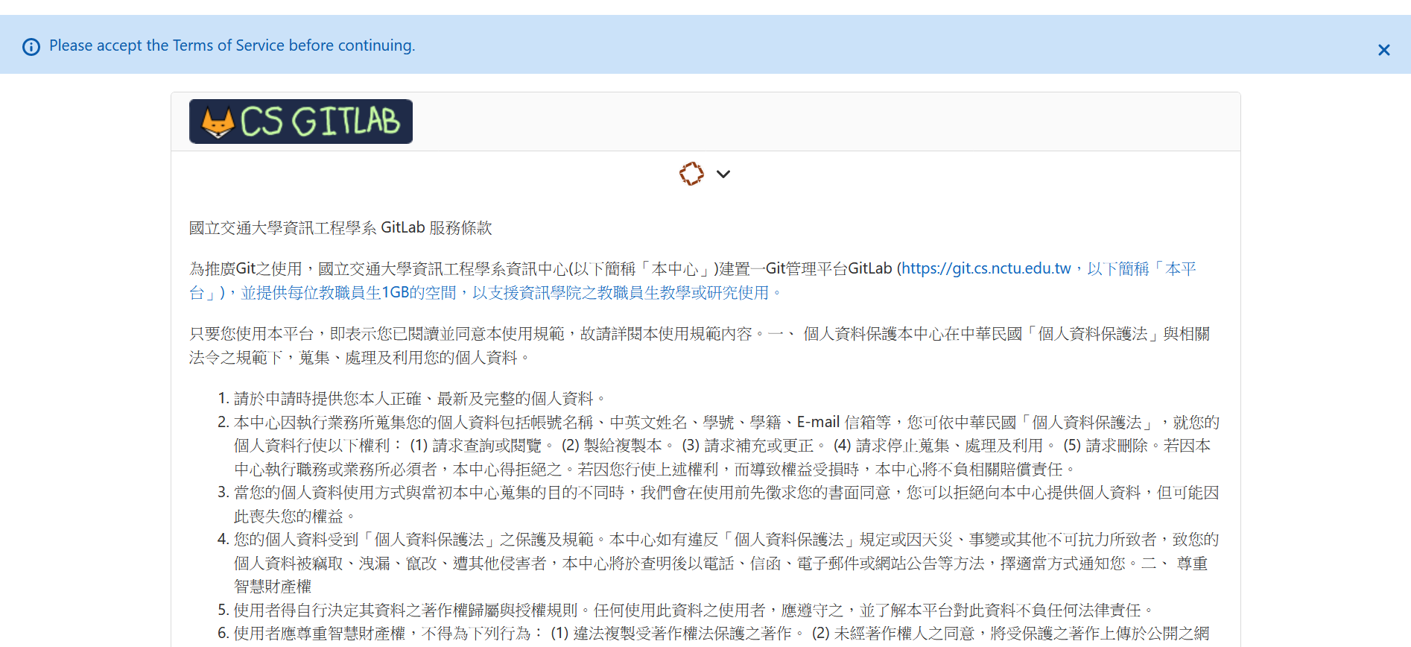
git.cs
You should have a cc account and use this account to sign in git.cs.
https://git.cs.nctu.edu.tw/
Note: You must sign in before 10/01 23:59 (Fri.)

Slide 40
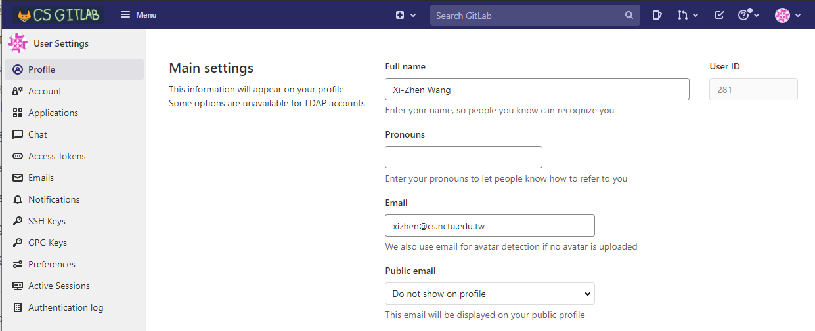
git.cs: application
Update your email on the Profile page.
Remember to confirm an email address in your mailbox.

Slide 41
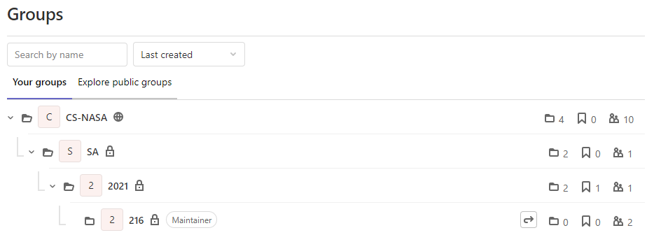
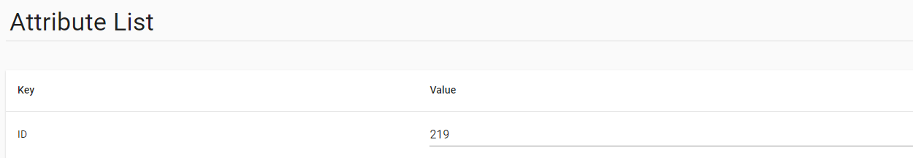
git.cs: CS-NASA Group
Find your the group in “CS-NASA”
The name of your group is your ID in Online Judge：

Slide 42
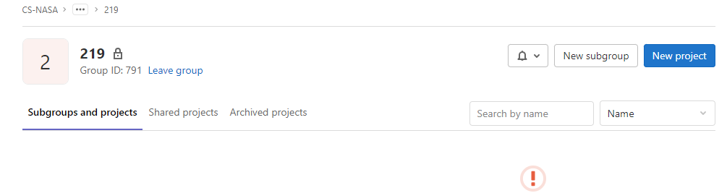
git.cs: New Project
Create a new project

Slide 43
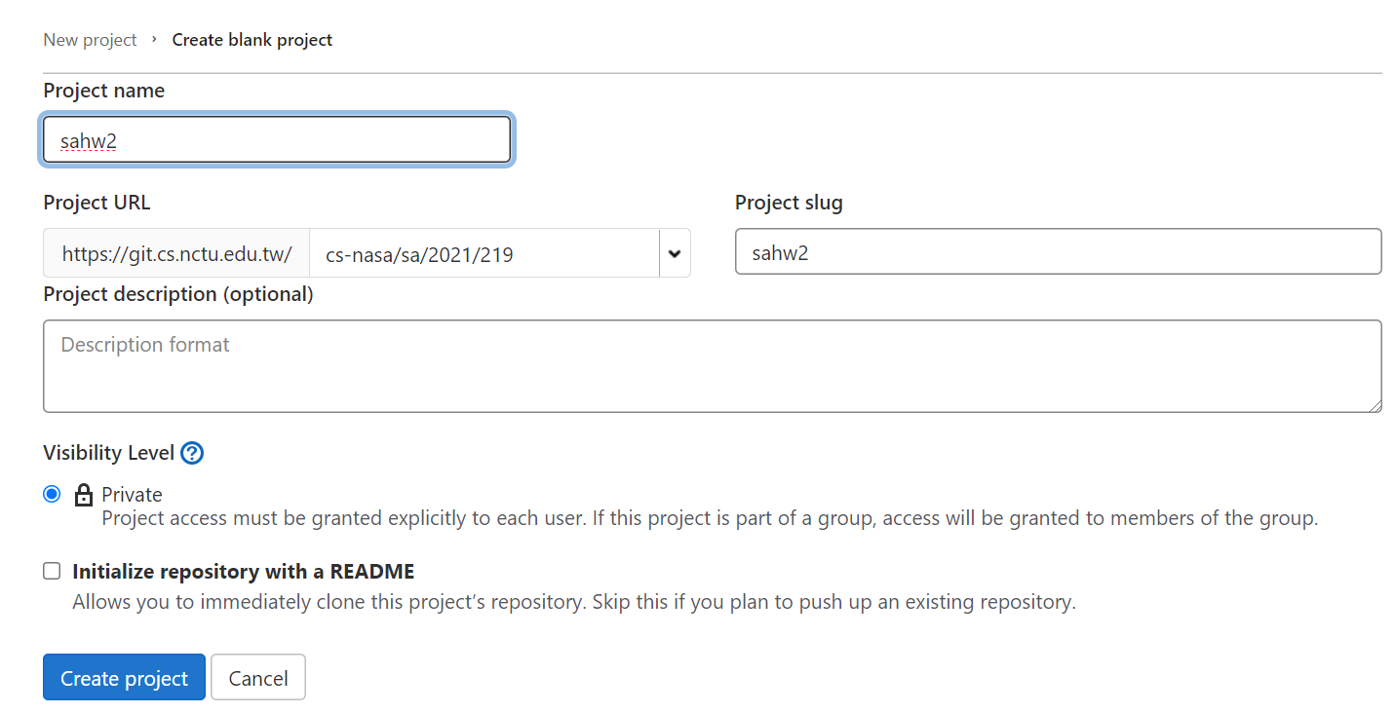
git.cs: New Project (Cont.)
It must be exactly the same
Check your URL again

Slide 44
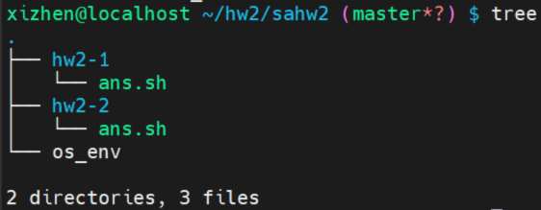
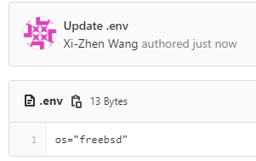
ans.sh
Make sure your directory structure is like this:
Check your permission:
os=”freebsd” / “centos” ...
x: execute

Slide 45
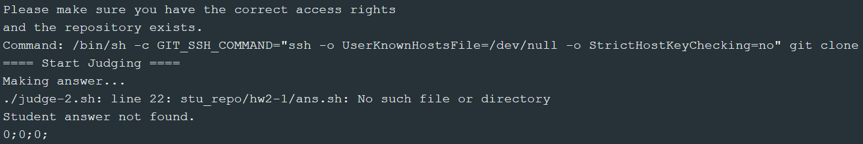
Debug HW2-1: Student answer not found

Slide 46
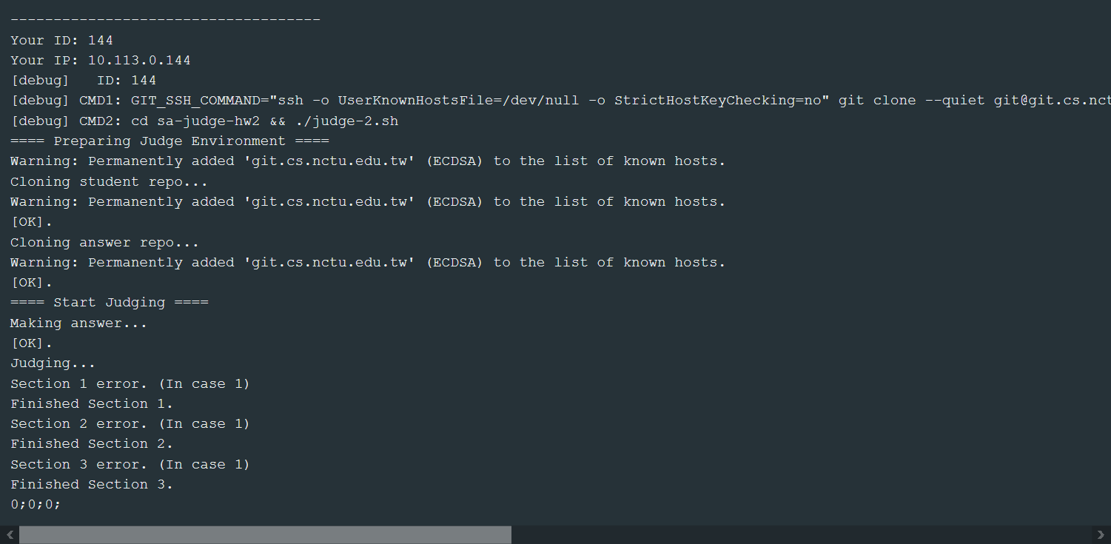
Debug HW2-1: 0;0;0; Wrong Answer
0 = Wrong answer, 1 = accepted

Slide 47
Attention!
You will get zero points if you just copy code from other students
You will get zero points if you tamper with TA’s system / file
You can use our workstations to complete your homework
HW 2-1 → Online Judge & Check Manually
We will check whether your script meets one-liner manually.
Online Judge only support FreeBSD currently.
HW 2-2 → Submit Code & Offline Judge
TA Judging Time: 10/22 (Fri.) and 10/29 (Fri.)
TA will clone your project from gitlab and release scores on next monday.
Due date: 10/29 23:59 (Fri.)
Notes:
取成績最高者
提醒
本來交作業是一次，要自己去檢查作業，交出去就來不及了
但我們特別開放 2-2 可以檢查兩次，兩次成績一樣，沒有遲交早交的差別，如果第一次交覺得成績不滿意，可以交第二次

Slide 48
Attention!
TA will use these operating systems to judge your homework
FreeBSD 12
CentOS Stream 8
Online Judge only supports built-in commands.
Notes:
其實用不同版本應該也可以啦，不用太緊張
如果評分出來分數不對，可以寄信 ta@ 給我們

Slide 49
Help me! TA!
Questions about this homework
Ask questions on https://groups.google.com/g/nctunasa
We MIGHT give out hints on google group
Be sure to join the group :D
Do not email us directly
Do not use E3 to email us
TA time : Wed. 15:00 - 17:00 at EC 324 (PC Lab)
You must use email to make an appointment first.
ta@nasa.cs.nctu.edu.tw
You must ask questions on google group first.
You can bring your laptop or use PC lab.
If there are too many people, we will announce another time slot.
Notes:
要求需要先論壇問，不能直接來
需要先預約

Slide 50
Good Luck!

