Slide 1
Homework 4
Web Services
stchang, rzhung, xizhen

Slide 2
Outline
HTTP Server (40%)
Virtual Hosts (5%)
HTTPS & HTTP2 (15%)
Hide Server Information (5%)
PHP / PHP-FPM (5%)
Access Control (10%)
Database (30%)
MySQL (10%)
PhpMyAdmin (5%)
DB Maintenance (Migration) (15%)
Kernel Module (30%)
Kernel Module (15%)
Websocketd (15%)

Slide 3
HTTP Server

Slide 4
Virtual Host (5%)
Setup a name-based virtual host.
Show different contents based on different domain / IP.
Your Domain Name: {ID}.nycu.cs
Your IP: 10.113.0.{ID}
{ID} is your wireguard ID
Hint:
You can use hosts file to map ip to your domain.
On FreeBSD, CentOS: /etc/hosts
On Windows: C:\Windows\System32\drivers\etc\hosts

Slide 5
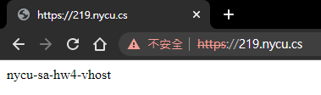
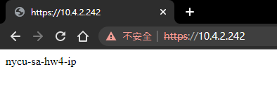
Virtual Host (5%)
Please show the following contents according to different URLs.
https://10.113.0.219
https://10.113.0.219
We will judge your work by 10.113.0.{ID} and {ID}.nycu.cs.
Be sure to adjust your configurations accordingly.

Slide 6
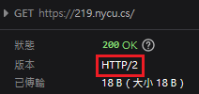
HTTPS & HTTP/2 (15%)
On virtual host {ID}.nycu.cs
Enable HTTPS
Please sign your own certificate on your domain.
Redirect all HTTP requests to HTTPS. (5%)
Enable HSTS (HTTP Strict Transport Security) (5%)
Enable HTTP/2 with HTTPS (5%)

Slide 7
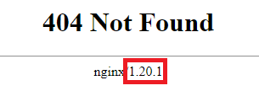
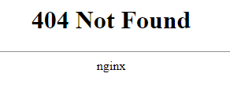
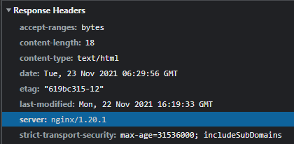
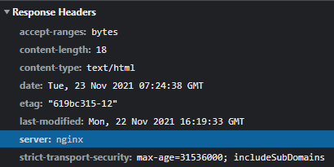

Hide Server Information (5%)
On virtual host {ID}.nycu.cs
Do not show the server version on error pages.
Hide Nginx/Apache version in header.

Slide 8
PHP / PHP-FPM (5%)
On virtual host {ID}.nycu.cs
Create https://{ID}.nycu.cs/info-{ID}.php with PHP info page.
Set up PHP 8 (or higher).
Hide PHP version information in header.
But the version needs to be displayed in the PHP info page.

Slide 9
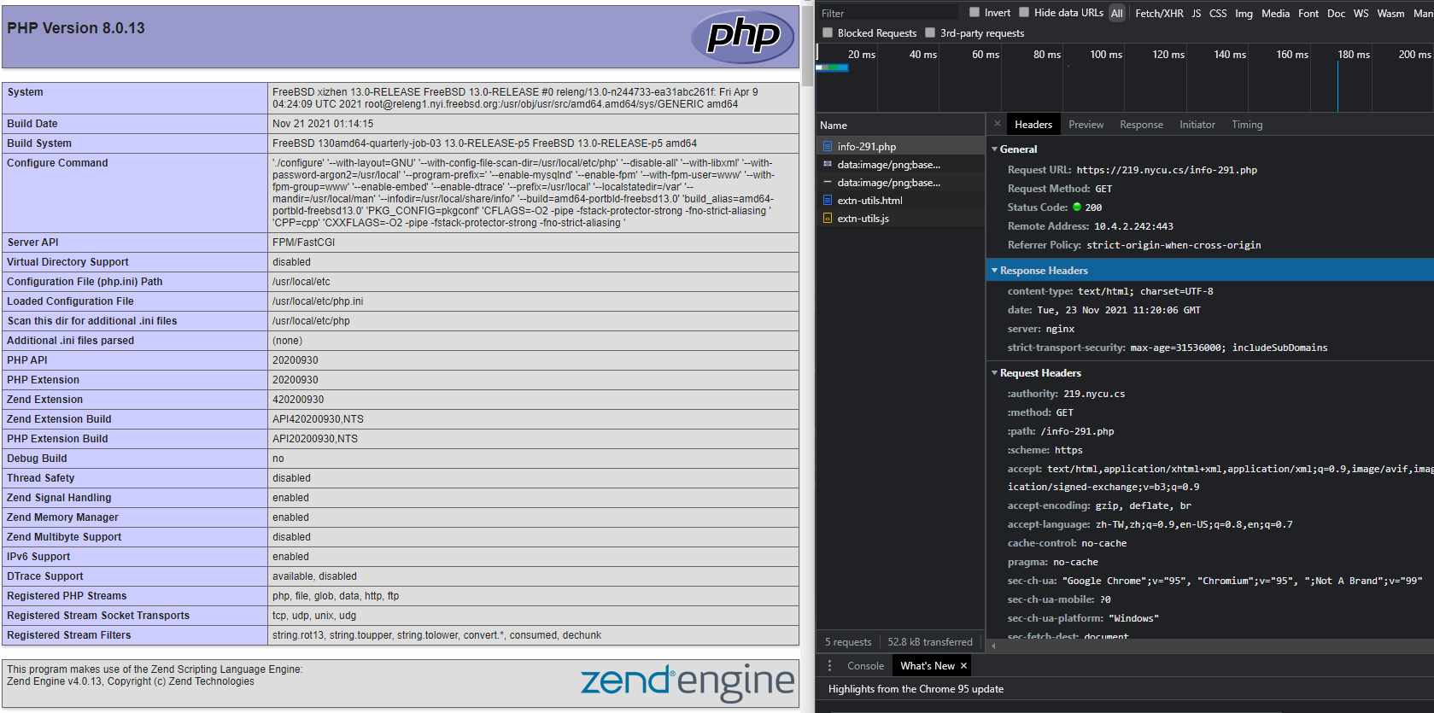
PHP / PHP-FPM (5%)
php version >= 8
no php version in header

Slide 10
Access Control (5%)
On virtual host 10.113.0.{ID}
There is a secret webpage on http://10.113.0.{ID}/private.
Deny access with domain {ID}.nycu.cs.
When accessing the web page from 10.113.0.254, the user is required to provide credentials (HTTP Basic Authentication).
Username: admin
Password: Your {IP} without dots. (e.g. 10113015)
When the webpage is accessed from any other location or accessed with domain:
403 Forbidden or 404 Not Found.
Even from localhost, you still have to return 403 or 404.

Slide 11
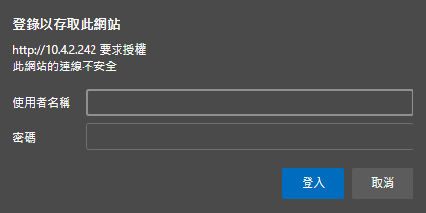
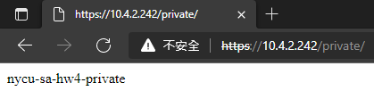
Access Control (5%)
http://10.113.0.219 要求授權
http://10.113.0.219/private
10.113.0.219/private

Slide 12
Database

Slide 13
MySQL (10%)
Create a “mortal” account (3%)
Username: judge
Password: Your {IP} without dots. (e.g. 101130221)
Can login from any host.
Secure MySQL (4%)
Allow root login ONLY from localhost.
Password: Your {IP} without dots. (e.g. 101130221)
Remove test database.
Create a database called judge (3%)
ONLY root have FULL privileges.
User judge have SELECT privilege and ONLY on this database.

Slide 14
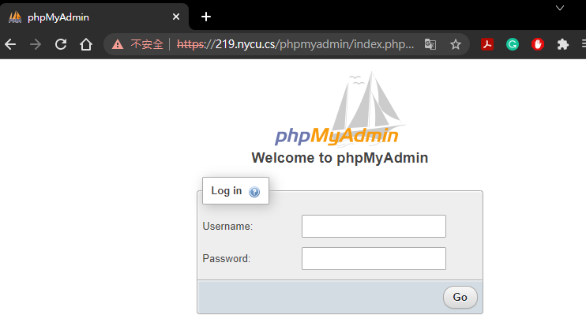
PhpMyAdmin (5%)
Build a PhpMyAdmin webside on https://{ID}.nycu.cs/phpmyadmin/.

Slide 15
DB Maintenance (15%)
There is a cold backup in our SA server.
Dump the data from server and restore to your database: judge. (10%)
The server information:
IP: 10.113.0.254 :3306
DB: OJ{ID} (e.g. OJ221)
Account: {ID} (e.g. 221) / Password: {IP} without dots (e.g. 101130221)
Store the dump data temp file at /home/judge/PrivKey.sql (5%)

Slide 16
Kernel Module

Slide 17
Kernel Module (15%)
Write a kernel module for add a device driver /dev/sockn.
When you run echo "hello" > /dev/sockn (or any other writing action), /dev/sockn must save the message into the buffer of sockn kernel module. Please overwrite old buffer data.
When you run cat /dev/sockn (or any other reading action) , you will get:
Line 1: the value of sysctl vm.uma.socket.stats.current, is the amount of socket
Line 2 and following: the message saved in the buffer of sockn.

Slide 18
Kernel Module (15%)
$ cat /dev/sockn
16
$ echo "hello" > /dev/sockn
$ cat /dev/sockn
16
hello
$ echo "world" > /dev/sockn
$ cat /dev/sockn
16
world

Slide 19
Kernel Module (15%)
You can download the C source code of sockn kernel module from https://nasa.cs.nctu.edu.tw/sa/2021/sockn.c
You have to build the kernel module and load it, pleass refer to https://docs.freebsd.org/en/books/arch-handbook/driverbasics/ and other FreeBSD doc.

Slide 20
Kernel Module (15%)
Scoring
Kernel module "sockn" is loaded and /dev/sockn exists (5%)
/dev/sockn works well. (10%)

Slide 21
WebSocket (15%)
A WebSocket is a persistent connection between a client and server.
Use websocket to keep logging your output of /dev/sockn.
Show new output of /dev/sockn every second.
The format of each websocket message is a,b
a: The first line of the output from /dev/sockn
b: The second line of the output from /dev/sockn

Slide 22
WebSocket (15%)
Create a new domain {ID}_ws.nycu.cs without HSTS.
ws://{ID}_ws.nycu.cs/wsconnect on port 80 (5%)
Add websocket proxy on {ID}.nycu.cs
wss://{ID}.nycu.cs/wsconnect on port 443 (5%)
Hint: websocketd

Slide 23
WebSocket (15%)
Create a webpage (5%)
http://{ID}_ws.nycu.cs/wsdemo.html
to connect to
ws://{ID}_ws.nycu.cs/wsconnect on port 80
wss://{ID}.nycu.cs/wsconnect on port 443
And show your results side by side on that webpage. (See next slide)
Bonus: Add a line chart to show changes of the amount of sockets (first line of /dev/sockn). (+5%)
Hint: You might need to trust your self-signed certificate to see wss on your browser.

Slide 24
WebSocket (15%) (Example)
https://imgur.com/a/Az70egl

Slide 25
Hints
You can use Apache or Nginx to complete this homework.
Although you can not test your setup in 10.113.0.x network, you can use ip from another interface or port forwarding.
If you find your system too slow, please consider adding more RAM to it.
If wss or https did not work, make sure you have trusted the self-signed certificate.

Slide 26
Homework 4
BACKUP your server before judge EVERY TIME.
We may do some things bad when judging.
TAs reserve the right of final explanations.
Start scoring at 2021/11/27 00:00
Deadline: 2021/12/20 23:59

Slide 27
Help me! TA!
TA time: 3 GH at EC 324 (PC Lab) or by appointment (mail us).
Questions about this homework
Ask them on https://groups.google.com/g/nctunasa
We MIGHT give out hints on google group
Be sure to join the group :D
Do not use E3 to email us.

Slide 28
Good Luck!

