Slide 1
Module 2: Web Fundamentals (Frontend Tech)

Slide 2
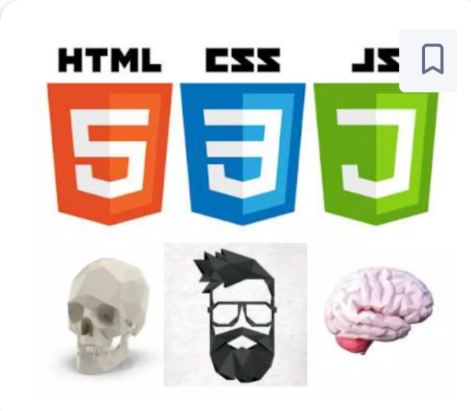
Introduction to web technologies:
HTML (HyperText Markup Language) is the standard language used to create and structure content on the web.
CSS (Cascading Style Sheets) is the language used to style and design HTML elements on a web page.
JavaScript is a programming language used to create interactive and dynamic content on websites.

Slide 3
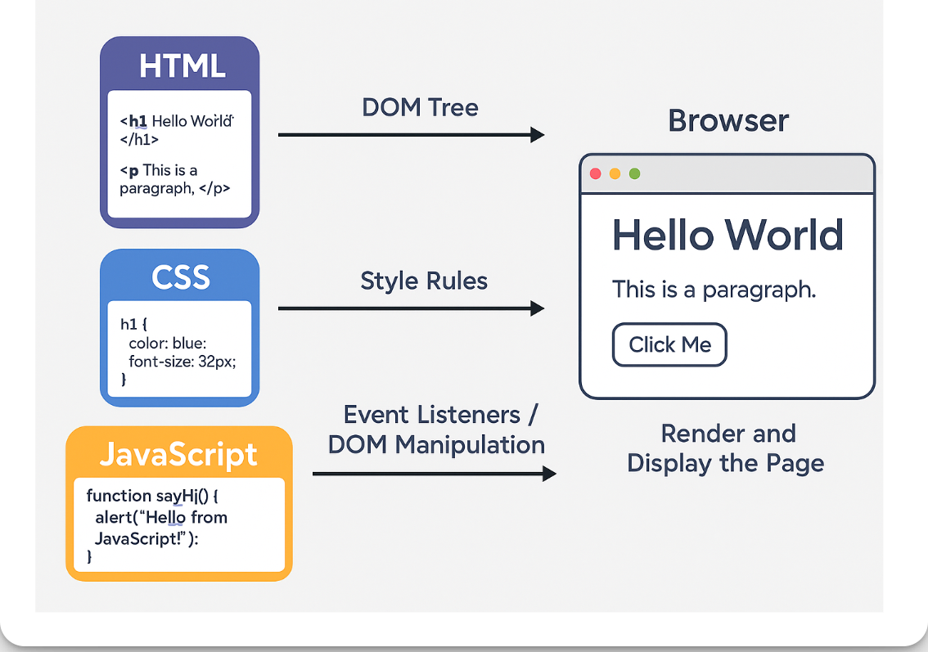
HTML, CSS, and JavaScript work together inside a browser.

Slide 4

HTML(HyperText Markup Language)

Slide 5
HTML
HTML means Hyper Text Markup Language.
The HTML allow us to define the structure of a document or a website.
HTML is NOT a programming language, it's a markup language, which means its purpose is to give structure to the content of the website, not to define an algorithm.
It is a series of nested tags (it is a subset of XML) that contain all the website information (like texts, images and videos). Here is an example of tags:
‹title>This is a title‹/title>
The HTML defines the page structure. A website can have several HTMLs to different pages.

Slide 6
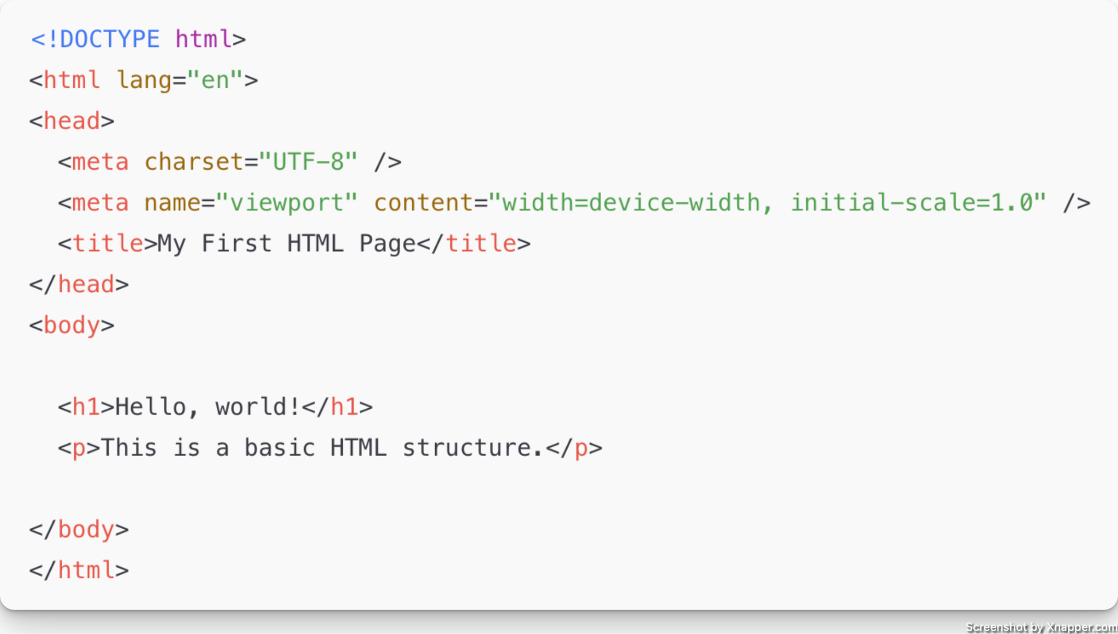
HTML Basic Template

Slide 7
HTML Key Elements Explained
<!DOCTYPE html> – Declares the document type as HTML5
<html> – The root element of the HTML document.
<head> – Contains metadata, links to stylesheets, etc.
<title> – The page title shown in the browser tab.
<body> – Contains the visible page content.

Slide 8
HTML Elements
The HTML element is everything from the start tag to the end tag or self closing tag:
<tagname>Content goes here...</tagname>
<tagname />
Examples of some HTML elements:
<h1>My First Heading</h1>
<p>My first paragraph.</p>
<img /> or <img> //Self Closing Tag

Slide 9
HTML Elements
div: a container, usually represents a rectangular area with information inside.
img: an image
a: a clickable link to go to another
p: a text paragraph
form: use to define a form for collecting user input.
label: use to define a label for an input element in a form
h1: a title (h2,h3,h4 are titles)
input: a widget to let the user introduce information
style: to insert CSS rules
script: to execute Javascript

Slide 10
HTML Elements
span: inline element that is used to group or style a portion of text or content within a block-level element
button: to create a button
audio: for playing audio
video: to play video
canvas: to draw graphics from javascript
iframe: to put another website inside ours
table: display data in grid format

Slide 11
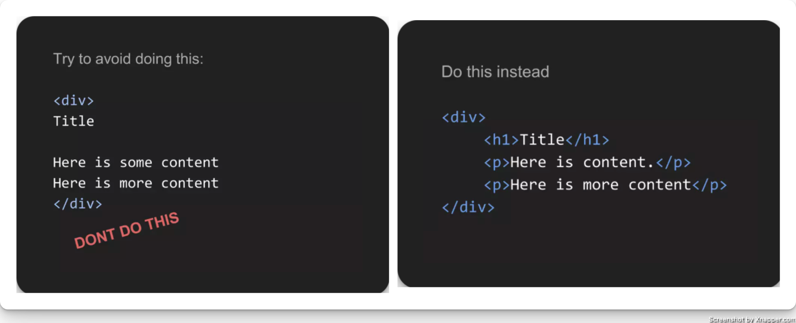
HTML: Tagging Correctly

Slide 12
HTML Block and Inline Elements
Every HTML element has a default display value, depending on what type of element it is.
The two most common display values are block and inline.

Slide 13
Block-level Elements
A block-level element always starts on a new line, and the browsers automatically add some space (a margin) before and after the element.
A block-level element always takes up the full width available (stretches out to the left and right as far as it can).
Two commonly used block elements are: <p> and <div>.
The <p> element defines a paragraph in an HTML document.
The <div> element defines a division or a section in an HTML document.
Example
<p>The “p” element is a block-level element.</p>
<div>The “div” element is a block-level element. </div>

Slide 14
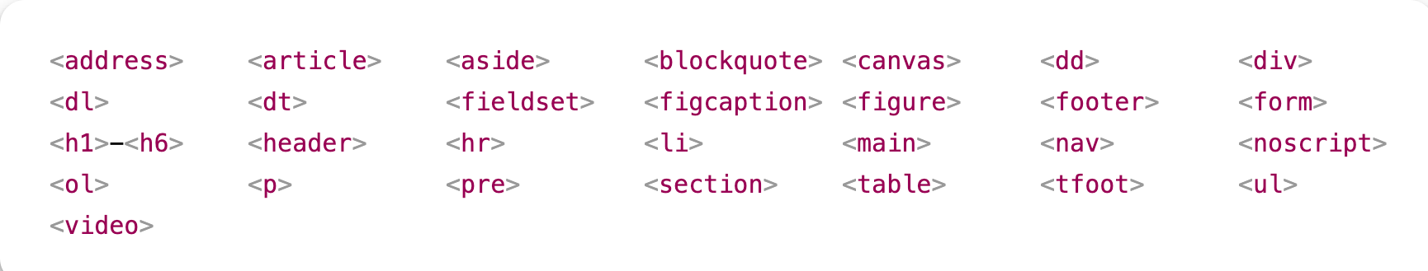
Here are the block-level elements in HTML:

Slide 15
Inline Elements
An inline element does not start on a new line.
An inline element only takes up as much width as necessary.
This is a <span> element inside a paragraph.
Example:
<span>Hello World</span>

Slide 16
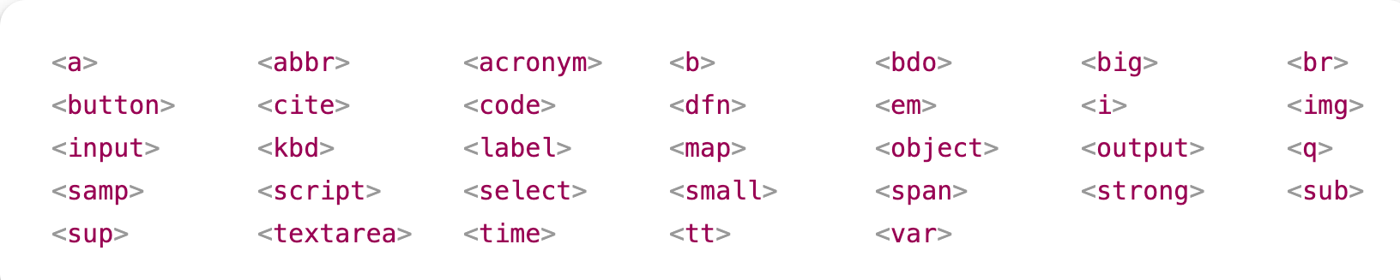
Here are the inline elements in HTML:

Slide 17
HTML Attributes
All HTML elements can have attributes
Attributes provide additional information about elements
Attributes are always specified in the start tag
Attributes usually come in name/value pairs like: name="value"

Slide 18
HTML Attributes
The href Attribute:
The <a> tag defines a hyperlink. The href attribute specifies the URL of the page the link goes to:
Example:
<a href="https://www.wikipedia.org">Visit Wikipedia</a>

Slide 19
HTML Attributes
The src Attribute:
The <img> tag is used to embed an image in an HTML page. The src attribute specifies the path to the image to be displayed:
Example:
<img src="heros.jpg" alt=”Hero Image”>

Slide 20
HTML Attributes
The style Attribute:
The style attribute is used to add styles to an element, such as color, font, size, and more.
Example:
<p style="color:red;">This is a red paragraph.</p>

Slide 21
HTML Attributes
The lang Attribute:
Always include the lang attribute inside the <html> tag, to declare the language of the Web page. This is meant to assist search engines and browsers.
Example:
<!DOCTYPE html>
<html lang="en">
<body>
...
</body>
</html>

Slide 22
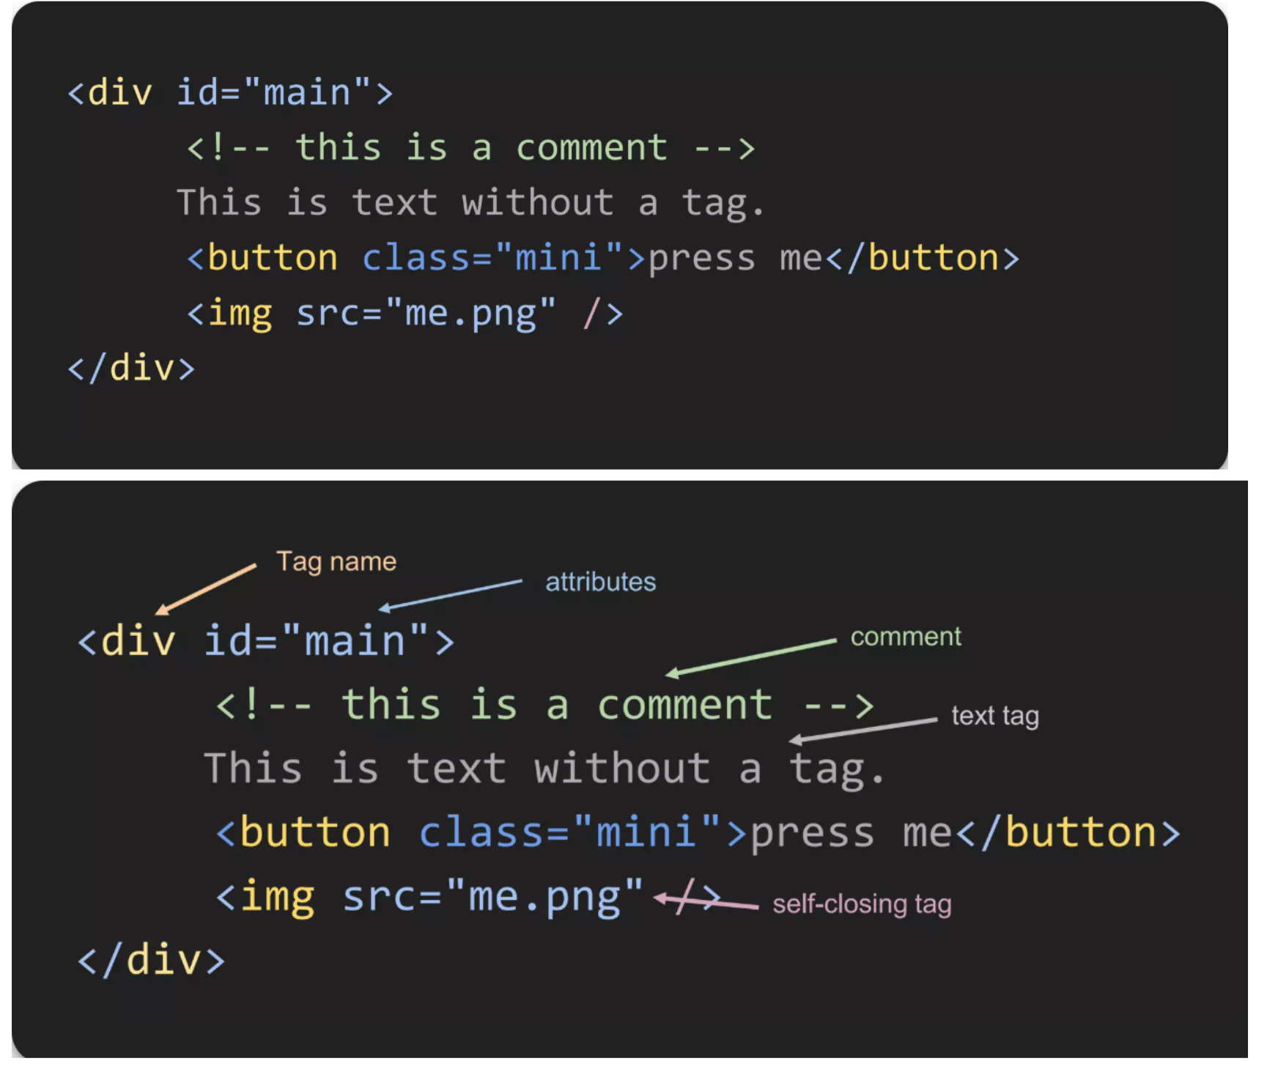
HTML Tag, Comment, Attribute

Slide 23
HTML DOM
The information is stored in a tree-like structure (nodes that contain nodes inside) called DOM (Document Object Model).
Every node can only have one parent, and every node can have several children, so the structure looks like a tree.

Slide 24
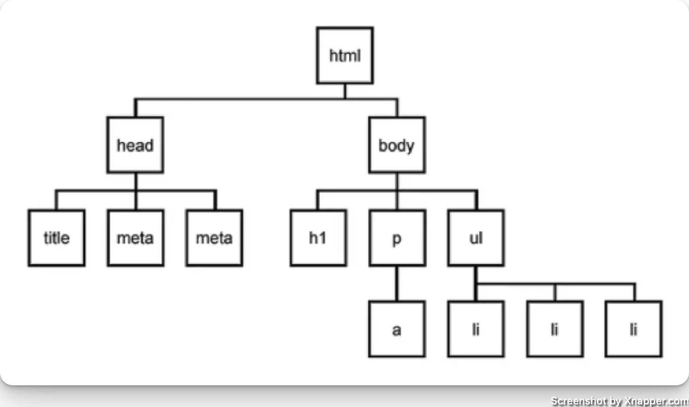
HTML Tree Structure

