Slide 1
CAPSTONE ROUND 1 · PITCH TO CHLEO
See exactly what the AI does
Complaint triage for a mid-size financial services firm
Ugo Ahukannah
Round 1 — research, dashboard, proof of concept, monitoring, cost
U.S. Consumer Financial Protection Bureau (CFPB) · public complaint data All figures trace to the project repository
Notes:
Over dinner, you told me you do not trust AI because you cannot see what it does. Today I will show you exactly what I am proposing, what the public evidence does and does not prove, and how we would test it safely with your data.
--- END OF SPOKEN NOTES ---
[Sources]
- CFPB Consumer Complaint Database: https://www.consumerfinance.gov/data-research/consumer-complaints/
- Project repository: README.md and linked evidence deliverables.
[/Sources]

Slide 2

CAPSTONE ROUND 1 · AI CONSULTING PITCH
A mid-size bank needs AI it can inspect
TAKEAWAY You never asked whether AI works. You asked what it is, and how you would see it.
ASSUMED CLIENT PROFILE
THE FEAR
THE PITCH
Financial services, mid-size
“AI is not transparent”
3 use cases
~500 staff, ~250,000 retail customers, EU. Current accounts, cards, personal and vehicle lending.
Your words. You could not say what “the AI” would be, or how you would sign up.
1. Complaint triage · 2. Anomaly flagging · 3. Reporting assistance. Ranked by how visible the reasoning is.
And 2 I refuse to build: a customer-facing chatbot, which fails in public in your customer's voice; and creditworthiness scoring, an Annex III high-risk use under the EU AI Act.
1
Notes:
I assessed 3 use cases: complaint triage, anomaly flagging, and reporting assistance. Complaint triage comes first because its recommendation and supporting evidence can be inspected, while a person keeps the final decision. I also ruled out a customer-facing chatbot and creditworthiness scoring. Here is the proposal in 1 minute.
--- END OF SPOKEN NOTES ---
[Sources]
- Project repository: research/use_cases.md.
- EU AI Act, Annex III: https://eur-lex.europa.eu/eli/reg/2024/1689/oj
[/Sources]

Slide 3

CAPSTONE ROUND 1 · AI CONSULTING PITCH
Complaint triage is a practical, low-risk test of AI value
ASK Approve a controlled test — not an AI deployment.
What the assistant does
What you are approving
Reads each complaint and suggests a team
Shows the customer’s own words behind its recommendation
Stops when checks fail; your staff make every final decision
Compare with 300 of your historical complaints
If justified, run a 60-day shadow pilot
Nobody acts on the AI’s recommendations
Evidence to date: public U.S. Consumer Financial Protection Bureau (CFPB) complaints; your evidence begins with the 300-case test.
2
Notes:
Chleo, your firm receives customer complaints that have to be reviewed and routed to the right team, and today that is largely a manual process. That gives us a practical, low-risk way to test whether AI can create real value.
I therefore propose an assistant that would read each complaint, suggest which team should handle it, and show the customer’s own words behind its recommendation. Your staff would still make every final decision.
I have already tested the approach on public complaint data. It showed enough promise to justify a proper test, and importantly, it stopped rather than forcing an answer when its checks failed. But public labels are not a substitute for decisions made by your own experienced handlers.
So, the next step is to test it against a representative sample of 300 of your historical complaints, then, if the results justify it, run a 60-day shadow pilot where nobody acts on the AI’s recommendations.
What I am asking you to approve today is that controlled test—not an AI deployment.
--- END OF SPOKEN NOTES ---
[Sources]
- Project repository: presentation/one_minute_pitch.md.
- CFPB Consumer Complaint Database: https://www.consumerfinance.gov/data-research/consumer-complaints/
- Project repository: langsmith/experiment_summary.json.
[/Sources]

Slide 4

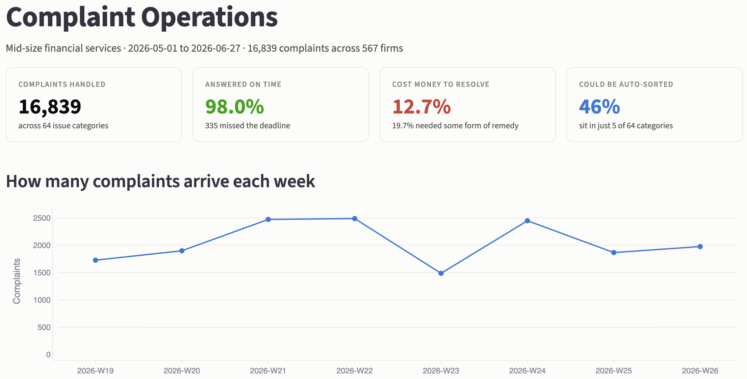
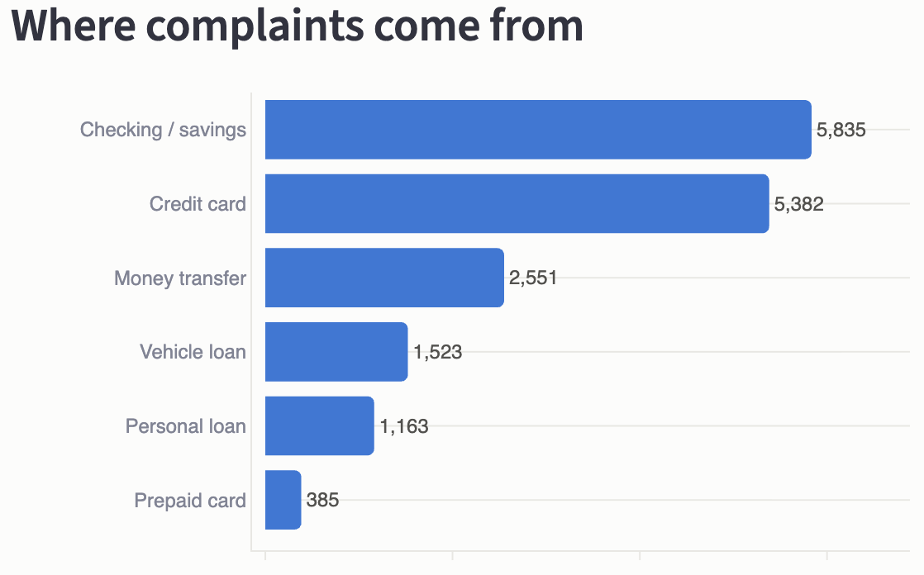
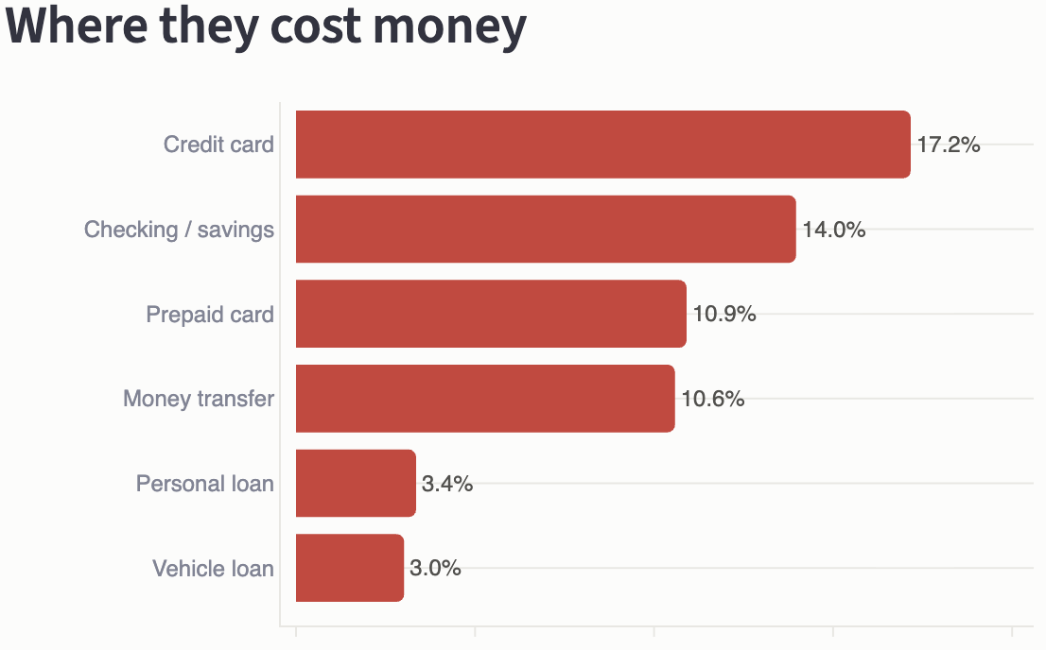
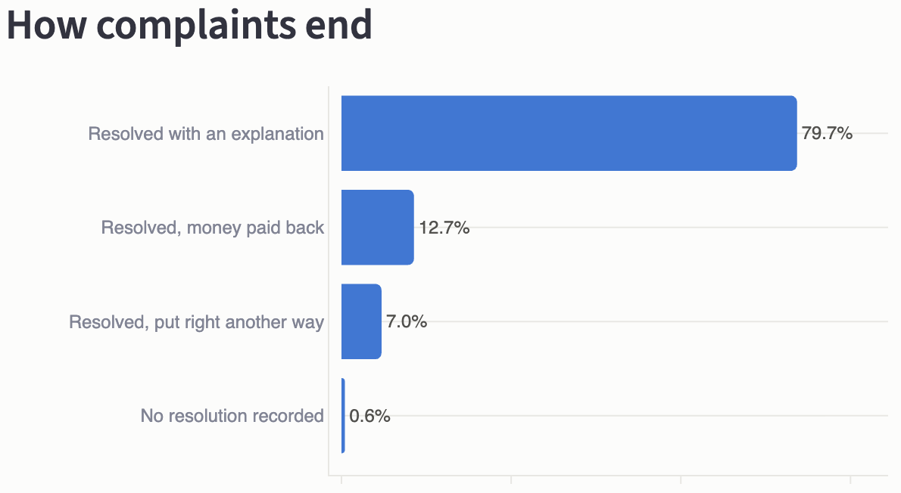
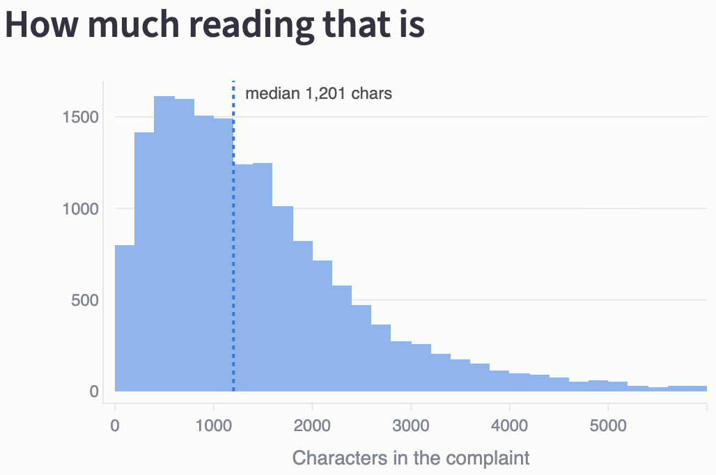
CAPSTONE ROUND 1 · AI CONSULTING PITCH
4 numbers define the opportunity
■ Why each one matters to you
16,839 public complaints — from CFPB, not your annual volume
98.0% timely responses — significant cost from human reading
12.7% ended with monetary relief — not complaint-handling cost
46.1% fall in 5 of 64 categories — a hypothesis to test in your data
These are CFPB figures across 567 firms. Phase 0 will measure your own volume, mix, and outcomes.
Source: CFPB Consumer Complaint Database (public U.S. data; 1 May–27 Jun 2026).
3
Notes:
This dashboard uses public CFPB data as a proxy. These are not your firm’s numbers; Phase 0 measures your real complaint mix and volume.
The analysis contains 16,839 public complaints across 567 firms. The CFPB timely-response field is 98.0%, while 12.7% ended with monetary relief. Neither figure describes your firm’s performance.
The key number is 46.1%: 5 of 64 issue categories account for almost half the complaints. That suggests a bounded start rather than asking a model to handle every issue equally well.
The public data tells us where to investigate; your data decides what enters the pilot.
Now let me show you a decision you can inspect.
--- END OF SPOKEN NOTES ---
[Sources]
- CFPB Consumer Complaint Database: https://www.consumerfinance.gov/data-research/consumer-complaints/
- Project repository: README.md and research/sector_research.md.
[/Sources]

Slide 5

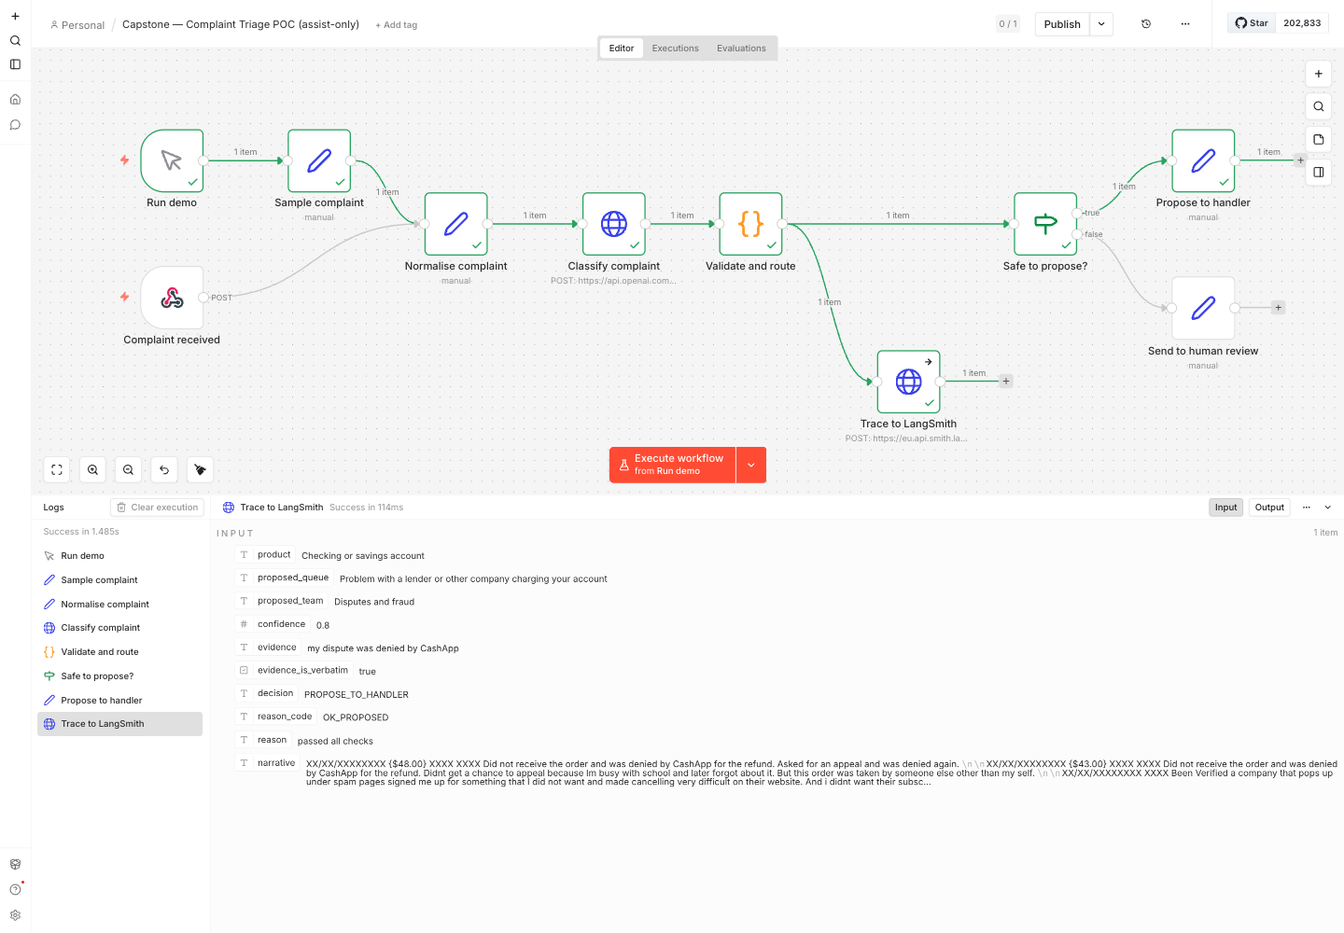
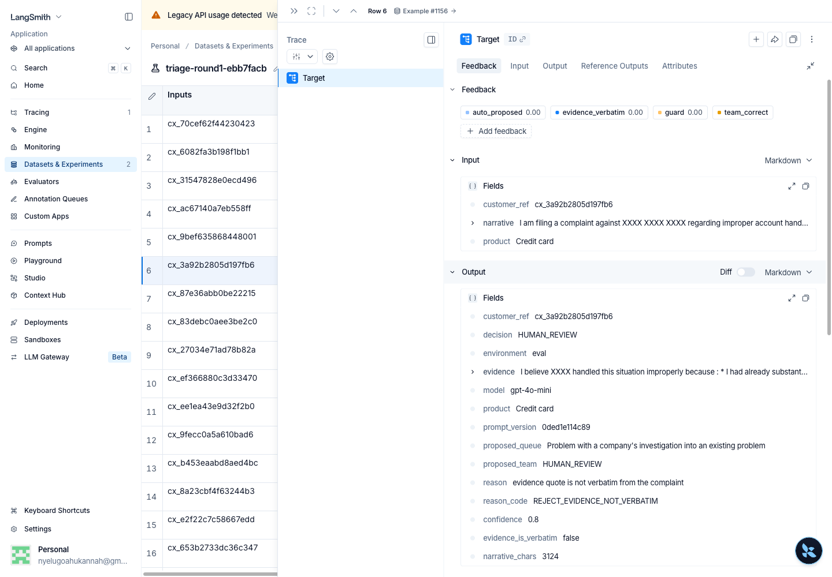
CAPSTONE ROUND 1 · AI CONSULTING PITCH
Every decision is visible — and uncertain cases stop
The workflow, running on 1 public CFPB complaint
A different case, stopped by the quote check
60 evaluation cases traced. ■ 52 proposed a team ■ 4 stopped, not confident enough ■ 4 stopped, quoted a sentence that was not there
Demo, not production. Agreement with consumer-selected CFPB labels is 60.5% — not deployment accuracy. The demo never routes autonomously; Phase 1 runs in shadow, with no action on suggestions.
Source: Project demo/evaluation on public CFPB complaints; agreement is not accuracy.
4
Notes:
Here is the demo workflow processing 1 public CFPB complaint. It proposes the Disputes and Fraud team, quotes the customer’s words as evidence, and leaves the routing decision to a person.
On the right is a different case — 1 of the 4 stopped by the quote check. LangSmith records every evaluation outcome. Of 60 cases, 52 produced a proposal; 4 stopped for low confidence and 4 because the quoted evidence was absent from the complaint.
Those fabricated quotations matter most. Validation caught them and sent each case to human review.
The broader evaluation produced 60.5% team-level agreement against consumer-selected CFPB labels. That is not deployment-quality evidence, and those labels are not expert routing decisions.
The demo is observable, but it does not establish deployment accuracy. Phase 0 creates expert labels from your complaints; Phase 1 measures performance in shadow mode. That is why the proposal is staged.
--- END OF SPOKEN NOTES ---
[Sources]
- Project asset: n8n/screenshots/n8n-execution.png.
- Project asset: langsmith/screenshots/trace-detail-guard-fired.png.
- Project repository: langsmith/traces_export.json and langsmith/experiment_summary.json.
- Project repository: classifier/eval_results_gpt-4o.json and classifier/FINDINGS.md.
[/Sources]

Slide 6

CAPSTONE ROUND 1 · AI CONSULTING PITCH
€14,000 to decide, not €24,500 to deploy
Consultant oversight: 8 days/year × €700 — €5,600
Platform: €150/mo × 12 — €1,800
Estimated annual operating cost: €7,400
▲ Estimated model calls — €0.29/year
0
1
2
Discovery + labelling — €5,600
Pilot, 60-day shadow run — €8,400
Deployment, only if it passes — €10,500
2 weeks elapsed · 8 consulting days × €700. 2 of your handlers label 300 complaints; their time is excluded.
11 weeks elapsed · 12 consulting days × €700. The system proposes; handlers do not act; results use the Phase 0 labels.
4 weeks elapsed · 15 consulting days × €700. Handlers may use proposals; autonomous routing needs separate approval.
2 assumptions: annual complaint volume uses a regulator benchmark for a firm your size; 4 avoided ombudsman referrals a year is the break-even hypothesis. Fixed phase fees are quoted; the pilot tests the benefit.
Sources: FCA and FOS benchmarks; OpenAI API pricing; project cost model.
5
Notes:
The pricing basis is €700 for each of my consulting days, contracted as a fixed fee per phase.
Phase 0 includes 8 of my consulting days, or €5,600. Over 2 weeks, 2 of your handlers label 300 complaints; their time is not included in my fee.
Phase 1 includes 12 of my consulting days, or €8,400. Over 11 weeks, that covers the build and 60-day shadow run. The system proposes; your handlers follow the existing process and do not act on suggestions. Results use the Phase 0 expert labels. Together, Phases 0 and 1 cost €14,000 and reach a decision point.
Phase 2 is contingent on the pilot passing. It includes 15 of my consulting days, or €10,500, taking the full programme to €24,500. This phase is assist-only: your handlers may use proposals, but autonomous routing requires separate approval.
Estimated annual operating cost is €7,400: 8 consultant review days cost €5,600, and the €150 monthly platform costs €1,800. Under the assumed volume, model calls add about €0.29. Accountable operation, not model calls, drives cost.
I am not claiming it will prevent 4 ombudsman referrals a year. The pilot must test that hypothesis.
The ask is €14,000 to reach an evidence-based decision, not €24,500 for a deployment that has not earned approval.
That is my proposal. Thank you. For Round 2, I would most value your view on whether the evidence, controls, and staged investment make Phase 0 a credible next step.
--- END OF SPOKEN NOTES ---
[Sources]
- Project repository: cost_estimation/cost_model.json and cost_estimation/cost_analysis.md.
- OpenAI GPT-4o-mini pricing: https://developers.openai.com/api/docs/models/gpt-4o-mini
- Financial Ombudsman Service case fees: https://www.financial-ombudsman.org.uk/businesses/resolving-complaint/case-fees
[/Sources]

Slide 7

CAPSTONE ROUND 1 · AI CONSULTING PITCH
Supporting evidence
Appendix for questions and discussion

Slide 8
CAPSTONE ROUND 1 · AI CONSULTING PITCH
Why complaint triage comes first
TAKEAWAY Ranked by how visible the reasoning is, not by the size of the prize.
3 use cases assessed
2 excluded uses + 1 guardrail
Complaint triage — proposed for Phase 0 and Phase 1
Anomaly flagging — later option; your investigator reviews each flag
Reporting assistance — later option; a named employee approves output
Customer-facing chatbot — excluded; public errors use your firm's voice
Creditworthiness scoring — excluded; Annex III high-risk
Guardrail — predicted payout never determines routing priority
6
Notes:
I ranked 3 candidate use cases by how visible and controllable their reasoning can be. Only complaint triage is proposed for Phase 0 and Phase 1; anomaly flagging and reporting assistance remain later options.
Complaint triage can propose a team and show the exact evidence behind the proposal. Anomaly flagging can identify unusual patterns for one of your investigators to review. Reporting assistance can draft material while leaving approval with a named employee in your firm.
I ruled out 2 uses. A customer-facing chatbot could make public errors in the firm’s voice. Creditworthiness scoring directly affects access to financial services and is classified as high-risk under the EU AI Act. A separate guardrail prevents predicted payout from determining routing priority.
The point is not to find the most impressive use case. It is to choose a use case whose risks can be bounded and whose decisions can be examined.
--- END OF SPOKEN NOTES ---
[Sources]
- Project repository: research/use_cases.md.
- EU AI Act, Annex III: https://eur-lex.europa.eu/eli/reg/2024/1689/oj
[/Sources]

Slide 9

CAPSTONE ROUND 1 · AI CONSULTING PITCH
5 categories account for 46.1% of complaints
TAKEAWAY Public CFPB data suggests a narrow test; Phase 0 selects your categories.
Managing an account — 19.9%
46.1% of 16,839 public complaints sit in 5 of 64 categories. Phase 0 tests whether your complaint book is similarly concentrated.
Problem with a purchase on your statement — 11.2%
A lender or company charging your account — 5.6%
Fraud or scam — 4.8%
Closing an account — 4.6%
Source: CFPB Consumer Complaint Database (public U.S. data; n=16,839).
7
Notes:
This chart explains how the public data supports a bounded initial test.
In the public dataset, 5 of 64 issue categories account for 46.1% of complaints. That makes it possible to test a narrow, high-volume starting point instead of pretending the model can handle the entire taxonomy equally well.
I would not assume that 46.1% applies to the client. Phase 0 must measure the client’s own concentration and decide which categories belong in the pilot.
The public result is a reason to investigate a focused scope, not a forecast of the client’s complaint book.
--- END OF SPOKEN NOTES ---
[Sources]
- Project repository: README.md and research/sector_research.md.
[/Sources]

Slide 10
CAPSTONE ROUND 1 · AI CONSULTING PITCH
Complaint volume does not predict monetary relief
TAKEAWAY In public CFPB data, credit-card complaints ended with monetary relief 5.7× as often as vehicle-loan complaints.
Product | Complaints | Share | Closed with money paid
Checking or savings | 5,835 | 34.7% | 14.0%
Credit card | 5,382 | 32.0% | 17.2%
Money transfer | 2,551 | 15.1% | 10.6%
Vehicle loan | 1,523 | 9.0% | 3.0%
This is a public-data relationship; Phase 0 tests whether it appears in your complaint book.
Source: CFPB public data; monetary relief is a reported outcome, not handling cost.
8
Notes:
This public-data slide separates how often complaints occur from how often they end with monetary relief.
Checking and savings accounts and credit cards produce most of the complaint volume in this dataset. But monetary relief appears in 17.2% of credit-card complaints, compared with 3.0% for vehicle-lending complaints. That is a 5.7× difference.
The implication is that volume alone does not describe likely monetary relief. That relationship is a hypothesis to test, not a routing rule.
This is a signal from public data, not a forecast for the client. The client’s own product mix, resolution costs, and escalation patterns must be measured during discovery and the pilot.
--- END OF SPOKEN NOTES ---
[Sources]
- Project repository: research/sector_research.md and dashboard evidence.
[/Sources]

Slide 11

CAPSTONE ROUND 1 · AI CONSULTING PITCH
All 60 evaluation decisions are accounted for
TAKEAWAY 60 evaluation cases; every outcome has a reason code.
WHAT HAPPENED | HOW OFTEN, IN 60 DECISIONS
Produced a proposal; validation checks passed | 52
Quote was not actually in the complaint | 4 — flagged for human review
Confidence below the 0.70 threshold | 4 — flagged for human review
Cases without a recorded outcome | 0
A system that explains itself convincingly but falsely is more dangerous than one that says nothing.
Source: Project LangSmith evaluation (n=60 public CFPB complaints).
9
Notes:
In the 60-case evaluation sample recorded in LangSmith, 52 complaints produced a proposal after passing the configured validation checks. Passing those checks does not prove that the proposed team was correct.
4 were flagged for human review because the model’s evidence quotation was not present verbatim in the complaint. Another 4 were flagged because confidence was below the threshold.
Every case in the sample has a recorded outcome and a reason code. 0 cases lack a recorded outcome.
This does not prove that every proposal was correct. It proves that proposals and stops can be traced and discussed.
--- END OF SPOKEN NOTES ---
[Sources]
- Project repository: langsmith/experiment_summary.json.
[/Sources]

Slide 12

CAPSTONE ROUND 1 · AI CONSULTING PITCH
60.5% agreement makes expert labels essential
TAKEAWAY CFPB labels are not expert routing ground truth; Phase 0 creates it.
What I measured
Why the number is what it is
60.5% agreement with CFPB-derived team labels (gpt-4o, n=240)
Paying 17× as much improved agreement by 3.7 percentage points
That comparison does not establish expert-routing accuracy
gpt-4o chose the same team on 89.0% of repeated runs
It still agreed with CFPB-derived team labels only 60.5%
Those labels came from consumer-selected issue menus, not expert routing
Sources: Project evaluation vs CFPB-derived labels; OpenAI API pricing; agreement, not accuracy.
10
Notes:
The 60.5% result should not be interpreted as a clean measure of model accuracy.
When the same model classified the same complaints again, it selected the same team approximately 89% of the time. It was relatively consistent with itself but disagreed much more often with the CFPB label.
The CFPB issue label is selected by the person filing the complaint, using a product-specific menu. It is not an expert judgement about which internal team should handle the case.
The 60.5% result therefore mixes model error with label mismatch; it cannot separate them. Phase 0 resolves that uncertainty by asking experienced handlers to create an expert-labelled reference set and by measuring their agreement with one another.
--- END OF SPOKEN NOTES ---
[Sources]
- Project repository: classifier/eval_results_gpt-4o.json and classifier/eval_results_gpt-4o-mini.json.
- Project repository: classifier/FINDINGS.md and cost_estimation/cost_model.json.
- OpenAI GPT-4o pricing: https://developers.openai.com/api/docs/models/gpt-4o
- OpenAI GPT-4o-mini pricing: https://developers.openai.com/api/docs/models/gpt-4o-mini
[/Sources]

Slide 13
CAPSTONE ROUND 1 · AI CONSULTING PITCH
3 data corrections changed the story
TAKEAWAY Each one would have produced a confident wrong answer.
WHAT THE DATA APPEARED TO SAY | WHAT WAS ACTUALLY HAPPENING
Complaints fell 73% in July | CFPB publication lag — records appear after a company responds or enough time passes. Analysis ends 27 Jun 2026
Handling time is 0 days | It measures the regulator's routing, not any firm's speed. Metric dropped
Timeliness 98.0% vs 0.6% untimely | Two different fields. Relabelled so a CEO is not shown a contradiction
Source: CFPB data-quality review; analysis window ends 27 Jun 2026.
11
Notes:
3 data problems could have produced confident but misleading conclusions.
First, recent complaint volume appeared to collapse by 73% because the CFPB publishes complaints only after the company responds or enough time passes. I removed the incomplete period and ended the analysis window on 27 June 2026.
Second, the apparent response-time field was 0 for 96% of records because it measured the regulator’s routing process, not the firm’s handling time. I excluded it.
Third, 2 different timeliness fields created apparently conflicting percentages. I separated their meanings instead of treating them as the same metric.
The lesson is that a field can be complete and still mean the wrong thing for the business question.
--- END OF SPOKEN NOTES ---
[Sources]
- Project repository: README.md and the documented data-quality checks.
[/Sources]

Slide 14
CAPSTONE ROUND 1 · AI CONSULTING PITCH
Human review supports a preliminary compliance view
TAKEAWAY This is a Round 1 working view, not a final legal classification.
Question | Round 1 working view
EU AI Act classification | Not identified as Annex III high-risk for this intended use; Round 2 legal validation is required
Decision boundary | The system proposes a route; a human confirms and resolves. Autonomous routing requires a new assessment
GDPR work | Round 2 assesses legal basis, retention, and whether a DPIA is required
Open risk | Hosting region and cross-border transfer controls are not yet verified
Source: EU AI Act Annex III; Round 1 working view; legal validation remains open.
12
Notes:
My Round 1 compliance position is deliberately preliminary. It is not a final legal classification.
This system proposes an internal complaint-routing team. It does not assess creditworthiness, determine access to a financial service, or make the final decision on a customer’s complaint. A human remains responsible for confirming the route and resolving the case.
On that intended use, I have not identified it as matching the Annex III creditworthiness use classified as high-risk. However, classification depends on the exact intended purpose, deployment context, data flows, and degree of human control.
Round 2 therefore needs a step-by-step classification and obligations assessment. If the system begins routing automatically or influencing substantive customer outcomes, that is a new assessment, not a minor product upgrade.
Round 2 must also establish the GDPR legal basis and retention period, decide whether a DPIA is required, and verify the hosting region and cross-border transfer controls. Those controls are open work, not completed safeguards.
--- END OF SPOKEN NOTES ---
[Sources]
- Project repository: research/opportunities_risks.md, §4.
- EU AI Act: https://eur-lex.europa.eu/eli/reg/2024/1689/oj
[/Sources]

Slide 15
CAPSTONE ROUND 1 · AI CONSULTING PITCH
Every number is measured, sourced, or assumed
Measured, sourced, and assumed figures are labelled separately.
Figure | Value | Source
Complaint corpus | 16,839 | U.S. Consumer Financial Protection Bureau (CFPB), 1 May–27 Jun 2026
Scenario complaint rate | 3.7 per 1,000 accounts | FCA aggregate benchmark, 2025 H2
Ombudsman case fee | £650 after 3 free cases/year | Financial Ombudsman Service 2025/26
Tokens per complaint | 684 input / 49 output tokens | Project measurement, n=12
Agreement with CFPB label | 60.5% | gpt-4o, n=240, seed 42
Sources: CFPB, FCA, Financial Ombudsman Service, and project evaluation files.
13
Notes:
Every figure in the pitch fits 1 of 3 categories: measured in this project, taken from a named public source, or explicitly labelled as an assumption or professional judgement.
The complaint analysis comes from the public CFPB dataset. The client-size and complaint-rate estimates use stated FCA benchmarks and scenario assumptions. The model behaviour comes from the project’s own evaluations. The 60.5% figure is agreement with CFPB-derived labels, not expert-routing accuracy. Soft inputs such as minutes per complaint, employer on-costs, and platform cost are labelled as judgements in the cost model.
The purpose of this slide is not to claim certainty. It is to make clear which figures are evidence, which are external benchmarks, and which must be validated during Phase 0 and the pilot.
--- END OF SPOKEN NOTES ---
[Sources]
- CFPB Consumer Complaint Database: https://www.consumerfinance.gov/data-research/consumer-complaints/
- Project repository: README.md, classifier evaluation files, and cost_estimation/cost_model.json.
[/Sources]

