Slide 1
AI CONSULTING CAPSTONE · ROUND 2
Assist
Three capabilities. One controlled decision process.
What works, what does not yet pay, and how to decide with evidence.
Notes:
Round 1 established that an inspectable, assist-only system was worth developing. Round 2 implemented all three use cases, built the MVP, and tested the economics and compliance constraints. The control mechanism works, but performance on the client's data and the value of a bespoke deployment are not yet proven.
[Sources]
- `presentation/round1_pitch.pptx`, slides 1–6
- `feedback/round1_decision.md`
- `README.md`, Round 2 deliverables and headline findings

Slide 2
Round 1 set the direction. Round 2 built the evidence
KEPT
CHANGED
Mid-size EU financial services firm
One implemented use case became three
Complaint triage remained the lead use case
A POC became a working MVP
The system proposes; a person decides
Cost estimates became ROI, risk and compliance assessments
Decision now: a staged evidence programme — not deployment.
Capstone Round 2 · Assist
1
Notes:
Round 1 kept the client, complaint triage and the human-decision boundary. The material change was scope: build all three use cases. Round 2 did that and added a working MVP, ROI analysis and compliance assessment. The decision now is whether to fund a controlled evidence programme, not whether to deploy.
[Sources]
- `feedback/round1_decision.md`
- `use_case_definition.md`, “How this evolved from Round 1”
- `presentation/round1_pitch.pptx`, slides 2–3

Slide 3
One decision spine controls all three
Validate input
→
Model proposes
→
Guards verify
→
Human decides
In scope? Confident enough to propose? Every quote, figure or value present in the evidence?
The system never routes, files or blocks anything by itself.
Capstone Round 2 · Assist
2
Notes:
Each request follows the same sequence. The input is validated. The model may propose. Deterministic guards test scope, confidence and grounding. A person then decides what happens next. The system never routes a case, files a report or blocks a transaction. The POC tests this sequence end to end.
[Sources]
- `mvp/mvp_documentation.md`, architecture, six guards and error handling
- `mvp/spine.py`
- `mvp/test_spine.py`

Slide 4
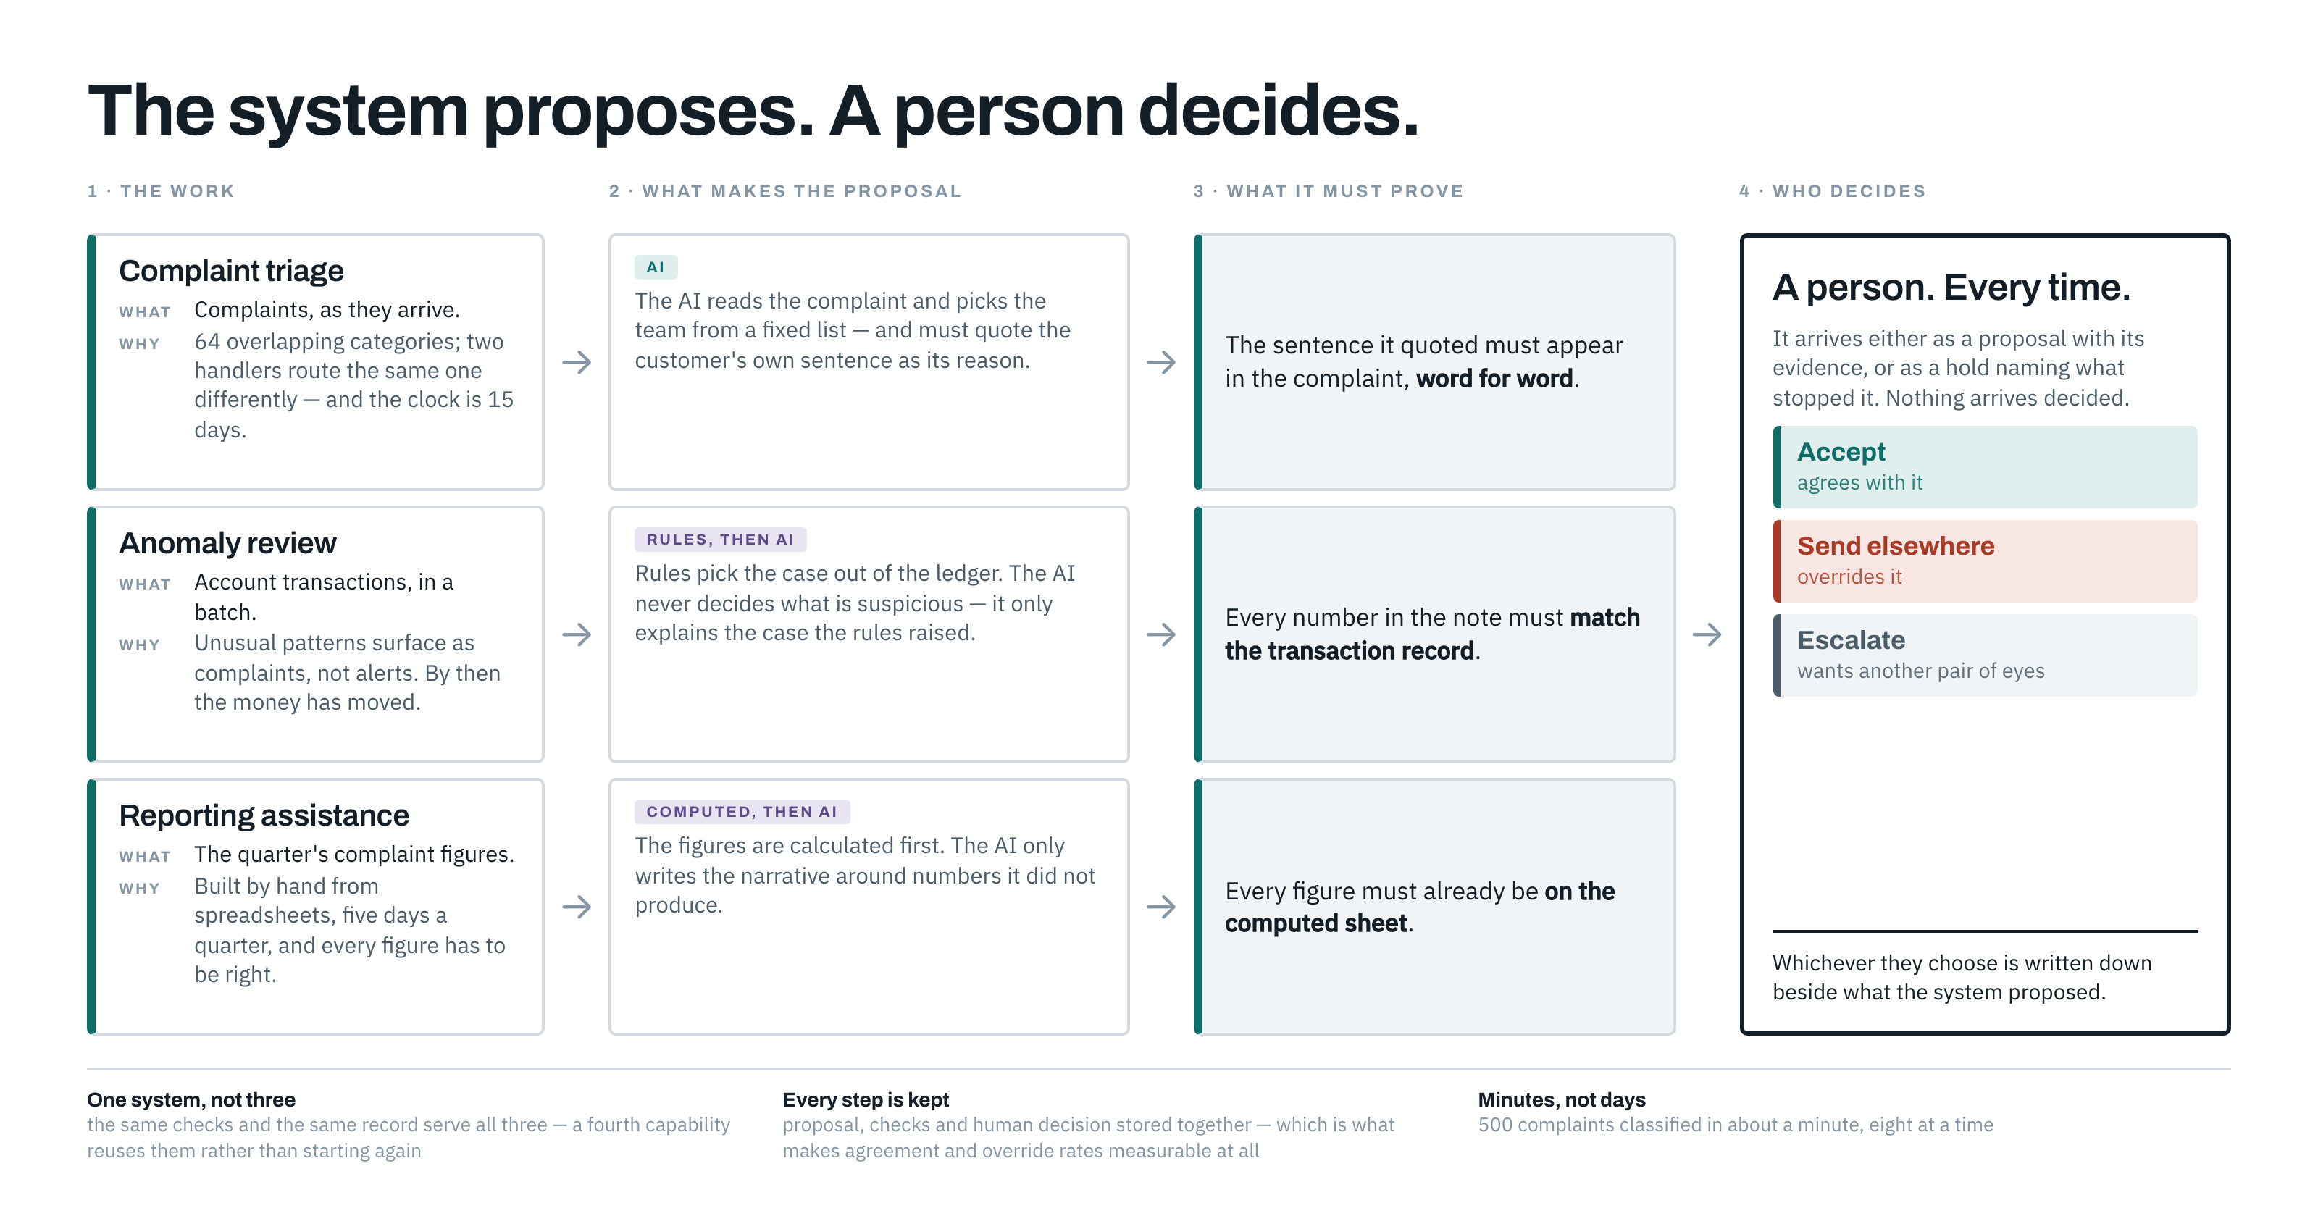
Capstone Round 2 · Assist
3
Notes:
Read it left to right, one row at a time. Three jobs, three different reasons they are hard today, and three different ways a proposal gets made — the AI only chooses in triage. For anomalies rules pick the case and the AI explains it; for reporting the figures are computed and the AI writes them up. Two of the three proposals are not the AI's call at all.
The third column is where it stops being a demo. Each capability has to prove its answer against something the system already holds: the customer's own sentence, the transaction record, the computed sheet. Same six checks, same order — only the proof differs.
Then one person, for all three, and their decision is stored beside the proposal. That pairing is what makes agreement and override rates measurable later.
[If asked which six checks] In scope, the model replied, the reply is readable, what it named exists, confident enough, evidence really there. It stops at the first failure, so a refusal always names exactly one reason.
[Sources]
- `mvp/spine.py`, the six stages and twelve reason codes
- `mvp/capabilities/`, what each capability submits as evidence
- `use_case_definition.md`, the three problems named in column one

Slide 5
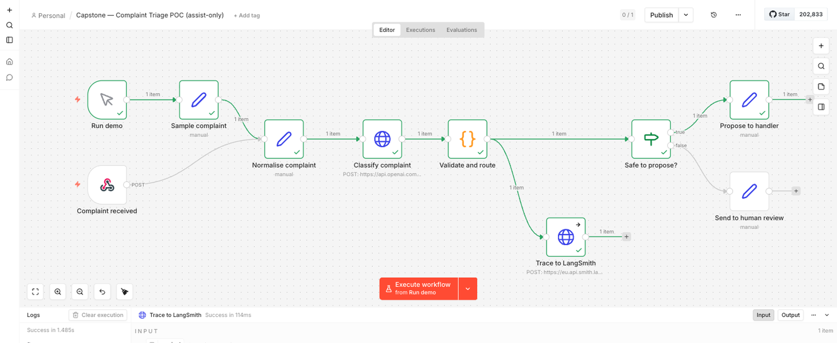
The POC proves the mechanism — not accuracy
Proves: the workflow can propose, cite evidence and stop safely.
Does not prove: client performance or value.
Capstone Round 2 · Assist
4
Notes:
The POC proposes a routing team and quotes the complaint as evidence. Low confidence or missing evidence stops the workflow and records the reason. It never routes the case. This proves the mechanism can propose, cite and abstain safely. It does not prove performance or value on client data; those require expert-labelled client cases.
[Sources]
- `poc/poc_documentation.md`
- `poc/poc_workflow.json`
- `demo/recordings/poc_demo.mp4`
- `classifier/FINDINGS.md`
- CFPB Consumer Complaint Database: https://www.consumerfinance.gov/data-research/consumer-complaints/

Slide 6
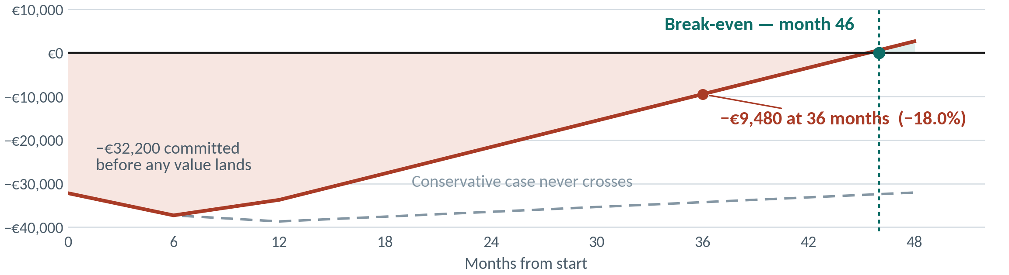
The system works; the bespoke economics do not
At 2,426 complaints a year, bespoke deployment breaks even in month 46. Approximately 3,100 are needed.
€9,918 of €17,326 is cash — ombudsman fees and fraud losses, not saved time.
Capstone Round 2 · Assist
5
Notes:
At 2,426 complaints a year this build does not pay for itself inside three years. The line crosses in month 46. At 36 months the firm is 9,480 euro down on 52,795 spent, which is minus 18 per cent. That already assumes the consultant hands oversight to a named internal owner after year one — charging the consultant rate for all three years would read minus 31, and would be pricing an engagement nobody is offering. The conservative line never crosses, and the gap between the two lines is the anomaly and reporting value the shadow pilot is built to measure. Of the 17,326 euro annual value, 9,918 is cash the firm does not spend: ombudsman case fees avoided at 650 pounds each, and fraud redress avoided by catching it earlier. The remaining 7,408 is displaced time, and displaced time is not a saving unless the hours are actually removed or redeployed. Three minutes on 2,426 complaints is 121 hours a year, which is seven per cent of one person. The model does not bank it. So the case rests on four avoided ombudsman referrals a year, and that is exactly what the shadow pilot is built to measure.
[If asked whether this ever pays] Not as a one-off build at this volume — about 3,100 complaints a year would be needed, and this firm has 2,426. Shared across five firms the same capability returns positive, and absorbing the oversight into an existing remit improves it further. That is my problem to solve, not a cost to load onto one firm.
[Sources]
- `roi_risk_assessment.md`, headline, ROI, break-even and sensitivity
- `cost_estimation/roi_model.json`
- `presentation/assets/roi_breakeven_chart.py`, which reads that model
- `strategic_plan.md`, commercialisation model

Slide 7
Three risks decide whether a pilot is defensible
Value assumptions fail on real data
4×5
Measure before committing to deployment. Fixed phase exits preserve the right to stop.
Handlers rubber-stamp proposals
4×4
Acceptance above 97% is a failure signal, measured per handler.
Oversight costs more than it saves
3×4
Measure effort during the shadow pilot from day one.
Capstone Round 2 · Assist
6
Notes:
Expected value may not appear in client data. Acceptance above 97 per cent may indicate rubber-stamping. Oversight may exceed three days per quarter and erase the savings. The pilot measures all three risks, and fixed phase exits preserve the option to stop.
[Sources]
- `roi_risk_assessment.md`, risk matrix R1–R3
- `strategic_plan.md`, Phase 1 KPIs and exit gates
- `mvp/mvp_documentation.md`, decision logging and monitoring

Slide 8
Not high-risk. Real-data use still has gates
AI Act:
Triage and reporting are not high-risk.
Anomaly flagging requires counsel confirmation. AI literacy applies now.
The full complaint narrative reaches the provider.
GDPR:
Close the DPA, transfer assessment and zero-retention controls before using real data.
Capstone Round 2 · Assist
7
Notes:
Under this assist-only design, triage and reporting are not high-risk. Anomaly flagging needs counsel confirmation because it profiles transaction behaviour. AI literacy applies now. The immediate GDPR issue is data transfer: the identifier is pseudonymised, but the full complaint narrative reaches the provider. Real-data work waits for the DPA, transfer assessment and zero-retention controls.
[Sources]
- `compliance/eu_ai_act_compliance.md`, classification conclusion and mandatory requirements
- `compliance/gdpr_documentation.md`, data flow, DPIA and transfer assessment
- Regulation (EU) 2024/1689: https://eur-lex.europa.eu/eli/2024/1689/oj
- Regulation (EU) 2016/679: https://eur-lex.europa.eu/eli/2016/679/oj

Slide 9
The programme earns each next step
PHASE · WHAT IT BUYS
FEE · EXIT
0 · Ground truth, baselines, legal closure
€5,600 · go/no-go on pilot
1 · Configuration + 60-day shadow run
€12,600 · go/no-go on deployment
2 · Integration, training and handover
€14,000 · only if gates pass
€18,200 reaches the deployment decision. Nobody acts on a suggestion in shadow.
Hard gates: ≥80% accuracy · 75–97% acceptance · zero ungrounded outputs.
Capstone Round 2 · Assist
8
Notes:
Phase 0 spends €5,600 to create expert labels, measure baselines and close the legal and data-transfer gates. Phase 1 adds €12,600 to configure the three capabilities and run a 60-day shadow pilot; staff continue the current process and do not act on AI suggestions. €18,200 therefore buys the evidence and a deployment decision. Phase 2 receives no funding unless every gate passes.
[Sources]
- `strategic_plan.md`, phase plan, milestones and KPIs
- `roi_risk_assessment.md`, upfront costs and recommendation
- `use_case_definition.md`, measurable success criteria

Slide 10
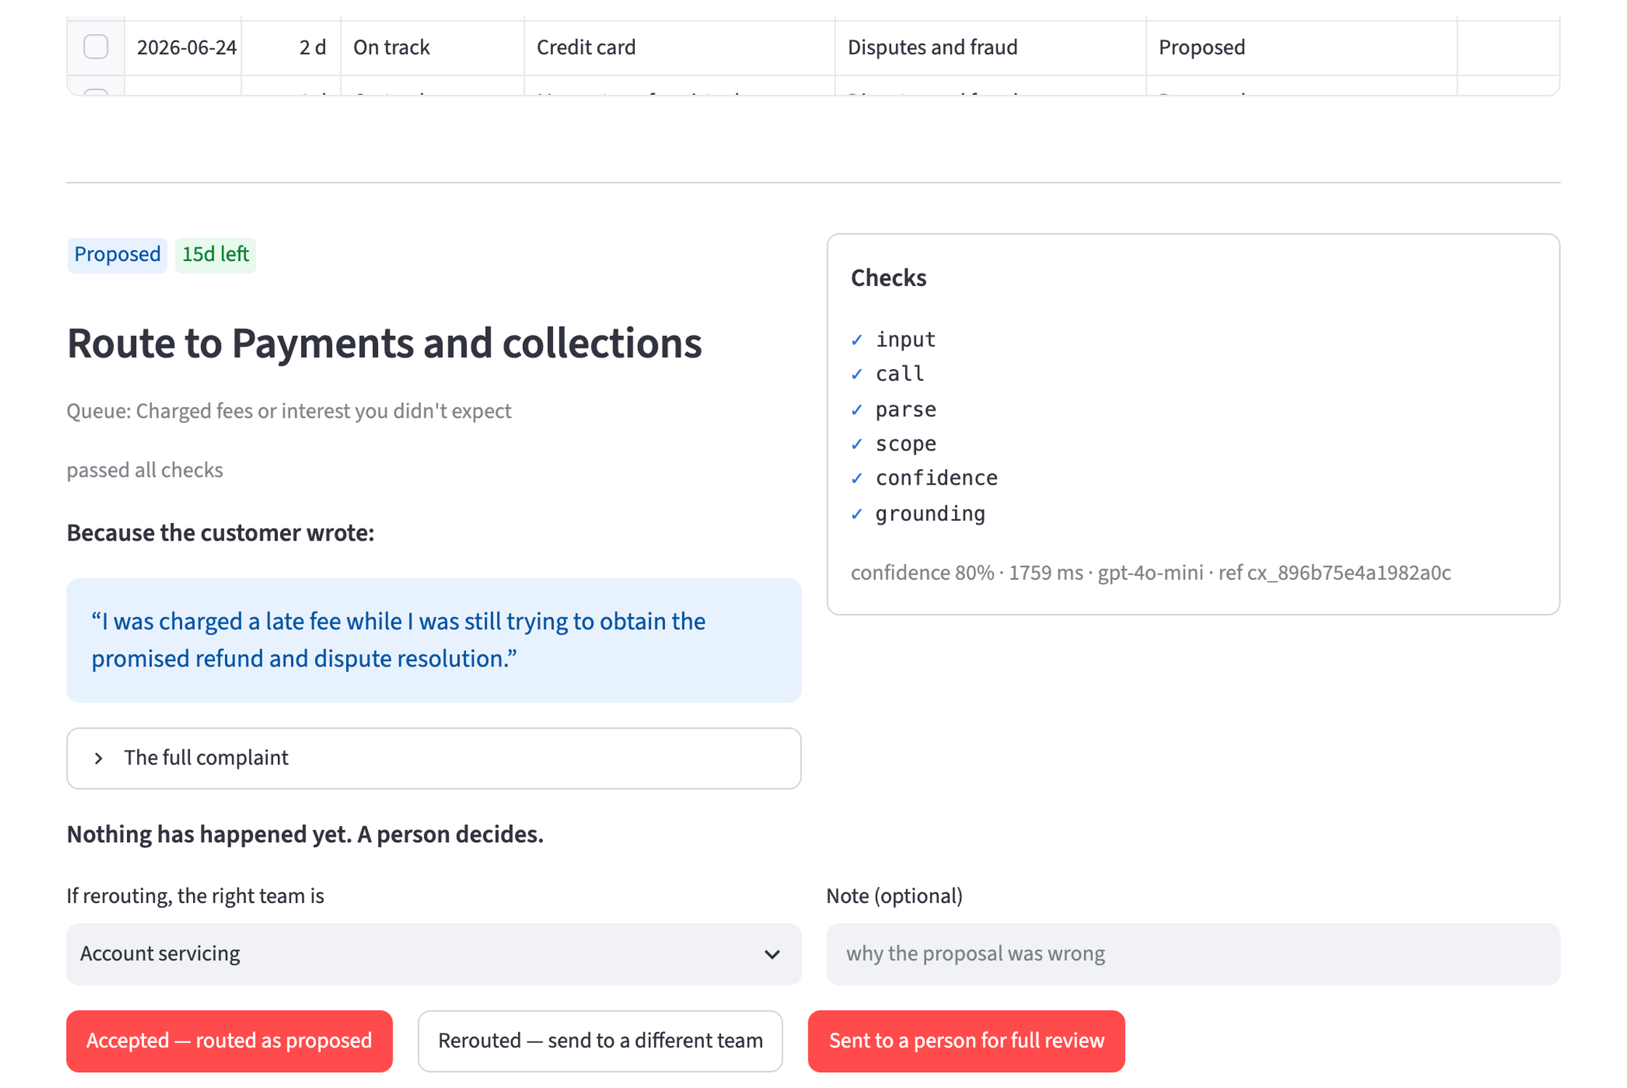
The MVP makes every proposal accountable
One record connects the proposal, its evidence, every check and the human decision.
Capstone Round 2 · Assist
9
Notes:
The MVP presents the team's work as a queue. One record shows the proposal, its evidence, every guard result and the named human decision. No case is routed until a person acts. The record makes the proposal's basis and the person's response reviewable.
[Sources]
- `mvp/mvp_documentation.md`, capabilities, UI, decision log and demo brief
- `demo/recordings/mvp_demo.mp4`
- `mvp/app.py`
- `mvp/queue_store.py`

Slide 11
Proceed to evidence — not deployment
Approve Phases 0 and 1 up to €18,200.
Close the legal and data-transfer gates before real-data processing.
Retain fixed phase exits and the stated pilot thresholds.
Do not fund the €14,000 deployment phase unless the evidence and commercial structure support it.
Capstone Round 2 · Assist
10
Notes:
My recommendation is to approve Phases 0 and 1, capped at €18,200. Before real-data processing, close the legal and transfer gates. Keep the stated performance thresholds and phase exits. Do not fund the €14,000 deployment phase unless client data proves the performance case and the commercial structure proves the economics.
[Sources]
- `roi_risk_assessment.md`, recommendation and phase costs
- `strategic_plan.md`, phase exits and deployment gates
- `compliance/gdpr_documentation.md`, blockers to real-data processing

Slide 12
The POC has not yet proved client performance
MEASURE
RESULT
Complainant labels · gpt-4o-mini (deployed) / gpt-4o
56.8% / 60.5%
Self-agreement on the same input · gpt-4o
88.0%
Synthetic anomaly precision
97.9%
Accuracy / anomaly precision on client data
Not measured
Phase 0 creates expert labels; the shadow pilot tests real-world usefulness.
Capstone Round 2 · Assist
11
Notes:
These figures are diagnostic, not client performance. The 60.5 per cent is agreement with complainant-selected CFPB labels, not expert accuracy. The model agreed with itself on 88.0 per cent of repeated inputs, showing that the disagreement is systematic rather than random; it does not identify the cause. The anomaly detector reached 97.9 per cent precision on synthetic data designed around its thresholds, and 98.9 per cent recall — it now misses one pattern in twenty on threshold structuring, which appeared only once the fixture grew from forty accounts to two hundred. Phase 0 creates the client benchmark. [If someone opens FINDINGS.md and sees different numbers] These are the 2026-08-28 run, which is the baseline this whole deck was built on, and FINDINGS.md says so. Re-running the identical sample six days later, gpt-4o came back within a third of a point — so the sampling, prompt and scoring are all doing the same thing — but gpt-4o-mini moved from 56.8 to 61.6, twelve of two hundred and forty predictions flipping. Nothing in the repo changed; the alias almost certainly resolves to a newer snapshot. The conclusion gets stronger, not weaker: the premium I charged gpt-4o with earning does not reproduce. Both runs are committed with dated evidence files.
[Sources]
- `classifier/FINDINGS.md`
- `classifier/eval_results_gpt-4o.json`
- `classifier/eval_results_gpt-4o-mini.json`
- CFPB Consumer Complaint Database: https://www.consumerfinance.gov/data-research/consumer-complaints/
- `mvp/synth/make_transactions.py`
- `mvp/capabilities/anomaly.py`
- `strategic_plan.md`, Phase 1 KPI G6

Slide 13
UC-1 and UC-3 are not high-risk; UC-2 needs counsel
STEP
FINDING
1 · AI system under Art. 3(1)
Yes
2 · Prohibited practice under Art. 5
None identified
4 · Annex III high-risk use
UC-1/3: no · UC-2: counsel
Articles 50 and 4
Marking + AI literacy
The intended use and human decision boundary drive the classification.
Capstone Round 2 · Assist
12
Notes:
UC-1 is complaint triage; UC-2 is anomaly flagging; UC-3 is reporting assistance. UC-1 and UC-3 do not match the Annex III high-risk uses under this assist-only design. UC-2 remains open because it profiles transaction behaviour. Counsel must confirm whether the fraud-detection reasoning applies. If counsel concludes that it does not, UC-2 becomes high-risk and can be disabled without affecting the other two.
[Sources]
- `compliance/eu_ai_act_compliance.md`, classification steps 1–7
- Regulation (EU) 2024/1689: https://eur-lex.europa.eu/eli/2024/1689/oj

Slide 14
The full complaint narrative still leaves the bank
WHAT
WHERE IT GOES
Complaint identifier
No · replaced before the model call
Complaint narrative
Yes · sent to the provider in full
Evidence + pseudonymous reference
Stored in monitoring
Pseudonymisation protects the reference, not the content. Transfer controls are the gate.
Capstone Round 2 · Assist
13
Notes:
The complaint identifier is replaced before the model call, but the full narrative still reaches the provider and quoted evidence is stored in monitoring. Pseudonymisation therefore protects the reference, not the content. The data remains personal data. The DPA, transfer assessment and zero-retention configuration are the real-data gates.
[Sources]
- `compliance/gdpr_documentation.md`, data flow and third-party transfers
- Regulation (EU) 2016/679: https://eur-lex.europa.eu/eli/2016/679/oj

Slide 15
Every pilot threshold must pass before deployment
MEASURE
THRESHOLD
Accuracy against expert labels
≥80%
Triage-time reduction
≥40%
Handler acceptance
75–97%
Oversight effort
≤3 days / quarter
Ungrounded outputs reaching a handler
Zero
Correct abstention
≥95%
Anomaly precision on disposition
≥30%
Capstone Round 2 · Assist
14
Notes:
The hard gates are at least 80 per cent accuracy against expert labels, 75 to 97 per cent handler acceptance and zero ungrounded outputs reaching a handler. The remaining thresholds test time saved, oversight, abstention and anomaly usefulness. Because the capabilities are separable, UC-2 can fail without blocking UC-1 and UC-3.
[Sources]
- `strategic_plan.md`, Phase 1 KPIs G1–G7
- `use_case_definition.md`, success criteria

