Slide 1



Sustainable Research Software
Emmanuel Nyenah, Robert Reinecke
SC5.13
Thu, 18 Apr, 14:00–15:45 (CEST)
1
Notes:
1

Slide 2
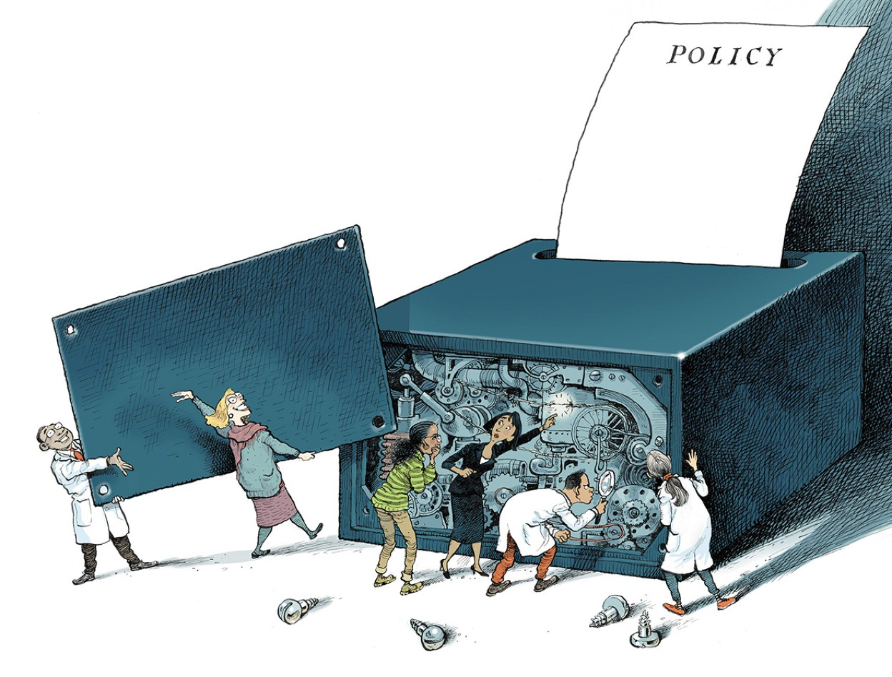
Research software is pivotal for science
We utilize Software every day to make sense of the world
Saltelli et al. (2020, Nature)
2
Notes:
Who is using software (apart from Word etc.) every day for their science?
Without software it would be almost impossible now to make use of the amount of data that we have available
Def: source code files, algorithms, computational workflows, and executables developed during the research process or for a research objective
2

Slide 3
Research software is pivotal for science
We utilize Software every day to make sense of the world
We can even build digital representations of the world: models
Saltelli et al. (2020, Nature)
3
Notes:
Models are likely the most complex implementation of research software
In a changing world, they allow us to carry out experiments that would otherwise be impossible
3

Slide 4
Research software is pivotal for science
We utilize Software every day to make sense of the world
We can even build digital representations of the world: models
Finding errors in these complex tools is hard
Saltelli et al. (2020, Nature)
4
Notes:
We mainly try to find errors in our understanding
Or utilize valuable tools like sensitivity analysis, but we rarely look at the code itself
4

Slide 5
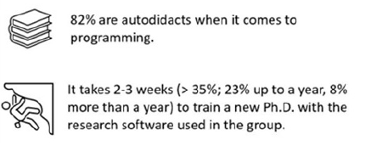
However, we face significant challenges when developing and using it
Reinecke et al. (2022, ERL)
The majority of experts have never learned how to develop code
This impacts the training of new PhDs
5
Notes:
5

Slide 6
However, we face significant challenges when developing and using it
Reinecke et al. (2022, ERL)
The majority of experts have never learned how to develop code
This impacts the training of new PhDs
And more importantly our science
6
Notes:
6

Slide 7
Our software is unsustainable
Daniel Katz:
“the process of developing and maintaining software that continues to meet its purpose over time”
Anzt et al. 2021
“software that is maintainable, extensible, flexible (adapts to user requirements), has a defined software architecture, is testable, has comprehensive in-code and external documentation, and is accessible”
7
Notes:
7

Slide 8
How can we make software that is sustainable?
By
writing clear and modular code.
using code quality metrics to assess our code.
documenting it with established tools
8
Notes:
8

Slide 9
Writing modular code is the first step towards reusable software
Maintainable
Extensible
Flexible
9
Notes:
9

Slide 10
Writing modular code is the first step towards reusable software
Maintainable
Ease of repair, improve, and understand software code
Measure of how easy it is to keep a software system running smoothly and effectively.
A maintainable system can be easily adapted to changing needs, whether those changes are made by the original developers or by new members of the team
10
Notes:
This includes fixing bugs, optimizing existing functionality, and adjusting code to prevent future issues.
Poor quality software is harder to maintain.
Bad code requires a larger effort and costs more to adapt to new requirements.
Software is more easily maintainable if it has high-quality code that is readable and well-documented
Therefore, good coding practices should be kept in mind while the software is still in development.
10

Slide 11
Writing modular code is the first step towards reusable software
Extensible
Ability to allow for a significant extension of its capabilities
! Without major changes to the core architecture
New features can be added easily
“Change is already built into the system”
11
Notes:
11

Slide 12
Writing modular code is the first step towards reusable software
Flexible
Often seen as a precursor to maintainable and extensible code
Code that can adapt to changing requirements and is able to grow efficiently over time
-> Modularity is critical to achieving that.
12
Notes:
12

Slide 13
What is modular code, and how do we develop it?
Rule:
Separation of Concern (SoC):
Encapsulate information into separate software pieces and expose it through well-defined interfaces
Hiding implementation details behind interfaces allows to modify a single concern without affecting the rest of the system
13
Notes:
SoC leads to code modularity. It helps in breaking down a complex system into manageable parts where each part addresses a single concern
A well-defined interface in software development is clear, complete, consistent, encapsulates its implementation, and is well-documented
This can happen either on the level of defining functions or methods inside a file or by utilizing classes and object oriented programming
13

Slide 14


Routines to read data (e.g., different NetCDF data from a project)
Model to estimate data based on inputs
Configuration file with paths and files to process
and info on where to write outputs
Routines to write data
Routines to calculate indicators by combining data

Slide 15
readData()
runModel()
runModel(parameters)
Configuration file
writeData()
calculateIndicators()
Final main program:
Data = readData()
Outputs = runModel(data)
Indicators = calculateIndictors(Outputs)
writeData(Indicators)

Slide 16
What is modular code, and how do we develop it?
2. Rule:
Don’t reinvent the wheel.
Use existing libraries whenever possible
Take a closer look at how others develop complex code
Utilize software patterns for very large projects (>1000 lines of code)
16
Notes:
16

Slide 17
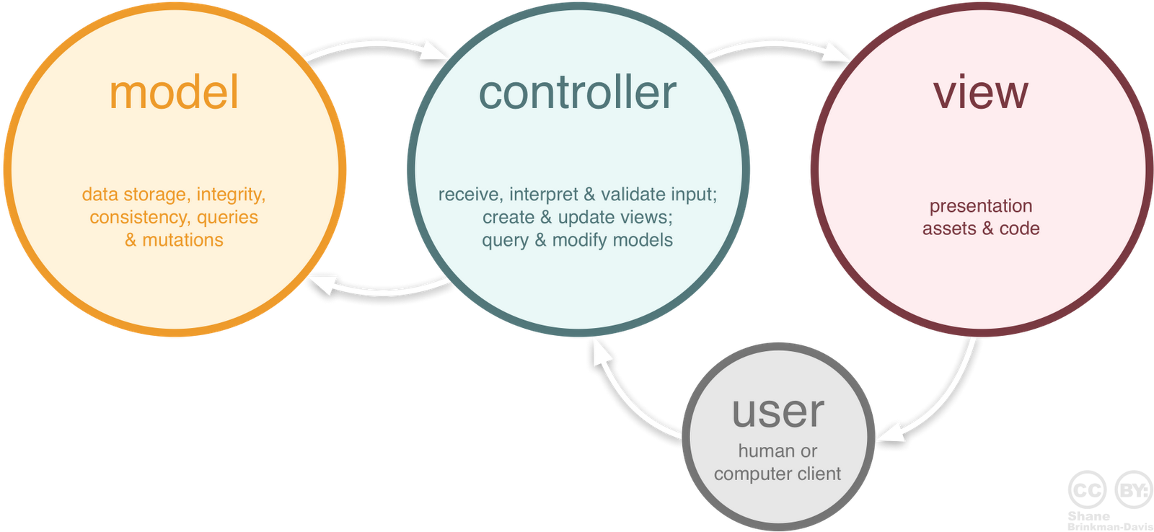

Slide 18
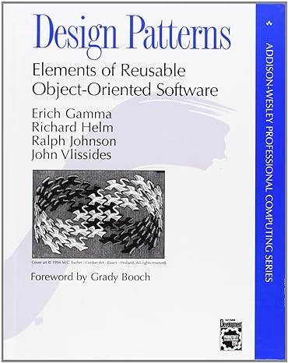

Slide 19
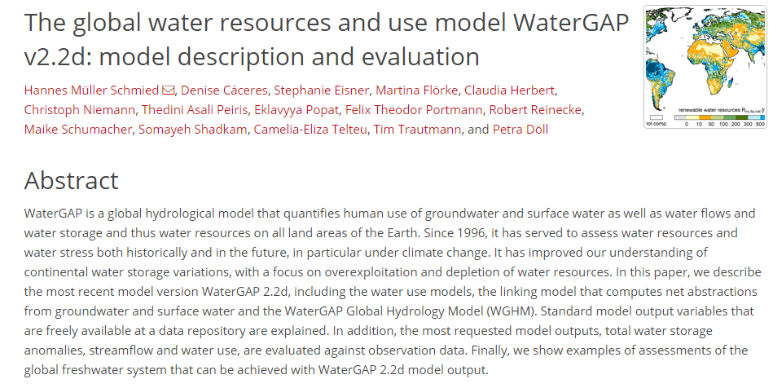
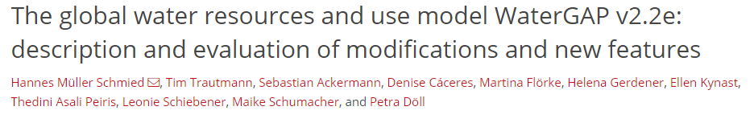
Towards a sustainable global hydrological model
(An exemplary Cases study)
19
Notes:
WaterGAP quantifies human use of groundwater and surface water, as well as water flows, storage, and overall water resources across all land areas on Earth.
19

Slide 20
Towards a sustainable global hydrological model
(An exemplary Cases study)
Our goal :
Completely rewrite the software WaterGAP from scratch with a modular structure using a modern programming language (python) and state-of-the-art (best) software engineering practices.
20
Notes:
20

Slide 21
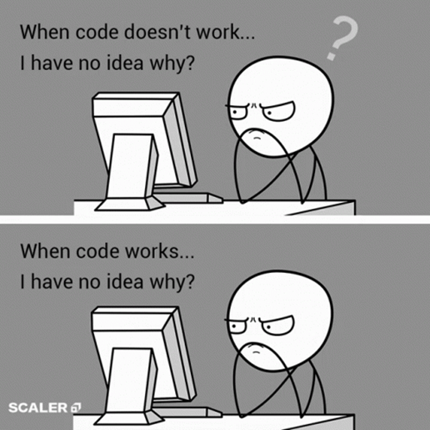
WHY REPROGRAM ?
No defined code Structure
Limited documentation
“Script-like” files with 10,000 lines of code per file
Can not be used Externally without guidance
Move to Python (readable)
21
Notes:
The global hydrological model, WaterGAP, has been in development for over 25 years, created primarily by PhDs and Postdocs with limited software development experience.
21

Slide 22

WHY REPROGRAM ?
Create a community global hydrological model which can be understood by a novice user and be used anywhere.
22
Notes:
22

Slide 23
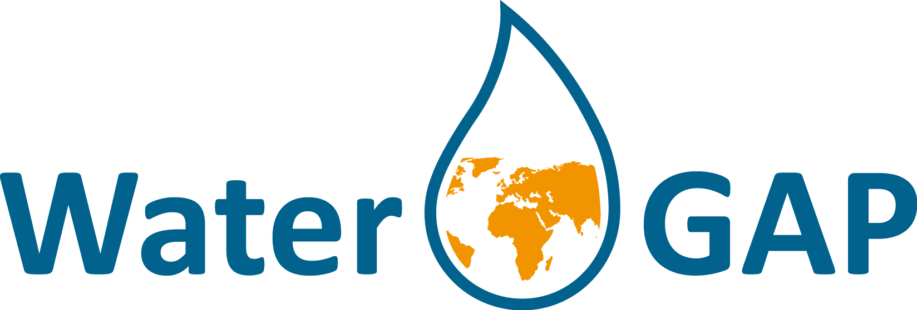
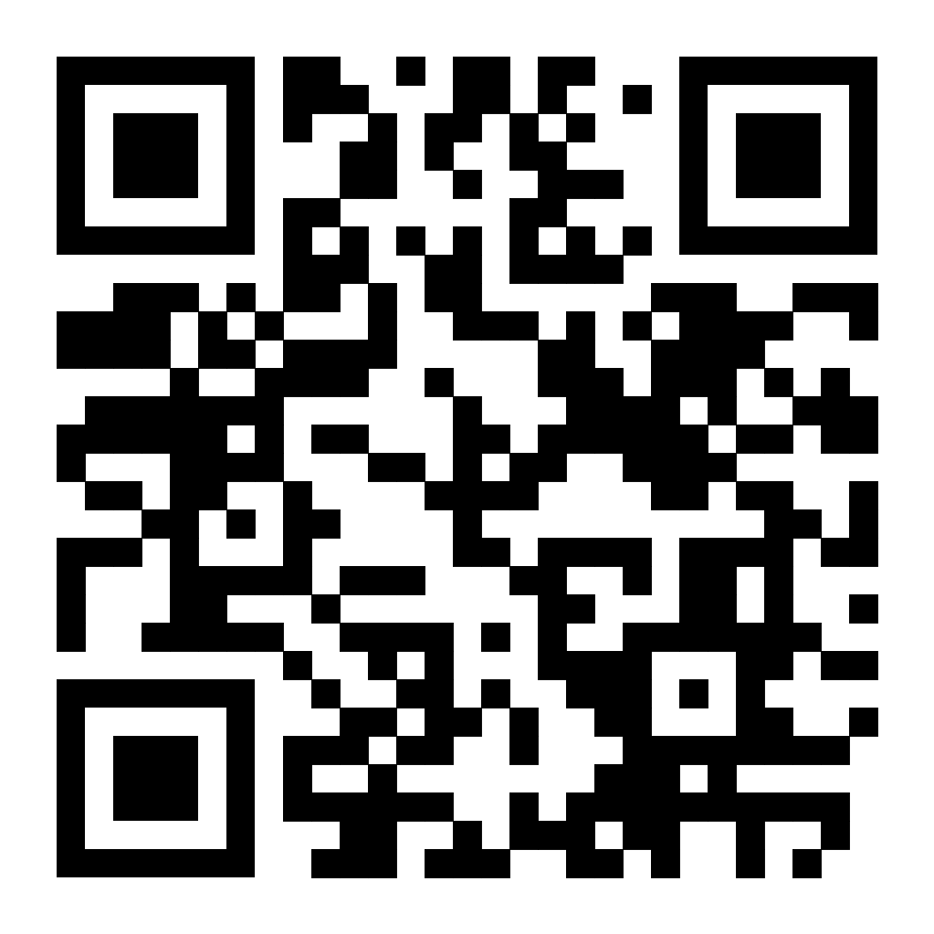
Contribute to our model
23
Notes:
23

Slide 24
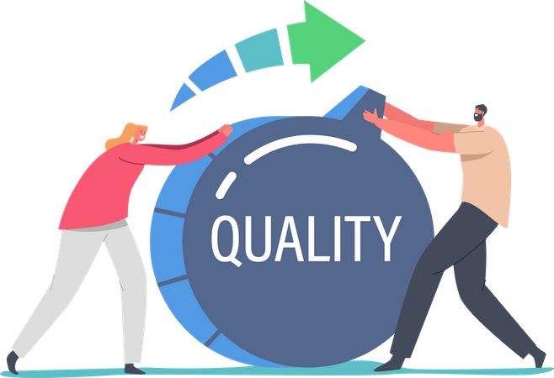
What you will learn
Using simple code quality metrics to improve code
Linting:
Analyzing source code for potential errors and bugs
Code comment density:
30-60% of all source lines of code should be a comment line
Total lines of code per file:
If source code lines and comment lines per file/module is more than 1000 readability issues occur, code might not be computing other things.
24
Notes:
24

Slide 25

What you will learn
Code documentation :
makes code/software easy to use, comprehend. Also makes code maintenance easier
Example for WaterGAP : https://hydrologyfrankfurt.github.io/ReWaterGAP/
We will follow a tutorial on Jupiter notebook to apply these simple code metrics and create a documentation using sphinx (a python documentation generator)
25
Notes:
25

Slide 26
Take home messages
Research software is an essential part of science
We can quantify if the software is sustainable
We can utilize tools and metrics to make software more valuable
26
Notes:
26

Slide 27
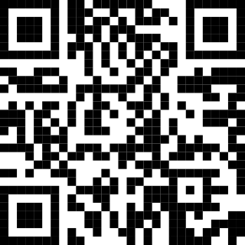
Participate in our survey
27
Notes:
27

