Slide 1
CSED332 소프트웨어설계방법
TEAM GREEN
20240505 공현성
20240985 박찬웅
20200120 차선호

Slide 2
Overall Plans
Week | TODO
Week 1 | Planning
Week 2 (Midterm) | Design ideas
Week 3 | Overall project design
Week 4 | Create test code
Week 5 | Creating physical code & Testing the system
Week 6 (Progress Slides Deadline) | Organizing Content, Preparing for Intermediate Presentation
Week 7 | Project Improvement and Maintenance
Week 8 (Project Deadline) | Preparing for Final Presentation

Slide 3
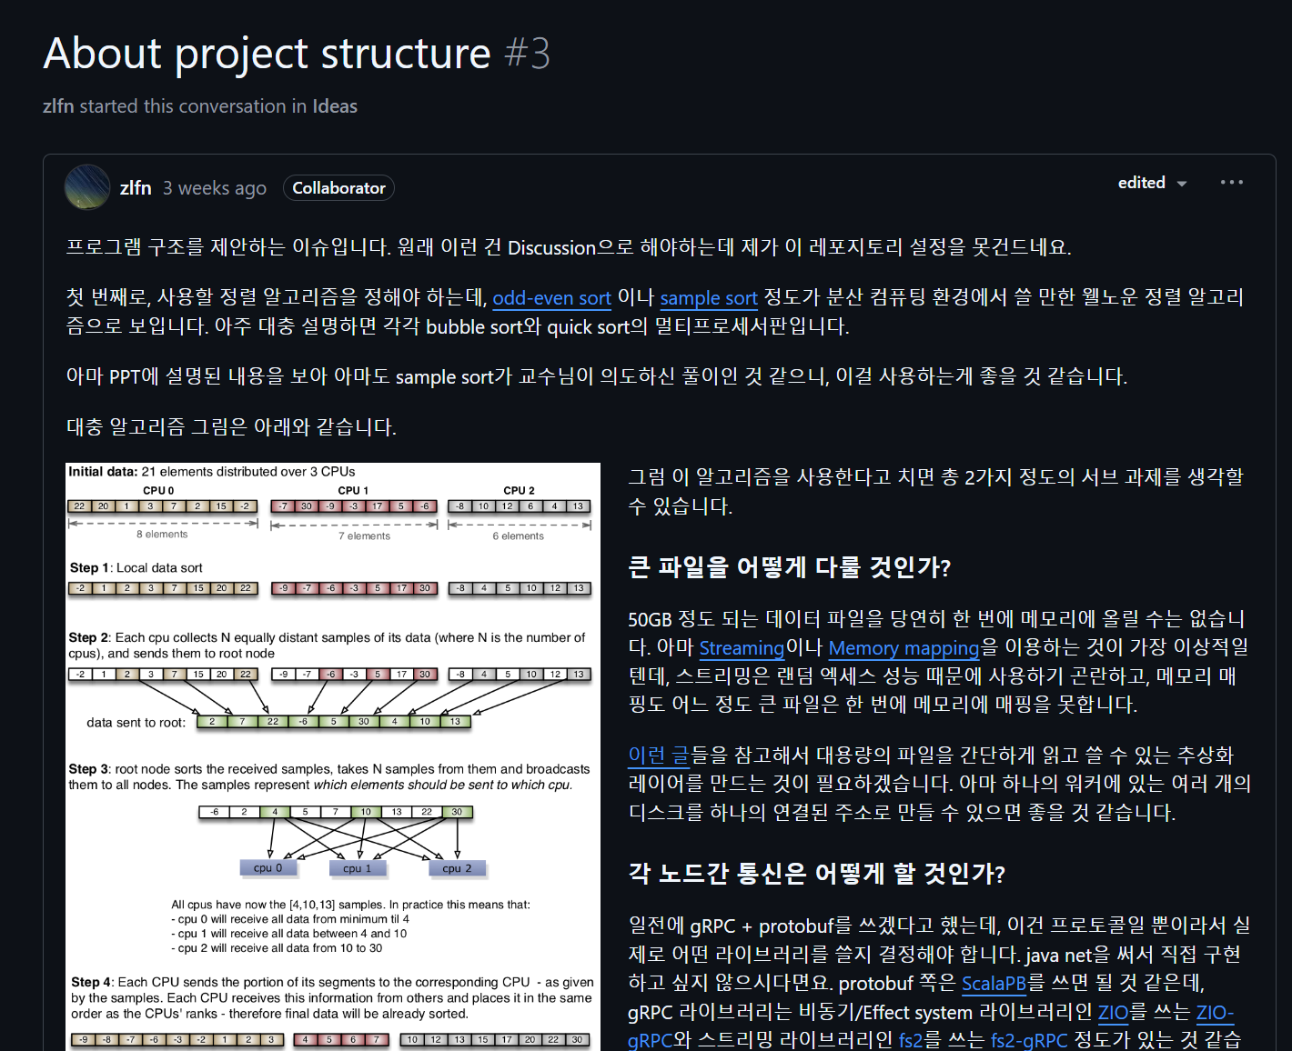
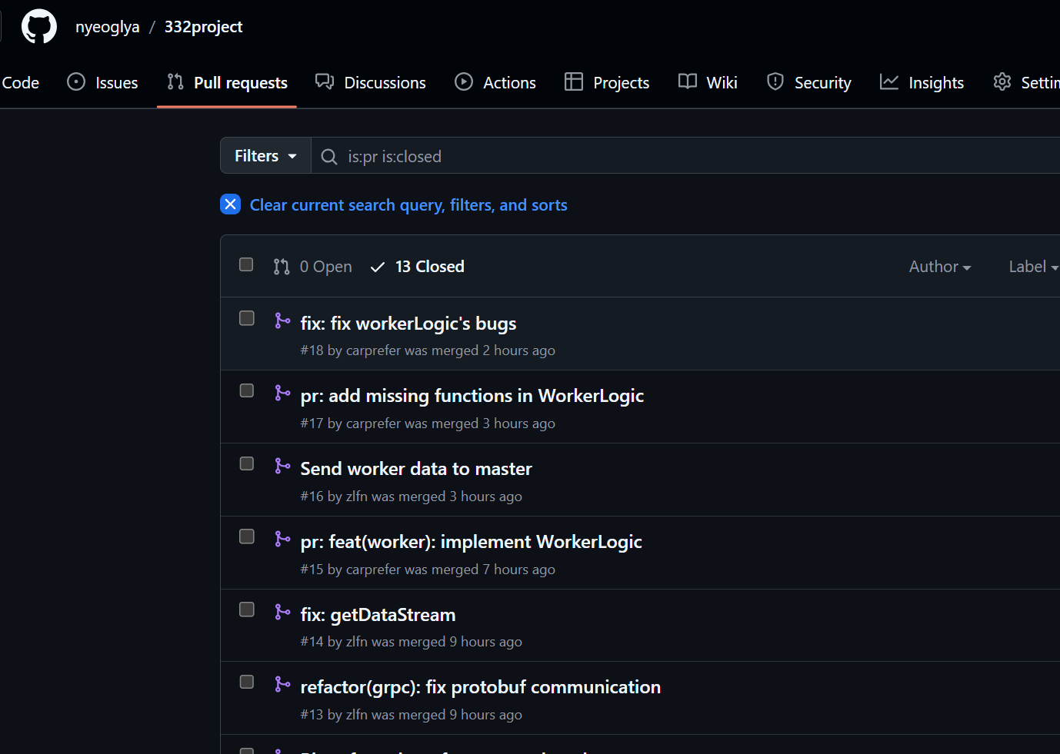
Basic Features
Role Division
zlfn(박찬웅) | Communication & Basic Structure
nyeoglya(공현성) | Master & Argument Parser
carprefer(차선호) | Worker
Team Communication
Regular meeting (On every Sunday 8pm, At POSTECH Library GSR)
Github Discussion
Manage Git Repository, Documentation
Commit convention
Github PR
Scala Naming convention
scaladoc

Slide 4
Overall Project Design
Worker
Master
object Main extends ZIOAppDefault
object Main extends ZIOAppDefault
- Worker의 Main
- Master의 Main
ServiceImpl
ServiceImpl(service: MasterLogic) extends MasterService
- WorkerService를 이용해서 request를 실제로 처리하는 클래스
- Worker 간의 데이터 통신도 관할
- MasterService를 이용하여 통신을 처리하는 클래스
- Server의 역할을 한다
WorkerService extends WorkerServiceLogic
MasterLogic
- Worker의 기본 Logic을 다루는 클래스
- Master의 기본 Logic을 다루고 통신을 처리하는 클래스
- Client의 역할을 한다
Config(args: Seq[String]) extends ScallopConf(args)
- CommandLine Argument Parsing 하여 그 결과를 담는 클래스

Slide 5
Overall Program Flow
run master
Calculate offset
Calculate pivot
Master
(141.223.16.227)
Sample Request
(+ Offset Data)
Return Sample
Send Pivots & Workers IP Data
Finished Receiving Streams
run worker
SORT & Create Sample
Calculate Stream
Worker N
(2.2.2.N)
Send Worker Info
Send Stream
SORT Using Streams
run worker
SORT & Create Sample
Calculate Stream
Worker K
(2.2.2.K)

Slide 6
ProtoBuf Message
Name | When | Source -> Dest. |  | Information Contained
WorkerData | As soon as the Worker starts executing | Worker | Master | int64 fileSize = 1; string workerAddress = 2;
WorkerDataResponse | When the Master successfully receives information from the Worker | Master | Worker | x
SampleRequest | When the Master requests samples to the Worker | Master | Worker | int64 offset = 1;
SampleResponse | When the Worker returns the sample to the Master | Worker | Master | repeated string pivots = 1;
ShuffleRequest | When the Master sends pivot information and other worker information to the Worker | Master | Worker | Pivots pivots = 1; repeated string workerAddresses = 2;
ShuffleResponse | When the Worker successfully receives the pivot information | Worker | Master | x
DataResponse | When the Worker receives a stream from another Worker | Worker | Worker | x
Entity | case class | Any | Any | string head = 1; string body = 2;
Pivots | case class | Any | Any | repeated string pivots = 1;

Slide 7
Specific Implementation - WorkerLogic & ServiceImpl
Unsorted File 1
sortSmallFile
sortedSmallFilePaths
List[List[Stream]]
Sorted File 1
Sorted File 2
Sorted File N
F1W1 | F1W2 | ... | F1WK
F2W1 |  | ...
 |  | ...
 |  | ...
 |  | ...
FNW1 |  | ... | FNWK
Unsorted File 2
sortSmallFile
Unsorted File N
sortSmallFile
originalSmallFilePaths
Communication(From Master)
splitFileIntoPartitionStreams
produceSampleFile
produceSampleFile
mergeBeforeShuffle
mergeBeforeShuffle
Communication(To Master)
Communication(To Worker)
produceSampleFile
Communication(From Worker)
mergeAfterShuffle
SampleFilesToSampleStream
Final Sorted File

Slide 8
Specific Implementation - Disk Based Sorting (Worker)
Sorted Data Storage
RAM
Insert the minimum value of the heap, then take the next minimum value from the stream that had the previous minimum value and insert it.
32MB
Processor 1
Data Storage
32MB
Processor 2
Heap Sort
32MB
Processor K
Stream 1
Composed of Files
Stream 2
Take files out, sort them, and put them back in
[MinData, Loc]
Stream K
Partially Sorted Data Storage
. . .
Heap sort with the min value
Sort by Files
Sampling, Calculating Pivots, Worker Communications

Slide 9
Specific Implementation - MasterLogic
Communication(From Worker)
Communication(To Worker)
workerDataList
clientLayers
offset
Communication(Request to Worker 1)
collectSample
Communication(Request to Worker 2)
collectSample
pivotCandicateList
Communication(Request to Worker K)
collectSample
selectPivots
Communication(To Worker 1)
sendPartitionToWorker
Communication(To Worker 2)
Communication(To Worker K)

Slide 10
Specific Implementation - Environment & Libraries
Environment | Linux(Ubuntu, Arch), Windows
Logging | zio-logging 2.1.12 (Plan)
Key Features | JDK 22, Scala 2.13.15, SBT 1.10
Library Name | Versions | Purpose
scalapb-runtime, scalapb-runtime-grpc | 0.11.17 | gRPC (communication), Protobuf (serialization)
zio, zio-streams | 2.1.12 | Safer functional programming
zio-test, zio-test-sbt, zio-test-junit | 2.1.12 | Test ZIO apps
junit, junit-interface, scalatest | 4.10, 0.13.3, 3.0.8 | Test basic functionality
scallop | 5.1.0 | Commandline argument parser
sbt-assembly | 0.15.0 | Make .jar file from scala code
sbt-protoc | 1.0.6 | To Compile protobuf files

Slide 11
Current Progress : Implement(Abstract) & Testing
 | Done | Currently Working
Master | Get workerDataList | Sending pivots to Workers
 | Calculate offset
 | Collecting samples from worker
 | Pivot selecting
Worker | Entire logics about sorting | Communication between Workers
 | Communication with Master
Current Progress
Unit Test | WorkerLogic 테스트 중 MasterLogic 구성 중
Integration Test | 구성 중
System Test | 구성 중

Slide 12
직접 써보며 팀원들이 느낀 ZIO 장단점
장점
안전한 비동기 처리 | Future, Promise와 달리 예외를 안전하게 처리함. 비동기 코드가 동기 코드처럼 읽히게 해서 익숙해지면 코드 이해가 빨라짐. 비동기 작업을 Effect로 다뤄서 컴파일 타임에 비동기 작업의 오류를 잡을 수 있음.
오류 처리 | IO[E, A] 타입 쓰면 성공/실패 명시적으로 구분됨. 다양한 오류를 구체적으로 다룰 수 있음.
함수형 프로그래밍 | 순수한 함수형 프로그래밍 지원함. 그래서 비동기 테스트 하기가 용이함.
단점
프로젝트 비용 증가 | 배우기 어렵고 복잡한 개념이 많음. 학습하는 데 꽤 많은 시간을 썼다. 제공하는 기능은 많은데 이걸 100% 활용하기 어려움
기존 코드와 호환성 부족함 | Future, Promise를 사용한 코드를 그대로 가져다 쓸 수가 없음. Test, Main도 ZIO에서 만든 것을 써야 하기 때문에 별도의 시간을 씀.
디버깅이 어려움 | 에러를 정교하게 처리하게 돕는 반면에 디버깅이 까다로워서 복잡한 오류를 추적하기 좀 힘듦.
생태계 부족 및 빠른 변화 | 신생 라이브러리라서 업데이트별로 기능들이 굉장히 빠르게 바뀜. 버전별로 함수나 기능들이 달라서 이걸 알아보고 적용하기가 복잡함.

Slide 13
Thank you
Q&A

Slide 14
Appendix) Current Progress : Implementation(Specific)
Master | class Config(args: Seq[String]) extends ScallopConf(args) lazy val offset: Long def addClient(clientAddress: String, clientSize: BigInt): Unit def collectSample(client: Layer[Throwable, WorkerServiceClient]): ZIO[WorkerServiceClient, Throwable, Pivots] def selectPivots(pivotCandicateZIOList: ZIO[Any, Throwable, List[Pivots]]): ZIO[Any, Throwable, Pivots]
 | def run() def sendPartitionToWorker(client: Layer[Throwable, WorkerServiceClient], pivots: ZIO[Any, Throwable, Pivots]): ZIO[Any, Throwable, Unit]
Comm. | override def run: ZIO[Environment with ZIOAppArgs with Scope,Any,Any] def builder def serverLive: ZLayer[MasterLogic, Throwable, zio_grpc.Server] class ServiceImpl(service: MasterLogic) extends MasterService val masterClientLayer: ZLayer[Config, Throwable, MasterServiceClient] val sendDataToMaster: ZIO[MasterServiceClient with WorkerServiceLogic, Throwable, WorkerDataResponse] def serverLive: ZLayer[WorkerServiceLogic, Throwable, zio_grpc.Server]
 | def getSamples(request: SampleRequest): IO[StatusException,Pivots] def startShuffle(request: ShuffleRequest): IO[StatusException,SortResponse] def sendData(request: Stream[StatusException,Entity]): IO[StatusException,DataResponse]

Slide 15
Appendix) Current Progress : Implementation(Specific)
Worker | object PathMaker def saveEntities(index: Integer, data: Stream[Throwable,Entity]): Unit def getFileSize(): Int def getDataStream(partition: Pivots): List[Stream[Throwable,Entity]] def getSampleStream(offset: Integer, size: Integer): List[String] def sortStreams(data: List[Stream[StatusException,Entity]]): Stream[Throwable,Entity] def readFile(filePath : String) : List[Entity] def writeFile(filePath : String, data : List[Entity]) : Unit def sortSmallFile(filePath : String) : String def produceSampleFile(filePath : String, stride : Integer) : String def sampleFilesToSampleStream(filePaths : List[String]) : List[String] def splitFileIntoPartitionStreams(filePath : String, pivots : List[String]) : List[Stream[Throwable, Entity]] def mergeBeforeShuffle(partitionStreams : List[Stream[Throwable, Entity]]) : Stream[Throwable, Entity] def mergeAfterShuffle(workerStreams : List[Stream[Throwable, Entity]]) : Stream[Throwable, Entity] val originalSmallFilePaths : List[String] val sortedSmallFilePaths : List[String]
 | def inputEntities: Stream[Throwable, Entity] def getFileSize(): Int def saveEntities(index: Integer, data: Stream[Throwable, Entity]) def getSampleStream(offset: Integer, size: Integer): List[String] def getDataStream(partition: Pivots): List[Stream[Throwable, Entity]] def sortStreams(data: List[Stream[StatusException, Entity]]): Stream[Throwable, Entity] def inputEntities: Stream[Throwable, Entity] def zio2entity(zio : ZIO[Any, Throwable, Entity]) : Entity

