Slide 1

Tricks and Tips in R
(ye matey)
Bioinformatics Student Seminar | May 22, 2010

Slide 2
Overview
A few things I want to try to cover today:
Graphics
Basic plot types
Heatmaps
Working with plotting devices
Drawing plots to files
Graphics parameters
Drawing multiple plots per device
Writing functions in R
Parsing large files in R

Slide 3
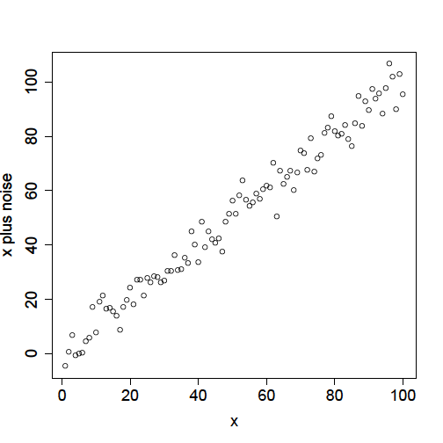
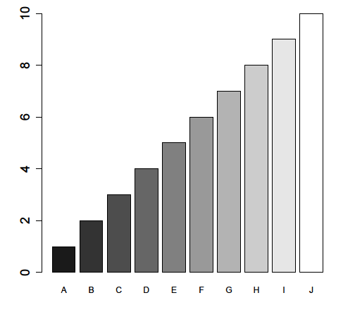
Basic plot types
Scatterplots:
x <- 1:100;
y <- x + rnorm(100,0,5);
plot(x, y,
xlab="x", ylab="x plus noise“);
OR
plot(y ~ x,
xlab="x", ylab="x plus noise");
Bar graphs:
barplot(
x=1:10,
names.arg=LETTERS[1:10],
col=gray(1:10/10)
);
Note: there is no parameter for error bars in this function!

Slide 4
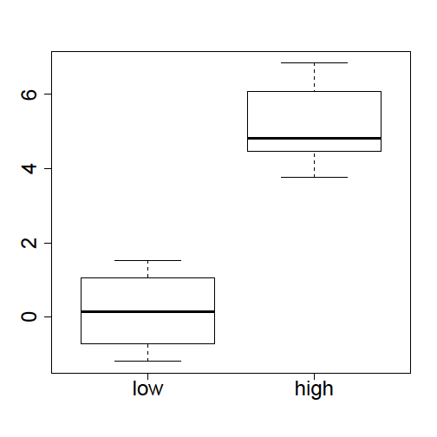
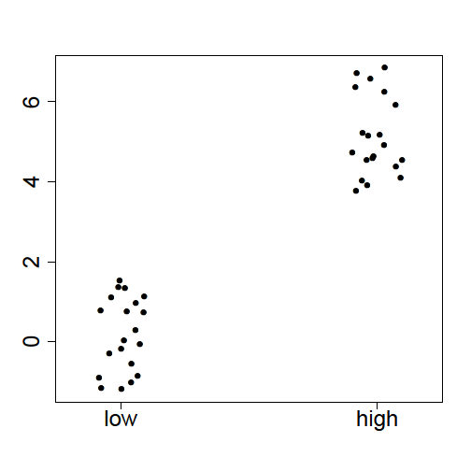
Basic plot types
Boxplots:
Useful for estimating distribution
lo.vec <- rnorm(20,0,1);
hi.vec <- rnorm(20,5,1);
boxplot(
x=list(lo.vec, hi.vec),
names=c("low", "high")
);
Dot plots:
Alternative to boxplots when n is small
lo.vec <- rnorm(20,0,1);
hi.vec <- rnorm(20,5,1);
stripchart(
x=list(lo.vec, hi.vec),
group.names=c("low", "high"),
vertical=TRUE,
pch=19, method="jitter"
);

Slide 5
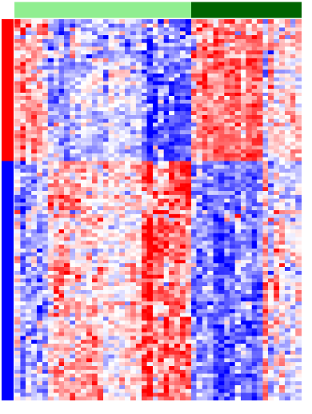
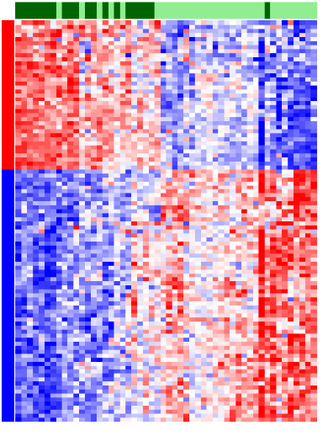
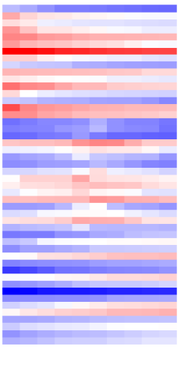
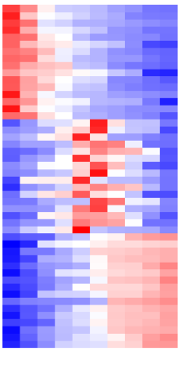
Heatmap basics
Supervised
Unsupervised
Clustering
Heatmaps are either:
ordered prior to plotting (“supervised” clustering)
or clustered on-the-fly (“unsupervised” clustering)
Scaling
By default, the heatmap() function scales matrices by row to a mean of zero and standard deviation of one (z-score normalization): shows relative expression patterns
samples
samples
genes
genes

Slide 6

Heatmap palettes
Some useful color palettes
bluered <- colorRampPalette(c("blue","white","red"))(256)
greenred <- colorRampPalette(c("green","black","red"))(256)
BGYOR <- rev(rainbow(n = 256, start = 0, end = 4/6))
grayscale <- gray((255:0)/255)
# these strips generated with image, for example:
image(1:256, xaxt="n", yaxt="n", col=bluered)

Slide 7
Heatmaps: putting it all together
Tricks for creating column or row labels:
# If class is a vector of zeroes and ones:
csc <- c("lightgreen", "darkgreen")[class+1]
# Or, if class is a character vector:
class <- c("case", "case", "control", "control", "case")
csc <- c(control="lightgreen", case=“darkgreen")[class]
# If you want to label genes by direction of fold change:
log2fc <- log2(control / case)
rsc <- c("blue", "red")[as.factor(sign(log2fc))]
An example of a typical call to heatmap():
# fold change labels by rows
# class labels by columns
# unsupervised clustering by rows
# supervised clustering by columns
# y-axis "flipped" so that row 1 is at top of plot
# blue/white/red color palette
heatmap(x, RowSideColors=rsc, ColSideColors=csc,
Rowv=NULL, Colv=NA, revC=TRUE, col=bluered)

Slide 8
Heatmap3
Some of the problems with heatmap():
Can’t draw multiple heatmaps on a single device
Can’t suppress dendrograms
Requires trial-and-error to get labels to fit
Solution:
heatmap3(): a (mostly) backwards-compatible replacement
Can draw multiple heatmaps on a single device
Can suppress dendrograms
Automatically resizes margins to fit labels (or vice versa)
Can perform 'semisupervised' clustering within groups
Let me know if you’re interested and I’ll send you the package!

Slide 9
Devices: X11 windows
> dev.list() # Starting with no open plot devices
NULL
> plot(x=1:10, y=1:10) # A new plot device is automatically opened
> dev.list()
X11
2
> x11() # Open another new plot device
> dev.list()
X11 X11
2 3
> dev.cur() # Returns current plot device
X11
3
> dev.set(2) # Changes current plot device
X11
2
> dev.off() # Shuts off current plot device
X11
3
> dev.off() # Plot device 1 is always the 'null device'
null device
1
> graphics.off() # Shuts off all plot devices

Slide 10
Devices: File output
> dev.list() # Starting with no open plot devices
NULL
> pdf("test.pdf") # Create a new PDF file
> dev.list() # Device is type 'pdf', not 'x11'
pdf
2
> plot(1:10, 1:10) # Draw something to it
> plot(0:5, 0:5) # This creates a new page of the PDF
> dev.off() # Close the PDF file
null device
1
> x11() # Open a new plot device
> plot(1:10, 1:10) # Plot something
> dev.copy2pdf(file="test2.pdf") # Copy plot to a PDF file
X11 # PDF file is automatically closed
2
> dev.copy(pdf,file="test3.pdf") # Or copy it this way;
pdf # PDF file is left open
3 # as the current device
Or, substitute one of the following for pdf: bmp, jpeg, png, tiff

Slide 11
Graphics parameters
The par() function: get/set graphics parameters
par(tag=value)
The ones I’ve found most useful:
mar=c(bottom, left, top, right) set the margins
cex, cex.axis, cex.lab, character expansion
cex.main, cex.sub (i.e., font size)
xaxt=“n”, yaxt=“n” suppress axes
bg background color
fg foreground color
las (0=parallel, 1=horizontal, orientation of axis labels
2=perpendicular, 3=vertical)
lty line type
lwd line width
pch (19=closed circle) plotting character

Slide 12
Drawing multiple plots per page
Drawing multiple plots per page with par() or layout()
To draw 6 plots, 2 rows x 3 columns, fill in by rows:
par(mfrow=c(2,3))
# then draw each plot
layout(matrix(data=1:6, nrow=2, ncol=3,
byrow=TRUE))
# then draw each plot
To draw 6 plots, 2 rows x 3 columns, fill in by columns:
par(mfcol=c(2,3))
# then draw each plot
layout(matrix(data=1:6, nrow=2, ncol=3,
byrow=FALSE))
# then draw each plot
1
2
3
4
5
6
1
3
5
2
4
6

Slide 13
Drawing multiple plots per page
Drawing multiple plots per page with split.screen()
To draw 6 plots, 2 rows x 3 columns, fill in by rows:
> split.screen(figs=c(2,3))
[1] 1 2 3 4 5 6
# draw plot 1 here...
> close.screen(1)
[1] 2 3 4 5 6
# draw plot 2 here...
> close.screen(2)
[1] 3 4 5 6
# repeat for plots 3-6
> close.screen(6)
> screen()
[1] FALSE
1
2
3
4
5
6

Slide 14
Drawing multiple plots per page
Drawing multiple plots per page with split.screen()
To draw 6 plots, 2 rows x 3 columns, fill in by columns:
> screens <- c(matrix(1:6, nrow=2, ncol=3, byrow=TRUE));
> screens
[1] 1 4 2 5 3 6
> split.screen(figs=c(2,3))
[1] 1 2 3 4 5 6
# draw plot 1 here...
> close.screen(screens[1])
[1] 2 3 4 5 6
> screen(screens[2])
# draw plot 2 here...
> close.screen(screens[2])
[1] 2 3 5 6
# repeat for plots 3-6
1
3
5
2
4
6

Slide 15
Writing functions: two quick examples
Using match.arg(), missing(), stop(), return():
rotation <- function (student = c("Cecilia", "Tajel", "Jorge"),
postdoc = "Mike",
prof)
{
student <- match.arg(student);
if (missing(prof)) {
stop("Sorry, the professor is on sabbatical. ");
}
sentence <-
sprintf("%s is working with %s in Professor %s’s lab.\n",
student, postdoc, prof);
return(sentence);
}
Using the ... (dots) argument:
plot2pdf <- function (x, y, filename, ...) {
pdf(filename);
plot(x, y, ...);
dev.off();
}

Slide 16
Parsing large text files in R
The easiest way to speed up text file parsing is to specify the column types ahead of time using the colClasses parameter.
For example, say we have a file that looks like this:
ID chrom start stop coverage
NM_0001 chr1 1000 2000 0.579
We could use the following:
types <- c("character", "character", "integer", "integer", "numeric");
x <- read.table(filename, colClasses=types,
col.names=c("ID", "chrom", "start", "stop", "coverage"));
Or, for a numeric matrix with row names and 100 numeric columns:
types <- c("character",rep("numeric", 100)));
For a BIG numeric matrix without row names, scan() is faster:
nc <- ncol(read.delim(filename, nrows=1)); # get number of columns
x <- scan(filename, what="numeric"); # slurp in file as vector
dim(x) <- c(nrow=length(x)/nc, ncol=nc); # convert to matrix

Slide 17
Parsing large binary files in R
For very large files, consider using one of the following methods:
writeBin/readBin
writeBin(object, con, size = NA_integer_,
endian = .Platform$endian)
readBin(con, what, n = 1L, size = NA_integer_, signed = TRUE,
endian = .Platform$endian)
Save/load
my.matrix <- matrix(rnorm(100),10,10)
save(my.matrix, file="my.matrix.rdb")
rm(my.matrix)
load("my.matrix.rdb")
str(my.matrix)
num [1:10, 1:10] 2.582 -0.34 0.776 0.415 1.246 ...
binmat (binary matrices) package
Another package I wrote, in R and C; fast and memory-efficient!

