Slide 1
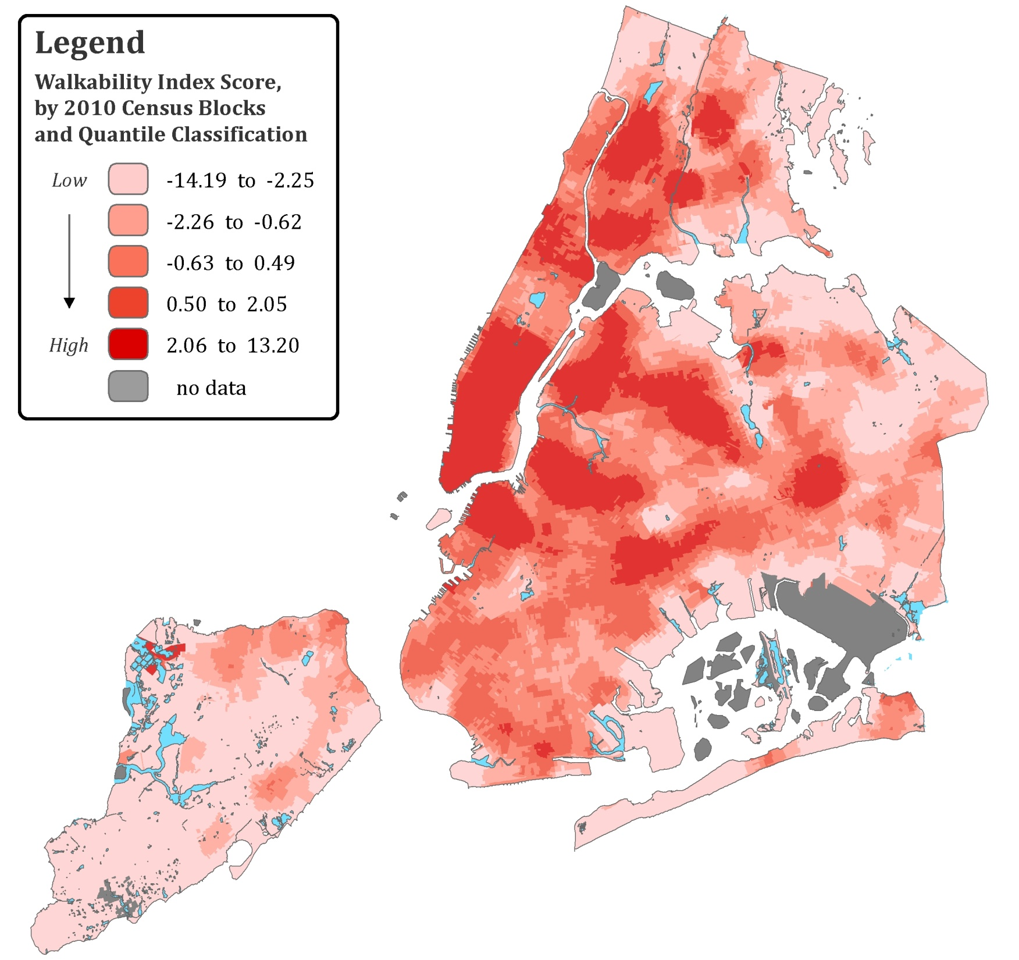
Old

Slide 2
