Slide 1
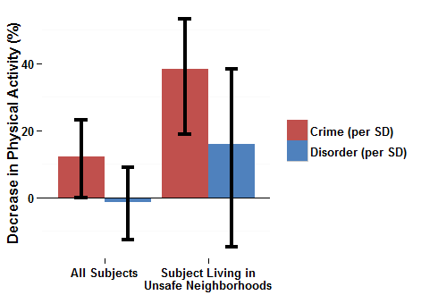
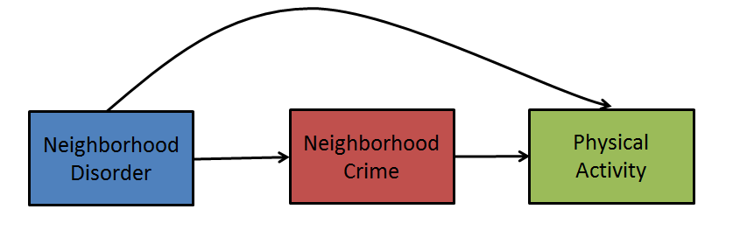
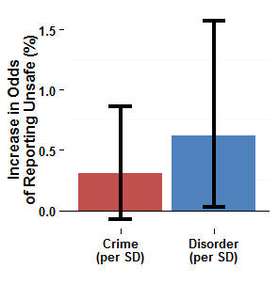
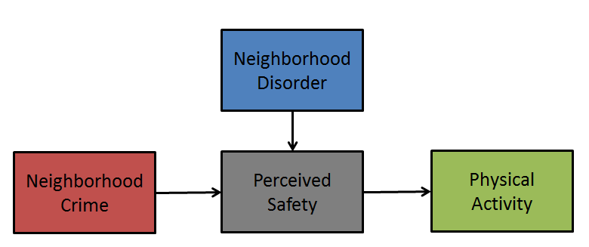
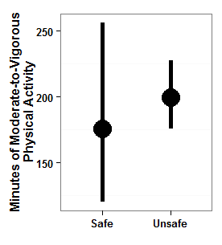
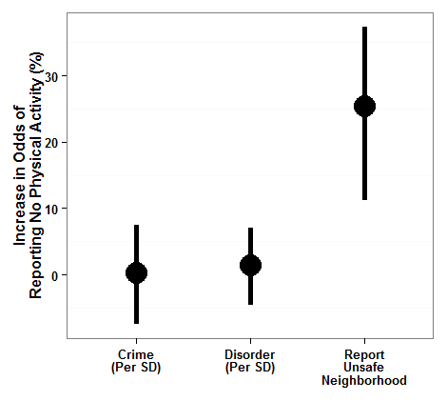
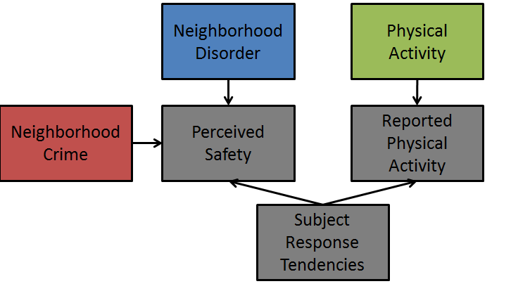

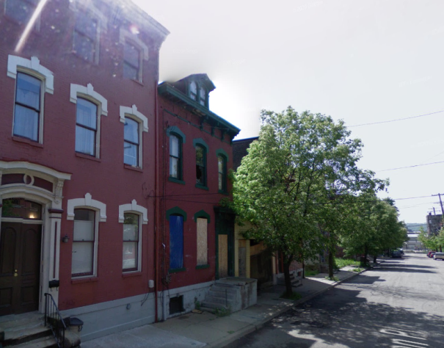


Neighborhood Safety and Physical Activity among New York City Adults
Stephen J Mooney¹, Michael DM Bader², Katherine F Bartley³, Gina S Lovasi¹,
Kathryn M Neckerman⁴, Julien O Teitler⁵, Daniel M Sheehan¹, Andrew G Rundle¹
¹Department of Epidemiology, Mailman School of Public Health, Columbia University, New York, NY; ²Department of Sociology, American University, Washington, DC
³Epidemiology Services, Division of Epidemiology, New York City Department of Health and Mental Hygiene, Queens, NY;
⁴Columbia Population Research Center, Columbia University, New York, NY; ⁵School of Social Work, Columbia University, New York, NY
BACKGROUND
Qualitative research suggests lack of safety deters physical activity, but quantitative findings have been more mixed.
To date few studies have used both independently observed and subject-reported measures of both neighborhood safety features and physical activity in order to test different hypotheses in the same subjects.
We tested three theories relating neighborhood safety and activity:
Neighborhood disorder may deter activity both directly through the aesthetic displeasure of experiencing a chaotic environment and indirectly as a root cause of crime, which itself deters activity.
Observed safety measures influence activity by affecting perceptions of safety.
Subject's tendencies to report positively or negatively may create artifactual associations between perceptions of safety and activity
RESULTS
THEORY 1: NEIGHBORHOOD DISORDER IS A ROOT CAUSE OF CRIME AND INACTIVITY
NEIGHBORHOOD DISORDER WAS NOT RELATED TO ACCELEROMETER-REPORTED ACTIVITY
CRIME WAS RELATED TO ACCELEROMETER-REPORTED ACTIVITY AMONG SUBJECTS WHO REPORTED NEIGHBORHOOD TO BE UNSAFE
NEIGHBORHOOD DISORDER WAS UNRELATED TO ACTIVITY
CRIME WAS RELATED TO ACTIVITY AMONG THOSE WHO REPORTED NEIGHBORHOOD TO BE UNSAFE
THEORY 2: DISORDER AND CRIME INDUCE FEAR, WHICH CONSTRAINS ACTIVITY
DISORDER WAS RELATED TO PERCEIVED SAFETY
CRIME WAS NOT RELATED TO PERCEIVED SAFETY
METHODS
This study used data from the New York City Physical Activity and Transit (PAT) survey, which included both a random-digit dial survey representative of adult residents of New York City and a follow up portion, in which a subset of respondents wore accelerometer and GPS devices for one week in March-November of 2011. This analysis included the 509 PAT subjects who had 4 or more 10+ hour days of GPS and accelerometer data. We used the accelerometer data to compute daily average moderate-equivalent minutes of physical activity. The survey also included information on: (1) demographic characteristics, (2) physical activity, and (3) whether crime made it unsafe to walk in their neighborhood during the day.
We geocoded subject home addresses and computed levels of homicide and disorder in 1km radial buffers around home addresses. The homicide measure, which we considered to represent all crime, was estimated from the New York Times website's reports from 2005-2010 using kernel density methods. The disorder measure was constructed by virtual street audit using the Computer Assisted Neighborhood Visual Assessment System (CANVAS) with Google Street View imagery. The disorder audit items were mostly developed from measures developed by the Project for Human Development in Chicago Neighborhoods for videotaped street audits.
All analyses used complex survey weights to demographically reflect New York City as a whole based on the 2006-2008 American Community Survey.
PERCEIVED SAFETY WAS NOT RELATED TO ACCELEROMETER-REPORTED ACTIVITY
THEORY 3: REPORTED UNSAFETY AND INACTIVITY ARE LINKED BY SAME-SOURCE BIAS
NEIGHBORHOOD DISORDER WAS UNRELATED TO ACTIVITY
CRIME WAS RELATED TO ACTIVITY AMONG THOSE WHO REPORTED NEIGHBORHOOD TO BE UNSAFE
CRIME AND DISORDER WERE NOT RELATED TO REPORTING ANY PHYSICAL ACVITITY
REPORTING THE NEIGHBORHOOD TO BE UNSAFE WAS ASSOCIATED WITH ELEVATED ODDS OF REPORTING NO ACTIVITY
KEY LIMITATIONS
Cross-sectional design does not allow us to account for neighborhood self-selection
Small sample size increases risk of false negative associations
Potential for measurement error due to participant non-compliance
Perceived safety measure was one dichotomous item and may not be sensitive to small-scale variation in safety perceptions
Spatial distribution of homicide may not reflect all spatial distribution of crime in general
1 km radial buffer may not be the most relevant neighborhood definition
CONCLUSIONS
High levels of crime in a neighborhood may deter physical activity among nearby residents
Disorder alone does not appear to deter physical activity
Researchers should be cautious not to over-interpret associations between self-reported neighborhood safety and self-reported activity
The CANVAS System for Virtual Street Audits
Google® Street View Imagery
CONTACT AND FUNDING ACKNOWLEDGEMENT
Stephen Mooney, 722 W 168th St, 7th Floor, New York, NY 10032 Email:sjm2186@columbia.edu Supported by a T32 fellowship from NCI (CA09529)

