Slide 1

Code Name Jeeves
Zipfian Final Project
- Melanie Warrick
nyghtowl.io
@nyghtowl

Slide 2
Jeeves Goal
Make my computer smarter
Classify and text emails that need a meeting location defined

Slide 3
Solution Flow
Tools
Challenges
Personal Gmail
~1000 total
~120 true condition
Getting data
Data
Features
Tfidf Vectorizer
Count Vectorizer
Expanding features
Logistic Regression
Naive Bayes (Gaussian, Bernoulli, Multinomial)
SVC
Random Forest
Gradient Boost
Reducing false negatives
Model

Slide 4
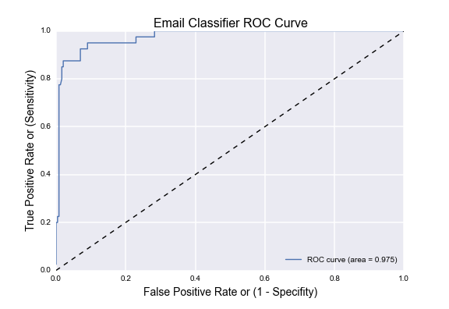
Classification Model Results
Accuracy ~97%

Slide 5
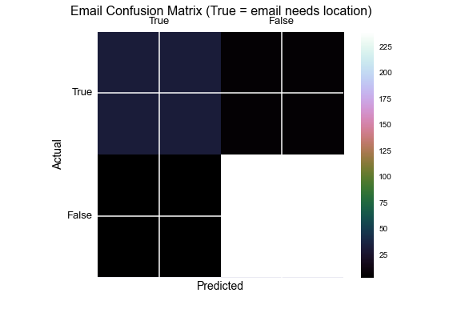
Classification Model Results
Treat like spam = prefer incorrect texts (FP) vs. miss an email (FN)
FN ~ 1%

Slide 6
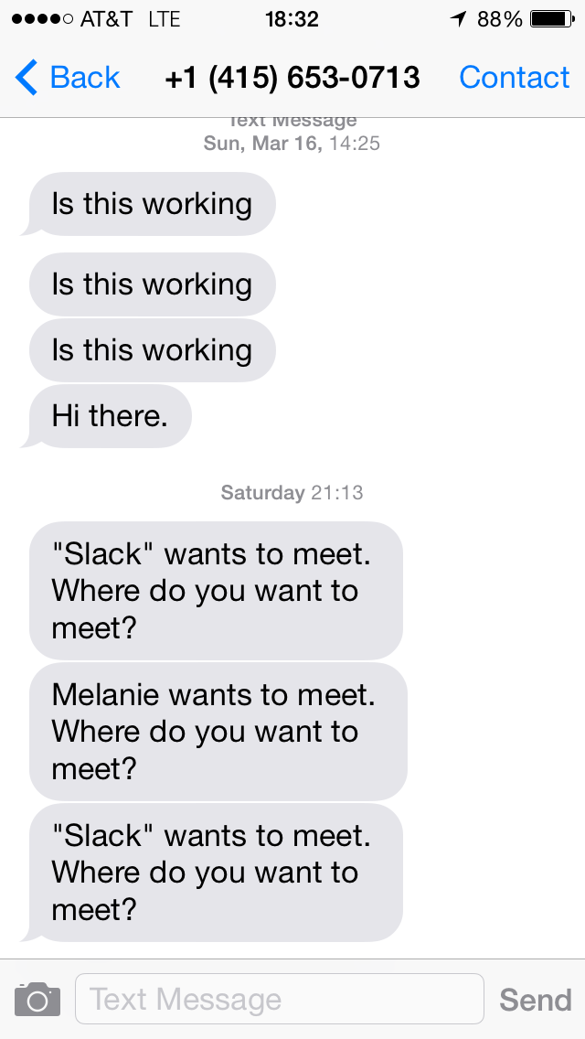
Example Text / Output

Slide 7
What’s Next
Get more data
Add features such as specific nlp regex to improve accuracy
Build location recommender

Slide 8
References & Tools
Scikit-Learn
NLTK
Pytho, SQL
Gmail Package https://github.com/charlierguo/gmail
Twilio
Flask
Pandas, Numpy, SciPy
PostgrSQL
Mentors (Jeremy, Thomson, Ryan & Mike)

Slide 9
Code Name Jeeves
Make my computer smarter
- Melanie Warrick
@nyghtowl

