Slide 1

Code Name Jeeves
Zipfian Final Project
- Melanie Warrick
nyghtowl.io
@nyghtowl

Slide 2
Jeeves Goal & Direction
Make computer smarter
Classify emails needing a meeting location defined
Send SMS alert
Notes:
It has all this info about me so why doesntt it do more

Slide 3
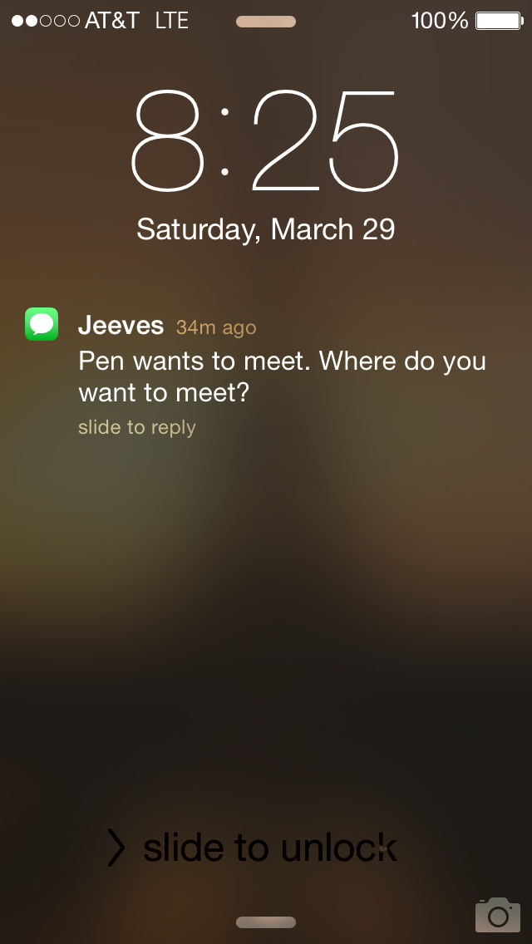
Process & Output
Gmails
TF-IDF
Logistic Regression

Slide 4
Approach - Features
Approach
Sample Top Features
TF-IDF
Remove stop words
Lemmatize
Tri-grams
Normalize
Remove threads
meet
coffee
lunch
place
work
javascript
vodka
http
my name
Notes:
NLP project - lemmitize, stem, n-grams

Slide 5
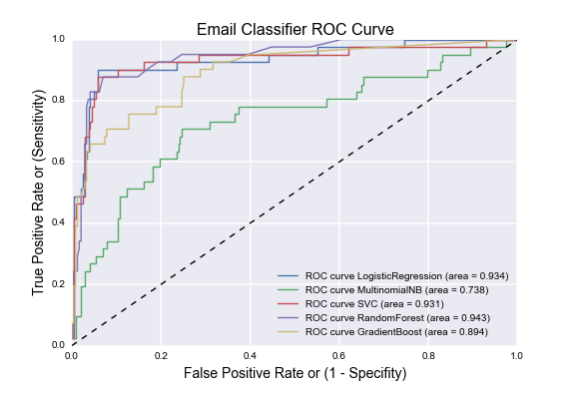
Approach - Classification
Models
Logistic Regression
Naive Bayes
SVM
Random Forest
Gradient Boost
Key Challenge
Avoid Overfitting
Notes:
NB - independence - shorter form text - email / tweet - was meeting and location - underperformed because...email text short form - interactions of combination of words (want to account for interactions vs assume indepedent)
complex performed just as good so when with the simpler

Slide 6
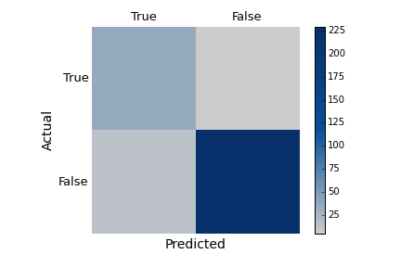
Logistic Regression Model Results
Treat like spam = prefer incorrect texts (FP) vs. miss an email (FN)
Accuracy ~ 93%
FN ~ 2%
Jeeves Confusion Matrix
Notes:
Prevent overfitting - logistic regression has regularization term - l2 norm, cross validation
Only as good as the data

Slide 7
What’s Next
Incorporate more data & different data
Expand features: PoS, NLP/Regex vocab
Explore models: ensembles, neural nets, more grid search
Build location recommender
Notes:
Expand product to chrome or something else...

Slide 8
Code Name Jeeves
More info at: nyghtowl.io
Melanie Warrick
@nyghtowl

Slide 9
References & Tools
Scikit-Learn
NLTK
Pytho, SQL
Gmail Package https://github.com/charlierguo/gmail
Twilio
Flask
Pandas, Numpy, SciPy
PostgrSQL
Mentors (Jeremy, Thomson, Ryan & Mike)

