Slide 1
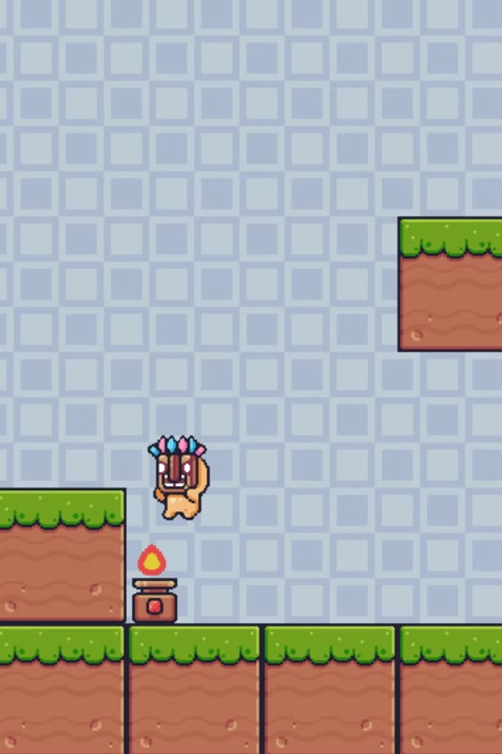

The Platformer Game: A Python-Based 2D Game
This is to present the development of a 2D platformer game built using Python and Pygame library. The game challenges players to navigate through blocks, jumping between platforms, overcoming obstacles, etc.

Slide 2
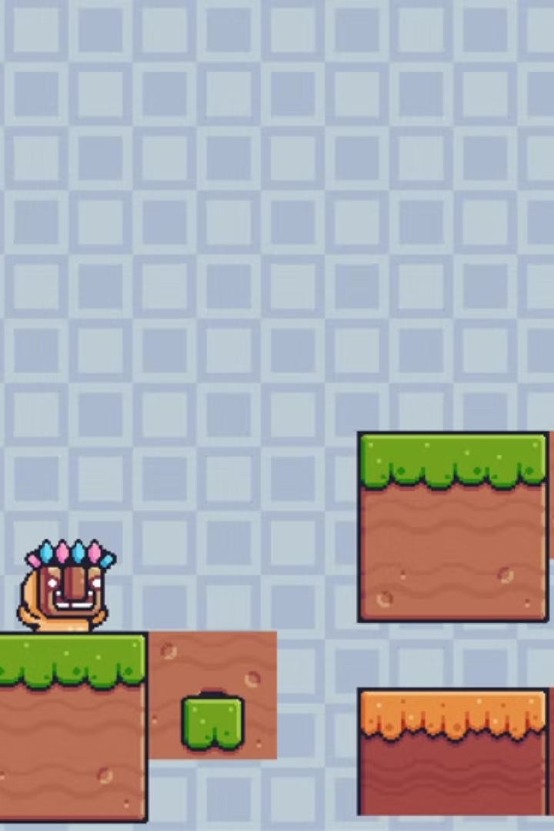
Introduction
The Platformer Game is a 2D video game where players control a character to navigate through paths and blocks, jumping between platforms, avoiding obstacles, and overcoming challenges. The game is developed using Python and the Pygame library, offering a simple yet engaging gameplay experience.

Slide 3
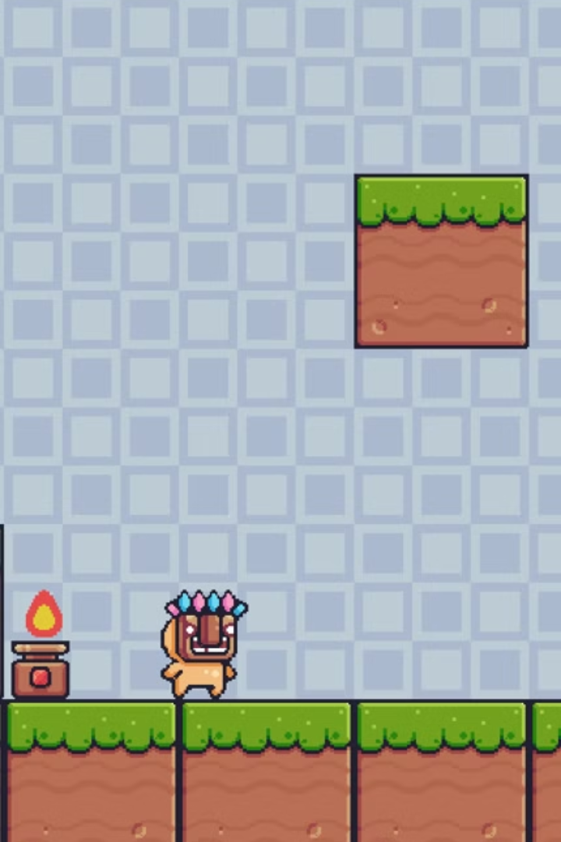
Objectives and Scope
1
Game Development
2
Character Control
Create a playable platformer game with interactive challenges.
Implement smooth and responsive character movement, including running and jumping.
3
Physics and Collisions
Incorporate realistic physics, such as gravity, and ensure accurate collision detection.

Slide 4
Application Tools
Programming Language
IDE
Libraries/Packages
Python
VS Code, Python IDLE, PyCharm
Pygame
Tkinter
PyInstaller

Slide 5
Project Design
1
Game Initialization
Setup the game window, initialize variables, and load resources (images, visual effects, etc).
2
Player Character
Implement movement controls (left, right, jump) with smooth transitions. Add collision detection to prevent falling off platforms or passing through walls.
3
Game Loop
The main loop runs the game, checking for player input, updating game objects, and rendering the game state to the screen.
4
Visual Effects
Visual elements to enhance the gaming experience.

Slide 6
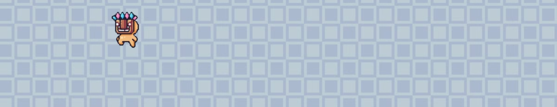
Project Implementation
The Platformer Game is a 2D game in which players control a character to navigate through various levels, jumping between platforms, avoiding obstacles, and overcoming challenges. This project is built using Python and utilizes the Pygame library for rendering graphics, handling user inputs, and managing game mechanics.

Slide 7
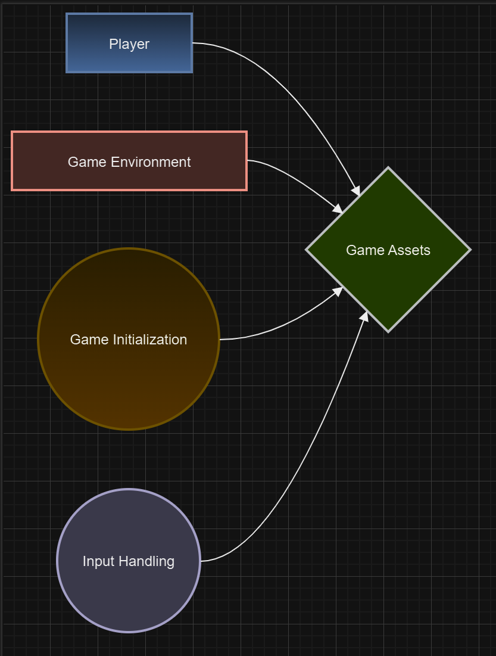
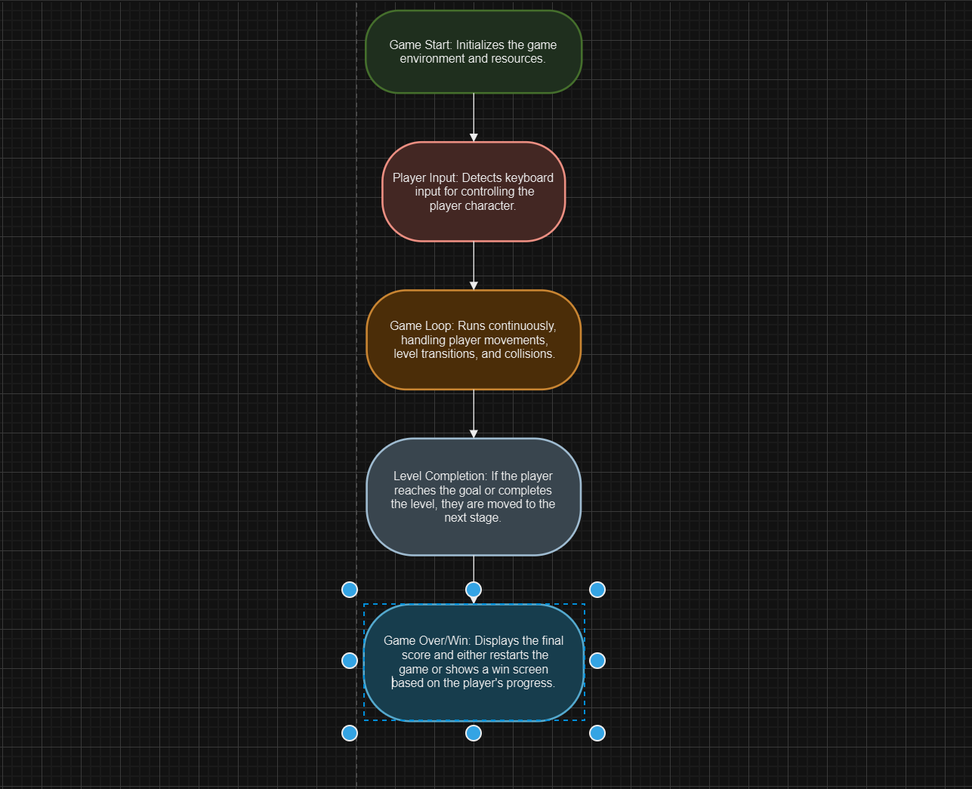
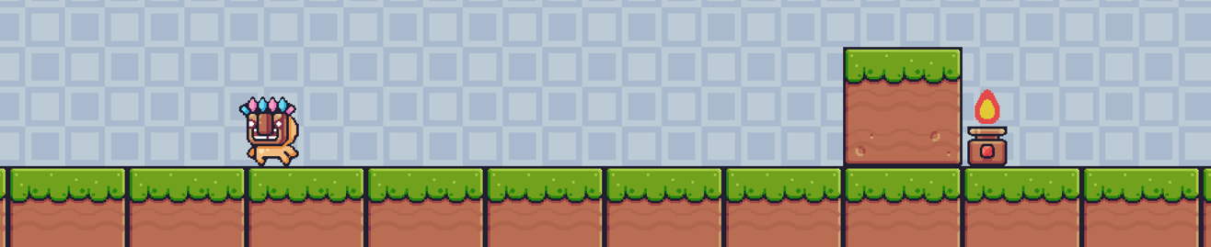
Flow Chart:

Slide 8
Testing and Validation
Test Case ID
Test Description
Input
Expected Output
Actual Output
Status
T01
Validate player movement
Press left, right, or spacebar for jump
Character moves left/right or jumps correctly
Character moved as expected
Passed
T02
Validate collision with platforms
Move player to platform and jump
Player lands or interacts with platform
Platform collision detected
Passed
T03
Test gravity behavior
Let the player fall from a height
Character falls according to gravity
Gravity applied correctly
Passed
T04
Test jumping height
Press spacebar to jump
Character jumps to a fixed height
Jump height correct
Passed
T05
Validate collision with obstacles
Move player into spikes or obstacles
Player loses health or dies
Collision detection with obstacles
Passed
T08
Test player death
Player falls off screen or hits an obstacle
Game over screen displayed
Game over condition triggered
Passed
T10
Validate level design and layout
Play through the level
Platforms and obstacles appear correctly
Level layout and design accurate
Passed
T11
Check movement smoothness
Move player continuously
Smooth transition without stuttering
Movement smooth, no lags
Passed
T12
Test jumping and landing accuracy
Jump and land on various platforms
Player lands without clipping through platforms
Landing behavior accurate
Passed
T13
Test performance under stress (e.g., large levels)
Play on larger levels or complex maps
Game runs without performance issues
Game performs without lag
Passed
T14
Test for potential bugs or glitches
Play through the game without interruptions
No unexpected crashes or bugs
Game stable, no crashes
Passed

Slide 9
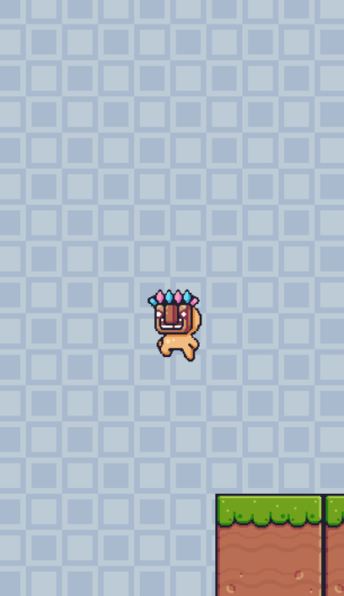
Future Scope
The Platformer Game provides a solid foundation for future enhancements, including:
Advanced Game Mechanics: Adding power-ups, new abilities, and more complex enemies.
Multiplayer Support: Implementing a cooperative or competitive multiplayer mode.
Mobile Version: Adapting the game for mobile platforms for wider accessibility.
AI Integration: Introducing AI-controlled enemies with dynamic behavior.

Slide 10
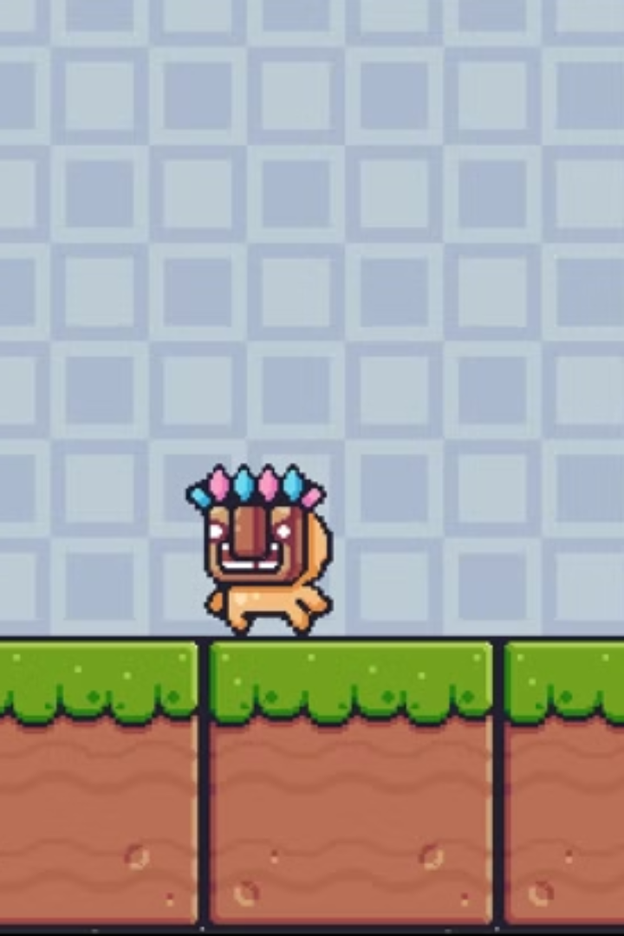
Summary
The Platformer Game has been designed to provide an engaging and enjoyable experience for players, focusing on smooth gameplay mechanics and improving thinking ability. By integrating simple yet effective movement controls, players can easily navigate through different platforms, jump over obstacles, and interact with the game environment. These gameplay mechanics contribute to a seamless experience that encourages players to immerse themselves in the game.

Slide 11
Bibliography
The following resources were used as references for the project:
Geeks for Geeks (https://www.geeksforgeeks.org/)
Javatpoint (https://www.javatpoint.com/)
W3Schools (https://www.w3schools.com/)
Draw.io (for flowchart)

