Slide 1



Key Solution to Efficient Prisons Management
Government of Goa
Inspector General of Prisons
Collectorate Building, Panaji, North Goa, -Goa
Tel: 91-832-2421921

Slide 2






Prisons Administration…..
3 Facets of Prison Administration
Jail Authorities
Prisoners
Security
Prison Laws and Rules
THE PRISONS ACT 1900
GOA PRISON RULES 2006
THE PRISON MANUAL 2006

Slide 3








Drawbacks of Manual System…
Duties and responsibilities of Executive/ clerical staff involves substantial calculations and figures
Time Consuming
Prone to human errors
Cumbersome and taxing
Necessity to maintain innumerable records & registers
Difficult to maintain antecedents of Prisoner
Difficult to retrieve, compile and analyze data
Difficult to satisfactorily implement rule of law

Slide 4







Project Highlights….
100% Processes related to Prisoner covered
100% implementation across all jails and levels of Prison administration
Centralized database -3 Tier-web based system
Eighteen Functional Modules
2 Mbps Connectivity across all Jails/Judicial Lockups
Capacity building with focus on e-Governance
Better manpower utilization
Complete ownership of the project with the department within 1 year

Slide 5
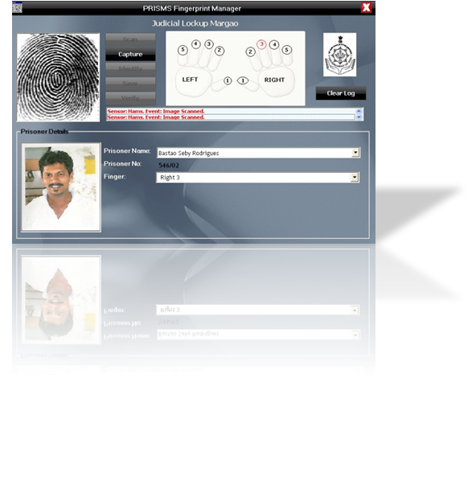
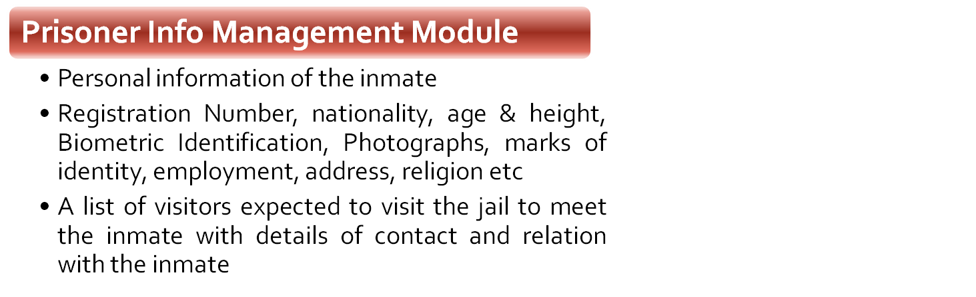
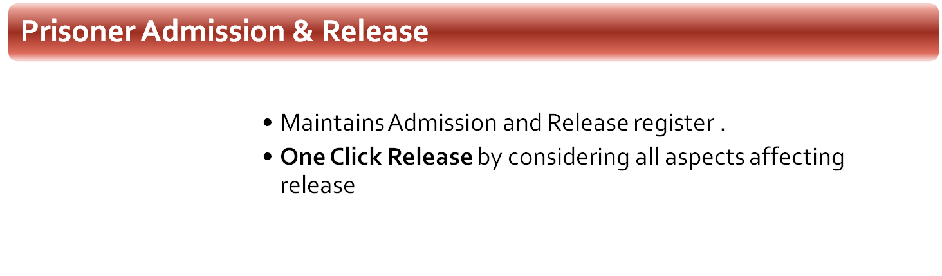

Major Modules of PRISMS….. Accurate PDR Calculation

Slide 6

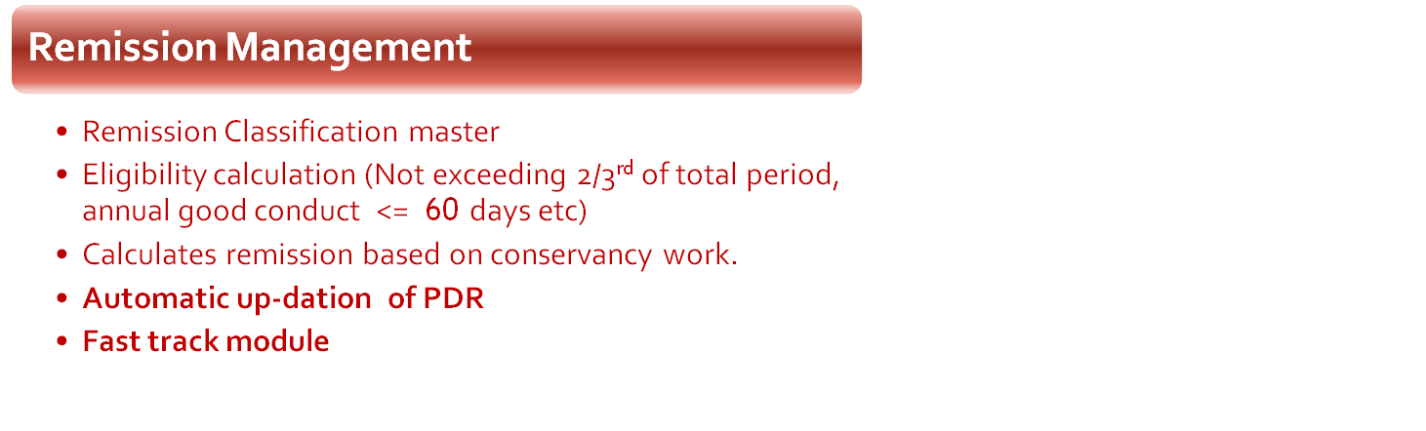
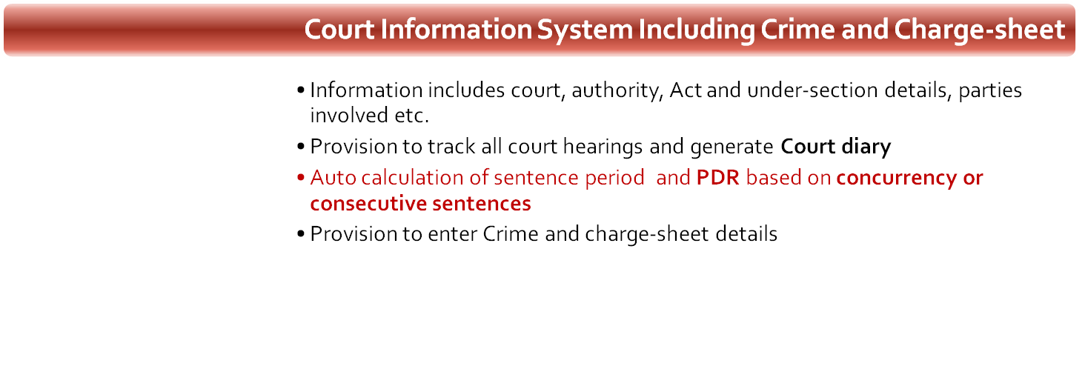

Major Modules of PRISMS….. Accurate PDR Calculation

Slide 7
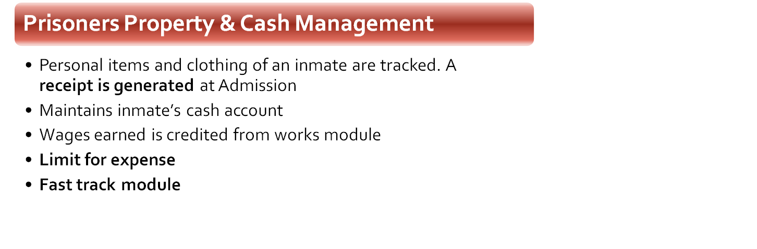

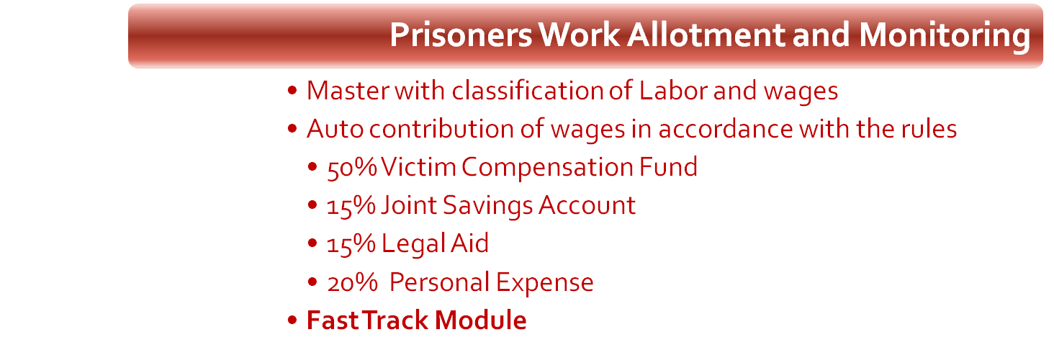

Major Modules of PRISMS….. Work Wages & PPC

Slide 8
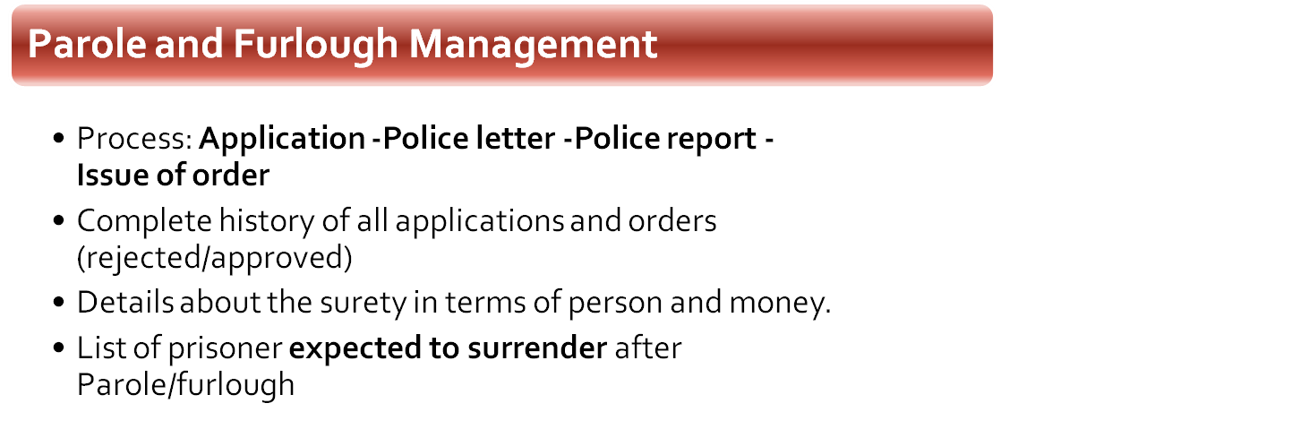
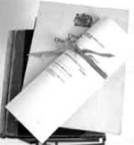
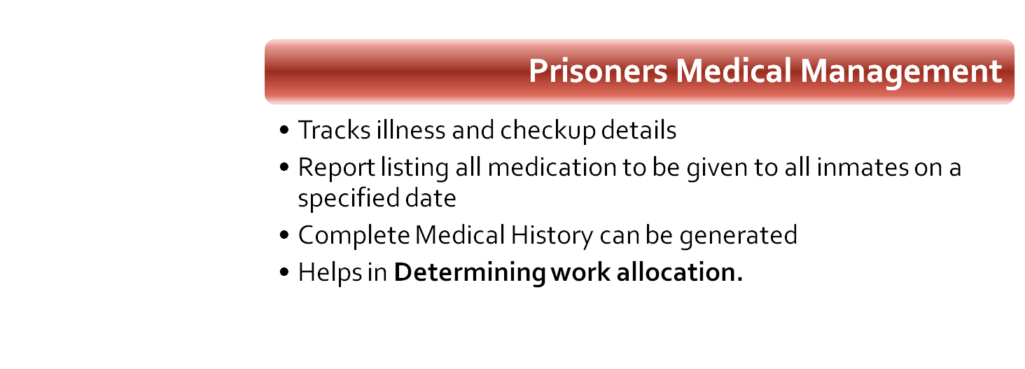

Major Modules of PRISMS….. Parole/Furlough and Medical

Slide 9


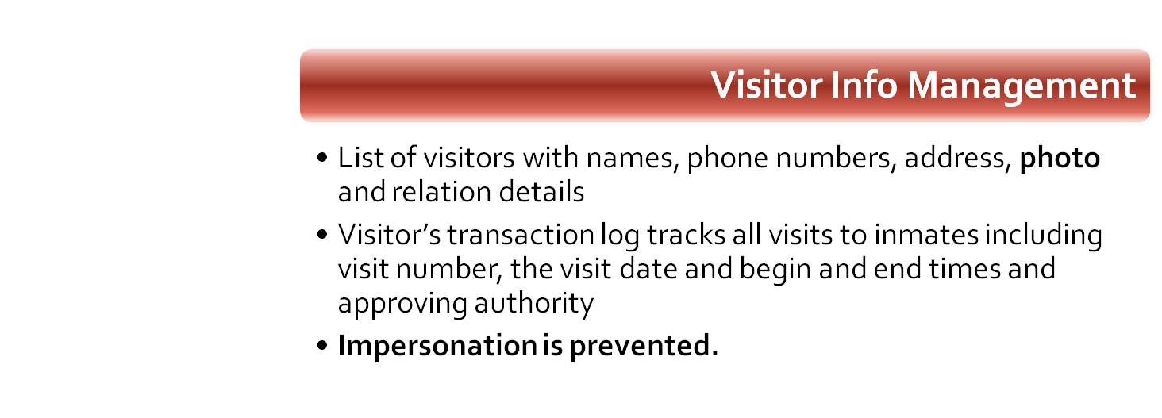
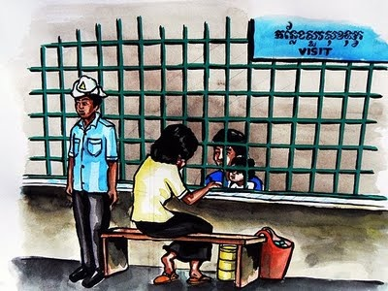
Major Modules of PRISMS…..

Slide 10
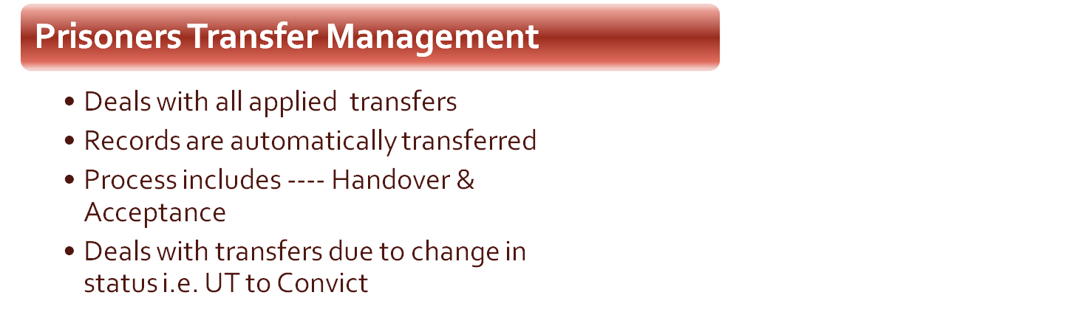
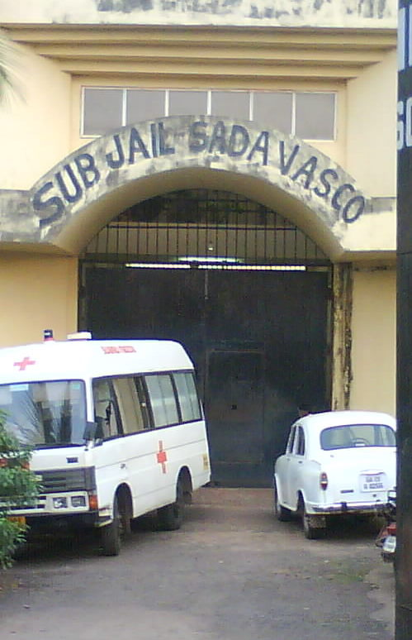
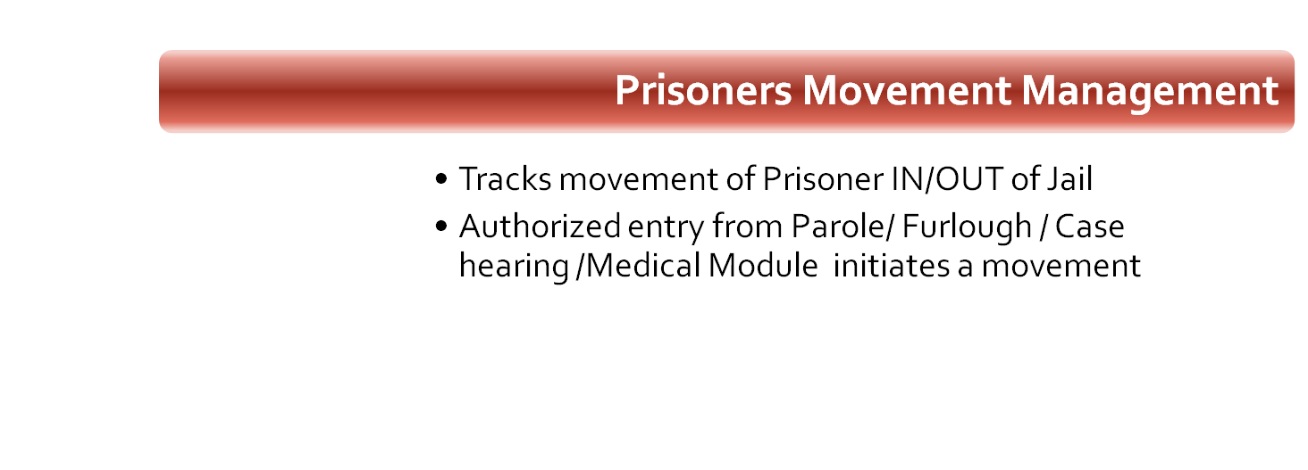

Modules of PRISMS…..

Slide 11
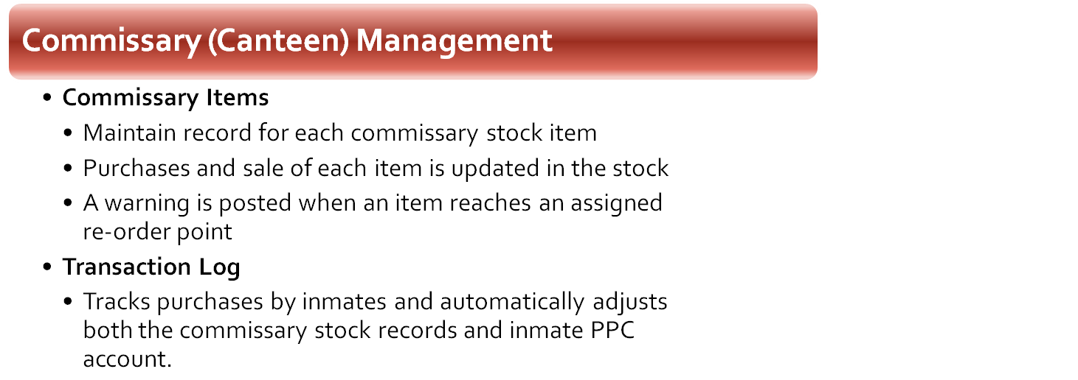


Modules of PRISMS…..
Prisoners Bail Management
  Prevention of release if other cases are pending to be bailed
  All Prisoner released on Bail
  Includes Surety bond details
  Tracks return date in case of Interim Bail

Slide 12
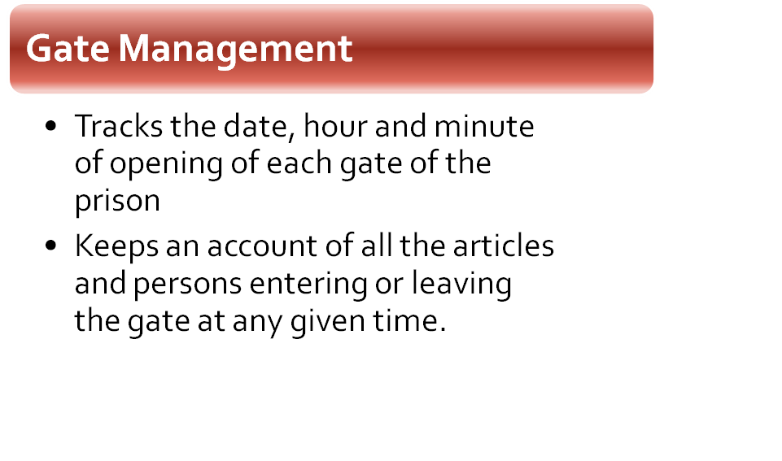

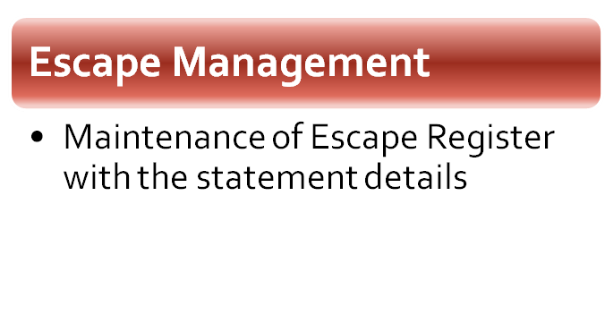
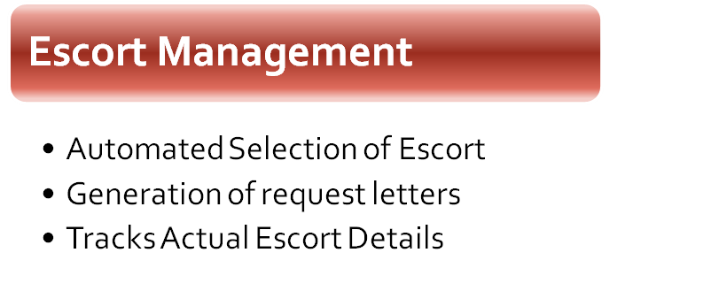
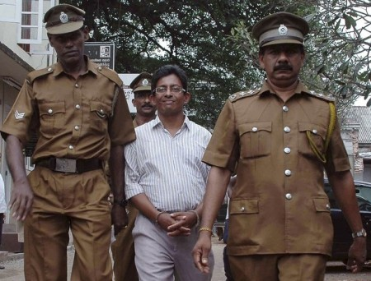
Modules of PRISMS…..

Slide 13





Benefits of PRISMS…..
Transformation and Transparency
Code Masters provides uniform data entry and validation.
Prisoner identification based on finger impression.
Helps faster analysis and reporting.
Centralized Database with 3 Tier Architecture
Instant generation of court diary for each prison
Expenditure Limit fixed on PPC by system
Work, Remission and PPC includes Fast Track Module
Tightly integrated system with auto data posting between modules avoids redundant data entry and management.
      Work and PPC
      Remission and Case
      Work and Remission
      Remission, Case and Release

Slide 14




Benefits of PRISMS…..
Transparent & Humane Approach to Prisoner Empowerment
Accurate and Fast Calculation of PDR
Instant information on wages earned and PPC
Accurate Information of Status of Parole/Furlough/ Transfer application
Police Department
Provision to access all information related to Prisoners, his/her Visitors and relatives

Slide 15





