Slide 1


Restaurant Waiter Bot
By
Nyi Nyi Myo Zin Htet ID - 5918154
Zin Zar Zar Lwin ID - 6017672

Slide 2

Content
Introduction
Project Objective
Project Overview
Project Overview Flowchart
System Layout
Code Flowchart Diagram
Testing and Result
Issues and Problem
Conclusion

Slide 3
Introduction
What is the core of our Bot?
To reduce manpower in restaurant field
To fix the common waiter error ( collecting wrong order)
Initially developed in recent years for the replacement of using human resources.

Slide 4
Project Objective

Slide 5
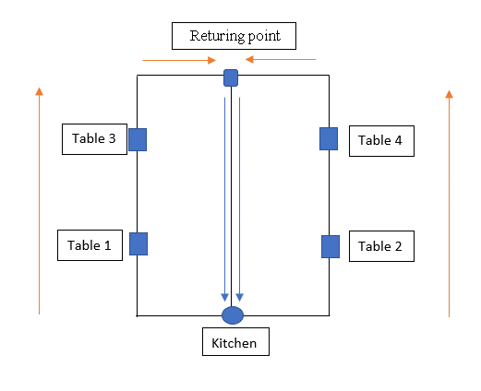
Project Overview
The waiter bot go to the destined table by following the marked line

Slide 6
System Layout
Kitchen

Slide 7
System Layout

Slide 8
System Layout
STOP

Slide 9
Issues and Problems

Slide 10
Conclusion

