Slide 1
Blumenuhr. Version Feb./2
9//2/22 für Anna

Slide 2
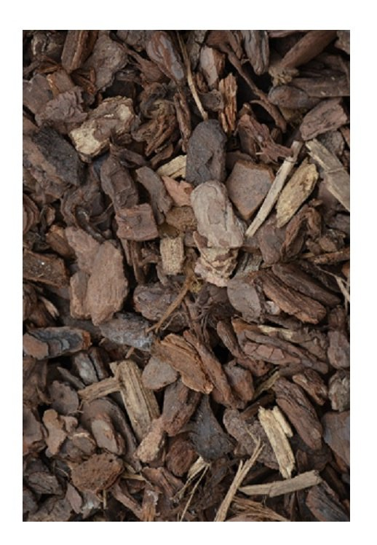
12
1
11
2
1
MAY
3
4
Centaurium
1
5
10
Calendula
8m
6
2
7
2
Hieracium
8
3
9
Gazania*
4
10
Hypochaeris
5
Linum
6
N
Ornithogalum
9
3
7
Helianthemum
8
Tragopogon
9
Delosperma
10
8
4
Gentiana**
7
5
*even if not flowering or not here in May, would keep the space free
** I suggest we put Gentiana in the inner circle for May (as no night species anyway
6

Slide 3
12
1
11
2
1
JUNE
3
4
Centaurium
1
5
10
Calendula
8m
6
2
7
2
Hieracium
8
3
9
Gazania
4
10
Hypochaeris
5
Linum
6
N
Ipomea purp.
9
3
7
Helianthemum
8
Oxalis
9
Delosperma
10
8
4
Silene
Ipomea/Mirabilis
Datura?
7
5
6

Slide 4
12
1
11
2
1
JULY
3
4
Centaurium
1
5
10
Calendula
8m
6
2
2
7
Hieracium
3
8
9
Gazania
4
10
Hypochaeris
5
Eschscholzia
6
N
9
Ipomea purp.
7
3
Cucurbita pepo
8
Oxalis
9
Cichorium
10
8
4
Ipomea
Mirabilis
Datura?
7
5
6

Slide 5
12
1
11
AUGUST
2
1
3
4
Centaurium
1
5
10
Calendula
8m
6
2
2
7
Hieracium
3
8
9
Gazania
4
10
Hypochaeris
5
Eschscholzia
6
N
9
Ipomea purp.
7
3
Cucurbita pepo
8
Oxalis
9
Cichorium
10
8
4
Ipomea
Mirabilis
Datura?
7
5
6

Slide 6
12
1
SEPTEMBER
11
1
2
3
4
Centaurium
1
5
10
Calendula
8m
6
2
2
7
Hieracium
3
8
9
Gazania
4
10
Convolvulus
5
Eschscholzia
6
N
9
Ipomea purp.
7
3
Tolpis barbata
8
*
Oxalis
9
Cichorium
10
8
4
Ipomea
Mirabilis
Datura?
7
5
6

Slide 7
Species turnover.
MAY
JUNE
JULY
AUGUST
SEPTEMBER
Area (m²)
16,57
12,86
8,90
10,64
5,58
5,08
9,06
8,79
7,26
5,14
2,85
1,63
1,46
Centaurium
1
1
1
1
1
Calendula
2
2
2
2
2
Hieracium
3
3
3
3
3
Gazania
4*
4
4
4
4
Hypochaeris
5
5
5
5
→Convolvulus
5
5,4
Linum
6
6
6
6,80
6
6
→Eschscholzia
Ornithogalum
→ Ipomea purp.
6,80
7
7
7
7
7
Helianthemum
8
8
→Cucurbita
8
8,80
8
→Tolpis
8
5,8
Tragopogon
9
9
9
9
9
Delosperma
10
10
→Cichorium
10
5,14
10
10
Gentiana
N1
Ipomea
Mirabilis
Datura
Silene
Zaluszianskya
Mirabilis
Datura
?
N2
N3

