Slide 1
FooD Court Management System

Slide 2
introduction
First of all, our honorable faculties have to go outside to take lunch so they can use this system to order food if any owner of food court use this system. As they have to work the all day long and spend their time behind us, they need some rest so we have to do something of them. So this is our main inspiration to do this project. As we are student we can take this as our side business. So we can use this system. Moreover furthermore now our university is closed because of the pandemic virus corona .In this situation the whole country has become lock down now . So many of us are infected and many of us are keep themselves in self quarantine. All of them can order food from here and those who wants to support homeless people , they also can order food from here.

Slide 3
Problem Statement
The reason behind choosing this project :
Time saving
24/7 service
Obtainable
Lucrative
Fastest delivery
Easy to manage
To enjoy discount/Offer
To avoid road side unhealthy food
Impact on economy and unemployment problem
Stay Safe Stay Home
Keep Ordering Consume Salubrious Food

Slide 4
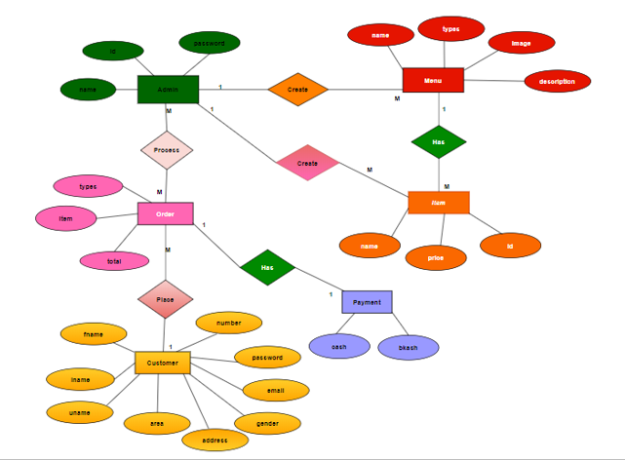
ER Diagram

Slide 5
Software Used
To develop this project we have used the following:
Visual Studio
Microsoft SQL server
Free Online Diagram Editor

Slide 6
Features
In this project the “Admin” has the following features:
Record Customer information.
Manage different types of order.
Calculate the total price of order.
Record different types of order and their price.
Add , Delete Admin and Change the password of Admin .

Slide 7
Features
In this project the “Customer” has the following features:
Any visitor can visit this system.
User have to register their information once in the system for ordering.
After successful registration, Customer can order various types of food.
Customer can order multiple types of different foods.
Before ordering, Customer can check the pricelist of various types of food.
After selecting various types of food, Customer can check the total price of order.
Customer can pay through some mobile banking systems like Bkash.
Customer can use promo code for getting 10% discount.
Customer can update their information which they have given in registration form.

Slide 8
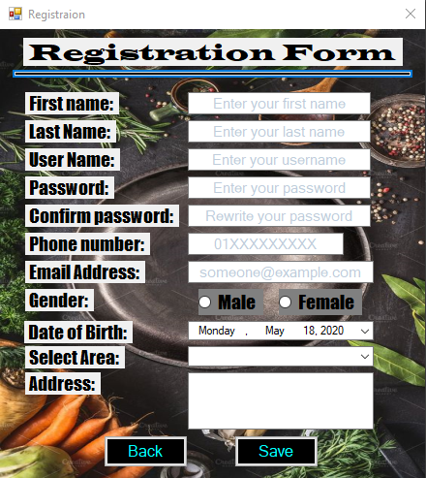
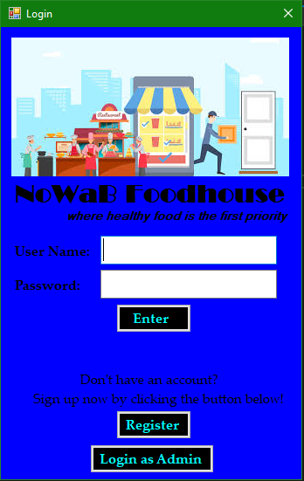
GUI Description
Customer login page
Registration Form

Slide 9
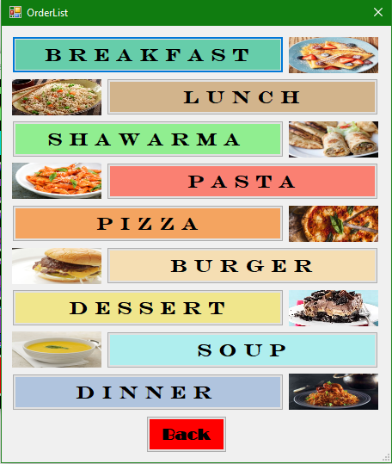
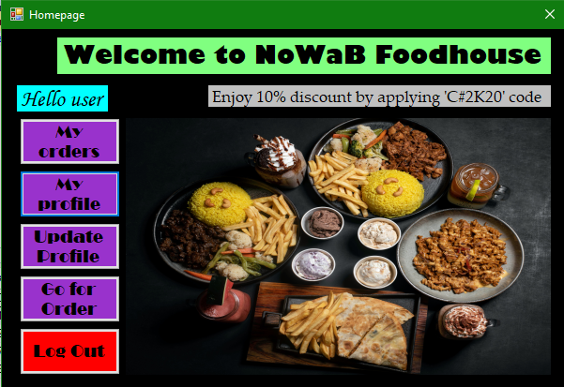
GUI Description
Customer homepage
Food types

Slide 10
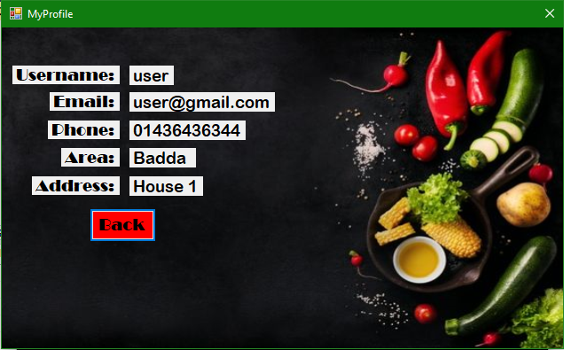
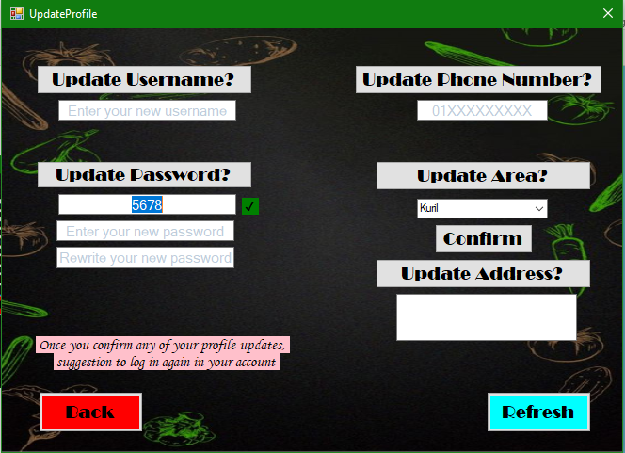
GUI Description
Customer’s profile section
Update profile section

Slide 11
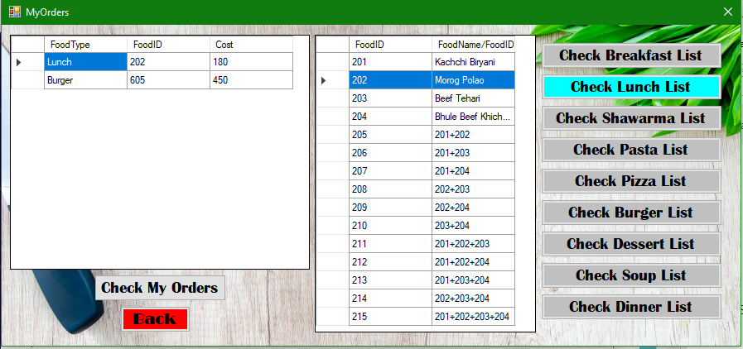
GUI Description
Customers’ check orders page

Slide 12
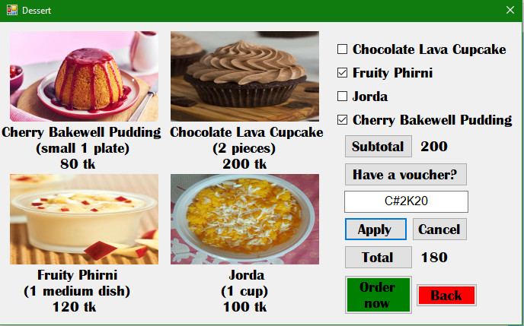
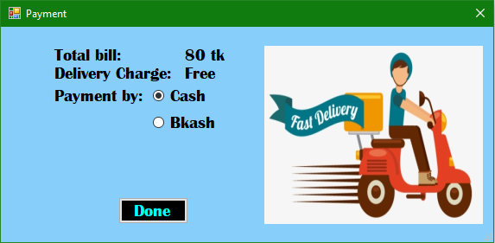
GUI Description
Payment process
Food items section

Slide 13
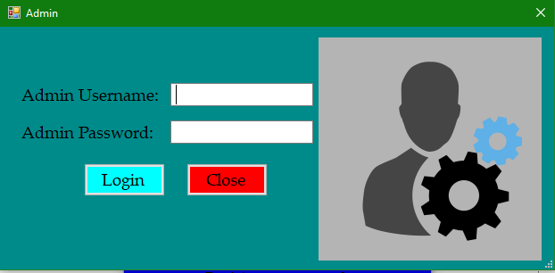
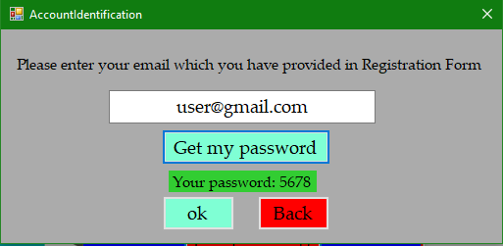
GUI Description
Admin login page
Customers’ account verification page

Slide 14
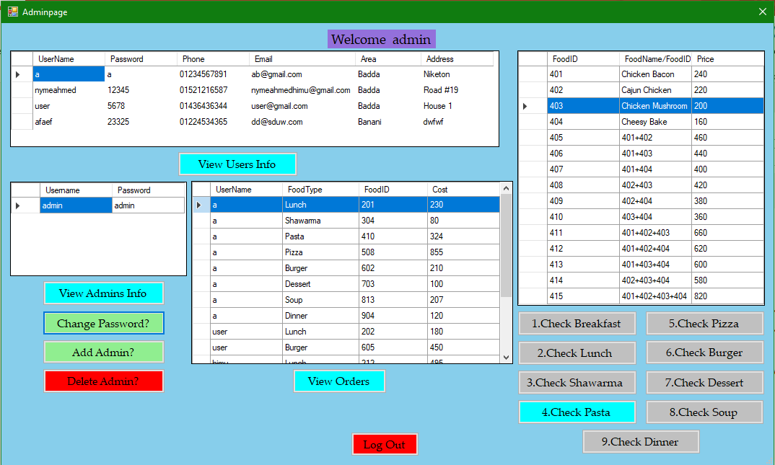
GUI Description
Admin homepage

Slide 15
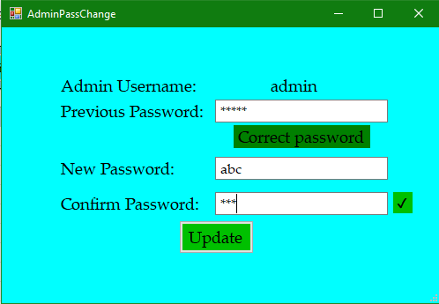
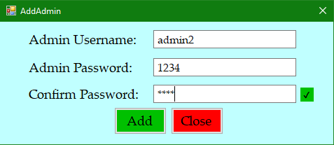
GUI Description
Add admin page
Admin password change page

Slide 16
Limitations
The price of foods are fixed.
We have only few types of food in our system.
The ordering food availability is not checked.
Quantity is fixed.
Can’t select same type food more than once at a time.
Can't select multiple types of food, customer have to select one by one type of food.
Once the order is confirmed, it can’t be cancelled.
Customers may not pay delivery charge.
Taka transfer can’t be verified.
In this short span of time we failed to attach drinks in menu.

