Slide 1
Best location for Sushi Restaurant in NYC

Slide 2
Factors to consider
Ease of commuting, is public transportation within walking distance. It is very expensive to maintain a car in the city, being easily accessible from public transportation will be a plus.
Income level of the neighborhood is important, as most likely customers will be from the neighborhood. People with higher income will be more likely to visit restaurant more often.
Average age in the neighborhood is also important. Younger people is more likely to visit restaurant to gathering.
Competitors in the neighborhood is also another important factor to consider.
population density around the neighborhood

Slide 3
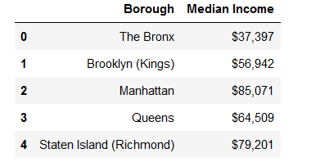
Median income for each Borough in NYC
The Median Income in Bronx rank the last

Slide 4
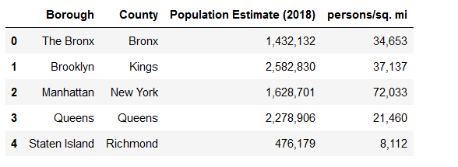
Population density
Population Density in Staten Island ranks the last

Slide 5
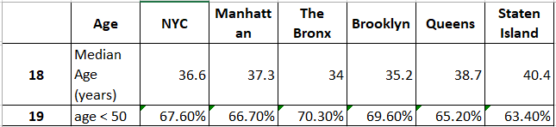
% of population below 50’s
. Based on median income, we will drop Bronx from our Potential Candidate
. Based on Population Density, we will drop Staten island from our list
. And Based on % of population below 50’s, we will pick Manhattan and Brooklyn as potential Borough the restaurant should pick

Slide 6
Neighborhood with least competition
. Using foursquare api, it was found there are 48 neighborhoods in Brooklyn and
Manhattan that has no Japanese/Sushi Restaurant
. Of these 48 Neighborhoods that has no Japanese/Sushi Restaurant, we again use
the foursquare API to find the list of neighborhoods that has the least number of
restaurants

Slide 7

Easy of commuting
Using the foursquare api, we look for neighborhood that has bus stop, bus station in the neighborhood (which here used these features as a proxy for easy commute)
And only the following neighborhood satisfy the requirement,
And this will be the location we recommend.

