Slide 1
ACADEMIC REPORT MANAGEMENT
[OOPS PROJECT]
TEAM :
PASNOORI NYMIKA (2018BCS-032)
LAUDYA MUKESH KUMAR(2018BCS-028)
RYAKAM ACHYUTA KUMAR(2018BCS-042)

Slide 2
INTRODUCTION
Academic Report Management as the name indicates will be used for managing student reports along with their personal information, their respective subjects and also professors’ Information.
There will be only teachers who will have to authority to make changes and modification in reports while using this system. Teachers will able to perform activities like, adding student records, modifying and deleting existing records, allowing authority to access particular section of student data from different departments. To perform teachers work, users have to select teacher panel and provide their password to access this section.

Slide 3
OBJECTIVES
To maintain and update Student Reports
Adding Student Records, Modifying and Deleting existing Records
To Display Students’ personal Information like Name, admission number, stream, date of birth, contact number, etc.
To provide an easy, interactive and secured interface by providing password to login for teachers.

Slide 4
NEED FOR THE PROJECT
As each institution has various departments which will use student records in order to carry out their task. Now, integrating task and sharing data among department can be easily achieved.
It has been difficult for students to search for their respective reports. So this maintains students’ database so it will be easy for students.
It has been difficult for the management and the teachers to maintain and update student reports and teachers’ Information.
Sometimes students may modify their respective reports. So, this is a secured interface which only enables the teachers with their password to add or modify the records.

Slide 5
CLASSES AND FUNCTIONS
Classes Defined:
Student
Prof
Subject
Date
Admsno
Bcs
imt
img

Slide 6
Class Student:
This class contains information about all the current existing students’ personal information like admission number, name, father’s name, mother’s name, date of birth, contact number and their academic report with marks of the respective stream’s subjects. It contains functions to enter the information by the user, and to display the information.
+enter(): Takes input of all
+display(): Display Personal Information.
+getad(): To get the students Admission roll number.
friend void add(): Add Student Records.
friend void disp_bcs(): Display all BCS Student Reports.
friend void disp_imt(): Display all IMT Student Reports.
friend void disp_img(): Display all IMG Student Reports.
friend void del(): Delete Student Records
friend void modify(): Modify Student Records
friend void search(): Search students’ reports by Roll Number.
friend void sort_per(): Sort students’ reports by their percentage.

Slide 7
Class Prof:
This class contains information about all the current existing professors’ personal information like Professor name and Professor ID.
Prof(): Contructor
Class Subject:
This class contains information about all the current existing Subjects for respective streams along with their professor details.
Subject(): Constructor
Class Date:
This class contains the format in which date must be entered.
Date(): Constructor
Class Admsno:
This Class contains the format in which admission number must be entered.
Admsno(): Constructor

Slide 8
Class bcs:
This Class is for students of BCS Stream.
entermarks: Enter the marks of respective subjects.
displaymarks: Display and Calculate total and percentage of all Subjects.
Class img:
This Class is for students of IMG Stream.
entermarks: Enter the marks of respective subjects.
displaymarks: Display and Calculate total and percentage of all Subjects.
Class imt:
This Class is for students of IMT Stream.
entermarks: Enter the marks of respective subjects.
displaymarks: Display and Calculate total and percentage of all Subjects.

Slide 9
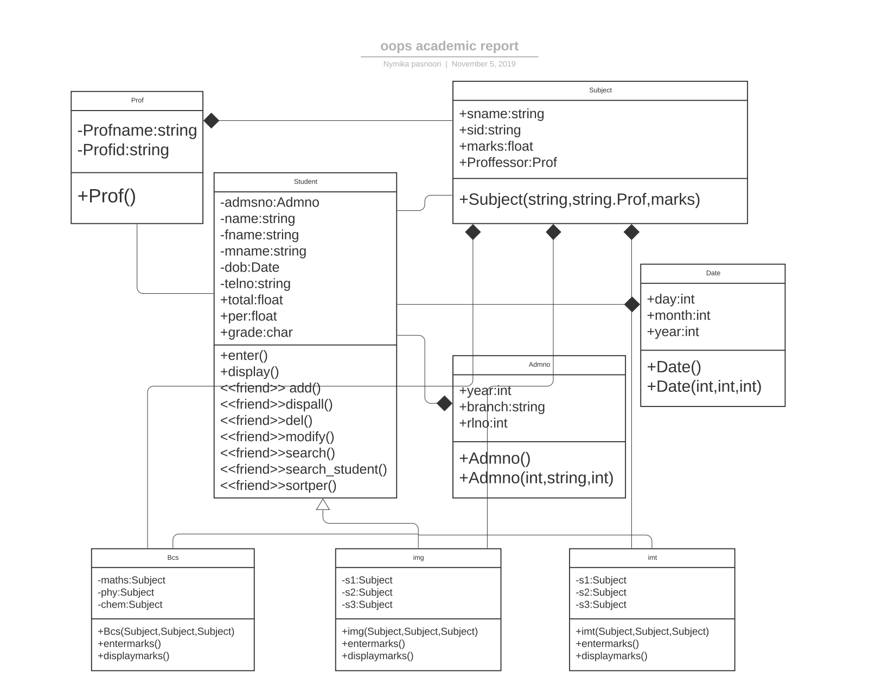
CLASS DIAGRAM

Slide 10
Header files in the Source Code: 1. prof.h 2. subject.h 3. date.h 4. admsno.h 5. student.h 6. Bcs.h 7. imt.h 8. img.h final.cpp is the main executable file. Modularity is an important concept in OOPS for executing large projects.

