Slide 1
Computational Probability and Statistics CIS 2033 Section 002
Shanshan Zhang

Slide 2
LAB Information
TA
Shanshan Zhang
zhang.shanshan@temple.edu
Lab Class
SERC 206
Friday 09:00 am ~ 10:50 am
Office Hour
SERC 303
Friday 11:00 am ~ 12:00 am or by appointment

Slide 3
Outline
Introduction
Matrix and Array
Character Strings
Function
Plots
Scripts
Control Flow
Help and Documentation

Slide 4
Numerical Computation
Visualization
Application Development
MATLAB
Linear algebra, statistics
Fourier analysis, filtering
Optimization, integration, differential
High-Level Language
Interactive environment
Built-in graphics
Integrating with external applications and languages
Mathematical Functions
Development Tools

Slide 5
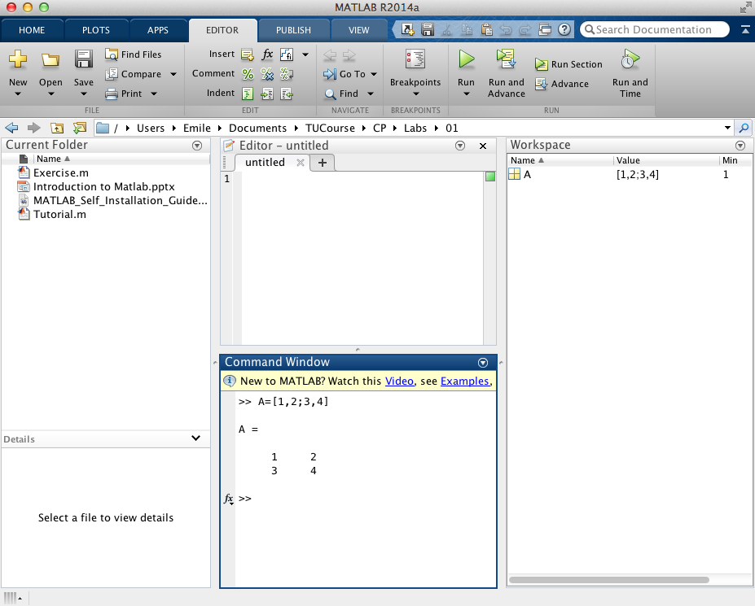
Layouts
Workspace:
To explore data that you create or import from files.
Current Folder:
To access your files.
Command Window:
To enter commands at the command lines, indicated by the prompt (>>).
Notes:
<number>

Slide 6
Matrices and Arrays
ALL MATLAB variables are multidimensional arrays
Array Creation
Using square brackets
Column separation: a comma ( , ) or a space
Row separation: a semicolon
Using function
ones: entry of 1s
zeros: entry of 0s
rand: entry of random numbers (0, 1)
Matrix and Array Operations
Concatenation

Slide 7
Matrices and Arrays
ALL MATLAB variables are multidimensional arrays
Array Creation
Matrix and Array Operations
Transpose ‘
Standard operation + - * / %
Element-wise operation .* ./ .^
Concatenation

Slide 8
Matrices and Arrays
ALL MATLAB variables are multidimensional arrays
Array Creation
Matrix and Array Operations
Concatenation
With square brackets ([ ])
Horizontal concatenation with commas
Vertical concatenation with semicolons

Slide 9
Array Indexing
To access selected elements of an array
To use a single subscript that traverses down each column in order
To specify row and column subscripts
One element: A(m, n)
Multiple elements:
A(start : step : end, column)
A(row, [ i, j, k])

Slide 10
Character Strings
A sequence of characters enclosed in single quotes
assign a string to a variable
use two single quotes within the definition if the text includes a single quote
Concatenation
With square brackets as concatenate numeric arrays
Convert numeric values to strings
num2str
int2str

Slide 11
Functions
Equivalent to subroutines or methods in other programming languages
To call a function, enclose its input arguments in parentheses
If there are multiple input arguments, separate them with commas
Return output from a function by assigning it to a variable
When there are multiple output arguments, enclose them in square brackets
To call a function that does not require any inputs and does not return any outputs, type only the function name

Slide 12
Plots
Two-dimensional line plots with the plot function
Label the axes
Add a title
Specify additional properties (e.g., line width, color, the marker, etc.)
Add plots to an existing figure by using the hold function
Display multiple plots in different subregions of the same window using the subplot function

Slide 13
Scripts
A file with a .m extension containing
multiple sequential lines of MATLAB commands
function calls
To run a script
Save the file in the current folder and type its name at the command line
Run scripts from the Editor by pressing the Run button
Comments
To describe the code
Add comments whenever you write code
Using the percent (%) symbol

Slide 14
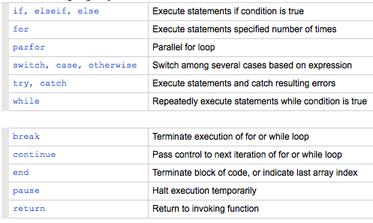
Control Flow
Conditional statements, loop and branching

Slide 15
Help and Documentation
Supporting documentation
Includes examples
Describes the function inputs, outputs, and calling syntax
To access this information
From the command line
Open it in a separate window using the doc command
Display it at the command window by using the help command
Display function hints (the syntax portion of the function documentation) in the Command Window by pausing after you type the open parentheses for the function input arguments
Access the complete product documentation by clicking the help icon
Notes:
<number>

