Slide 1
Runway Pika
Prompt Test

Slide 2

the setting is similar to george orwell27s novel2c 1 - Image Creator from Microsoft Designer (bing.com)
Text/Image to Video - Runway (runwayml.com)

Slide 3

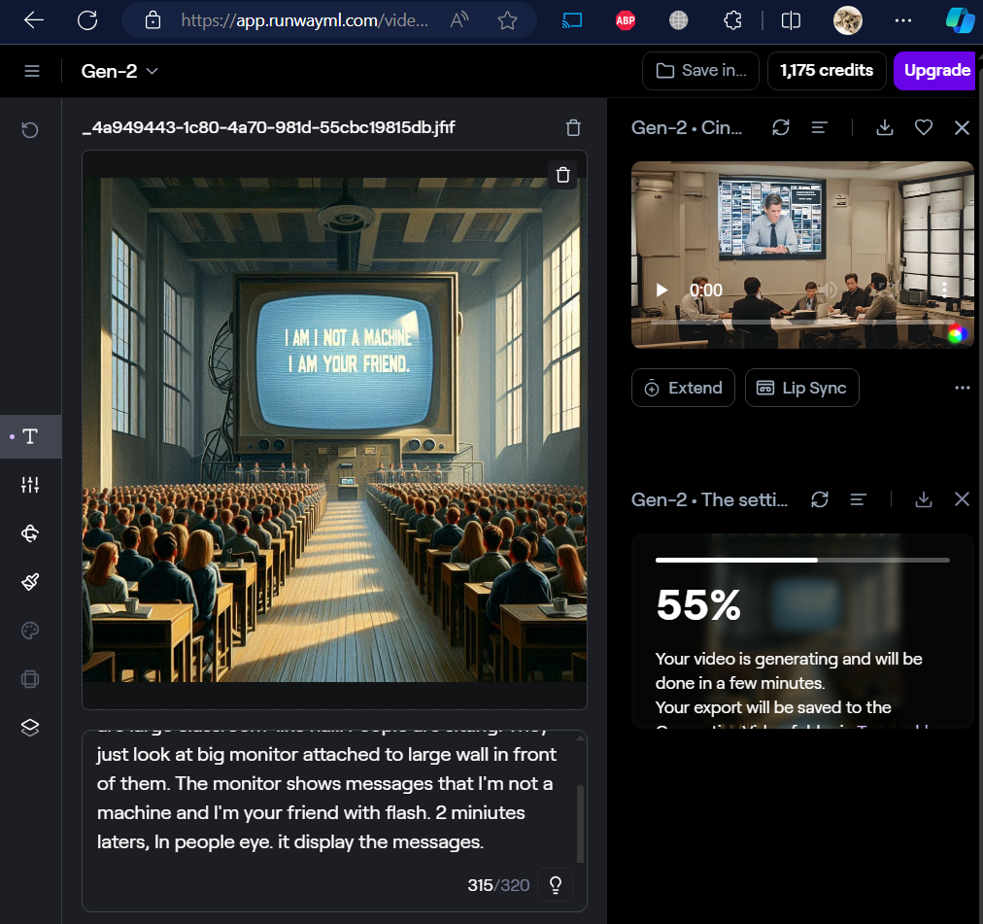

Slide 4
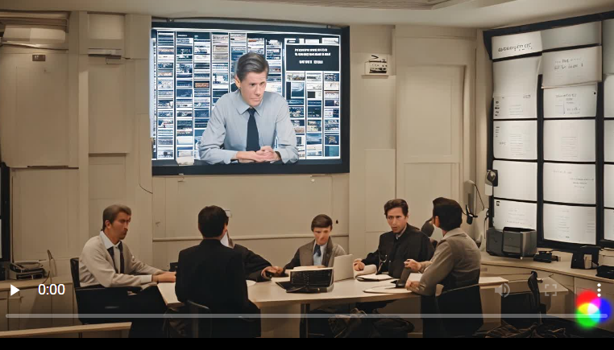
The setting is similar to George Orwell's novel, 1984. There is a large classroom-like hall, and people are sitting neatly. They are just looking at the very large cathode ray tube monitor on the large wall in front of them. The large monitor keeps showing the message that I am not a machine and that I am your friend. The monitor sometimes flashes. The camera focuses on people's eyes. Those eyes display the message that I am not a machine.

Slide 5
The setting likes George Orwell's novel, 1984. There are large classroom-like hall. People are sitting. They just look at big monitor attached to large wall in front of them. The monitor shows messages that I'm not a machine and I'm your friend with flash. 2 miniutes laters, In people eye. it display the messages.

Slide 6
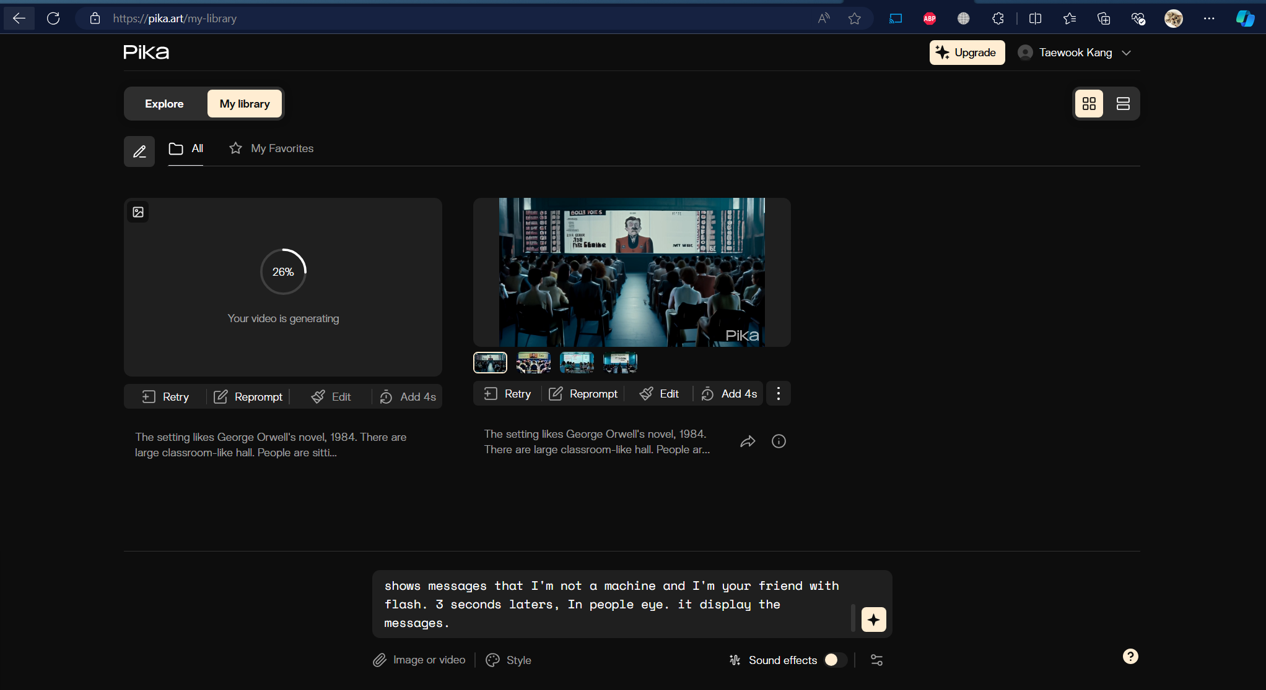
draw this "The setting is similar to George Orwell's novel, 1984. There is a classroom-like office, and people are sitting neatly. They just look at the large monitor attached to the large wall in front of them. The large monitor keeps showing the message that I am not a machine and that I am your friend. The monitor sometimes flashes".

Slide 7
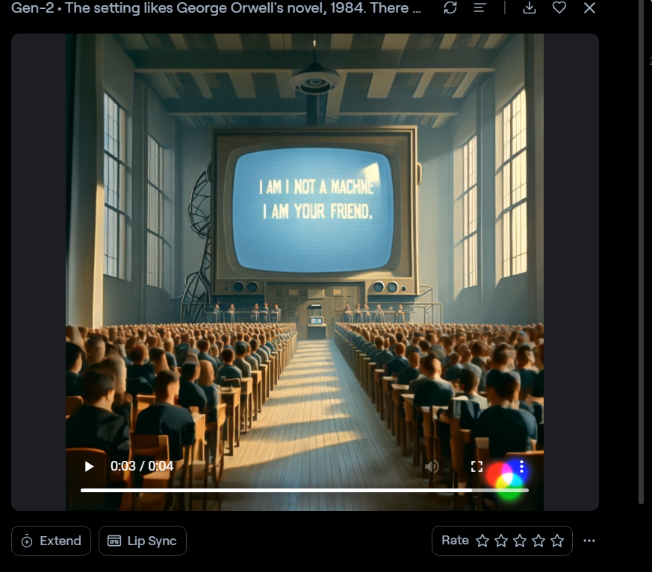
The setting likes George Orwell's novel, 1984. There are large classroom-like hall. People are sitting. They just look at big monitor attached to large wall in front of them. The monitor shows messages that I'm not a machine and I'm your friend with flash. 3 seconds laters, In people eye. it display the messages.

