Slide 1

AI BUILDER CUP 2026
Savvy Cart
AI
A grocery plan that accounts for
your cards and every extra trip.
Retail & Commerce
gTaprobane
Yogendran Nadaraja and Tharindu N. Madhusankha
Notes:
Savvy Cart AI helps a Colombo household choose what to buy, when to shop, where to go and which card to use. We submit under Retail & Commerce, with a working local prototype and a Google Cloud deployment path.
Sources: https://aibuildercup.com/themes.html ; README.md. Cover: original AI-generated illustrative artwork, not a record of a real shopping event. Team supplied by the user.

Slide 2
The weekly shopping decision
Karuppan's household
A budget of LKR 12,000, three credit cards and four supermarket chains.
Decision | What changes the answer
What to buy | Purchase history and the next estimated purchase date
Where and when | Shelf prices, store promotions and offer weekdays
Which card | Exclusions, minimum spend, caps and combining rules
One store or several | The saving after the cost of another trip
Karuppan is a fictional Colombo demo persona. Budget and wallet are sample preferences.
2
Notes:
A household must combine purchase history with store prices and card rules. The same basket can cost differently by day, card and number of stores. Savvy Cart brings those decisions into one reviewable plan.
Sources: README.md; .adlc/specs/SC-014-v2-wallet-pantry-multistore.md; fixtures/v2/offers.json. Persona is fictional. This is a product problem hypothesis, not a quantified market study.

Slide 3
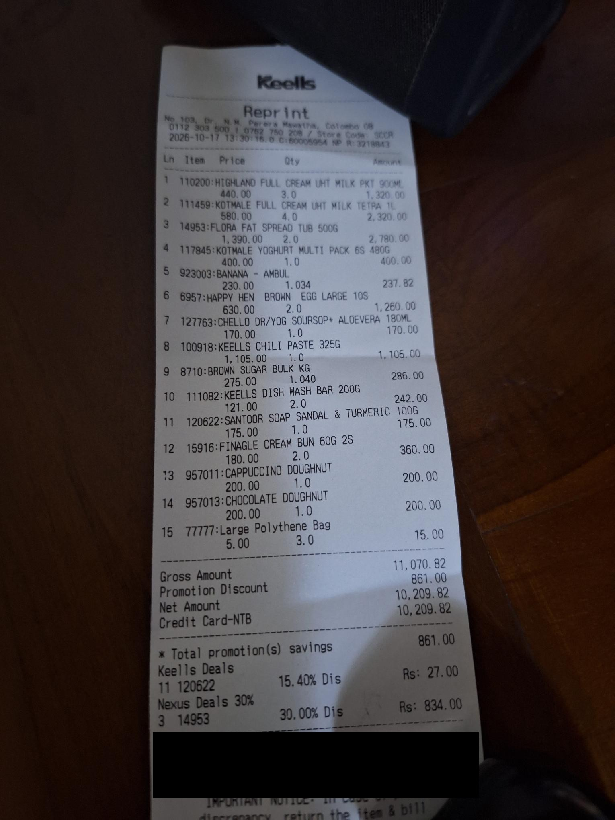
Evidence from a household's receipts
26
de-identified Keells bills
21 purchase dates
5 May to 17 October 2026
Receipts show item-level promotions. Four dates contain multiple receipts.
The demo adds 17 fictional bills. Competitor prices and store promotions remain simulated.
Source: samples/purchase-history.json and the redacted receipt. One household, not market validation.
3
Notes:
We began with 26 de-identified bills from one shopper, spread over 21 dates. That gives us real receipt formats and item promotions. We label the additional fictional history and sample prices, and we do not claim measured household savings.
Sources: samples/purchase-history.json; samples/receipts/keells-2026-10-17-redacted.jpg; fixtures/v2/history-fictional.json. Four dates contain multiple receipts, which alone does not establish separate store visits. The receipt photograph is original supplied project evidence.

Slide 4
A shopping plan the household can review
1
2
3
4
5
Pantry
Wallet
Plan
Why
Approve
Review items
and quantities.
Choose cards.
Set the cost of
another trip.
Compare days,
stores and
baselines.
Ask questions.
Review the tool
comparisons.
Review the plan
and mock
fulfilment.
Offer Reality Check
Paste bank terms or upload a screenshot to see what the offer pays on this basket.
Implemented guest workflow. The final approval creates a MOCK preview. No order is sent.
4
Notes:
The guest journey starts with the household's estimated needs and ends with its own decision. Offer Reality Check is available as an optional branch. Every figure remains inspectable, and the prototype sends no orders.
Sources: src/savvycart/http.py; .adlc/specs/SC-023-offer-reality-check.md; .adlc/specs/SC-027-v24-ux-hierarchy-profile.md; .adlc/specs/SC-030-v25-ui-polish.md. The diagram describes implemented screens and is not a screenshot.

Slide 5
Offer Reality Check
Published offer: 10% off on Total Bill every Saturday
Headline arithmetic
Modeled card payout
LKR 593
LKR 0
The basket misses the minimum by LKR 2,475
LKR 5,525 bill after store promotions, against an LKR 8,000 minimum.
Six promoted lines cannot combine with this offer.
Seylan Keells terms checked 18 Oct 2026. Sample basket and promotions. No bank affiliation.
5
Notes:
A ten-percent headline suggests 593 rupees on the default sample basket. Published Seylan terms require an 8,000-rupee minimum. The modeled bill is 2,475 short, so the card payout is zero. The page shows the conditions behind that result.
Primary source, rechecked 18 October 2026: https://www.seylan.lk/promotions/cards/supermarket/keells . Model source: fixtures/v2/offer-sample-seylan.json; src/savvycart/offercheck.py; tests/test_v22_page.py. Basket shelf total 5,932, promoted bill 5,525, minimum 8,000. Only 3 of 4 UHT milk units count; six store-promotion lines do not combine. Milk powder and dhal are NOT in this default basket and do not cause the zero. Cardholder eligibility and channel restrictions still apply. Values are modeled on sample prices, not a bank quote.

Slide 6
The extra trip must earn its cost
LKR 63
extra saving over the best single store
At LKR 320 per extra trip, Cargills alone wins at LKR 4,667.
LKR 1,328 below the shelf baseline. Every saving here is simulated.
Simulated default basket, before adding the sample receipt. Trip estimate LKR 250. Whole-rupee amounts.
6
Notes:
The default two-store plan costs 4,604 rupees including travel. Its advantage over the best single store is just 63 rupees. Raise the extra-trip cost to 320, and one store wins. This demonstrates the decision logic on labeled sample data.
Sources: README.md; src/savvycart/planner.py; fixtures/v2/catalog.json; fixtures/v2/offers.json; tests/test_v25_page.py. Fresh default planning date 22 Oct, recommended Friday 23 Oct. Keells bill 1,294 plus Cargills bill 3,060 plus extra trip 250 = 4,604. Shelf baseline 5,932. Best single store Cargills 4,667. Six published default card headlines have assumed terms, HNB and all store promotions are fictional. No claim of realized household savings. Native chart workbook retains all three values.

Slide 7
Gemini reads the inputs. Code prices the basket.
Gemini understands | The application checks and acts
Receipt photo | Catalog SKU, decimal quantity and confidence; update session history
Offer text or screenshot | Structured rate, dates, exclusions, minimum, cap and combining rules
Shopper question | ADK tools compare plans or check an offer against the basket
Shoppers can review and correct extracted terms
The pantry estimates purchase timing. OR-Tools CP-SAT calculates store assignment and cost.
Implemented integration paths. Live Gemini checked 18 Oct 2026: the Why answer about 30 seconds, offer reading about 7 seconds; accuracy sampling is ongoing.
7
Notes:
Gemini reads receipts and bank offers, and turns shopper questions into tool calls. Structured fields remain reviewable. The pantry and exact optimizer compute dates and money, so the model does not supply a shelf price or calculate the basket total.
Sources: src/savvycart/gemini.py; src/savvycart/offercheck.py; src/savvycart/agent.py; src/savvycart/pantry.py; src/savvycart/planner.py. The initial offer preview computes immediately; the app does not require a separate confirmation click before the first calculation. The shopper can correct and recheck terms. Tests use fake or scripted model outputs.

Slide 8
Google Cloud deployment architecture
Cloud Run
Gemini
FastAPI guest UI and API
Reads receipts and
offers. Uses tools.
Guest browser
One ADK agent, six tools and callbacks
No login
Pantry cadence engine
OR-Tools CP-SAT shopping planner
Secret
Manager
Packaged catalog, offers and history fixtures
Model configuration
Runtime service account authenticates Gemini calls with ADC.
Deployed on Cloud Run (asia-southeast1, scale to zero). ADK runs inside the application container; no separate Agent Engine deployment.
8
Notes:
Cloud Run hosts the guest interface, ADK agent and deterministic engines in one container. Gemini is a managed API. The runtime service account authenticates calls, while Secret Manager supplies model configuration. The service is deployed and live on Cloud Run.
Sources: Dockerfile; docs/deploy.md; src/savvycart/http.py; src/savvycart/agent.py. Configured Cloud Run region asia-southeast1; Gemini model location global; min instances 0, max instances 3, timeout 120 seconds. There is no deployed database, Cloud Storage dependency, separate Agent Engine service or live partner feed in this prototype. Default deployment uses ADC, not a committed API key. This diagram describes the deployed architecture, serving at a public Cloud Run URL.

Slide 9
Implementation evidence and safeguards
120
Rules in code
Minimums, caps, exclusions, promotion limits and travel cost.
Observable reasoning
automated tests pass
Tool arguments and comparisons remain inspectable.
Two guardrail layers
Reproducible engine behavior and integration contracts.
Agent callbacks and page checks filter known numeric failures.
Human decision
No card-number collection. Approval creates a mock preview.
Local test run on 18 Oct 2026: 120 passed. Scripted model tests do not establish live AI performance.
9
Notes:
A fresh local run passes 120 tests. They cover deterministic pricing and integration contracts, including scripted ADK behavior. Users can inspect tool calls and compare results. Guardrails reduce known failures, but they do not guarantee semantic correctness of every answer.
Sources: python -m pytest -q, observed 18 Oct 2026, 120 passed; tests/test_guardrails.py; tests/test_offer_check.py; tests/test_planner_promotions.py; src/savvycart/guardrails.py. Tests intentionally remove live model credentials. Receipt images are processed in memory and are not persisted to storage or logs. No durable receipt database exists.

Slide 10
The business model starts with a household pilot
Household value
Distribution hypothesis
A plan that shows the conditions and assumptions behind a saving.
Compare the full basket after card rules and travel cost, with reasons for each line.
Issuers or retailers may support distribution or pay for consented referrals, subject to data agreements.
Ranking follows shopper cost; commercial relationships need disclosure.
Pilot measures
Repeat use and comparison time.
Data freshness and purchased cost versus planned cost.
Proposed validation and commercial hypotheses. No signed partners, revenue or adoption claims.
10
Notes:
The next business step is a free household pilot. We will measure repeat use and compare planned costs with purchases. Issuer or retailer distribution and consented referrals are hypotheses to test, dependent on trustworthy data access and disclosed commercial terms.
Sources: README.md, prototype limits and business-model notes. This slide proposes a business model and validation plan. No partner, pricing, revenue, conversion, market-size or savings-adoption claim is established by the repository.

Slide 11
Colombo first, reusable rules for other markets
1
2
3
Household pilot
Authorized data feeds
Another market
Validate receipt reading and decisions with real purchases.
Add versioned retailer prices and issuer terms with refresh checks.
Adapt catalogs, currencies, rounding and local card rules.
Seeking pilot households and retailer or issuer data partners
Proposed roadmap. Expansion depends on data access, product matching and local offer coverage.
11
Notes:
We start with a Colombo household workflow. A pilot should establish extraction quality and real purchase outcomes. Authorized price and offer feeds are the next scaling dependency. The catalog adapters and rule engine can then extend to another market with local currency and eligibility rules.
Sources: README.md; src/savvycart/planner.py; fixtures/v2. Roadmap only. Household persistence, partner-feed operations, broader eligibility matching and multi-market support require further implementation. Current fixtures cover 17 SKUs and four store chains.

Slide 12
Appendix: prototype boundaries and status
Available now | Still to validate or complete
Live Cloud Run deployment; guest workflow and reproducible totals | Demo video and submission-portal upload
Gemini receipt / offer clients and an ADK tool loop | Live extraction accuracy across many receipts
Real receipt history plus labeled sample data | Fresh retailer prices and complete default offer terms
MOCK approval and example partner APIs | Actual checkout, payments and partner integrations
One household supplies the real history. Savings remain simulated. Guardrails need ongoing evaluation.
Status as of 18 Oct 2026. The deployed Cloud Run link and the public repository are live; the demo video is the remaining submission item.
12
Notes:
This appendix distinguishes the built prototype from future work. The demo video must be finalized and uploaded before submission; the public repository is live. Realized savings, broad user adoption and live partner integrations have not been demonstrated.
Official requirements: https://aibuildercup.com/Faqs.html and https://aibuildercup.com/themes.html . FAQ calls for a deployed prototype link, public GitHub repository, detailed deck, and a video under three minutes. Theme page calls for a PDF deck. The theme page contains inconsistent legacy category wording; Retail & Commerce is one of its six explicit themes. The service is deployed and live on Cloud Run.

Slide 13
Appendix: sources and reproducible evidence
Competition requirements and judging
https://aibuildercup.com/themes.html
https://aibuildercup.com/Faqs.html
Published Seylan Keells offer
https://www.seylan.lk/promotions/cards/supermarket/keells
Captured sample: fixtures/v2/offer-sample-seylan.json
Source repository
https://github.com/nyogendran/savvy-cart-ai
Public repository, open to anonymous visitors
Local reproduction
python -m pytest -q
README.md; fixtures/v2; samples/purchase-history.json
External sources checked 18 Oct 2026. Detailed provenance and scenario inputs also appear in speaker notes.
13
Notes:
Sources
https://aibuildercup.com/themes.html
https://aibuildercup.com/Faqs.html
https://aibuildercup.com/
https://www.seylan.lk/promotions/cards/supermarket/keells
https://github.com/nyogendran/savvy-cart-ai (public repository)
Repository evidence: README.md; pyproject.toml; Dockerfile; docs/deploy.md; src/savvycart/gemini.py; agent.py; guardrails.py; planner.py; offercheck.py; pantry.py; http.py; fixtures/v2/catalog.json; offers.json; history-fictional.json; offer-sample-seylan.json; samples/purchase-history.json; tests/test_v25_page.py; tests/test_offer_check.py; tests/test_guardrails.py. Artwork: original generated illustration saved at .pitch-build/assets/cover-illustration.png.

