Slide 1
Third-Party Services Dashboard
Claude Code + official MCP servers → local files → one search
Nadav Ohayon
Notes:
Project overview: we connect Claude Code to online services through their official MCP servers, download the data into documented local files, and search all of it from one small dashboard.

Slide 2
From cloud service to one search box
1
2
3
Connect
Download
Search
Each service is added to Claude Code as an official MCP server in .mcp.json, authorized with OAuth or a token from an environment variable.
Ask in plain words ("download all my GitHub issues"). A skill fetches the data and saves it with tools/save_export.py.
The local dashboard reads dataExports/ and searches one service or all of them at once.
Notes:
The whole pipeline is three steps. Connecting happens once per service. Downloading is repeatable through skills. Searching is fully local, so it works offline.

Slide 3
Notion and GitHub done, Linear next
Notion
GitHub
Linear
Gmail
Required
Required
Extra (replaced Google Calendar)
Skipped
17
11
—
—
pages downloaded
repos, issues and PRs
sign-in pending
professor approved: MCP preview rejects test accounts
Notes:
Notion and GitHub are the required services and both are exported. Linear is my extra service; it replaced Google Calendar. Gmail was skipped with the professor's approval because Google's Gmail MCP server is only in a developer preview that does not accept test accounts. All data is fictional test data for the Project Apollo scenario.

Slide 4
One pipeline for every service
Cloud service
Official MCP server
Download skill
save_export.py
dataExports/
Dashboard
Read-only: skills only call get, list and search tools, never create or delete.
One writer: save_export.py adds schemaVersion, exportedAt and searchText, and updates each _manifest.json.
Pluggable: a new service folder under dataExports/ appears in the dashboard automatically.
Notes:
Each service plugs into the same pipeline. The skills are read-only. Only the save script writes to disk, so every file follows the spec. The dashboard discovers service folders on its own.

Slide 5
One envelope makes everything searchable
dataExports/
notion/
_manifest.json
pages/<slug>_<hash8>/
github/
_manifest.json
repos/<owner>-<repo>_<hash8>.json
issues/<repo>-<n>_<slug>_<hash8>.json
linear/
issues/<KEY>_<slug>_<hash8>.json
1
service
which service
2
id, title, date, url
list, sort and open any item
3
searchText
lower-cased text for search
4
source
MCP server, tools, request
5
data
service-specific fields + raw
Notes:
File names come from the item itself plus a short hash of its id, so the same item always lands at the same path. Every record shares a common envelope, which is all the dashboard needs to list and search items from any service. Full details are in localStorageFormats.md.

Slide 6
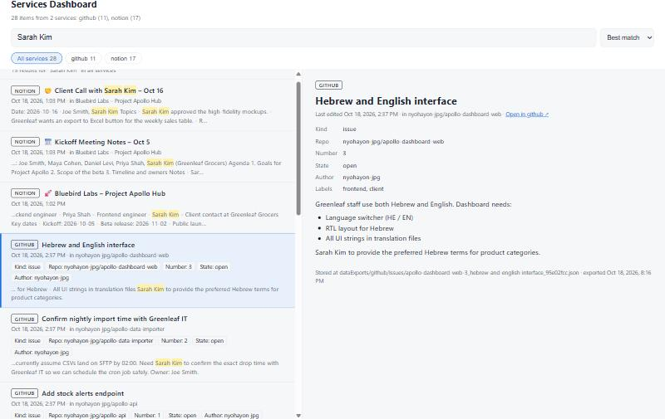
One search across Notion and GitHub
28
items from 2 services
15
results for "Sarah Kim", each tagged with its service
Notes:
Live demo: search Sarah Kim. Results come from Notion meeting notes and GitHub issues together, each labeled with its source. Filter chips narrow to one service, and each result links back to the original item.

Slide 7
No secrets, and easy to extend
✓
Security
+
Adding a service
OAuth tokens live in the OS keychain, managed by Claude Code
GitHub token comes from the GITHUB_PAT environment variable
.gitignore blocks .env, credentials and token files
Only test accounts and fictional data
Add its official MCP server to .mcp.json
Add a section to localStorageFormats.md
Add a download-<service> skill
Save with save_export.py; the dashboard picks it up
Notes:
No password, token or client secret is committed. Each service is self-contained, so a teammate can add their own extra service in four steps without touching Notion or GitHub.

Slide 8
Next: Linear, then the final demo
Sign in to Linear and download its issues · Refresh screenshots with all three services · Record the demo video
Notes:
Remaining work: authorize the Linear MCP server and run the download-linear skill, then update the screenshots and record the demo video.

