Slide 1
COMP 472
Fall 2020
Assignment 1
Experiments with Machine Learning
Victor Soledad
#21297627

Slide 2
Experiments with Machine Learning
Datasets:
32x32 black white images with symbols
Dataset 1, Letters from A to Z
Dataset 2, 10 Greek Letters
Training Data
Dataset 1: 1197 entries
Dataset 2: 7800 entries
Test Data:
Dataset 1: 80 entries
Dataset 2: 520 entries

Slide 3
Dataset Analysis
Training dataset 1 has a balanced amount of labels, averaging between 40-60 entries per label
The second Dataset is not as balanced, some letters have way more entries than others
The second training dataset contains a lot more entries compared to the first one thus will give better results
The more entries the better results, but it also increases process time, clearly visible on the MLP models

Slide 4
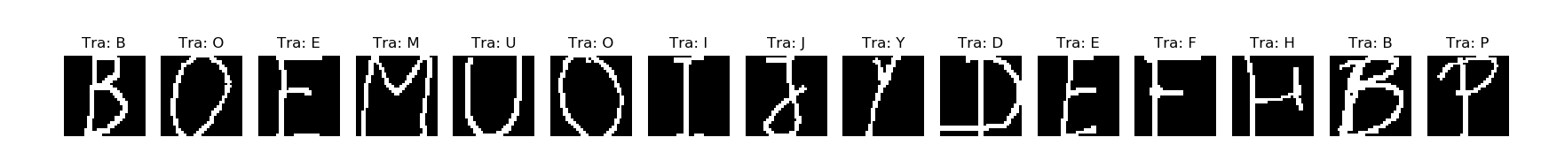
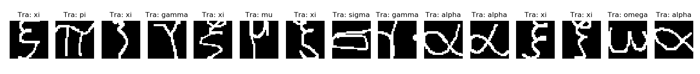
Results Analysis
Training Dataset 1 Example
Training Dataset 2 Example

Slide 5
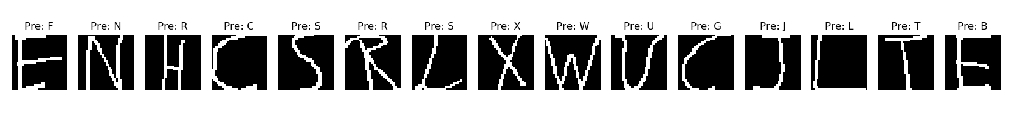
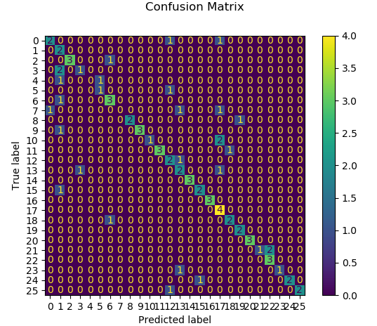
GNB: a Gaussian Naive Bayes Classifier, with default parameter values
Dataset 1 Predictions
Confusion Matrix

Slide 6
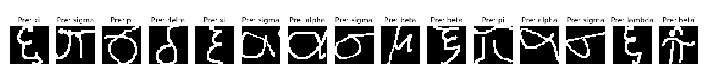
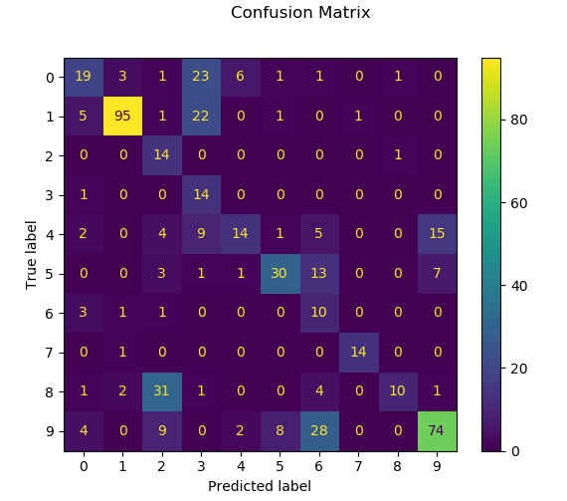
GNB: a Gaussian Naive Bayes Classifier, with default parameter values
Dataset 2 Predictions
Confusion Matrix

Slide 7
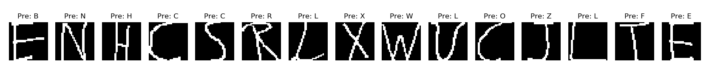
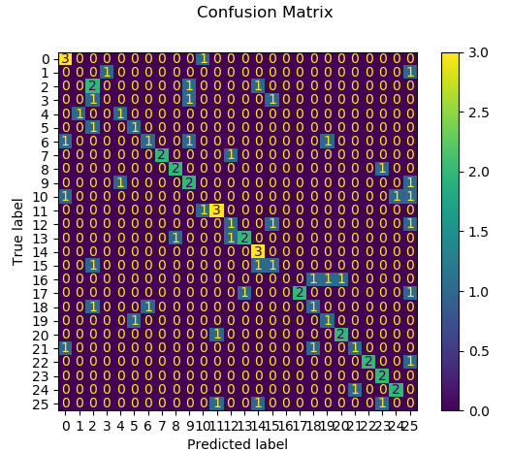
Base-DT: a baseline Decision Tree
Dataset 1 Predictions
Confusion Matrix

Slide 8
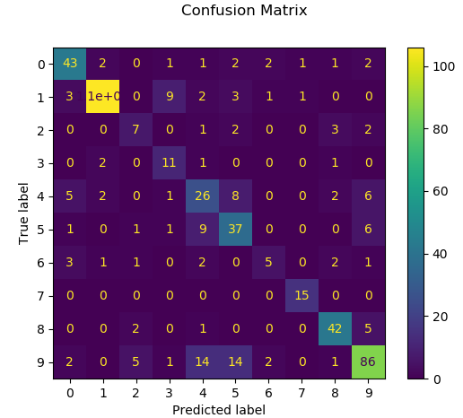
Base-DT: a baseline Decision Tree
Dataset 2 Predictions
Confusion Matrix

Slide 9
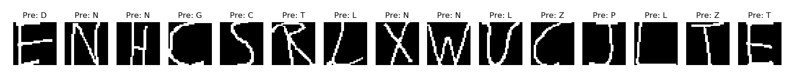
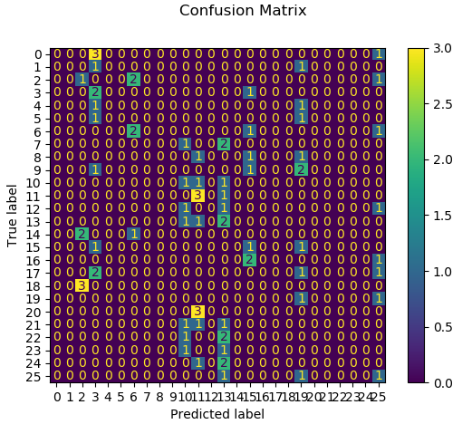
Best-DT: a better performing Decision Tree
Dataset 1 Predictions
Confusion Matrix

Slide 10
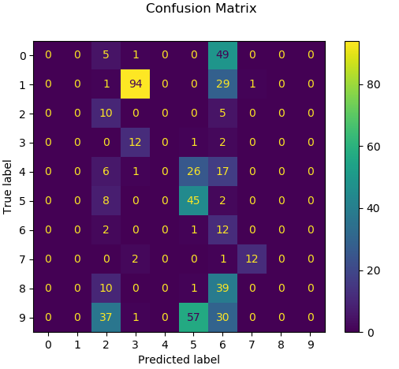
Best-DT: a better performing Decision Tree
Dataset 2 Predictions
Confusion Matrix

Slide 11
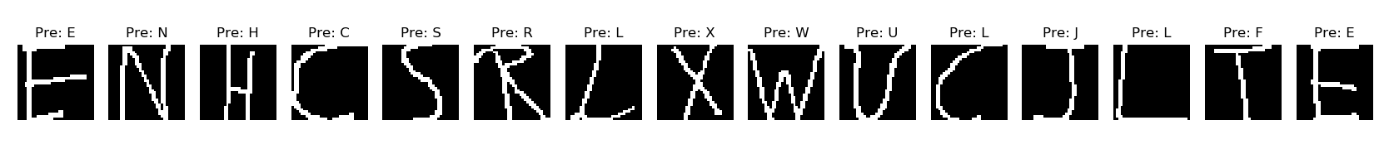
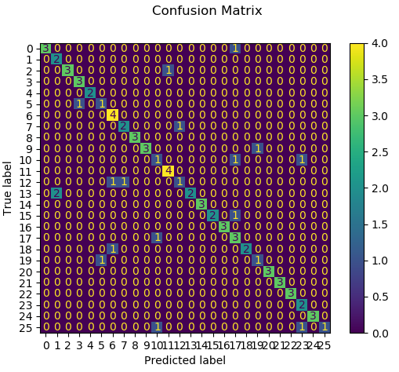
PER: a Perceptron, with default parameter values.
Dataset 1 Predictions
Confusion Matrix

Slide 12
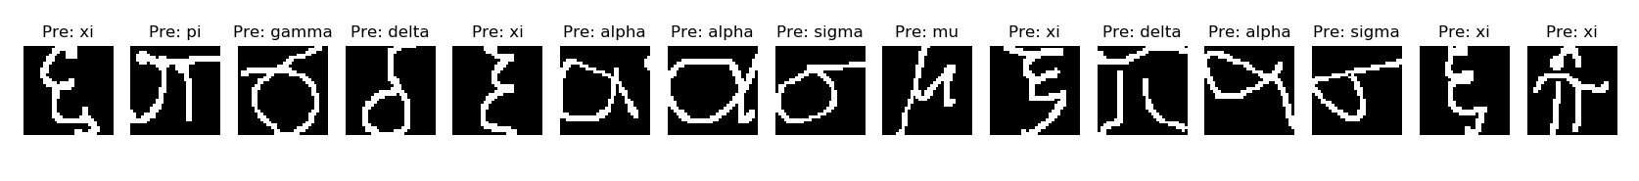
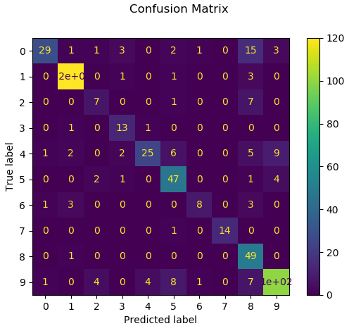
PER: a Perceptron, with default parameter values.
Dataset 2 Predictions
Confusion Matrix

Slide 13
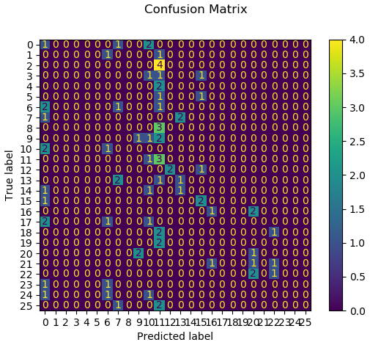
Base-MLP: a baseline Multi-Layered Perceptron
Dataset 1 Predictions
Confusion Matrix

Slide 14
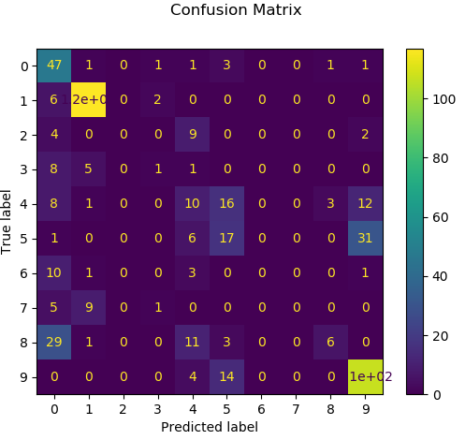
Base-MLP: a baseline Multi-Layered Perceptron
Dataset 2 Predictions
Confusion Matrix

Slide 15
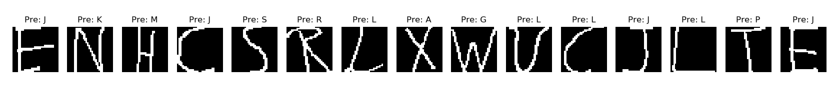
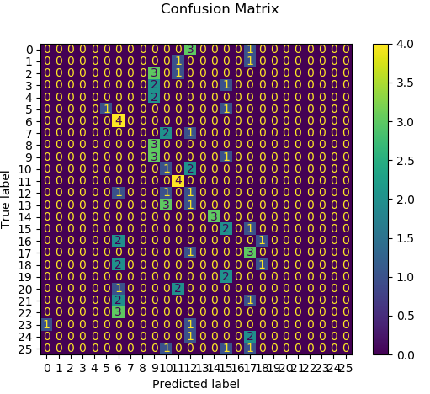
Best-MLP: a better performing Multi-Layered Perceptron
Dataset 1 Predictions
Confusion Matrix

Slide 16
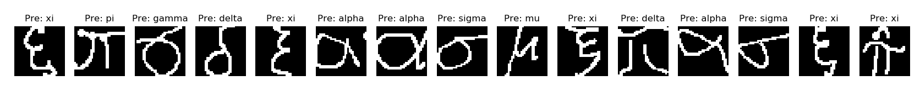
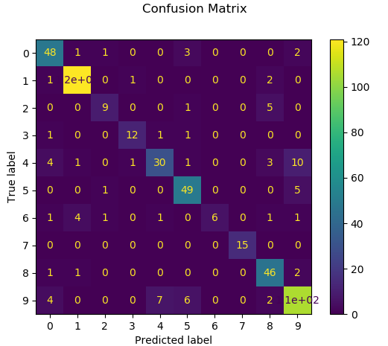
Best-MLP: a better performing Multi-Layered Perceptron
Dataset 2 Predictions
Confusion Matrix

Slide 17
Results Analysis
As seen on the images of the results, the most accurate predictions for the Dataset 1, came from the GNB and the Perceptron models.
GNB accuracy = 0.66
PER accuracy = 0.79
From the GNB model for Dataset 1,
3 letters had perfect f1-score of 1.00
14,O
16,Q
20,U
From the Perceptron model for Dataset 1,
8 letters had perfect f1-score of 1.00
4,E
8,I
14,O
16,Q
20,U
21,V
22,W
24,Y

Slide 18
Results Analysis
The most accurate predictions from the Dataset 2, were the Base-MLP and the Best-MLP. The size of the dataset helped these models perform better overall.
Base-MLP accuracy = 0.73
Best-MLP accuracy = 0.85
From the Base-MLP for Dataset 2,
The highest f1-score was 0.90 for symbol 1,alpha
3 letters had a f1-score of 0
2,beta
6,lambda
7,omega
From the Best-MLP for Dataset 2,
The highest f1-score was 1.00 for symbol 7,omega
The smallest f1-score was 0.57 for symbol 6,lambda
The slowest models were the Base-MLP and the Best-MLP. Most of the time, the models seemed to reach maximum iterations before converging into meaningful labels. But when the dataset size increased the predictions became more accurate.

