Slide 1

CMPT 135
Assignment 5 is due on Wednesday!
Week 14
Templates
Other C++ Features

Slide 2
Function Templates
void swap(int& a, int& b) { int temp = a; a = b; b = temp; }
void swap(string& a, string& b) { string temp = a; a = b; b = temp; }
Swapping values is very useful in sorting. But we need one swap function for each type of value.
But this function only swaps int variables. What if we want to swap strings?
Write another swap function!

Slide 3
Function Templates
void swap(int& a, int& b) { int temp = a; a = b; b = temp; }
void swap(string& a, string& b) { string temp = a; a = b; b = temp; }
Swapping values is very useful in sorting. But we need one swap function for each type of value.
Code for both functions is nearly identical. The only difference is the type name.
Idea Could we also somehow pass the type to the function?

Slide 4
Function Templates
void swap(int& a, int& b) { int temp = a; a = b; b = temp; }
void swap(string& a, string& b) { string temp = a; a = b; b = temp; }
Swapping values is very useful in sorting. But we need one swap function for each type of value.
void swap(T& a, T& b) { T temp = a; a = b; b = temp; }
If we write this then C++ will expect a and b to be of type T, which we have not defined. Somehow we have to say T can be any type.

Slide 5
Function Templates
void swap(int& a, int& b) { int temp = a; a = b; b = temp; }
void swap(string& a, string& b) { string temp = a; a = b; b = temp; }
Swapping values is very useful in sorting. But we need one swap function for each type of value.
Easy to use since C++ will usually automatically infer the type of T when you use swap.
This works! This is a template function that works with almost any type T.
template <typename T>
void swap(T& a, T& b) { T temp = a; a = b; b = temp; }
int x = 4; int y = 7; swap(x, y);
string s = "cow"; string t = "rabbit"; swap(s, t);

Slide 6
Function Templates
void swap(int& a, int& b) { int temp = a; a = b; b = temp; }
void swap(string& a, string& b) { string temp = a; a = b; b = temp; }
Swapping values is very useful in sorting. But we need one swap function for each type of value.
The type of T is inferred at compile-time by the compiler, so this is quite efficient.
Easy to use since C++ will usually automatically infer the type of T when you use swap.
This works! This is a template function that works with almost any type T.
template <typename T>
void swap(T& a, T& b) { T temp = a; a = b; b = temp; }
int x = 4; int y = 7; swap(x, y);
string s = "cow"; string t = "rabbit"; swap(s, t);

Slide 7
Function Templates
void swap(int& a, int& b) { int temp = a; a = b; b = temp; }
void swap(string& a, string& b) { string temp = a; a = b; b = temp; }
Swapping values is very useful in sorting. But we need one swap function for each type of value.
Notice that not every type T will work with swap. What are the constraints on T?
This works! This is a template function that works with almost any type T.
template <typename T>
void swap(T& a, T& b) { T temp = a; a = b; b = temp; }
int x = 4; int y = 7; swap(x, y);
string s = "cow"; string t = "rabbit"; swap(s, t);

Slide 8
Function Templates
void swap(int& a, int& b) { int temp = a; a = b; b = temp; }
void swap(string& a, string& b) { string temp = a; a = b; b = temp; }
Swapping values is very useful in sorting. But we need one swap function for each type of value.
Notice that not every type T will work with swap. What are the constraints on T?
Type T must have operator= defined for it. Otherwise you’ll get a compiler error.
This works! This is a template function that works with almost any type T.
template <typename T>
void swap(T& a, T& b) { T temp = a; a = b; b = temp; }
int x = 4; int y = 7; swap(x, y);
string s = "cow"; string t = "rabbit"; swap(s, t);

Slide 9
Function Templates
template <typename T> T min_of(const T& a, const T& b) { if (a < b) return a; return b; }
This template function returns the smaller of two values of the same type.
What are the constraints on type T?

Slide 10
Function Templates
template <typename T> T min_of(const T& a, const T& b) { if (a < b) return a; return b; }
This template function returns the smaller of two values of the same type.
We don’t know the exact type of a and b, but we do know they are the same type T.
What are the constraints on type T?
Type T must have operator< defined for it.

Slide 11
Function Templates
template <typename T> T min_of(const T& a, const T& b) { if (a < b) return a; return b; }
This template function returns the smaller of two values of the same type.
We don’t know the exact type of a and b, but we do know they are the same type T.
What are the constraints on type T?
Type T must have operator< defined for it.
Type T needs a copy constructor: the return values is a copy of the value being returned.

Slide 12
Function Templates
template <typename T> T min_of(const T& a, const T& b) { if (a < b) return a; return b; }
This template function returns the smaller of two values of the same type.
template<typename T> T min_of(const vector<T>& v) { assert(v.size() > 0); T min = v[0]; for(int i = 1; i < v.size(); i++) { min = min_of(min, v[i]); } return min;
}
You can use template functions to build other template functions.

Slide 13
Function Templates
template <typename T> T min_of(const T& a, const T& b) { if (a < b) return a; return b; }
This template function returns the smaller of two values of the same type.
template<typename T> T min_of(const vector<T>& v) { assert(v.size() > 0); T min = v[0]; for(int i = 1; i < v.size(); i++) { min = min_of(min, v[i]); } return min;
}
vector<int> nums = {2, 7, -5, 0}; cout << min_of(nums); // -5 vector<string> words = {"up", "down", "all"}; cout << min_of(nums); // "all" vector<vector<int>> m = { {4}, {1, 2, 3}, {5, 6}, {2}
}; cout << min_of(m); // {1, 2, 3}
Oops, operator<< not defined.

Slide 14
Function Templates
template <typename T> ostream &operator<<(ostream &os, const vector<T> &v) { os << "{"; for (int i = 0; i < v.size(); i++) { os << v[i]; if (i < v.size() - 1) os << ", "; } os << "}"; return os; }
This template function prints a vector<T>.
What are the constraints on type T?
Type T must have operator<< defined for it.

Slide 15
Class Templates
template <typename T> class Stack { vector<T> v;
public: Stack() : v() { } Stack(const Stack<T>& other) : v(other.v) { } bool is_empty() const { return v.size() == 0; } void push(const T& x) { v.push_back(x); } const T& peek() const { return v.back(); }
T pop() { T top = peek(); v.pop_back(); return top; }
};
C++ also uses templates to create generic contains, like vector<T>.
This is a generic stack container built on top of a vector. It works with almost any type T.
What are the constraints on type T?

Slide 16
Class Templates
template <typename T> class Stack { vector<T> v;
public: Stack() : v() { } Stack(const Stack<T>& other) : v(other.v) { } bool is_empty() const { return v.size() == 0; } void push(const T& x) { v.push_back(x); } const T& peek() const { return v.back(); }
T pop() { T top = peek(); v.pop_back(); return top; }
};
C++ also uses templates to create generic contains, like vector<T>.
This is a generic stack container built on top of a vector. It works with almost any type T.
What are the constraints on type T?
Type T must work with vector<T>, and have a copy constructor.

Slide 17
Class Templates
template <typename T> class Stack { vector<T> v;
public: Stack() : v() { } Stack(const Stack<T>& other) : v(other.v) { } bool is_empty() const { return v.size() == 0; } void push(const T& x) { v.push_back(x); } const T& peek() const { return v.back(); }
T pop() { T top = peek(); v.pop_back(); return top; }
};
template<typename T> void print(Stack<T> s) { if (s.is_empty()) { cout << "empty stack"; } else { while (!s.is_empty()) { T val = s.pop(); cout << val << " "; } } }
You can use class templates containers to make template functions.

Slide 18
Templates
Templates a popular feature of modern C++
Many language features have been added to C++ to better support templates
Template start simple, but they quickly become more complex!
Error messages of templates are notoriously long and difficult to understand
But concepts may help!
Can be used to do almost any computation at compile-time!
Often used for creating general-purpose code libraries

Slide 19
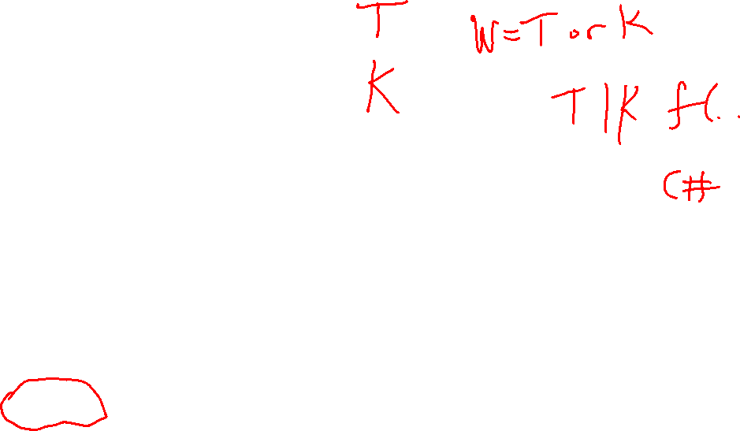
Templates
Templates have other names
Generic programming
Parameterized types
They are a feature in many statically typed languages
E.g. Java and Go initially had no support for templates due to their extra complexity, but added them later
The big win for templates is probably the ability for any programmer to create generic containers
Good example of the balance between complexity and utility: if a feature is useful enough, it might added even though it adds complexity
Languages like Python and JavaScript don’t have generics in the same way that C++ does
They are already “built in” to those languages by virtue of being able to assign different types to the same variable
But Python and JavaScript are not compiled so template errors are usually only caught at run-time
The language Typescript is a superset of JavaScript that adds much more support for types, including templates like those in C++

