Slide 1

CMPT 135
Assignment 3 is due on Wednesday!
Week 9
Exceptions
Recursion

Slide 2
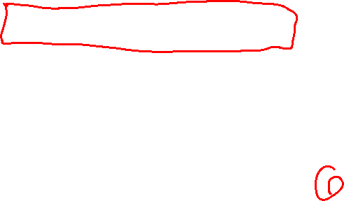
Exceptions
Exceptions are a general-purpose technique for error-handling used in many languages.
void example() { cout << "Hello!\n";
throw std::runtime_error("An error!");
cout << "Goodbye!\n"; }

Slide 3

Exceptions
Exceptions are a general-purpose technique for error-handling used in many languages.
void example() { cout << "Hello!\n";
throw std::runtime_error("An error!");
cout << "Never reached!\n"; }
Exceptions are thrown. A throw immediately stops the function and passes the exception object out of the function up to the calling function.
The second cout statement is never run because the exception caused the flow of control to jump out of the function.
Hello! terminate called after throwing an instance of 'std::runtime_error’
what(): An error! fish: './exceptions' terminated by signal SIGABRT (Abort)
An exception can crash your program. The message in the runtime_error object is printed, which is useful for debugging.

Slide 4
Exceptions
Exceptions are a general-purpose technique for error-handling used in many languages.
void example() { cout << "Hello!\n";
throw std::runtime_error("An error!");
cout << "Never reached!\n"; }
We will use exceptions to signal serious errors at run-time.
Rule of Thumb When you throw an exception there is always the possibility that it might stop the program.
So only throw exceptions for errors that are serious enough to stop the program
Hello! terminate called after throwing an instance of 'std::runtime_error’
what(): An error! fish: './exceptions' terminated by signal SIGABRT (Abort)

Slide 5
Exceptions
Exceptions are a general-purpose technique for error-handling used in many languages.
void example() { cout << "Hello!\n";
throw std::runtime_error("An error!");
cout << "Never reached!\n"; }
C++ pre-defines a few common exception classes. We will stick to just runtime_error, which is a good exception for errors that occur at run time.
Hello! terminate called after throwing an instance of 'std::runtime_error’
what(): An error! fish: './exceptions' terminated by signal SIGABRT (Abort)

Slide 6

Exceptions
Exceptions are a general-purpose technique for error-handling used in many languages.
double invert(double x) { if (x == 0) { throw runtime_error("Cannot invert 0"); } return 1 / x; }
Since 1/0 is mathematically undefined, this throws an exception when x is 0.
The return statement only runs when x is not 0.

Slide 7
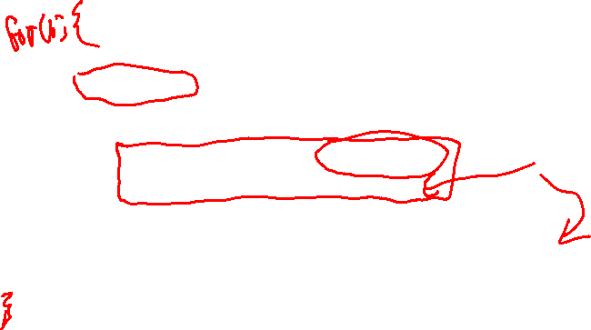
Exceptions
Exceptions are a general-purpose technique for error-handling used in many languages.
double invert(double x) { if (x == 0) { throw runtime_error("Cannot invert 0"); } return 1 / x; }
An exception can be caught using a try/catch block.
void demo() {
cout << "Enter a number: ";
double x;
cin >> x;
try {
double result = invert(x);
cout<< result << "\n\n";
} catch (const runtime_error &e) {
cout << "Error: can't invert 0\n\n";
}
}
If any code in the try part of the block throws a runtime_error, then the program will jump out of the try block and run the code in the catch block.
If the code in the try block runs without an exceptions, then the catch block is skipped.

Slide 8
Exceptions
Exceptions are a general-purpose technique for error-handling used in many languages.
double invert(double x) { if (x == 0) { throw runtime_error("Cannot invert 0"); } return 1 / x; }
Using try/catch blocks you can catch exceptions and handle them in whatever way you like.
void demo() {
cout << "Enter a number: ";
double x;
cin >> x;
try {
double result = invert(x);
cout<< result << "\n\n";
} catch (const runtime_error &e) {
cout << "Error: can't invert 0\n\n";
}
}
E.g. you could print a “nice” error message, or maybe to recover from or fix the error. What to do depends upon the error and the particular situation.

Slide 9
Exceptions
Exceptions are a general-purpose technique for error-handling used in many languages.
try {
some_code();
}
catch (const runtime_error& e)
{
cout << "Error: " << e.what();
}
catch (const bad_alloc& e)
{
cout << "Allocation error: " << e.what();
}
try/catch blocks can have multiple catch parts, one for each kind of exception you want to handle

Slide 10
Exceptions
Exceptions are a general-purpose technique for error-handling used in many languages.
try {
some_code();
}
catch (const runtime_error& e)
{
cout << "Error: " << e.what();
}
catch (const bad_alloc& e)
{
cout << "Allocation error: " << e.what();
} catch (...) { // catches all exceptions cout << "Unknown error"; }
This (…) notation catches any exception. If you use it, it only makes sense to put it as the final catch block.

Slide 11
Exceptions
Exceptions are a general-purpose technique for error-handling used in many languages.
int main() { try {
some_code();
} catch (...) { // catches all exceptions cout << "Unknown error "; } }
You could use catch (...) to handle any error a program throws.

Slide 12
Exceptions
Exceptions are a general-purpose technique for error-handling used in many languages.
. . .
If a function does not catch an exception, then the exception propagates (goes to) the next function on the call stack, giving that function a chance to catch it. If no function catches the exception the program crashes.
d()
c()
b()
a()
Call stack

Slide 13
Exceptions
Exceptions are a general-purpose technique for error-handling used in many languages.
. . .
If d throws an exception and does not catch it. The exception propagates to the next function on the call stack.
If a function does not catch an exception, then the exception propagates (goes to) the next function on the call stack, giving that function a chance to catch it. If no function catches the exception the program crashes.
d()
c()
b()
a()
Call stack

Slide 14
Exceptions
Exceptions are a general-purpose technique for error-handling used in many languages.
. . .
If d throws an exception and does not catch it. The exception propagates to the next function on the call stack.
If a function does not catch an exception, then the exception propagates (goes to) the next function on the call stack, giving that function a chance to catch it. If no function catches the exception the program crashes.
d()
c()
The exception keeps being passed to the next function on the call stack until it is caught.
b()
a()
Call stack

Slide 15
Exceptions
Exceptions are a general-purpose technique for error-handling used in many languages.
. . .
If d throws an exception and does not catch it. The exception propagates to the next function on the call stack.
If a function does not catch an exception, then the exception propagates (goes to) the next function on the call stack, giving that function a chance to catch it. If no function catches the exception the program crashes.
d()
c()
The exception keeps being passed to the next function on the call stack until it is caught.
b()
a()
Call stack

Slide 16
Exceptions
Exceptions are a general-purpose technique for error-handling used in many languages.
. . .
If d throws an exception and does not catch it. The exception propagates to the next function on the call stack.
If a function does not catch an exception, then the exception propagates (goes to) the next function on the call stack, giving that function a chance to catch it. If no function catches the exception the program crashes.
d()
c()
The exception keeps being passed to the next function on the call stack until it is caught.
b()
If the exception is not caught, then the program crashes.
a()
Call stack

Slide 17
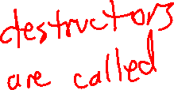
Exceptions
Exceptions are a general-purpose technique for error-handling used in many languages.
. . .
If d throws an exception and does not catch it. The exception propagates to the next function on the call stack.
If a function does not catch an exception, then the exception propagates (goes to) the next function on the call stack, giving that function a chance to catch it. If no function catches the exception the program crashes.
d()
c()
The exception keeps being passed to the next function on the call stack until it is caught.
b()
If the exception is not caught, then the program crashes.
a()
Call stack
program crashes

Slide 18
Exceptions
Exceptions are a general-purpose technique for error-handling used in many languages.
void memory_leak()
{
int *arr = new int[10];
throw runtime_error(“error!");
delete[] arr;
}
Exceptions can cause memory leaks! When the runtime_error is thrown here there delete[] is never called, and so the array has “leaked”.

Slide 19
Exceptions
Exceptions are a general-purpose technique for error-handling used in many languages.
void memory_leak()
{
int *arr = new int[10];
throw runtime_error(“error!");
delete[] arr;
}
Exceptions can cause memory leaks! When the runtime_error is thrown here there delete[] is never called, and so the array has “leaked”.
struct my_array {
int *arr;
my_array(int size) {
arr = new int[size];
}
~my_array() {
delete[] arr;
}
};
A good way to avoid this problem is to avoid raw arrays, and instead use a class that does allocation in the constructor and de-allocation in the destructor …

Slide 20
Exceptions
Exceptions are a general-purpose technique for error-handling used in many languages.
struct my_array {
int *arr;
my_array(int size) {
arr = new int[size];
}
~my_array() {
delete[] arr;
}
};
void works_well()
{
my_arr arr(10);
throw runtime_error("error!");
cout << "never reached“;
}
No memory leak!
This is because destructors are called when exceptions are thrown. When the runtime_error goes out of the function, the destructor for arr is automatically called. So no memory leak.

Slide 21
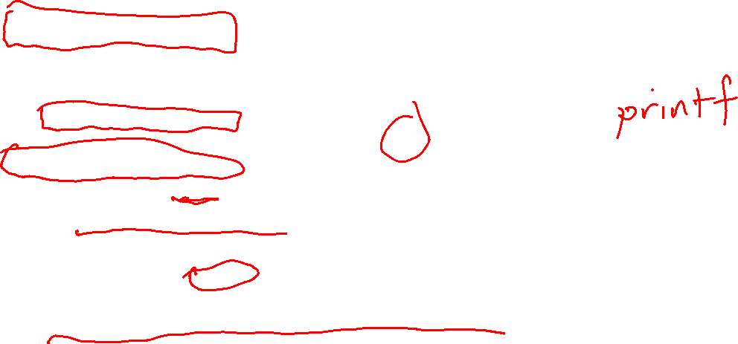
Other ways to handle errors
Use global variable flags
A function sets a flag to an error value when it recognized an error has occurred
Then the function returns
The error is handled only if the programmer checks the error flag
Many C functions do this
Easy to ignore, or not even know about, e.g. cout can set error bits
Extra error return value
Functions in the Go language can return more than one value, e.g. f, err = Open_file(fname)
If an errors occurs when opening the file, an error code is returned in err
If no error occurs, err is nil (i.e. the nullptr)
Harder for programmers to ignore errors
Error-handling code and non-error-handling code gets intermixed, which can clutter programs

Slide 22
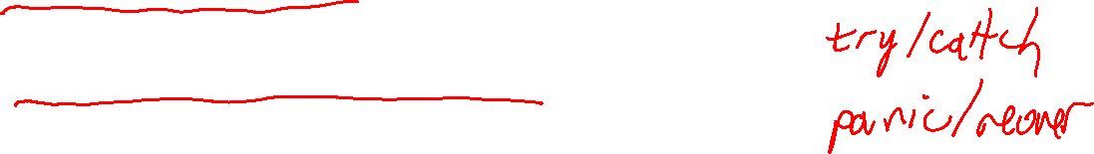
Notes on Error Handling
Dealing with errors is an important part of any real-world program
A non-trivial % of the code of real-world programs is about error handling
There is no one best way to deal with errors
Some errors are more serious than others
an “out of memory” is more serious than a “file name not found”
you might be able to recover from some errors, not others
Some errors are obvious, some not
syntax errors are mostly caught by the compiler
some “errors” may be a matter of opinion, e.g. some programmers might think it is almost always an error to use printf in C++

Slide 23
No Slides
There is no PowerPoint presentation for this lecture!
The class was done by running code in the file recursion.cpp and using hand-written notes during the class.

Slide 24
No Slides
There is no PowerPoint presentation for this lecture!
The class was done by running code in the file recursion.cpp and using hand-written notes during the class.

