Slide 1

CMPT 135
Remember to finish the weekly quiz!
Start assignment 2
Week 4
Pointers and memory management
Introduction to object-oriented programming

Slide 2
Example 3: filtering an array
0
1
2
3
Write a function that takes an int* to an array as input, and returns a pointer to a newly created array that is the same as the original, but all negative ints are removed.
Name the function remove_negatives. It returns an int* to the new array. You write the inputs for it!
a
-1
0
-3
2
after calling int* p = remove_negatives(???)
0
1
2
3
a
-1
0
-3
2
0
1
Constraint: don’t use a struct or class in your answer!
p
0
2

Slide 3
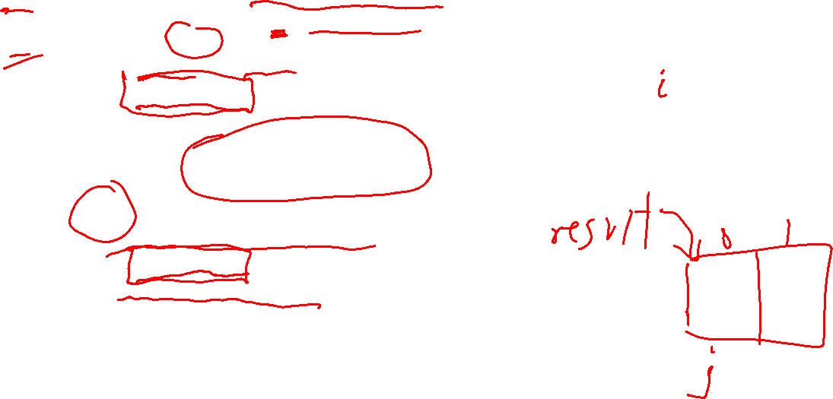
Example 3: filtering an array
int* remove_negatives(int* arr, int size,
int& result_size)
{ result_size = 0;
for (int i = 0; i < size; i++) {
if (arr[i] >= 0) result_size++;
}
int* result = new int[result_size];
int j = 0;
for (int i = 0; i < size; i++) {
if (arr[i] >= 0) {
result[j] = arr[i];
j++;
}
}
return result;
}
0
1
2
3
a
-1
0
-3
2
count # positive ints
after calling int* p = remove_negatives(???)
make new array
copy just positive ints into new array

Slide 4
Example 3: filtering an array
int* remove_negatives(int* arr, int size,
int& result_size)
{ result_size = 0;
for (int i = 0; i < size; i++) {
if (arr[i] >= 0) result_size++;
}
int* result = new int[result_size];
int j = 0;
for (int i = 0; i < size; i++) {
if (arr[i] >= 0) {
result[j] = arr[i];
j++;
}
}
return result;
}
0
1
2
3
a
-1
0
-3
2
count # positive ints
after calling int* p = remove_negatives(???)
make new array
0
1
copy just positive ints into new array
p
0
2
The array length is returned in the result_size parameter.
array a is still there, unchanged

Slide 5
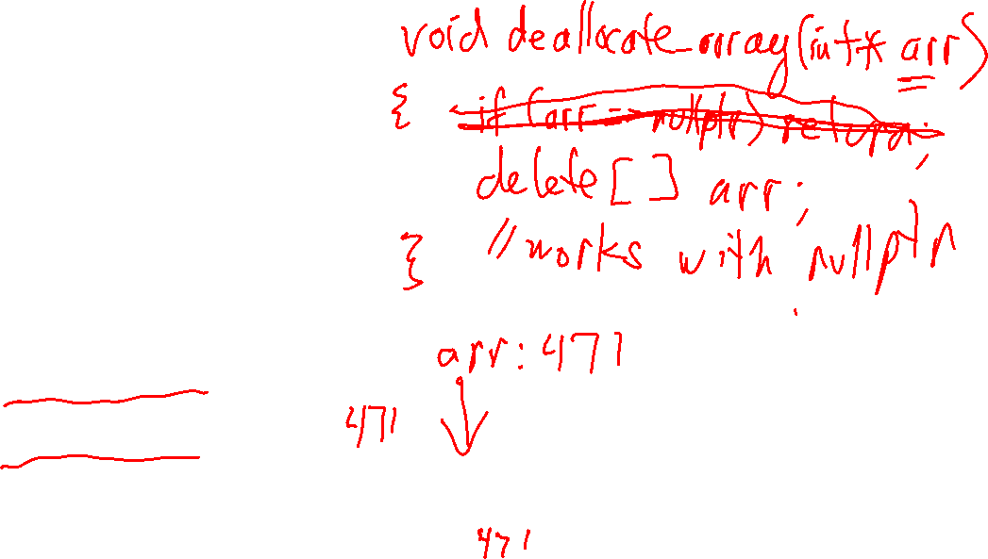
Example 4: a function to de-allocate an array
Let’s write a function that will make it easier to initialize arrays of ints on the free store. We want to write code like this:
int* a = make_array(4, 3);
int* b = make_array(3);
// ...
deallocate_array(a); deallocate_array(b);
0
1
2
3
a
3
3
3
3
0
1
2
b
0
0
0

Slide 6

Example 4: a function to de-allocate an array
void deallocate_array(int* arr)
{
delete[] arr;
}
Let’s write a function that will make it easier to initialize arrays of ints on the free store. We want to write code like this:
int* a = make_array(4, 3);
int* b = make_array(3);
// ...
deallocate_array(a); deallocate_array(b);
This function isn’t very useful. It doesn’t help with common errors:
can forget to call it, so memory leaks are possible
can call it twice, so double deletion errors are possible
the pointer you pass into it becomes a dangling pointer
can pass it a non-array pointer
0
1
2
3
a
3
3
3
3
0
1
2
b
0
0
0

Slide 7
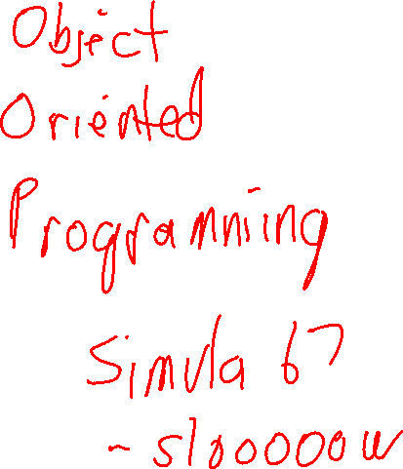
Common pointer problems
Pointer addresses are unpredictable
Dangling pointers 1
Dangling pointers 2
Memory leaks
Double deletion 1
Double deletion 2
Passing pointers to functions

Slide 8

Common pointer problems
void f()
{
int n = 25;
int* p = &n;
cout << p
<< "\n";
}
Every time you call f it prints a different value. In general, there’s no predicting where in memory p is stored!
Pointer addresses are unpredictable
Dangling pointers 1
Dangling pointers 2
Memory leaks
Double deletion 1
Double deletion 2
Passing pointers to functions

Slide 9
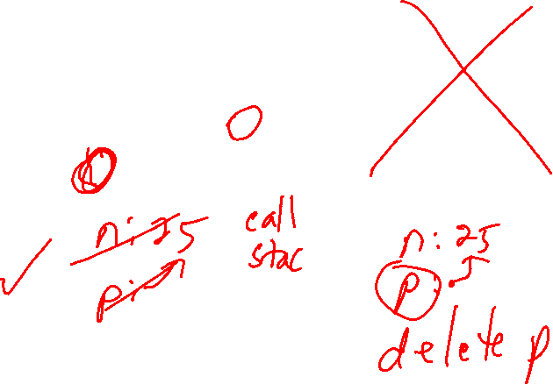
Common pointer problems
Question
Is function f correct, or is function g correct?
void f()
{
int n = 25;
int* p = &n;
cout << p
<< "\n";
}
void g()
{
int n = 25;
int* p = &n;
cout << p
<< "\n";
delete p;
}
Pointer addresses are unpredictable
Dangling pointers 1
Dangling pointers 2
Memory leaks
Double deletion 1
Double deletion 2
Passing pointers to functions

Slide 10
Common pointer problems
Question
Is function f correct, or is function g correct?
void f()
{
int n = 25;
int* p = &n;
cout << p
<< "\n";
}
void g()
{
int n = 25;
int* p = &n;
cout << p
<< "\n";
delete p;
}
Pointer addresses are unpredictable
Dangling pointers 1
Dangling pointers 2
Memory leaks
Double deletion 1
Double deletion 2
Passing pointers to functions
Answer
f() is correct, and g() has a serious error: p was not declared on the free store with new, so you should not call delete on it.

Slide 11
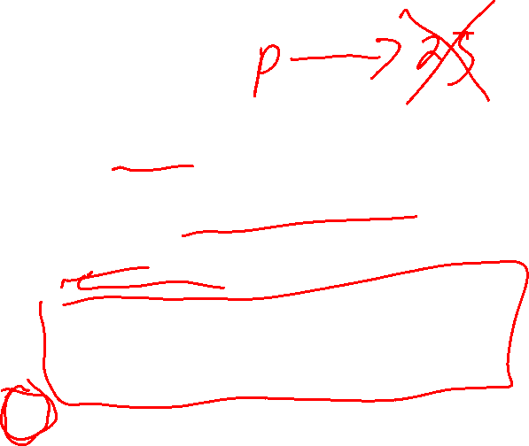
Common pointer problems
void f() {
int* p = new int(25);
// ... do things with p ...
delete p;
*p = 42; // oops: dangling pointer
cout << "*p: " << *p;
}
Pointer addresses are unpredictable
Dangling pointers 1
Dangling pointers 2
Memory leaks
Double deletion 1
Double deletion 2
Passing pointers to functions
A dangling pointer is a pointer that points to an invalid memory location.

Slide 12
Common pointer problems
void f() {
int* p = new int(25);
// ... do things with p ...
delete p;
*p = 42; // oops: dangling pointer
cout << "*p: " << *p;
}
Pointer addresses are unpredictable
Dangling pointers 1
Dangling pointers 2
Memory leaks
Double deletion 1
Double deletion 2
Passing pointers to functions
A dangling pointer is a pointer that points to an invalid memory location.
After delete p, the address in p is the same, but now that address does not refer to valid memory. Using *p in any way is an error!

Slide 13

Common pointer problems
string* exclaim_bug(const string& s) {
string result = s + "!";
return &result;
}
void f() {
string* p = exclaim_bug("hello");
cout << *p << "\n";
}
Pointer addresses are unpredictable
Dangling pointers 1
Dangling pointers 2
Memory leaks
Double deletion 1
Double deletion 2
Passing pointers to functions
A dangling pointer is a pointer that points to an invalid memory location.
exclaim_bug returns a pointer to a local variable. But when exclaim_bug ends, its local variables are de-allocated, so the pointer is invalid.

Slide 14
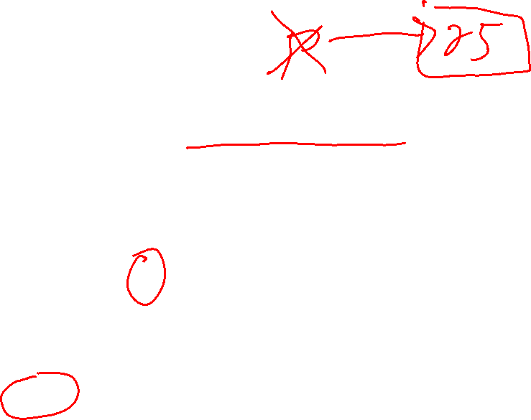
Common pointer problems
void f() {
int* p = new int(25);
cout << " p: " << p << "\n";
cout << "*p: " << *p << "\n";
// error: forgot to de-allocate p!
}
Pointer addresses are unpredictable
Dangling pointers 1
Dangling pointers 2
Memory leaks
Double deletion 1
Double deletion 2
Passing pointers to functions
A memory leak occurs when you no longer need some memory on the free store but don’t de-allocate it.
In practice, memory leaks can be difficult to find and fix.
If your program runs out of memory due to a memory leak, then a call to new is likely what causes the crash. But the error is not due to new. The error is that you are missing a delete.
Run your program with valgrind to see if it has any memory leaks.

Slide 15

Common pointer problems
void f() {
int* p = new int(25);
// ...
delete p; // ok
// ...
delete p; // error!
}
Pointer addresses are unpredictable
Dangling pointers 1
Dangling pointers 2
Memory leaks
Double deletion 1
Double deletion 2
Passing pointers to functions
Double deletion is when you delete a memory location more than once. It’s a kind of dangling pointer problem.

Slide 16
Common pointer problems
void f() {
int* p = new int(25);
// ...
delete p; // ok
// ...
delete p; // error!
}
Pointer addresses are unpredictable
Dangling pointers 1
Dangling pointers 2
Memory leaks
Double deletion 1
Double deletion 2
Passing pointers to functions
After the first delete, p is a dangling pointer. You can’t de-reference or use dangling pointers. So, the second delete p is an error.
Double deletion is when you delete a memory location more than once. It’s a kind of dangling pointer problem.

Slide 17
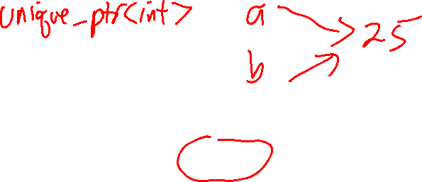
Common pointer problems
void f() {
int* a = new int(25);
int* b = a;
// ...
delete a; // ok
// ...
delete b; // error: b points to } // invalid memory
Pointer addresses are unpredictable
Dangling pointers 1
Dangling pointers 2
Memory leaks
Double deletion 1
Double deletion 2
Passing pointers to functions
Double deletion is when you delete a memory location more than once. It’s a kind of dangling pointer problem.

Slide 18
Common pointer problems
double g(double a);
double h(double& b);
a is passed by value, i.e. g gets a copy of the value in a.
Pointer addresses are unpredictable
Dangling pointers 1
Dangling pointers 2
Memory leaks
Double deletion 1
Double deletion 2
Passing pointers to functions
Pass-by-reference can be faster than pass-by-value, since no copy need be made.
b is passed by reference: h gets access to the actual value in b. So, h can change the value of b.
void h(double& b){
b = 2.0;
}
Using pointers, you can simulate pass-by-reference!
Note that you cannot call h(3.14) because h might assign a value to b, and you cannot assign a value to 3.14.
Notes:
It’s useful to trace through calling h(b) both when b is passed by reference and passed by value. Doing it side-by-side helps make the difference clearer.

Slide 19
Common pointer problems
Question Can we write a function to swap the values of two variables?
int x = 4; int y = 1; swap(x, y);
// now x == 1, y == 4
Pointer addresses are unpredictable
Dangling pointers 1
Dangling pointers 2
Memory leaks
Double deletion 1
Double deletion 2
Passing pointers to functions
Using pointers, you can simulate pass-by-reference!

Slide 20
Common pointer problems
Question Can we write a function to swap the values of two variables?
int x = 4; int y = 1; swap1_bad(x, y);
// now x == 1, y == 4
Pointer addresses are unpredictable
Dangling pointers 1
Dangling pointers 2
Memory leaks
Double deletion 1
Double deletion 2
Passing pointers to functions
void swap1_bad(int a, int b) {
int temp = a;
a = b;
b = temp;
}
Trace this code step-by-step with the example in the blue box to see what it does.
Using pointers, you can simulate pass-by-reference!

Slide 21
Common pointer problems
Question Can we write a function to swap the values of two variables?
int x = 4; int y = 1; swap2(x, y);
// now x == 1, y == 4
Pointer addresses are unpredictable
Dangling pointers 1
Dangling pointers 2
Memory leaks
Double deletion 1
Double deletion 2
Passing pointers to functions
void swap2(int& a, int& b) {
int temp = a;
a = b;
b = temp;
}
Trace this code step-by-step with the example in the blue box to see what it does.
Using pointers, you can simulate pass-by-reference!

Slide 22
Common pointer problems
Question Can we write a function to swap the values of two variables?
int x = 4; int y = 1; swap3(x, y);
// now x == 1, y == 4
Pointer addresses are unpredictable
Dangling pointers 1
Dangling pointers 2
Memory leaks
Double deletion 1
Double deletion 2
Passing pointers to functions
void swap3(int* a, int* b) { int temp = *a; *a = *b;
*b = temp;
}
Trace this code step-by-step with the example in the blue box to see what it does.
Does not compile with this code! x and y are type int, but swap3 takes values of type int*
Using pointers, you can simulate pass-by-reference!

Slide 23
Common pointer problems
Question Can we write a function to swap the values of two variables?
int x = 4; int y = 1; swap3(&x, &y);
// now x == 1, y == 4
Pointer addresses are unpredictable
Dangling pointers 1
Dangling pointers 2
Memory leaks
Double deletion 1
Double deletion 2
Passing pointers to functions
void swap3(int* a, int* b) { int temp = *a; *a = *b;
*b = temp;
}
Trace this code step-by-step with the example in the blue box to see what it does.
Using pointers, you can simulate pass-by-reference!
Rule of thumb
In C++, prefer pass-by-reference using & instead of pointers.

Slide 24
Object-oriented programming (OOP)
A popular style of programming
Can work well with anything where this is some kind of identifiable object
Things in a video game, e.g. characters, projectiles, explosions, backgrounds
Graphical user interface (GUI), e.g. windows, scroll bars, the mouse pointer, icons, etc. can all be modelled as objects
Data type, e.g. strings, big integers, lists, trees, tables, functions, etc. can all be modelled as objects
Data and operations are combined into a single value called an object

Slide 25
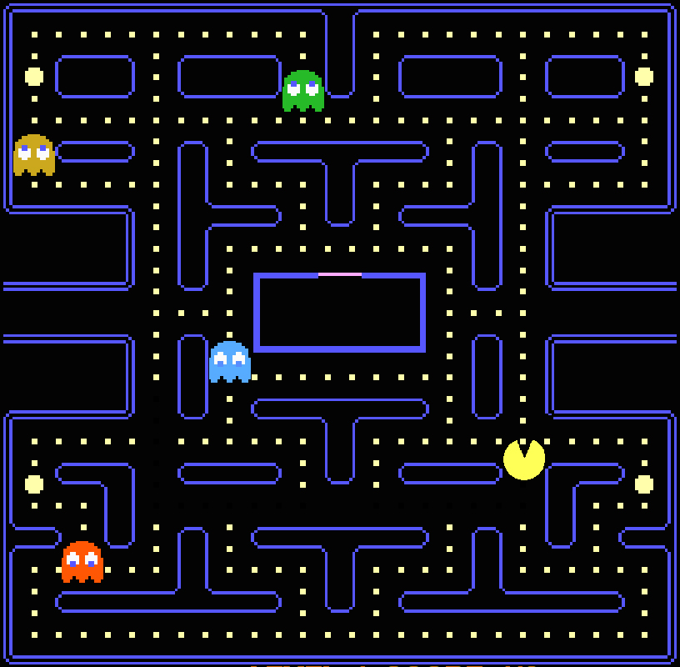
Object-oriented programming (OOP)
Suppose you had to program your own version of Pac Man in an object-oriented style. What classes and objects would you make?

Slide 26
Object-oriented programming (OOP)
Suppose you had to program your own version of Pac Man in an object-oriented style. What classes and objects would you make?
Pac man
the “ghosts”
the small pellets
the power pellets
Walls in the maze

Slide 27
Object-oriented programming (OOP)
Suppose you had to program your own version of Pac Man in an object-oriented style. What classes and objects would you make?
Pac man
the “ghosts”
the small pellets
the power pellets
Walls in the maze
The contents of an object are specific by a class
E.g. one class called Small_Pellet, and then each individual pellet you see is an instance of Small_Pellet

Slide 28
Object-oriented programming (OOP)
Suppose you had to program your own version of Pac Man in an object-oriented style. What classes and objects would you make?
Pac man
the “ghosts”
the small pellets
the power pellets
Walls in the maze
The contents of an object are specific by a class
E.g. one class called Small_Pellet, and then each individual pellet you see is an instance of Small_Pellet
This is a not a definitive list! Different programmers might choose different classes/objects. For example, since there is only one Pac Man, they might not bother making a Pac_Man class.

Slide 29
Object-oriented programming (OOP)
;
; COLLISION CHECK
;
COLCHK LDX #0
LDY #1
COLLLP LDA M1STAT,X
ASL A
BMI NXCOLL
TYA
BIT M1PL
BEQ NXCOLL
.
.
.
The original Pac Man was implemented in assembly language: https://github.com/DillonDepeel/Pacman-Source-Code
Assembly language is very low-level, specific to the CPU being used. It does not directly support object-oriented programming.
So object-oriented programming is a choice. It may be a good way to implement a program, but it is never the only way.

Slide 30
Object-oriented programming (OOP): Array Example
C++ arrays: the Good
C++ arrays: the Bad

Slide 31
Object-oriented programming (OOP): Array Example
C++ arrays: the Good
C++ arrays: the Bad
Efficient. arr[i] is fast for any length of array
No wasted memory. Just the values in the array and nothing else
Built-in support. The compiler knows about arrays
Work well with pointers.

Slide 32
Object-oriented programming (OOP): Array Example
C++ arrays: the Good
C++ arrays: the Bad
Efficient. arr[i] is fast for any length of array
No wasted memory. Just the values in the array and nothing else
Built-in support. The compiler knows about arrays.
Work well with pointers.
Arrays don’t know their length. Programmer must track it manually.
Fixed size. Can’t get smaller or bigger.
Error prone. Pointer or indexing errors are common.
Free store problems. Correctly allocating/de-allocating is tricky.

Slide 33
Object-oriented programming (OOP): Array Example
struct intarray
{
int* arr;
int size;
};
a
Since we almost always want the array and its size to go together, let's put them in the same object using a struct.
0
1
2
3
arr
2
2
1
4
intarray a{new int[4], 4};
a.arr[0] = 2;
a.arr[1] = 2;
a.arr[2] = 1;
a.arr[3] = 4;
size
4

Slide 34
Object-oriented programming (OOP): Array Example
struct intarray
{
int* arr;
int size;
};
We can write “make” functions that return a new intarray object (not a pointer to an intarray, but a regular intarray).
intarray make_intarray(int n)
{
assert(n >= 0);
intarray result;
result.arr = new int[n];
result.size = n;
// set all the array elements to 0
for (int i = 0; i < result.size; i++)
{
result.arr[i] = 0;
}
return result;
}
a
0
1
2
3
arr
2
2
1
4
size
4
intarray a = make_intarray(4);
a.arr[0] = 2;
a.arr[1] = 2;
a.arr[2] = 1;
a.arr[3] = 4;

Slide 35
Object-oriented programming (OOP): Array Example
struct intarray
{
int* arr;
int size;
};
Note that we pass in a single object, the intarray. It gives us both the array pointer and size.
a
0
1
2
3
void print(intarray a) {
if (a.size == 0) {
cout << "{}";
} else {
cout << "{" << a.arr[0];
for (int i = 1; i < a.size; i++) {
cout << ", " << a.arr[i];
}
cout << "}";
}
}
arr
2
2
1
4
size
4
note that the loop starts at i=1

Slide 36
Object-oriented programming (OOP): Array Example
struct intarray
{
int* arr;
int size;
};
int sum(intarray a)
{
int total = 0;
for (int i = 0; i < a.size; i++)
{
total += a.arr[i];
}
return total;
}
a
0
1
2
3
arr
2
2
1
4
size
4
Challenge
Write a function called sort(a) that uses std::sort to sort the elements of intarray a into ascending order.

Slide 37
Object-oriented programming (OOP): Array Example
struct intarray
{
int* arr;
int size;
};
Challenge
Write a function called sort(a) that uses std::sort to sort the elements of intarray a into ascending order.
a
0
1
2
3
arr
2
2
1
4
#include <algorithm> // for std::sort
size
4

Slide 38
Object-oriented programming (OOP): Array Example
struct intarray
{
int* arr;
int size;
};
Challenge
Write a function called sort(a) that uses std::sort to sort the elements of intarray a into ascending order.
a
0
1
2
3
arr
2
2
1
4
#include <algorithm> // for std::sort
void sort(intarray a)
{
std::sort(a.arr, a.arr + a.size);
}
size
4
Perhaps surprisingly, this function works. The intarray a is passed-by-value, i.e. a copy is made, so it might seem like it shouldn’t work …

Slide 39
Object-oriented programming (OOP): Array Example
struct intarray
{
int* arr;
int size;
};
#include <algorithm> // for std::sort
void sort(intarray a)
{
std::sort(a.arr, a.arr + a.size);
}
lst
0
1
2
3
intarray lst = make_intarray(5);
lst.arr[0] = 2;
lst.arr[1] = 2;
lst.arr[2] = 1;
lst.arr[3] = 4;
sort(lst);
arr
2
2
1
4
size
4
a
arr
When lst is passed by value to sort, the struct is copied, but the underlying array that arr points to is not copied.
sort(lst) only changes the underlying array, so passing lst by value works.
size
4

Slide 40
Object-oriented programming (OOP): Array Example
struct intarray
{
int* arr;
int size;
};
What about de-allocating an intarray when we are done with it? We could manually call delete[] on arr, but that’s error-prone and hard to do correctly every time.
0
1
2
3
arr
2
2
1
4
size
{
intarray lst;
// … use lst …
// done: lst.arr can be de-allocated }
Many uses of an intarray follow the pattern in this code. When the final } is reached, then lst is automatically de-allocated (since it is local and on the call-stack), but the underlying array is not de-allocated … a memory leak!
4

Slide 41
Object-oriented programming (OOP): Array Example
struct intarray
{
int* arr;
int size;
};
0
1
2
3
arr
2
2
1
4
How can we automatically delete the underlying array at the same time lst is de-allocated?
size
{
intarray lst;
// … use lst …
// done: lst.arr can be de-allocated }
Many uses of an intarray follow the pattern in this code. When the final } is reached, then lst is automatically de-allocated (since it is local and on the call-stack), but the underlying array is not de-allocated … a memory leak!
4

Slide 42
OOP: Object-oriented Programming
intarray works pretty well!
So why not add features that specifically support this style of programming?
That’s part of the idea of C++: it add object-oriented programming features to C
Plus other features, like references and exceptions
There’s a bunch of OPP terminology and features to learn

Slide 43
Object-oriented programming: ovbjects and classes
Objects
Classes (aka structs)
Exist at run-time.
Don’t exist at compile-time.
Are values typically composed of many smaller values.
Must be allocated and de-allocated.
Have the type of their class.
Exist at compile-time.
Don’t exist at run-time in C++ (at least the way we’re using them)
Are like blue-prints for creating an object.
Classes are the types for the objects they describe.

Slide 44
Object-oriented programming: ovbjects and classes
Objects exist at run-time
Classes (aka structs) exist at compile-time
{ string s = "cat"; s[0] = 'b';
cout << s.size(); }
class string { char* data; size_t size;
// … public:
size_t size() const { return size; } // … };

Slide 45
Object-oriented programming: ovbjects and classes
Objects exist at run-time
Classes (aka structs) exist at compile-time
A string is usually (but not always!) implemented as an array of characters on the free store.
{ string s = "cat"; s[0] = 'b';
cout << s.size(); }
class string { char* data; size_t size;
// … public:
size_t size() const { return size; } // … };
When the variable s goes out of scope, it is automatically popped from the call stack, and the string object will automatically de-allocate the underlying char array.
A class says what variables and functions the object has.

Slide 46
Object-oriented programming: methods
struct Person { string name; int age;
};
name and age are variables that will appear in every Person object. We call them member variables, or properties.
Each Person object gets its own personal copy of name and age.
Person
Person bob{"Robert", 25}; cout << bob.name; // Robert cout << bob.age; // 25
Person zoe{"Zoey", 41}; cout << zoe.name; // Zoey cout << zoe.age; // 41
name: Bob age: 14
bob
Person
zoe
name: Zoey age: 25

Slide 47
Object-oriented programming: methods
struct Person { string name; int age;
string to_string() {
return name + " " +
std::to_string(age);
}
};
A function that appears in a struct is called a method of that struct. to_string is a method of Person.
Methods can access the member variables of the struct without any special notation.
Together, the member variables and methods are called Person’s members.
We must use std::to_string to avoid the method calling itself!

Slide 48
Object-oriented programming: methods
struct Person { string name; int age;
string to_string() {
return name + " " +
std::to_string(age);
}
};
Key idea: objects combine data, and operations on that data, into a single “value”.
Person bob{"Robert", 25}; cout << bob.name; // Robert cout << bob.age; // 25
cout << bob.to_string(); // Robert 25
Object methods are called using the dot-notation, just like variables.

Slide 49
Object-oriented programming: structs vs classes
struct (public by default)
class (private by default)
struct Person { string name; int age;
string to_string() {
return name + " " +
std::to_string(age);
}
};
class Person { public: string name; int age;
string to_string() {
return name + " " +
std::to_string(age);
}
};
The difference between a struct and a class is:
by default, all members of a struct are public
by default, all members of a class are private

Slide 50
Object-oriented programming: structs vs classes
struct (public by default)
class (private by default)
struct Person { string name; int age;
string to_string() {
return name + " " +
std::to_string(age);
}
};
class Person { public: string name; int age;
string to_string() {
return name + " " +
std::to_string(age);
}
};
The difference between a struct and a class is:
by default, all members of a struct are public
by default, all members of a class are private

Slide 51
Object-oriented programming: public vs private
struct Person { private: string name; int age;
public:
string to_string() {
return name + " " +
std::to_string(age);
}
};
struct Person { string name; int age;
string to_string() {
return name + " " +
std::to_string(age);
}
};
Person bob{"Robert", 25}; cout << bob.name; // Robert cout << bob.age; // 25
cout << bob.to_string(); // Robert 25
Person bob{"Robert", 25}; cout << bob.name; // compiler error! cout << bob.age; // compiler error!
cout << bob.to_string(); // Robert 25

Slide 52
Object-oriented programming: dates
Let’s look at a class called Date that represents a date as (day, month, year)
1 <= day <= 31
1 <= month <= 12
0 <= year (an int)
For example, February 15, 2034 is (15, 2, 2024)
class Date {
public:
int day; int month; int year;
};
We use a class here just to show that you can. In OOP, many programmers prefer to use class since it signals they are using OOP.

Slide 53
Object-oriented programming: members
class Date {
public:
int day; int month; int year; void print() const {
cout << "(" << day
<< ", " << month
<< ", " << year
<< ")";
} void println() const {
print();
cout << "\n";
}
};
Let’s look at a class called Date that represents a date as (day, month, year)
1 <= day <= 31
1 <= month <= 12
0 <= year (an int)
For example, February 15, 2024 is (15, 2, 2024)
day, month, and year are public member variables
print() and println() are public const methods

Slide 54
Object-oriented programming: const methods
class Date {
public:
int day; int month; int year; void print() const {
cout << "(" << day
<< ", " << month
<< ", " << year
<< ")";
} void println() const {
print();
cout << "\n";
}
};
Let’s look at a class called Date that represents a date as (day, month, year)
1 <= day <= 31
1 <= month <= 12
0 <= year (an int)
For example, February 15, 2024 is (15, 2, 2024)
day, month, and year are public member variables
print() and println() are public const methods

Slide 55
Object-oriented programming: const methods
If a method is declared const, it is guarantee by the compiler that they will not change any variables in the object.
Let’s look at a class called Date that represents a date as (day, month, year)
1 <= day <= 31
1 <= month <= 12
0 <= year (an int)
For example, February 15, 2024 is (15, 2, 2024)
class Date {
public:
int day; int month; int year; void print() const {
cout << "(" << day
<< ", " << month
<< ", " << year
<< ")";
} void println() const {
print();
cout << "\n";
}
};
print() and println() are both declared const, so calling the on a Date object is guaranteed (by the compiler!) to not modify the objects.

Slide 56
Object-oriented programming: const methods
A const method is also called a non-mutating method.
A non-const method is called a mutating method, or a mutator for short.
Let’s look at a class called Date that represents a date as (day, month, year)
1 <= day <= 31
1 <= month <= 12
0 <= year (an int)
For example, February 15, 2024 is (15, 2, 2024)
class Date {
public:
int day; int month; int year; void print() const {
cout << "(" << day
<< ", " << month
<< ", " << year
<< ")";
} void println() const {
print();
cout << "\n";
}
};

Slide 57
Object-oriented programming: validity checking
Let’s look at a class called Date that represents a date as (day, month, year)
1 <= day <= 31
1 <= month <= 12
0 <= year (an int)
For example, February 15, 2024 is (15, 2, 2024)
class Date {
public:
int day; int month; int year;
bool is_valid() const
{
return 1 <= day && day <= 31
&& 1 <= month && month <= 12
&& 0 <= year;
}
// …
};
is_valid() checks to make sure that the date is always valid. Useful for debugging, and reading real-world data that might have errors.

Slide 58
Object-oriented programming: constructors
Let’s look at a class called Date that represents a date as (day, month, year)
1 <= day <= 31
1 <= month <= 12
0 <= year (an int)
For example, February 15, 2024 is (15, 2, 2024)
class Date {
public:
int day; int month; int year;
Date(int d, int m, int y)
: day(d), month(m), year(y)
{ } // …
};
This is a constructor. A constructor is a special method that creates a new object.

Slide 59
Object-oriented programming: constructors
class Date {
public:
int day; int month; int year;
Date(int d, int m, int y)
: day(d), month(m), year(y)
{ } // …
};
Let’s look at a class called Date that represents a date as (day, month, year)
1 <= day <= 31
1 <= month <= 12
0 <= year (an int)
For example, February 15, 2024 is (15, 2, 2024)
The constructor takes as input whatever it needs to properly initialize itself.
No explicit return type.
Same name as the class.

Slide 60
Object-oriented programming: constructors
Let’s look at a class called Date that represents a date as (day, month, year)
1 <= day <= 31
1 <= month <= 12
0 <= year (an int)
For example, February 15, 2024 is (15, 2, 2024)
class Date {
public:
int day; int month; int year;
Date(int d, int m, int y)
: day(d), month(m), year(y)
{ } // …
};
This is an initializer list. Its job is to initialize variables in the class.
starts with a :
A comma-separated list of variables with initial values.
Initializer lists use the v(val) notation style to initialize variables.
This works with more kinds of objects than v = val style notation.
Not all objects work with operator=

Slide 61
Object-oriented programming: constructors
Let’s look at a class called Date that represents a date as (day, month, year)
1 <= day <= 31
1 <= month <= 12
0 <= year (an int)
For example, February 15, 2024 is (15, 2, 2024)
class Date {
public:
int day; int month; int year;
Date(int d, int m, int y)
: day(d), month(m), year(y)
{ } // …
};
In this case, the initializer list does everything we need so the body is empty. But, in general, you can put whatever other code you need to initialize the object here in the body.

Slide 62
Object-oriented programming: constructors
Let’s look at a class called Date that represents a date as (day, month, year)
1 <= day <= 31
1 <= month <= 12
0 <= year (an int)
For example, February 15, 2024 is (15, 2, 2024)
class Date {
public:
int day; int month; int year;
Date(int d, int m, int y)
: day(d), month(m), year(y)
{ assert(is_valid()); } // …
};
Here in the body we could, for example, add an assertion that checks that the passed-in data is valid. The program crashes if the data is invalid. This way, there’s no way to construct an invalid Date.

Slide 63
Object-oriented programming: encapsulation
Encapsulation is the idea of protecting the implementation details of an object. We’ll refine it to two main ideas:
Data hiding. The implementation details of an object are intentionally hidden from the programmer. Thus they don’t need to worry about those details, and it allows for changing the object’s implementation later.
Example: a std::string is typically implemented using an array of characters, and the programmer does not need to know this when they use it.
Access control. The object carefully controls how you can read/write its variables. This can simplify interacting with the object.
Example: in a std::string object, you can read the size of the string, but you cannot set the size of the string directly

Slide 64
Object-oriented programming: encapsulation
Let’s look at a class called Date that represents a date as (day, month, year)
1 <= day <= 31
1 <= month <= 12
0 <= year (an int)
For example, February 15, 2024 is (15, 2, 2024)
class Date {
int day; int month; int year; public:
Date(int d, int m, int y)
: day(d), month(m), year(y)
{ assert(is_valid()); } // …
};
These variables are now private, i.e. they can only be accessed by code in the Date class. Code outside of Date cannot directly access them.
Date d(14, 28, 2024); // okay cout << d.day; // compiler error! cout << d.month; // compiler error!
cout << d.year; // compiler error!

Slide 65
Object-oriented programming: encapsulation
Let’s look at a class called Date that represents a date as (day, month, year)
1 <= day <= 31
1 <= month <= 12
0 <= year (an int)
For example, February 15, 2024 is (15, 2, 2024)
class Date {
int day; int month; int year; public:
// …
int get_day() const { return day; } int get_month() const { return month; } int get_year() const { return year; } // …
};
These three methods are called getters, or accessors. They return a value of on object’s variable. Getters are usually const, because they don’t modify the object.
Date d(14, 28, 2024); // okay cout << d.day; // compiler error! cout << d.get_day(); // okay

Slide 66
Object-oriented programming: encapsulation
Let’s look at a class called Date that represents a date as (day, month, year)
1 <= day <= 31
1 <= month <= 12
0 <= year (an int)
For example, February 15, 2024 is (15, 2, 2024)
class Date {
int day; int month; int year; public:
// …
int get_day() const { return day; } int get_month() const { return month; } int get_year() const { return year; } // …
};
Important!
A getter does not need to just return a variable. It can run any other code it needs.
Date d(14, 28, 2024); // okay cout << d.day; // compiler error! cout << d.get_day(); // okay

Slide 67
Object-oriented programming: encapsulation
Let’s look at a class called Date that represents a date as (day, month, year)
1 <= day <= 31
1 <= month <= 12
0 <= year (an int)
For example, February 15, 2024 is (15, 2, 2024)
class Date {
int day; int month; int year; public:
// …
void set_day(int d) { day = d; } void get_month(int m) { month = m; } void get_year(int y) { year = y; } // …
};
These three methods are called setters, or mutators. They change the value of on object’s variable. Setters can’t be const.
Date d(14, 28, 2024); // okay d.day = 10; // compiler error! d.set_day(10); // okay

Slide 68
Object-oriented programming: encapsulation
class Date {
int day; int month; int year; public:
// …
void set_day(int d) { if (d < 1 || d > 31) { assert("error!"); } day = d; } // …
};
As with getters, we make the body of a getter do more than just assign a value. We could, for example, do error checking.
Let’s look at a class called Date that represents a date as (day, month, year)
1 <= day <= 31
1 <= month <= 12
0 <= year (an int)
For example, February 15, 2024 is (15, 2, 2024)
Date d(14, 28, 2024); // okay d.set_day(32); // run-time error! d.set_day(10); // okay

Slide 69
Object-oriented programming: immutable objects
A common pattern in OOP is to make objects with getters but no setters of any kind. Once such an object is created, it can never change. This can make it easier to reason about, and can speed up certain operations, e.g. copying the object is just making a pointer point to it.
Let’s look at a class called Date that represents a date as (day, month, year)
1 <= day <= 31
1 <= month <= 12
0 <= year (an int)
For example, February 15, 2024 is (15, 2, 2024)
class Date {
int day; int month; int year; public:
// …
int get_day() const { return day; } int get_month() const { return month; } int get_year() const { return year; } // no getters or other mutating methods
};

Slide 70
Object-oriented programming: immutable objects
Let’s look at a class called Date that represents a date as (day, month, year)
1 <= day <= 31
1 <= month <= 12
0 <= year (an int)
For example, February 15, 2024 is (15, 2, 2024)
class Date {
int day; int month; int year; public:
// …
int get_day() const { return day; } int get_month() const { return month; } int get_year() const { return year; } // no getters or other mutating methods
Date next_year() const {
return Date{day, month, year + 1};
}
};
Since you can’t modify a Date, all you can do is create new Dates with the values you want, as next_year does.

