Slide 1

CMPT 135
Lecture 1: Course Introduction

Slide 2

Introduction
CMPT 135 is a second course in C/C++ programming
It’s assumed you’ve already done C/C++ programming in CMPT 130
Main topics
Testing
Pointers and memory management
Object-oriented programming
Namespaces and exceptions
Recursion
Basic searching, sorting, and algorithms
Templates and the STL
If time: smart pointers, regular expressions, …
Bjarne Stroustrup Original designer of C++

Slide 3

Home Page
Go to CMPT 135 on Canvas
On the home page is a link to the Obsidian notes website
All assignment/exam/quiz dates are posted
Except for the final exam: SFU will announce the day/time in a few weeks
Assignment 1 is already posted if you want to get started
Lots of notes, code, and examples are posted on Obsidian and github

Slide 4
Labs and Office Hours
Wednesday lab hours
Optional
You can go to any of the hours (not just your assigned one)
TA will be there to help with assignments etc.
First lab starts next week
Weekly office hours
My and TAs have office hours each week
Check Canvas home page for times and locations

Slide 5
Quizzes, Assignments, and Exams
Weekly quizzes
Done on Canvas each Friday
Have until the Sunday to do them
Multiple choice and similar questions covering topics up to about the Monday of that week
Lowest-scoring quiz will be ignored
Assignments
5 programming assignments
Exams
Midterm exam
Final exam
See Canvas for exact due dates, % weight, etc.

Slide 6
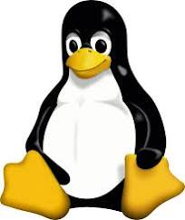

Getting Started with C++
Your assignments will be compiled, run, and marked using g++ on Ubuntu Linux
So you should use the same environment for writing your programs
On Windows, installing Windows Subsystem for Linux (WSL) is the easiest way to get Linux
On a Mac, you can probably use the built-in terminal
We recommend you VS Code for this course
Free, popular, high-quality programming editor
Supports C++ and lots of other languages
Works well with WSL
In class I use WSL and VS Code

Slide 7
C++ Version
We’ll be using C++17
Later version of C++ are not yet fully supported by all compilers
If you use features beyond C++17, your programs might not compile when marked!
We’ll provide exact compiler options to make sure you use the correct version
in a makefile

Slide 8
Review of C++
Sample code to review
Hello, world
Basic types
If statements and switch statements
Loops: while, for, for-each

Slide 9
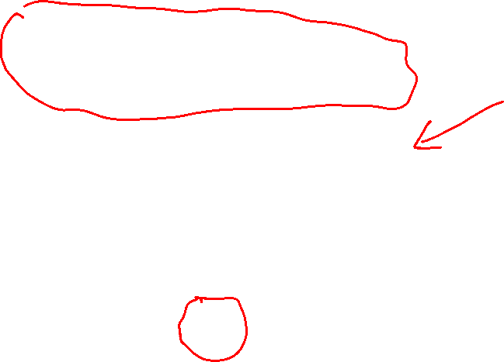
// hello_world.cpp
#include <iostream>
using namespace std;
int main()
{
cout << "Hello World!\n";
}

Slide 10
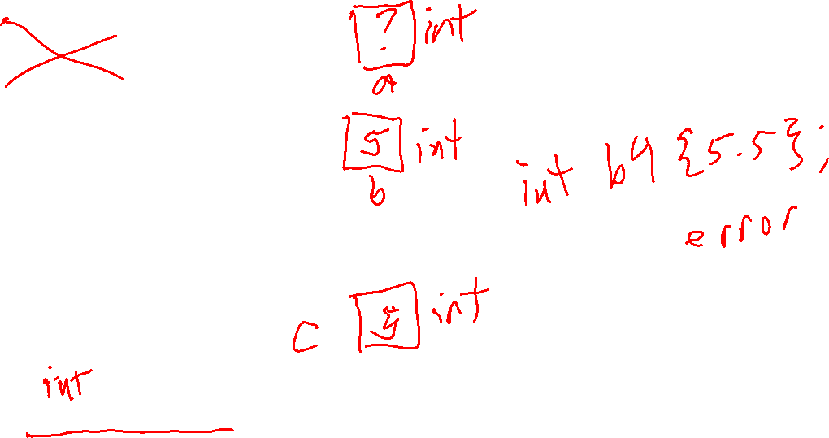
int type (whole numbers)
For 32-bit ints:
min int = -2147483648
max int = 2147483647
int a;
int b = 5;
int b2(5); int b3{5};
int c = 5.5;
auto d = 5;

Slide 11
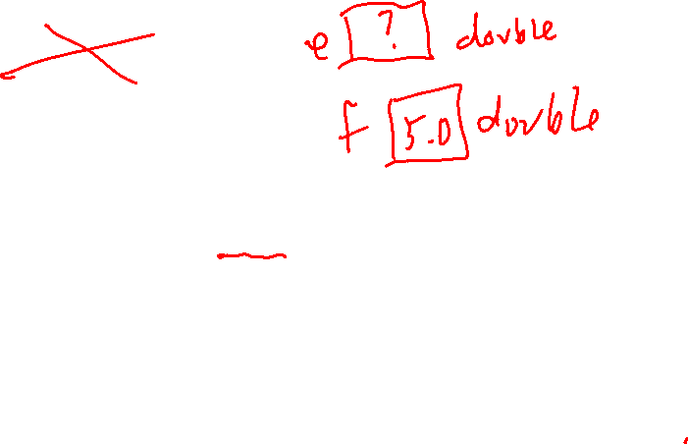
double type (decimal numbers)
double e; double f = 5;
double g = 5.5; double g2(5.5); double g2{5.5};
auto h = 5.5;

Slide 12
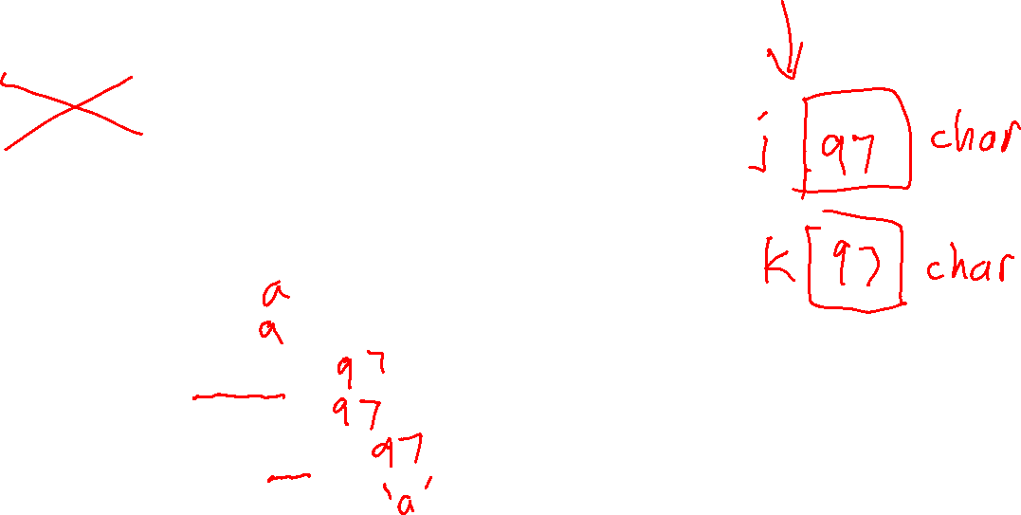
char type (single character)
char i; // unknown initial value
char j = 'a';
char k = 97; // ASCII value of 'a'
auto l = 'a'; cout << j; cout << k; cout << int(j);
cout << int(k); cout << int('a');
cout << char(97);

Slide 13

unsigned int type (non-negative ints)
For 32-bit ints:
min unsigned int = 0 max unsigned int = 4294967295
unsigned int m;
unsigned int n = 5;
unsigned int p = -5;
auto q = 5u;
cout << p; // prints 4294967291 cout << q;
The u at the end means 5u is an unsigned int literal. Without the u, it would be 5 which is of type int.

Slide 14
unsigned int type (non-negative ints)
typedef unsigned int uint;
uint m;
uint n = 5;
uint p = -5;
typedef lets you give any C++ type another name. This lets you make names that are shorter or more descriptive.
typedef does not create a new type: it just gives another name to an existing type.

Slide 15
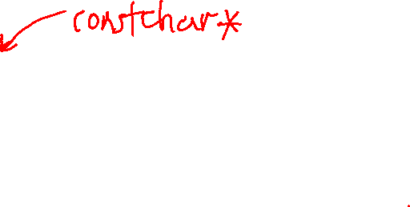
C++ string type (sequence of chars)
Important!
string is the name of the standard C++ string type, and it’s what you should use in this course
A C-style string is an array of characters ending with a '\0'. They are used as strings in C, but in C++ we will usually only use them for string literals like "hello world!”.
string r;
string s = "Hello World!";
string t("Hello World!"); string u{"Hello World!"}; string v('!', 5);
cout << "r = \"" << r << "\"";
cout << "v = \"" << v << "\"";

Slide 16
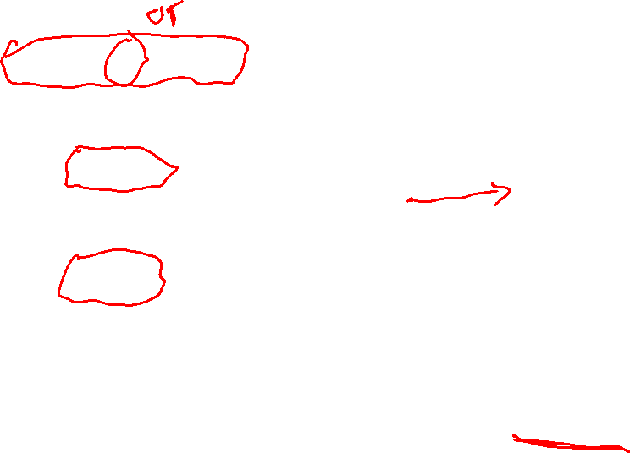
if-statements
switch statements
char d = 'm';
if (d == 'm' || d == 'M')
{
cout << "Monday";
}
else if (d == 'w')
{
cout << "Wednesday";
}
else if (d == 'f')
{
cout << "Friday";
}
else
{
cout << "Invalid day";
}
char d = 'm'; switch (d)
{
case 'm':
case 'M':
cout << "Monday";
break;
case 'w':
cout << "Wednesday";
break;
case 'f':
cout << "Friday";
break;
default:
cout << "Invalid day: '";
break;
}

Slide 17
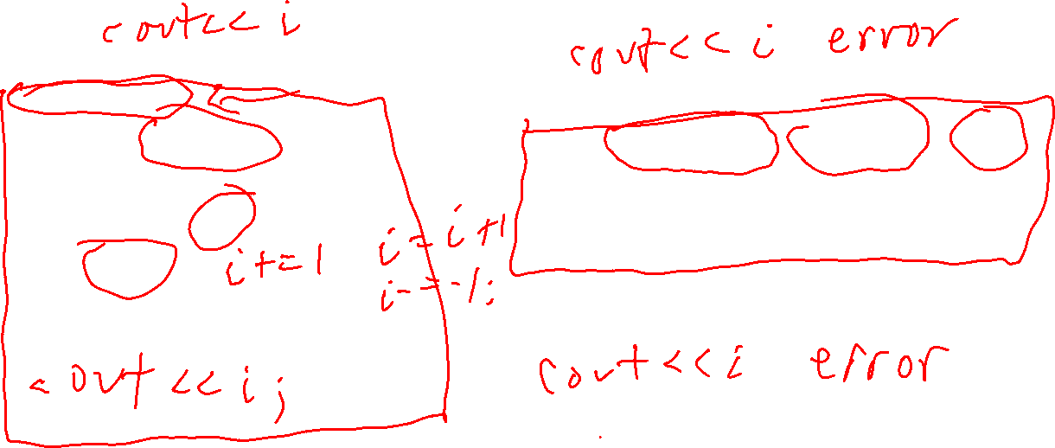
while loop
for loop
int total = 0;
int i = 0;
while (i < 100)
{
total += i;
i++;
}
cout << total; // 4950
int total = 0;
for(int i = 0; i < 100; i++)
{
total += i;
}
cout << total; // 4950

Slide 18
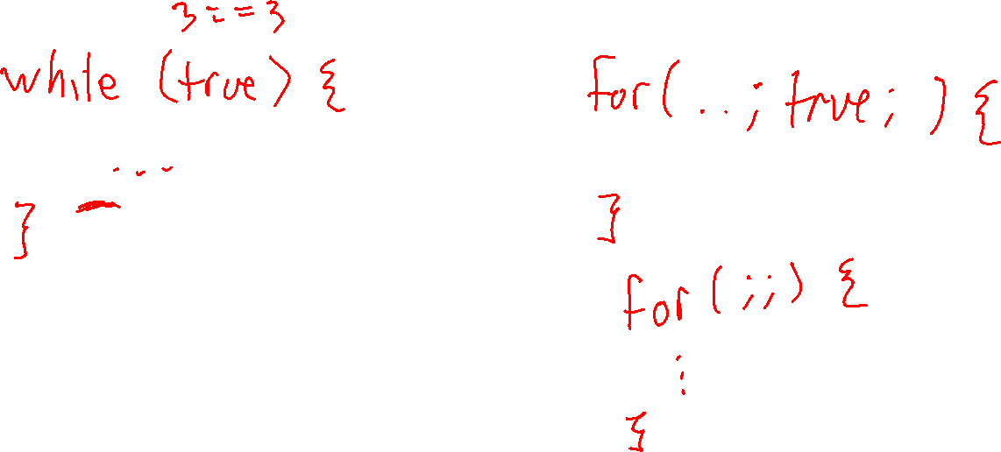
while loop
Can you make an infinite loop, i.e. a loop that never ends? Make one using while, and one using for.
for loop

Slide 19
while loop
Can you make an infinite loop, i.e. a loop that never ends? Make one using while, and one using for.
for loop
while (true)
{
cout << "!";
}
for(;;)
{
cout << "!";
}
Many others are possible!

Slide 20
vector<int> v;
for (int i = 0; i < 100; i++) {
v.push_back(i);
}
Make sure to #include <vector> and using namespace std;
for loop
for-each loop
int total = 0;
for(int i = 0; i < v.size(); i++)
{
total += v[i];
}
cout << total;
int total = 0;
for(int n : v)
{
total += n;
}
cout << total;

Slide 21
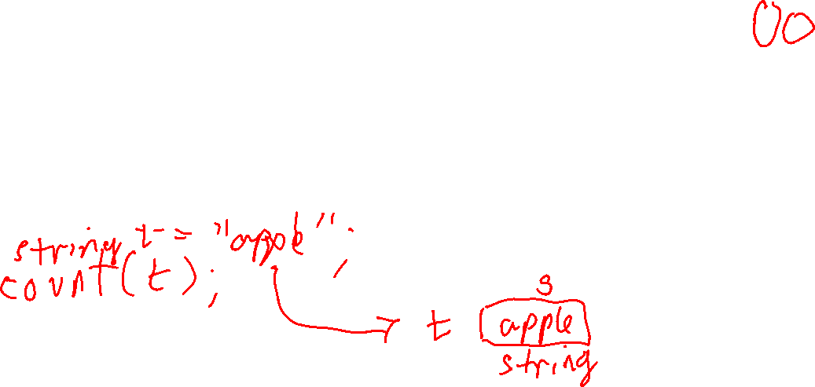
Pass-by-value
Pass-by-reference
int count(string s) { int num = 0;
for(char c : s) { if (c == ' ') num++; }
return num;
}
int count(string& s) { int num = 0;
for(char c : s) { if (c == ' ') num++; }
return num;
}

Slide 22
Pass-by-value
Pass-by-reference
int count(string s) { int num = 0;
for(char c : s) { if (c == ' ') num++; }
return num;
}
int count(string& s) { int num = 0;
for(char c : s) { if (c == ' ') num++; }
return num;
}
Makes a new copy of the passed-in string s. Slow, and uses extra memory.
Does not make a copy of s. Works on the actual passed-in string. Fast!

Slide 23

Pass-by-reference
Pass-by-constant-reference
int count(string& s) { int n = 0;
for(char c : s) { if (c == ' ') n++; }
return n;
}
int count(const string& s) { int n = 0;
for(char c : s) { if (c == ' ') n++; }
return n;
}
Does not make a copy of s. Works on the actual passed-in string. Fast!

Slide 24
Pass-by-reference
Pass-by-constant-reference
int count(string& s) { int n = 0;
for(char c : s) { if (c == ' ') n++; }
return n;
}
int count(const string& s) { int n = 0;
for(char c : s) { if (c == ' ') n++; }
return n;
}
Does not make a copy of s. Works on the actual passed-in string. Fast!
As fast as pass-by-reference, but guarantees to compiler that count does not modify s.

Slide 25
Local variables
int count(const string& s) { int n = 0;
for(char c : s) { if (c == ' ') n++; }
return n;
}

Slide 26
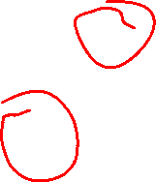
Local variables
Local variables exist only when the function is active. They are automatically created when the function is called, and then automatically deleted when the function ends.
int count(const string& s) { int n = 0;
for(char c : s) { if (c == ' ') n++; }
return n;
}

Slide 27
Return values are returned by value
int count(const string& s) { int n = 0;
for(char c : s) { if (c == ' ') n++; }
return n;
}

Slide 28
Return values are returned by value
int count(const string& s) { int n = 0;
for(char c : s) { if (c == ' ') n++; }
return n;
}
When n is returned, a copy is returned. So be careful returning large values: they could use a lot of time and memory.
The returned int must be a copy because n is a local variable that’s automatically deleted when the function ends.

Slide 29
Counting Long Lines
Write a program that counts and prints the number of lines in a text file that have more than 100 characters.

Slide 30
Counting Words
wc is the Linux “word count” utility:
> wc austenPride.txt
13427 124580 704158 austenPride.txt
In the sample code for week 1 you’ll find an implementation of this …

Slide 31
How function calls work
Knowing how function calls work in C++ is helpful
It lets you better understand program flow, memory management, and local/global variables
It also helps when understanding recursive functions

Slide 32
How function calls work: Stacks
an empty stack
A stack if a simple data structure that supports these operations:
is_empty() returns true if the stack is empty, and false otherwise
push x puts x on the top of the stack
pop removes the top element of the stack
peek returns a copy of the top element of the stack.
pushing onto a full stack causes an error: stack overflow
popping/peeking an empty stack causes an error (stack underflow)
push 5
4
push 2
push 4
pop
pop
2
2
2
5
5
5
5
5
bottom of stack
bottom of stack
bottom of stack
bottom of stack
bottom of stack

Slide 33
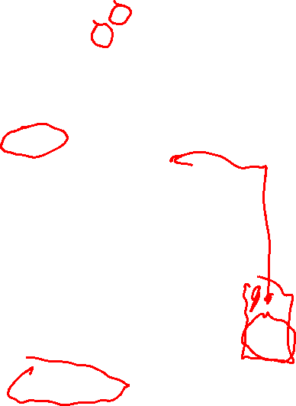
How function calls work
int g(int a) {
int n = a + 2;
return 3*n; }
int n = 5; g(n); // push onto call stack cout << "done!";
For a running C++ program, C++ designates part of memory as the programs call stack
Every time a function is called, the function, its parameters, and return address are pushed onto the call stack
Everything that gets pushed is refer to as a stack frame
Local variables are stored in the functions stack frame
Every time a function exists, the stack frame on top of the is popped and the return-value of the function can is put there (conceptually)
Local variables are deleted by this pop
g(n)
a=5 n=7
return address
push
previous function calls
previous function calls
bottom of stack
bottom of stack

Slide 34
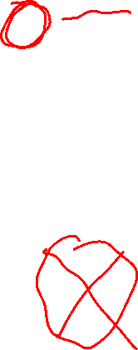
How function calls work
int g(int a) {
int n = a + 2;
return 3*n; }
int n = 5; g(n); // push onto call stack cout << "done!";
For a running C++ program, C++ designates part of memory as the programs call stack
Every time a function is called, the function, its parameters, and return address are pushed onto the call stack
Everything that gets pushed is refer to as a stack frame
Local variables are stored in the functions stack frame
Every time a function exists, the stack frame on top of the is popped and the return-value of the function can is put there (conceptually)
Local variables are deleted by this pop
a=5 n=7
}
21
return value
pop
previous function calls
previous function calls
bottom of stack
bottom of stack

Slide 35
How function calls work
int f() {
int i = 7; i++; return i;
}
int main() {
int i = 0;
cout << f();
}
For a running C++ program, C++ designates part of memory as the programs call stack
Every time a function is called, the function, its parameters, and return address are pushed onto the call stack
Everything that gets pushed is refer to as a stack frame
Local variables are stored in the functions stack frame
Every time a function exists, the stack frame on top of the is popped and the return-value of the function can is put there (conceptually)
Local variables are deleted by this pop
main()
push
main
i=0
bottom of stack
bottom of stack

Slide 36

How function calls work
int f() {
int i = 7; i++; return i;
}
int main() {
int i = 0;
cout << f();
}
For a running C++ program, C++ designates part of memory as the programs call stack
Every time a function is called, the function, its parameters, and return address are pushed onto the call stack
Everything that gets pushed is refer to as a stack frame
Local variables are stored in the functions stack frame
Every time a function exists, the stack frame on top of the is popped and the return-value of the function can is put there (conceptually)
Local variables are deleted by this pop
f
i=7
f()
main
i=0
push
main
i=0
bottom of stack
bottom of stack

Slide 37
How function calls work
int f() {
int i = 7; i++; return i;
}
int main() {
int i = 0;
cout << f();
}
For a running C++ program, C++ designates part of memory as the programs call stack
Every time a function is called, the function, its parameters, and return address are pushed onto the call stack
Everything that gets pushed is refer to as a stack frame
Local variables are stored in the functions stack frame
Every time a function exists, the stack frame on top of the is popped and the return-value of the function can is put there (conceptually)
Local variables are deleted by this pop
f
i=8
f()
main
i=0
push
main
i=0
bottom of stack
bottom of stack

Slide 38
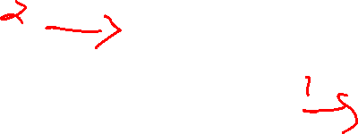
How function calls work
int f() {
int i = 7; i++; return i;
}
int main() {
int i = 0;
cout << f();
}
For a running C++ program, C++ designates part of memory as the programs call stack
Every time a function is called, the function, its parameters, and return address are pushed onto the call stack
Everything that gets pushed is refer to as a stack frame
Local variables are stored in the functions stack frame
Every time a function exists, the stack frame on top of the is popped and the return-value of the function can is put there (conceptually)
Local variables are deleted by this pop
f
i=8
f()
8
main
i=0
pop
main
i=0
bottom of stack
bottom of stack

Slide 39
How function calls work
int f() {
int i = 7; i++; return i;
}
int main() {
int i = 0;
cout << f();
}
For a running C++ program, C++ designates part of memory as the programs call stack
Every time a function is called, the function, its parameters, and return address are pushed onto the call stack
Everything that gets pushed is refer to as a stack frame
Local variables are stored in the functions stack frame
Every time a function exists, the stack frame on top of the is popped and the return-value of the function can is put there (conceptually)
Local variables are deleted by this pop
8 gets printed
main()
8
main
i=0
pop
bottom of stack
bottom of stack
main() is finished: program is done!

Slide 40
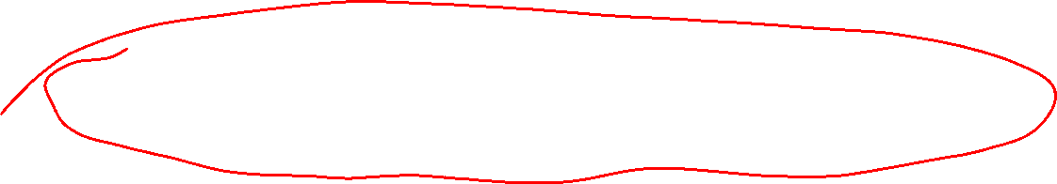
How function calls work
Stacks are easy to implement efficiently
use an array and an index variable to keep track of the top of the stack
Function calls are generally quite efficient
C++ compilers can use function inlining to replace short functions calls with the contents of their body, thus avoiding the overhead of pushing/popping the call stack
It’s possible to call so many functions without returning that you get a stack overflow error
Your program crashes because it’s out of memory
This can be a significant issue in programs with limited memory, e.g. embedded systems
Works with recursive functions, e.g. functions that call themselves

