Slide 1
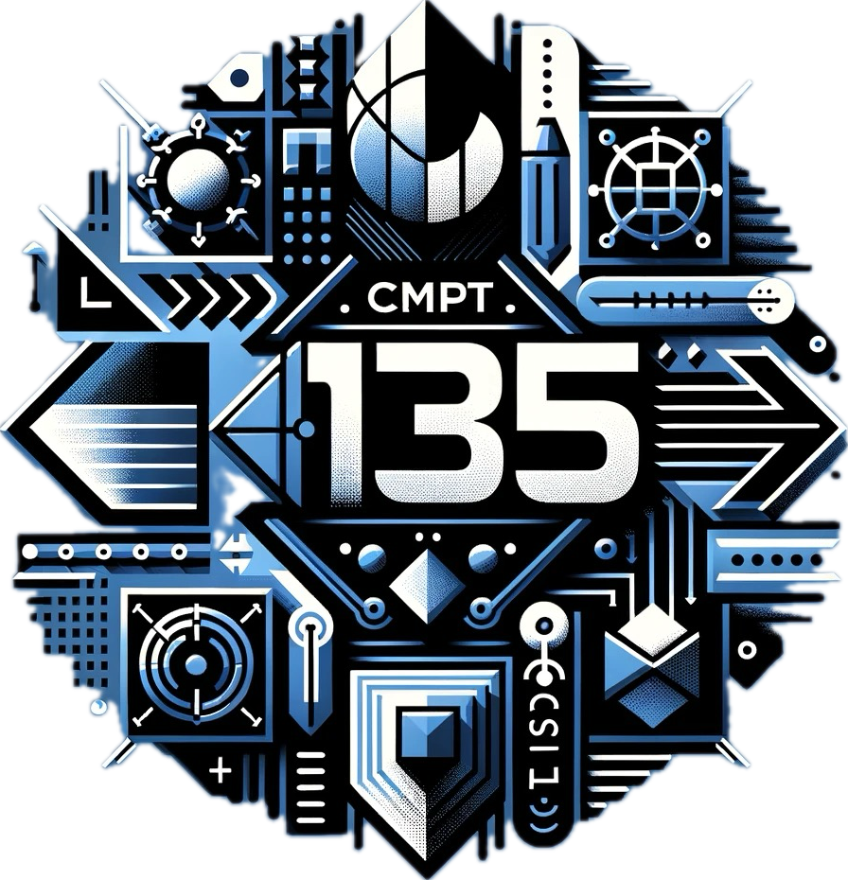
CMPT 135
Week 2
Testing Code
Introduction to Pointers and Memory Management

Slide 2
Administrative Notes
Check Canvas for due dates!
Quizzes are coming up, do them!
First lab is this week
Labs are optional
TAs will be there to provide help
TAs are the ones marking your assignments
Good place to get help installing and using C++
Do you are assignment in lab
Assignment 1 is available is online

Slide 3
How do you know if a program is correct?
Is this function correct?
void f(int& n)
{ n++; }

Slide 4
How do you know if a program is correct?
Is this function correct?
void f(int& n)
{ n++; }
We don’t know if it is correct! It depends on what it is supposed to do, and we are not sure what it does.

Slide 5
How do you know if a program is correct?
Are these functions correct?
// adds 1 to n void f(int& n)
{ n++; }
// adds 2 to n void g(int& n)
{ n++; }

Slide 6
How do you know if a program is correct?
Correct!
Wrong!
// adds 1 to n void f(int& n)
{ n++; }
// adds 2 to n void g(int& n)
{ n++; }
Important!
A function is correct (error-free) if it does what we want it to do. So to test it, we must specify what the function does.

Slide 7
How do you know if a program is correct?
In C++, specifications are usually put in comments. Or if it’s obvious, in the function name.
// adds 1 to n void f(int& n)
{ n++; }
// adds 2 to n void g(int& n)
{ n++; }
Important!
A function is correct (error-free) if it does what we want it to do. So to test it, we must specify what the function does.

Slide 8
How do you know if a program is correct?
Suppose I give you a function with this header:
void f(const string& v);
I claim f(s) returns s duplicated, e.g. f("cat") returns "catcat" f("bird") returns "birdbird" f("a house") returns "a housea house" etc.
How can I prove to you that my claim about f is true?

Slide 9
How do you know if a program is correct?
Bad answers:
It’s true because I say so.
It’s so simple that it couldn’t be wrong.
I got it from the web.
I got it from CoPilot/ChatGPT.
Someone told me how I did it is correct.
Suppose I give you a function with this header:
void f(const string& v);
I claim f(s) returns s duplicated, e.g. f("cat") returns "catcat" f("bird") returns "birdbird" f("a house") returns "a housea house" etc.
How can I prove to you that my claim about f is true?

Slide 10
How do you know if a program is correct?
This is called inspection: you read the code and look for errors
Suppose I give you a function with this header:
void f(const string& v);
I claim f(s) returns s duplicated, e.g. f("cat") returns "catcat" f("bird") returns "birdbird" f("a house") returns "a housea house" etc.
How can I prove to you that my claim about f is true?
Better answers:
Ask to see how f is implemented.
Call it a few different strings and check that it returns the right answer.
This is called testing: give it some input and check that it returns the correct output

Slide 11
How do you know if a program is correct?
Inspection
Done manually by the programmer.
Works well for small/simple programmers.
Usually too tedious/complicated for bigger programs.
Testing
Can be done automatically or manually
Requires making (input, output) pairs.
Comes in many varieties …

Slide 12
Varieties of Testing
Unit testing: test one part (“unit”) of a program, e.g. a single function
Whitebox testing: make test cases based on the implementation
Blackbox testing: make test cases based on the specification only, without seeing an implementation
System testing
Testing the entire system

Slide 13
Varieties of Testing
Can start as soon as you write one function.
Test-driven development (TDD) is when you write unit tests at the same time as you write your code.
Unit testing: test one part (“unit”) of a program, e.g. a single function
Whitebox testing: make test cases based on the implementation
Blackbox testing: make test cases based on the specification only, without seeing an implementation
System testing
Testing the entire system
Needs the system to be in a working state. Waiting until a system is mostly working is a very bad idea!

Slide 14
Varieties of Testing
Advantages
Can check that every line of code is run by the tests.
Also allows you to do some inspection.
Disadvantages
Test cases need to added/removed if implementation changes
Unit testing: test one part (“unit”) of a program, e.g. a single function
Whitebox testing: make test cases based on the implementation
Blackbox testing: make test cases based on the specification only, without seeing an implementation
System testing
Testing the entire system
Advantages
Can write test cases before you write the code!
Same test cases can work if implementation changes but header stays the same.
Disadvantages
Can’t test any implementation-specific details.

Slide 15
How do you know if a program is correct?
Challenge 1
Write a version of function f that is not completely correct, but does work correctly for the three example cases?
Suppose I give you a function with this header:
void f(const string& v);
I claim f(s) returns s duplicated, e.g. f("cat") returns "catcat" f("bird") returns "birdbird" f("a house") returns "a housea house" etc.
How can I prove to you that my claim about f is true?

Slide 16
How do you know if a program is correct?
Challenge 2
Write a version of function f that is not completely correct, but fails on exactly one input.
Suppose I give you a function with this header:
void f(const string& v);
I claim f(s) returns s duplicated, e.g. f("cat") returns "catcat" f("bird") returns "birdbird" f("a house") returns "a housea house" etc.
How can I prove to you that my claim about f is true?

Slide 17
How do you know if a program is correct?
Challenge 3
Write a version of function f that for any given input string may, or may not, return the correct answer.
Suppose I give you a function with this header:
void f(const string& v);
I claim f(s) returns s duplicated, e.g. f("cat") returns "catcat" f("bird") returns "birdbird" f("a house") returns "a housea house" etc.
How can I prove to you that my claim about f is true?

