Slide 1

CMPT 135
Remember to finish the weekly quiz!
Assignment 2 is due on Wednesday!
Week 6
Inheritance and Polymorphism

Slide 2
Introduction
Namespaces
Separate compilation

Slide 3
Introduction
Namespaces are used for organizing code into logical groups.
Namespaces
Separate compilation

Slide 4
Inheritance
class int_vec : public vector<int> {
};
Goal: Create a class called int_vec that works just like vector<int>, but also has a sort() method so we can write v.sort()
With inheritance, we can easily create such a class:
Make a new class called int_vec
int_vec inherits from vector<int>
add the sort() method to int_vec
This makes int_vec inherit all the members of vector<int>.
With the exception of constructors and assignment operator: those are not inherited.
int_vec v;
v.push_back(2);
v.push_back(1);
for (int n : v) {
cout << n << " ";
}
int_vec now works like a vector<int>

Slide 5
Inheritance
class int_vec : public vector<int> {
public: Goal: Add other useful methods
With inheritance, we can use the methods in vector<int> in any methods we add to int_vec.
sort() {
std::sort(begin(), end());
}
};
Goal: Create a class called int_vec that works just like vector<int>, but also has a sort() method so we can write v.sort()
With inheritance, we can easily create such a class:
Make a new class called int_vec
int_vec inherits from vector<int>
add the sort() method to int_vec
begin() and end() are inherited from vector<int>
int_vec v;
v.push_back(2);
v.push_back(1);
v.sort();
for (int n : v) {
cout << n << " ";
}

Slide 6
Inheritance
class int_vec : public vector<int> {
public: int sum() const {
// ...
}
};
You can add any other methods you’d like to int_vec. Let’s add a sum() method …
Goal: Add other useful methods
With inheritance, we can use the methods in vector<int> in any methods we add to int_vec.
int_vec v;
v.push_back(2);
v.push_back(1);
cout << v.sum(); // 3

Slide 7
Inheritance
class int_vec : public vector<int> {
public: int sum() const {
return std::accumulate(begin(),
end(),
0);
}
};
Goal: Add other useful methods
With inheritance, we can use the methods in vector<int> in any methods we add to int_vec.
accumulate is in #include <numeric>
0 is the initial value of the sum
int_vec v;
v.push_back(2);
v.push_back(1);
cout << v.sum(); // 3

Slide 8
Inheritance
class int_vec : public vector<int> {
public: int sum() const {
int result = 0; for(int i = 0; i < size(); i++) { result += ; } return result;
}
};
Goal: Add other useful methods
With inheritance, we can use the methods in vector<int> in any methods we add to int_vec.
What goes in here?
int_vec v;
v.push_back(2);
v.push_back(1);
cout << v.sum(); // 3

Slide 9
Inheritance
class int_vec : public vector<int> {
public: int sum() const {
int result = 0; for(int i = 0; i < size(); i++) { result += (*this)[i]; } return result;
}
};
Goal: Add other useful methods
With inheritance, we can use the methods in vector<int> in any methods we add to int_vec.
Every C++ object has a special pointer called this that points to the object itself.
v
this
…
int_vec v;
v.push_back(2);
v.push_back(1);
cout << v.sum(); // 3

Slide 10
Inheritance
class int_vec : public vector<int> {
public: int sum() const {
int result = 0; for(int i = 0; i < this->size(); i++) { result += (*this)[i]; } return result;
}
};
Goal: Add other useful methods
With inheritance, we can use the methods in vector<int> in any methods we add to int_vec.
Sometimes it might be useful to use this even when it is not strictly needed. Here it makes clear that size() is from int_vec.
v
this
…
int_vec v;
v.push_back(2);
v.push_back(1);
cout << v.sum(); // 3

Slide 11
Inheritance
class int_vec : public vector<int> {
public: int sum() const {
int result = 0; for(int n : *this) { result += n; } return result;
}
};
Using a for-each loop.
Goal: Add other useful methods
With inheritance, we can use the methods in vector<int> in any methods we add to int_vec.
v
this
…
int_vec v;
v.push_back(2);
v.push_back(1);
cout << v.sum(); // 3

Slide 12
Inheritance
class int_vec : public vector<int> {
string name;
public: int_vec(const string &name) : name(name) {
assert(name.size() > 0);
}
string get_name() const {
return "<intvec:" + name + ">";
}
void set_name(const string &name) { assert(name.size() > 0);
this->name = name;
}
// ...
};
constructor
Goal: Add a member variable
We can also add member variables to int_vec that don’t appear in vector<int>.
For example, suppose we want to give an int_vec a name …
int_vec v; // compiler error: no name
int_vec w("temps"); cout << w.get_name(); // <intvec:temps> w.set_name(""); // run-time error

Slide 13
Polymorphism
void summarize(const vector<int>& v) {
for (int i = 0; i < v.size(); i++) {
cout << "v[" << i << "] = " << v[i]
<< "\n";
}
cout << "size: " << v.size() << "\n";
}
Wherever a vector<int> can be used, we can replace it with an int_vec.
That’s because an int_vec can do everything a vector<int> can do (plus more).
vector<int> v;
v.push_back(2);
v.push_back(1);
summarize(v);
int_vec w("test");
w.push_back(2);
w.push_back(1);
summarize(w);
Which code works with summarize?

Slide 14
Polymorphism
void summarize(const vector<int>& v) {
for (int i = 0; i < v.size(); i++) {
cout << "v[" << i << "] = " << v[i]
<< "\n";
}
cout << "size: " << v.size() << "\n";
}
Wherever a vector<int> can be used, we can replace it with an int_vec.
That’s because an int_vec can do everything a vector<int> can do (plus more).
vector<int> v;
v.push_back(2);
v.push_back(1);
summarize(v);
int_vec w("test");
w.push_back(2);
w.push_back(1);
summarize(w);
summarize takes a vector<int> as input, so this code works
v[0] = 2
v[1] = 1
size: 2

Slide 15
Polymorphism
void summarize(const vector<int>& v) {
for (int i = 0; i < v.size(); i++) {
cout << "v[" << i << "] = " << v[i]
<< "\n";
}
cout << "size: " << v.size() << "\n";
}
Wherever a vector<int> can be used, we can replace it with an int_vec.
That’s because an int_vec can do everything a vector<int> can do (plus more).
vector<int> v;
v.push_back(2);
v.push_back(1);
summarize(v);
int_vec w("test");
w.push_back(2);
w.push_back(1);
summarize(w);
summarize takes a vector<int> as input, so this code works
summarize also works if you pass it an int_vec, because an int_vec can do everything a vector<int> does
v[0] = 2
v[1] = 1
size: 2
v[0] = 2
v[1] = 1
size: 2

Slide 16
Polymorphism
void summarize(const vector<int>& v) {
for (int i = 0; i < v.size(); i++) {
cout << "v[" << i << "] = " << v[i]
<< "\n";
}
cout << "size: " << v.size() << "\n";
}
Wherever a vector<int> can be used, we can replace it with an int_vec.
That’s because an int_vec can do everything a vector<int> can do (plus more).
vector<int> v;
v.push_back(2);
v.push_back(1);
summarize(v);
int_vec w("test");
w.push_back(2);
w.push_back(1);
summarize(w);
summarize takes a vector<int> as input, so this code works
summarize also works if you pass it an int_vec, because an int_vec can do everything a vector<int> does
If instead you called v.get_name() here you’d get a compiler error saying vector<int> doesn’t have a get_name method.
Summarize always prints the name v. This is because a vector<int> does not have a name.
v[0] = 2
v[1] = 1
size: 2
v[0] = 2
v[1] = 1
size: 2

Slide 17
Polymorphism
void summarize(const int_vec& v) {
for (int i = 0; i < v.size(); i++) {
cout << v.get_name() << "[" << i << "] = " << v[i] << "\n";
}
cout << "size: " << v.size() << "\n";
}
Wherever a vector<int> can be used, we can replace it with an int_vec.
That’s because an int_vec can do everything a vector<int> can do (plus more).
vector<int> v;
v.push_back(2);
v.push_back(1);
summarize(v);
int_vec w("test");
w.push_back(2);
w.push_back(1);
summarize(w);
Do these code fragments work with the above version of summarize?
Idea: Change the type of v to int_vec so we can call get_name()

Slide 18
Polymorphism
void summarize(const int_vec& v) {
for (int i = 0; i < v.size(); i++) {
cout << v.get_name() << "[" << i << "] = " << v[i] << "\n";
}
cout << "size: " << v.size() << "\n";
}
Wherever a vector<int> can be used, we can replace it with an int_vec.
That’s because an int_vec can do everything a vector<int> can do (plus more).
vector<int> v;
v.push_back(2);
v.push_back(1);
summarize(v);
int_vec w("test");
w.push_back(2);
w.push_back(1);
summarize(w);
summarize works with an int_vec,
<intvec:test>[0] = 2
<intvec:test>[1] = 1
size: 2

Slide 19
Polymorphism
void summarize(const int_vec& v) {
for (int i = 0; i < v.size(); i++) {
cout << v.get_name() << "[" << i << "] = " << v[i] << "\n";
}
cout << "size: " << v.size() << "\n";
}
Wherever a vector<int> can be used, we can replace it with an int_vec.
That’s because an int_vec can do everything a vector<int> can do (plus more).
vector<int> v;
v.push_back(2);
v.push_back(1);
summarize(v); // compile-time // error: v is // wrong type
int_vec w("test");
w.push_back(2);
w.push_back(1);
summarize(w);
summarize works with an int_vec,
Cannot call summarize with an object of type vector<int>, since it has no get_name method
<intvec:test>[0] = 2
<intvec:test>[1] = 1
size: 2

Slide 20
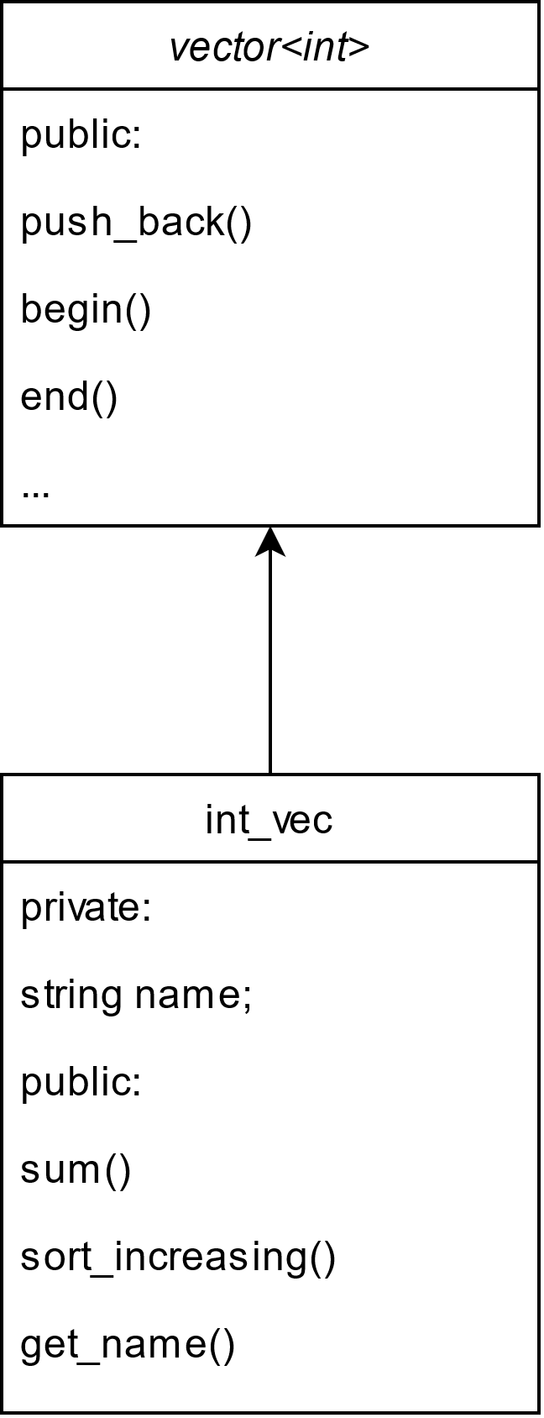
Class Diagrams
Terminology
parent class
super-class
class being inherited from
In object-oriented programs with many classes and a lot of inheritance, class diagrams can help clarify how classes are related.
Remember: in a class diagram, a child class always points to its parent class
Terminology
child class
sub-class
inheriting class
extended class
derived class

Slide 21
Class Diagrams
Terminology
This is a class hierarchy.
Arrows show when a class is inheriting from another.
Parent is called the base class of the hierarchy.
In object-oriented programs with many classes and a lot of inheritance, class diagrams can help clarify things.
Remember: in a class diagram, a child class always points to its parent class
Parent
A
B
C
Terminology
class B is a child of class Parent
Class E is a child of class B
Class B is the parent of class E
Class E is a grandchild of Parent
Class D and E are siblings
etc.
D
E
F

Slide 22
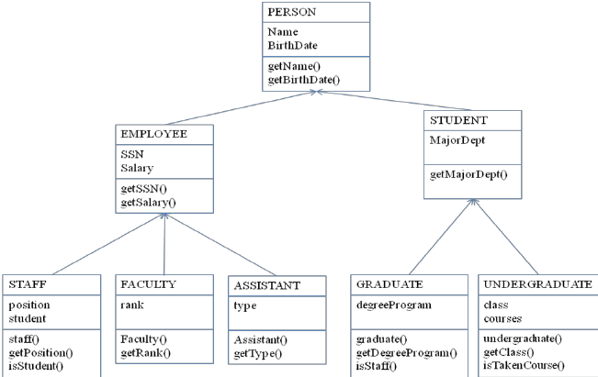
Class Diagrams
In object-oriented programs with many classes and a lot of inheritance, class diagrams can help clarify things.
Remember: in a class diagram, a child class always points to its parent class
In object-oriented programs, designing a class hierarchy is an important step that affects the entire life of the program.
Object-oriented design (OOD) is it’s own topic that we will only get into a little bit …

