Slide 1

CMPT 135
Week 2
Testing Code
Introduction to Pointers and Memory Management

Slide 2
Administrative Notes
Check Canvas for due dates!
Quiz 0 (practice, worth 0 marks) is on Friday
Academic integrity quiz due the week after: don’t wait, do it now!
First lab is this week
Labs are optional
TAs will be there to provide help on assignments, etc.
TAs are the ones marking your assignments
Good place to get help installing and using C++
Assignment 1 is available is online

Slide 3

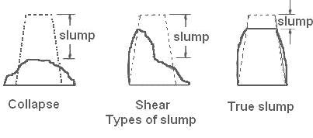


How do civil engineers ensure their constructions “work”?
They do many things!
hire experts
follow safety standards
use good materials and techniques
inspect and test as they go
…
Wet concrete slump test
Wet concrete table test

Slide 4
How do you know if a program is correct?
Occasionally, it may be possible to mathematically prove a program is correct. A mathematical proof can be thought of as a detailed and systematic inspection. In practice, it is rarely used since the proofs are usually more complex than the code.
Two basic techniques:
Inspection e.g. read the source code to make sure there are no errors, and that all cases are handled
many software companies (e.g. Google, Microsoft) require at least one other person to read any code you submit
Testing e.g. run the program on some sample inputs and make sure it does the right thing
continuous and automated testing is the general standard that most good software companies follow, or at least aim for

Slide 5
How do you know if a program is correct?
Is this function correct?
void f(int& n)
{ n++; }

Slide 6
How do you know if a program is correct?
Is this function correct?
void f(int& n)
{ n++; }
We don’t know if it is correct! It depends on what it is supposed to do, which we don’t know.

Slide 7
How do you know if a program is correct?
Are these functions correct?
// adds 1 to n void f(int& n)
{ n++; }
// adds 2 to n void g(int& n)
{ n++; }

Slide 8
How do you know if a program is correct?
Correct!
Wrong!
// adds 1 to n void f(int& n)
{ n++; }
// adds 2 to n void g(int& n)
{ n++; }
Important!
A function is correct (error-free) if it does what we want it to do. So to test it, we must specify what the function does.

Slide 9
How do you know if a program is correct?
In C++, specifications are usually put in comments. Or if it’s obvious, in the function name.
// adds 1 to n void f(int& n)
{ n++; }
// adds 2 to n void g(int& n)
{ n++; }
Important!
A function is correct (error-free) if it does what we want it to do. So to test it, we must specify what the function does.

Slide 10
How do you know if a program is correct?
Suppose I give you a function with this header:
void f(const string& v);
I claim f(s) returns s duplicated, e.g. f("cat") returns "catcat" f("bird") returns "birdbird" f("a house") returns "a housea house" etc.
How can I prove to you that my claim about f is true?

Slide 11
How do you know if a program is correct?
Bad answers:
It’s true because I say so.
It’s so simple that it couldn’t be wrong.
I got it from the web.
I got it from CoPilot/ChatGPT.
Someone told me how I did it is correct.
Suppose I give you a function with this header:
void f(const string& v);
I claim f(s) returns s duplicated, e.g. f("cat") returns "catcat" f("bird") returns "birdbird" f("a house") returns "a housea house" etc.
How can I prove to you that my claim about f is true?

Slide 12
How do you know if a program is correct?
Suppose I give you a function with this header:
void f(const string& s);
I claim f(s) returns s duplicated, e.g. f("cat") returns "catcat" f("bird") returns "birdbird" f("a house") returns "a housea house" etc.
How can I prove to you that my claim about f is true?
Better answers:
Ask to see how f is implemented.
Call it a few different strings and check that it returns the right answer.
This is inspection: you read the code and look for errors
This is testing: give f some input and check that it returns the correct output

Slide 13
How do you know if a program is correct?
Inspection
Done manually by the programmer.
Works well for small/simple programs.
Especially useful when the done by someone other than the original programmer.
Can be too tedious/complicated for bigger programs.
Testing
Can be done automatically or manually
Usually requires making (input, output) pairs
Comes in many varieties …

Slide 14
Varieties of Testing
Unit testing: test one part (“unit”) of a program, e.g. a single function
Whitebox testing: make test cases based on the implementation
Blackbox testing: make test cases based on the specification only, without seeing an implementation
System testing
Testing the entire system

Slide 15
Varieties of Testing
Can start as soon as you write one function.
Test-driven development (TDD) is when you write unit tests at the same time as you write your code.
Unit testing: test one part (“unit”) of a program, e.g. a single function
Whitebox testing: make test cases based on the implementation
Blackbox testing: make test cases based on the specification only, without seeing an implementation
System testing
Testing the entire system
Needs the system to be in a working state. Waiting until a system is mostly working is a very bad idea!

Slide 16

System testing on a bridge: load testing
Load testing on the Pelješac Bridge in 2022
40 tonnes of trucks drove across the bridge
Engineers measured to ensure the bridge deformed as expected
Obviously, the bridge had to be nearly finished to do this test
In software, we often do load testing for websites or servers to make sure they can handle a lot of requests

Slide 17
Varieties of Testing
Advantages
Can check that every line of code is run by a test.
Also allows you to do some inspection.
Disadvantages
Test cases need to added/removed if implementation changes
Unit testing: test one part (“unit”) of a program, e.g. a single function
Whitebox testing: make test cases based on the implementation
Blackbox testing: make test cases based on the specification only, without seeing an implementation
System testing
Testing the entire system
Advantages
Can write test cases before you write the code.
Same test cases can work if implementation changes but header stays the same.
Disadvantages
Can’t test implementation-specific details.

Slide 18

How do you know if a program is correct?
Challenge 1
Write a version of function f that is not completely correct, but does work correctly for the three example cases.
Suppose I give you a function with this header:
void f(const string& s);
I claim f(s) returns s duplicated, e.g. f("cat") returns "catcat" f("bird") returns "birdbird" f("a house") returns "a housea house" etc.
How can I prove to you that my claim about f is true?

Slide 19
How do you know if a program is correct?
Challenge 1
Write a version of function f that is not completely correct, but does work correctly for the three example cases.
Suppose I give you a function with this header:
void f(const string& s);
I claim f(s) returns s duplicated, e.g. f("cat") returns "catcat" f("bird") returns "birdbird" f("a house") returns "a housea house" etc.
How can I prove to you that my claim about f is true?
string f(const string &s)
{
if (s == "cat")
{
return "catcat";
}
else if (s == "bird")
{
return "birdbird";
}
else
{
return "a housea house";
}
}

Slide 20

How do you know if a program is correct?
Challenge 2
Write a version of function f that is not completely correct, but fails on exactly one input.
Suppose I give you a function with this header:
void f(const string& s);
I claim f(s) returns s duplicated, e.g. f("cat") returns "catcat" f("bird") returns "birdbird" f("a house") returns "a housea house" etc.
How can I prove to you that my claim about f is true?

Slide 21
How do you know if a program is correct?
Challenge 2
Write a version of function f that is not completely correct, but fails on exactly one input.
Suppose I give you a function with this header:
void f(const string& s);
I claim f(s) returns s duplicated, e.g. f("cat") returns "catcat" f("bird") returns "birdbird" f("a house") returns "a housea house" etc.
How can I prove to you that my claim about f is true?
string f(const string &s)
{
if (s == "swordfish")
{
return "wrong!";
}
return s + s;
}

Slide 22
How do you know if a program is correct?
Challenge 3
Write a version of function f that for any given input string may, or may not, return the correct answer.
Suppose I give you a function with this header:
void f(const string& s);
I claim f(s) returns s duplicated, e.g. f("cat") returns "catcat" f("bird") returns "birdbird" f("a house") returns "a housea house" etc.
How can I prove to you that my claim about f is true?

Slide 23
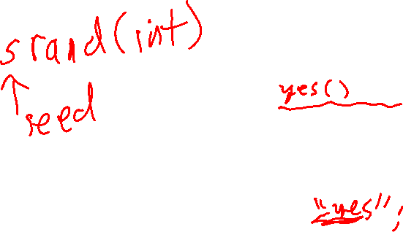
How do you know if a program is correct?
Challenge 3
Write a version of function f that for any given input string may, or may not, return the correct answer.
Suppose I give you a function with this header:
void f(const string& s);
I claim f(s) returns s duplicated, e.g. f("cat") returns "catcat" f("bird") returns "birdbird" f("a house") returns "a housea house" etc.
How can I prove to you that my claim about f is true?
string f(const string &s)
{
if (rand() == 0)
{
return "wrong!";
}
return s + s;
}
rand() returns a random int from 0 to about 2 billion (for 32-bit ints)

Slide 24
Some ways to test code: Test Drivers
// return a copy of s with trailing and leading spaces // removed
string strip(const string &s)
{
int begin = 0;
while (begin < s.size() && s[begin] == ' ')
{
begin++;
}
int end = s.size() - 1;
while (end >= 0 && s[end] == ' ')
{
end--;
}
return s.substr(begin, end - begin + 1);
}
We usually want automated testing
But there is one kind of manual testing that can be helpful: test drivers
Test drivers are small interactive programs that print the input to functions
They let you experiment with functions and get immediate feedback
Like an interpreter in Python or Java … but you need to write the code!

Slide 25
Some ways to test code: Test Drivers
// return a copy of s with trailing and leading
// spaces removed
string strip(const string &s)
{
int begin = 0;
while (begin < s.size() && s[begin] == ' ')
{
begin++;
}
int end = s.size() - 1;
while (end >= 0 && s[end] == ' ')
{
end--;
}
return s.substr(begin, end - begin + 1);
}
int main() {
for (;;) {
cout << "--> ";
string input;
getline(cin, input);
string result = strip(input);
cout << " strip(\"" << input << "\") = \""
<< result << "\"\n";
}}
reads an entire line of input
--> cat
strip(" cat ") = "cat"
--> cat
strip(" cat ") = "cat"
-->
strip(" ") = ""
-->
strip("") = ""
Sample test driver interaction

Slide 26
Testing Techniques
// returns a copy of s in ""-marks // e.g. quote("Hi!") returns "\"Hi!\"" string quote(const string& s)
We’ll use quote(s) as a sample function for looking at different testing techniques.
If-style tests
Assert-style tests
Table-based tests
Property testing
Using ChatGPT to help with testing

Slide 27
Testing Techniques
// returns a copy of s in ""-marks // e.g. quote("Hi!") returns "\"Hi!\"" string quote(const string& s)
void test_quote_if_style() { if (quote("cat") != "\"cat\"") { cout << "test failed"; } if (quote("hot soup") != "\"hot soup\"") { cout << "test failed"; } if (quote("") != "\"\"") { cout << "test failed"; } }
If-style tests
Assert-style tests
Table-based tests
Property testing
Using ChatGPT to help with testing
Pros
relatively simple and flexible
put whatever code you want in the if-statement bodies, e.g. could write stats to a file, or give more detailed error messages
Cons
A lot of typing, programmer may get tired of doing it.

Slide 28
Testing Techniques
// returns a copy of s in ""-marks // e.g. quote("Hi!") returns "\"Hi!\"" string quote(const string& s)
#include <cassert> // assert is from here void test_quote_assert_style() { assert(quote("\"cat\"") == "\"cat\"");
assert(quote("hot soup") == "\"hot soup\"");
assert(quote("") == "\"\"");
cout << "all quote tests passed\n";} }
If-style tests
Assert-style tests
Table-based tests
Property testing
Using ChatGPT to help with testing
Pros
Short and simple to type
When an assert fails, it immediately crashes the program and includes the exact text of the assertion
When an assert fails, includes the line number of the failure
Cons
Not very flexible: can only crash on failure

Slide 29
Testing Techniques
// returns a copy of s in ""-marks // e.g. quote("Hi!") returns "\"Hi!\"" string quote(const string& s)
#include <cassert> // assert is from here void test_quote_assert_style() { // ... assert(quote("cat") == "\"dog\""); // ... }
If-style tests
Assert-style tests
Table-based tests
Property testing
Using ChatGPT to help with testing
assert(expr) fails when expr evaluates to false (it does nothing when it evaluates to true)
A failed assert prints its content and its line number … this is non-trivial! …
❯ ./assertexample
assertexample: assertexample.cpp:17: int main(): Assertion `quote("cat") == "\"dog\""' failed.
fish: './assertexample' terminated by signal SIGABRT (Abort)

Slide 30
Testing Techniques
// returns a copy of s in ""-marks // e.g. quote("Hi!") returns "\"Hi!\"" string quote(const string& s)
#include <cassert> // assert is from here void test_quote_assert_style() { assert(quote("\"cat\"") == "\"cat\"");
assert(quote("hot soup") == "\"hot soup\"");
assert(quote("") == "\"\"");
cout << "all quote tests passed\n";} }
If-style tests
Assert-style tests
Table-based tests
Property testing
Using ChatGPT to help with testing
assert(expr) is a macro, not a function!
In C++:
Functions evaluate their arguments first before being passed into the function
Macros pass their arguments into the function unevaluated
In general, C++ macros are complex and error-prone and you should only use them in a few specific cases (like assert).
Making assert(expr) a macro is how it can print its unevaluated input.

Slide 31
Testing Techniques
// returns a copy of s in ""-marks // e.g. quote("Hi!") returns "\"Hi!\"" string quote(const string& s)
struct Test { string input; string expected_output; }; vector<Testcase> all_tests = { Testcase{"cat", "\"cat\""}, Testcase{"hot soup", "\"hot soup\""}, Testcase{"", "\"\""}, }; void test_quote_table_style() { for(Testcase tc : all_tests) { string actual = quote(tc.input); if (actual != expected) { cout << "test failed\n"; }}}
If-style tests
Assert-style tests
Table-based tests
Property testing
Using ChatGPT to help with testing
Pros
Very easy to add tests
Flexible: do whatever you need inside the if-statement
Cons
More overhead to set up

Slide 32
Testing Techniques
// returns a copy of s in ""-marks // e.g. quote("Hi!") returns "\"Hi!\"" string quote(const string& s)
n is the size of s
If-style tests
Assert-style tests
Table-based tests
Property testing
Using ChatGPT to help with testing
Some Properties of quote(s)
quote(s).size() == s.size() + 2
quote(s)[0] == '"' && quote(s)[n-1] == '"'
quote("") == "\"\""
for(int i = 0; i < 100; i++) { string s = random_string(); // you write random_string if (quote(s).size() != s.size() + 2) { cout << "failure\m"; }}
Pros
No need to write (input, output) pairs: that’s done automatically.
Can test with random data, which is relatively easy to generate, and avoids bias.
Cons
Need to write functions like random_string().
Can be hard to know which, and how many, properties to test.

Slide 33
Testing Techniques
// returns a sorted copy of v // e.g. sort({4,1,7}) returns {1,4,7} void sort(const vector<int>& v)
Some Properties of sort(v)
sort({}) == {}
sort({x}) == {x}
…
If-style tests
Assert-style tests
Table-based tests
Property testing
Using ChatGPT to help with testing
Challenge Write some properties of sort(v) that might be useful for testing.

Slide 34
Testing Techniques
// returns a sorted copy of v // e.g. sort({4,1,7}) returns {1,4,7} void sort(const vector<int>& v)
Some Properties of sort(v)
sort({}) == {}
sort({x}) == {x}
sort(v).size() == v.size() (length preservation)
sort(reverse(v)) == sort(v)
sort(sort(v)) == sort(v) (idempotence)
sort(random_shuffle(v)) == sort(v)
sort(v + w) == sort(w + v)
sum(v) == sum(sort(v))
min(v) == sort(v)[0] for v non-empty
max(v) == sort(v)[v.size()-1] for v non-empty
For all ints x, if x is in v, then x is in sort(v)
For all ints x, if x is in sort(v), then x is in v
v before calling sort(v) is equal to v after calling sort(v)
For any two random index values i and j of v, if i <= j, then v[i] <= v[j]
If-style tests
Assert-style tests
Table-based tests
Property testing
Using ChatGPT to help with testing
Challenge Write some properties of sort(v) that might be useful for testing.

Slide 35
Testing Techniques
Tools like ChatGPT/CoPilot can help generate test cases and test code …
//
// Returns a copy of s with all leading and // trailing spaces removed.
// E.g. strip(" apple ") returns "apple".
//
string strip(const string& s)
{
int i = 0;
while (i < s.size() && s[i] == ' ')
{
i++;
}
int j = s.size() - 1;
while (j >= 0 && s[j] == ' ')
{
j--;
}
return s.substr(i, j - i + 1);
}
If-style tests
Assert-style tests
Table-based tests
Property testing
Using ChatGPT to help with testing

Slide 36
Testing Techniques
I gave this entire “prompt” into ChatGPT …
Write test code for this C++ function:
//
// Returns a copy of s with all leading and trailing spaces removed.
// E.g. strip(" apple ") returns "apple".
//
string strip(const string& s)
{
int i = 0;
while (i < s.size() && s[i] == ' ')
{
i++;
}
int j = s.size() - 1;
while (j >= 0 && s[j] == ' ')
{
j--;
}
return s.substr(i, j - i + 1);
}
Use table-style testing where each test starts with a string description
followed by an input and an expected output. Include a variety of test cases:
small inputs, big input, extreme inputs, random inputs, etc. Use code to check
that all the inputs are correct. If a test fails, print a neatly indented error
message showing the expected and actual results in a way that's easy for the
programmer to understand. Also number the test cases, and at the end print a
summary of how many tests passed and how many failed.
If-style tests
Assert-style tests
Table-based tests
Property testing
Using ChatGPT to help with testing
This test is “boilerplate” that could be saved and re-used for any testing you want to do. Tweak it to get the results you want.

Slide 37
Testing Techniques
It output this entire program …
// ... some code removed ...
// Struct to hold test cases
struct TestCase {
string description;
string input;
string expectedOutput;
};
// Test function
void testStripFunction()
{
// Table of test cases
vector<TestCase> testCases = {
{"Leading spaces", " Hello", "Hello"},
{"Trailing spaces", "Hello ", "Hello"},
{"Leading and trailing spaces", " Hello ", "Hello"},
{"No spaces", "Hello", "Hello"},
{"Only spaces", " ", ""},
{"Empty string", "", ""},
{"Mixed spaces", " Hello World ", "Hello World"},
{"Long string with spaces",
" This is a test string with spaces at both ends ",
"This is a test string with spaces at both ends"},
{"String with no leading or trailing spaces",
"No extra spaces", "No extra spaces"},
{"String with tabs and spaces", "\t Hello\t ", "\t Hello\t"}};
// ... continued on next slide ...
If-style tests
Assert-style tests
Table-based tests
Property testing
Using ChatGPT to help with testing

Slide 38
Testing Techniques
It output this entire program …
// ... Continued from previous slide ...
int passedTests = 0, failedTests = 0;
for (size_t i = 0; i < testCases.size(); ++i)
{
const auto &testCase = testCases[i];
string result = strip(testCase.input);
if (result != testCase.expectedOutput) {
cout << "\nTest " << i + 1 << " failed: "
<< testCase.description << "\n";
cout << " Expected: \"" << testCase.expectedOutput
<< "\"\n";
cout << " Actual: \"" << result << "\"\n";
failedTests++;
}
else {
cout << "Test " << i + 1 << " passed: "
<< testCase.description << endl;
passedTests++;
}
}
cout << "\nTest Summary: " << passedTests << " passed, "
<< failedTests << " failed.\n";
}
int main() {
testStripFunction();
return 0;
}
If-style tests
Assert-style tests
Table-based tests
Property testing
Using ChatGPT to help with testing
You could “chat” with it to change the code to be the way you wanted.

Slide 39
Testing Techniques
It output this entire program …
// ... Continued from previous slide ...
int passedTests = 0, failedTests = 0;
for (size_t i = 0; i < testCases.size(); ++i)
{
const auto &testCase = testCases[i];
string result = strip(testCase.input);
if (result != testCase.expectedOutput) {
cout << "\nTest " << i + 1 << " failed: "
<< testCase.description << "\n";
cout << " Expected: \"" << testCase.expectedOutput
<< "\"\n";
cout << " Actual: \"" << result << "\"\n";
failedTests++;
}
else {
cout << "Test " << i + 1 << " passed: "
<< testCase.description << endl;
passedTests++;
}
}
cout << "\nTest Summary: " << passedTests << " passed, "
<< failedTests << " failed.\n";
}
int main() {
testStripFunction();
return 0;
}
If-style tests
Assert-style tests
Table-based tests
Property testing
Using ChatGPT to help with testing
Careful!
ChatGPT and other large language models sometimes make mistakes (like people!) and don’t always give the same results for the same input (like people!)

Slide 40
Final Thoughts on Testing
You must do it! How else do you know your program works correctly?
Always try to do it automatically
Test as you go
“Eat your own dog food”
Use the programs you write in your own work … shows you trust it
Tools like ChatGPT seem promising, make it less work to do testing
Other kinds of testing
Usability testing, e.g. how easy is it to use your system?
Security testing, e.g. does your program protect private information?
Performance testing, e.g. is your program fast enough?
Stress testing, e.g. can your program handle lots of input?

Slide 41
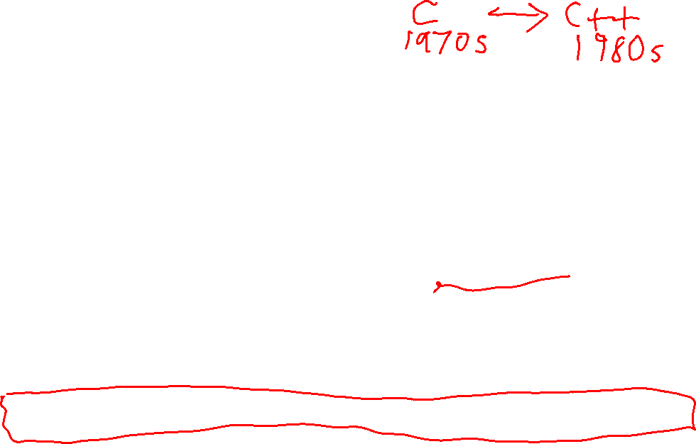
Pointers and Memory Management
Managing memory is a major topic in C++
While call-stack memory is automatically managed, free store memory is manually managed by the programmer
In contrast, most other programming languages automatically manage memory using a special program called a garbage collector that runs while your program runs
The garbage collector automatically de-allocates any unused memory
Garbage collectors can result in slightly slower programs, or programs with short pauses, which might not be acceptable in real-time applications
In C++, to use free store memory you must use pointers …

Slide 42
Memory of a running C++ program
456
457
458
459
460
1291
1292
1293
1294
. . .
. . .
. . .
This starting address is probably different every time you run the program. 456 is an arbitrary value
You can think of the memory of a running C++ program as a long array of bytes.
But this array probably doesn’t start at address 0: it is placed in a free region of memory in your computer by the operating system.
When you run a program, the operating system (OS) gives your program a chunk of memory it can use. Accessing memory out of these bounds is usually makes the OS kill your program

Slide 43
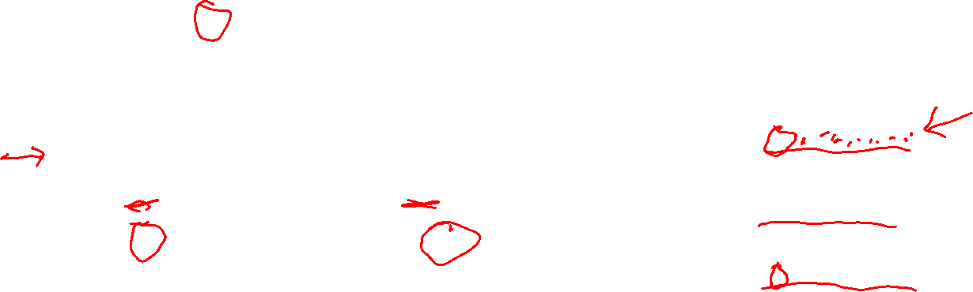
Memory of a running C++ program
The 0x at the start means hexadecimal (base 16). Each digit/letter is 4 bits.
456
457
458
459
460
1291
1292
1293
1294
. . .
'a'
. . .
. . .
c
value of c: a
address of c: 0x7ffdf3f9a7d7
value of c: a
address of c: 0x7fff62a536c7
value of c: a
address of c: 0x7fff6ba0fa47
char c = 'a'; cout << c; // prints value of c: 'a' cout << &c; // prints address of c: 457
& is the address-of operator: &x returns the address of variable x
3 separate runs of the code different address for c each time

Slide 44

Memory of a running C++ program
456
457
458
459
460
1291
1292
1293
1294
. . .
'a'
. . .
. . .
c
char c = 'a'; cout << c; // prints value of c: 'a' cout << &c; // prints address of c: 457
char x = c; // put a copy of c’s value in x
??? px = &x; // store the address of x in px
Question: what is the type of an address?

Slide 45
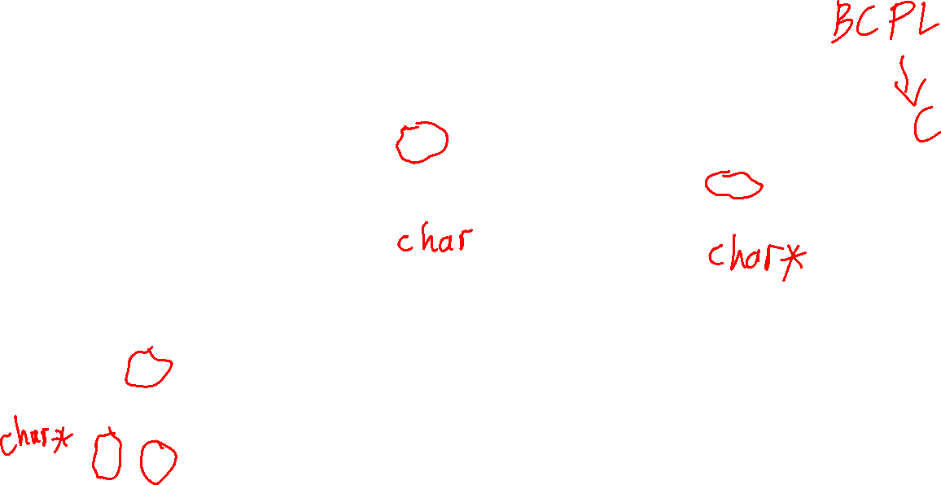
Memory of a running C++ program
456
457
458
459
460
1291
1292
1293
1294
. . .
'a'
'a'
. . .
460
. . .
c
x
px
char c = 'a'; cout << c; // prints value of c: 'a' cout << &c; // prints address of c: 457
char x = c; // put a copy of c’s value in x
??? px = &x; // store the address of x in px
Question: what is the type of an address?

Slide 46
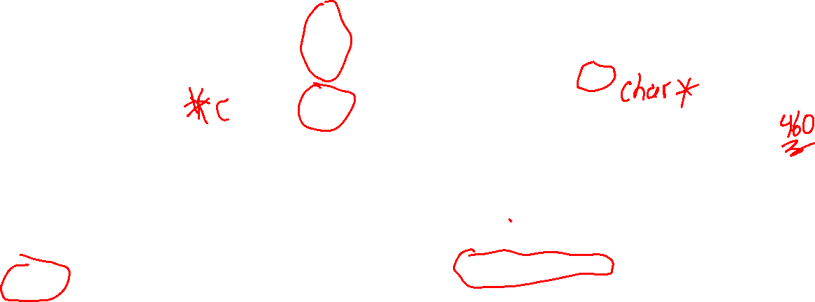
Memory of a running C++ program
456
457
458
459
460
1291
1292
1293
1294
. . .
'a'
'a'
. . .
460
. . .
c
x
px
*px
char c = 'a'; cout << c; // prints value of c: 'a' cout << &c; // prints address of c: 457
char x = c; // put a copy of c’s value in x
char* px = &x; // store address of x in px
cout << px; // print value of px: 460 cout << *px; // print value at address // contained in px: 'a'
*px is called a pointer de-reference: it is the value in the address px stores
Address 460 now has two names: x and *px
Question: what is the type of an address?

Slide 47
Memory of a running C++ program
Usually we don’t write a specific address … we write variables and draw arrows …
457
460
1293
'a'
'a'
460
c
x
px
*px
char c = 'a'; cout << c; // prints value of c: 'a' cout << &c; // prints address of c: 457
char x = c; // put a copy of c’s value in x
char* px = &x; // store address of x in px
cout << px; // print value of px: 460 cout << *px; // print value at address // contained in px: 'a'
*px is called a pointer de-reference: it is the value in the address px stores
Address 460 now has two names: x and *px
Question: what is the type of an address?

Slide 48
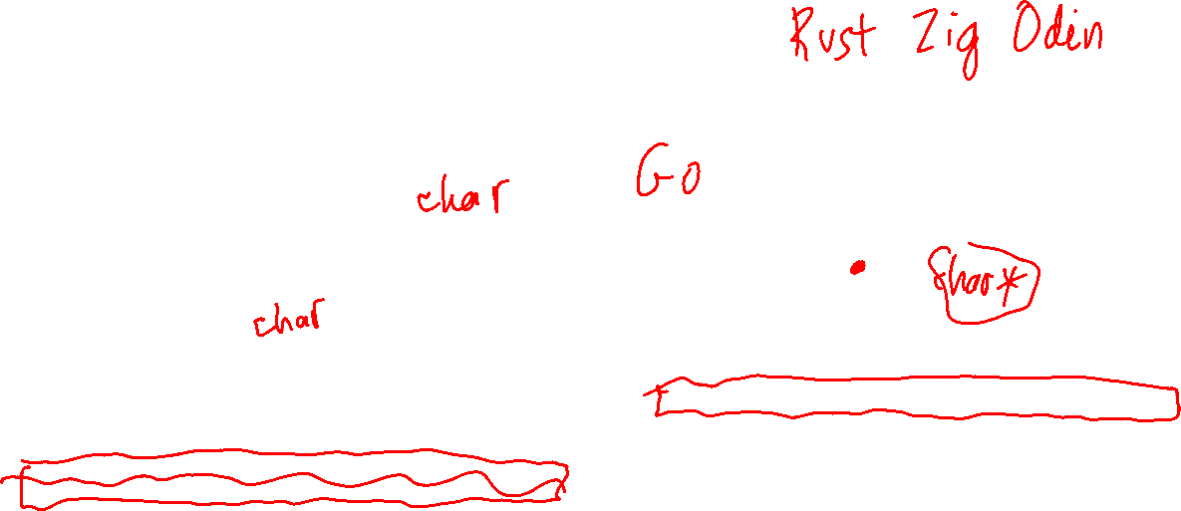
Memory of a running C++ program
Usually we just draw the variables we care about with a specific address …
'a'
'a'
c
x
px
*px
char c = 'a'; cout << c; // prints value of c: 'a' cout << &c; // prints address of c: 457
char x = c; // put a copy of c’s value in x
char* px = &x; // store address of x in px
cout << px; // print value of px: 460 cout << *px; // print value at address // contained in px: 'a'
*px is called a pointer de-reference: it is the value in the address px stores
Address 460 now has two names: x and *px
Question: what is the type of an address?

Slide 49
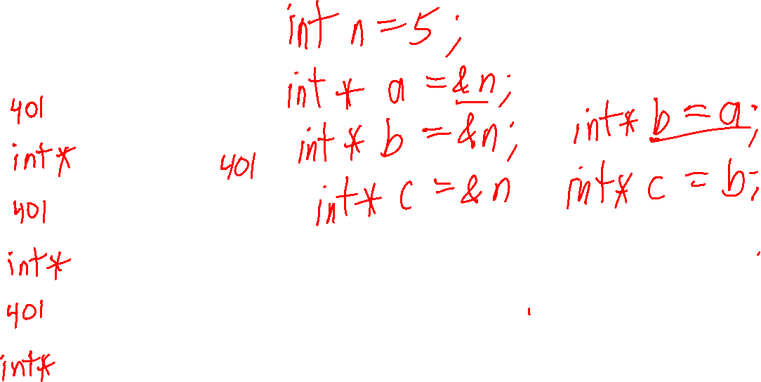
Memory of a running C++ program
Challenge
Write a program that makes memory look like this.
a
5
n
b
int
c

Slide 50
Memory of a running C++ program
Challenge
Write a program that makes memory look like this.
int n = 5;
int* a = &n;
int* b = &n;
int* c = &n;
a
int*
5
n
b
int
int*
c
int*

Slide 51
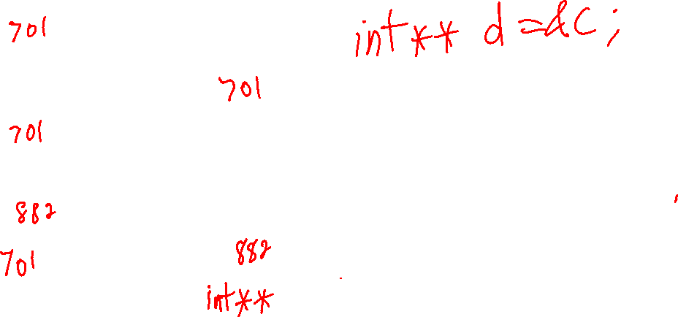
Memory of a running C++ program
int n = 5;
int* a = &n;
int* b = &n;
int* c = &n;
a
int*
5
n
b
int
int*
d
Challenge
Modify the program to make memory look like this.
c
int*

Slide 52
Memory of a running C++ program
int n = 5;
int* a = &n;
int* b = &n;
int* c = &n; int** d = &c;
a
int*
5
n
b
int
int*
d
Challenge
Modify the program to make memory look like this.
c
int*
int**

Slide 53
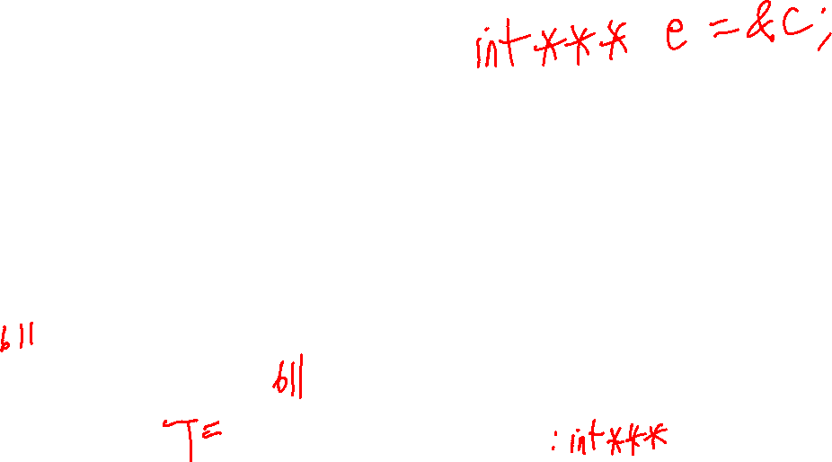
Memory of a running C++ program
int n = 5;
int* a = &n;
int* b = &n;
int* c = &n; int** d = &c;
a
int*
5
n
b
int
int*
d
Challenge
Modify the program to make memory look like this.
c
e
int*
int**

Slide 54
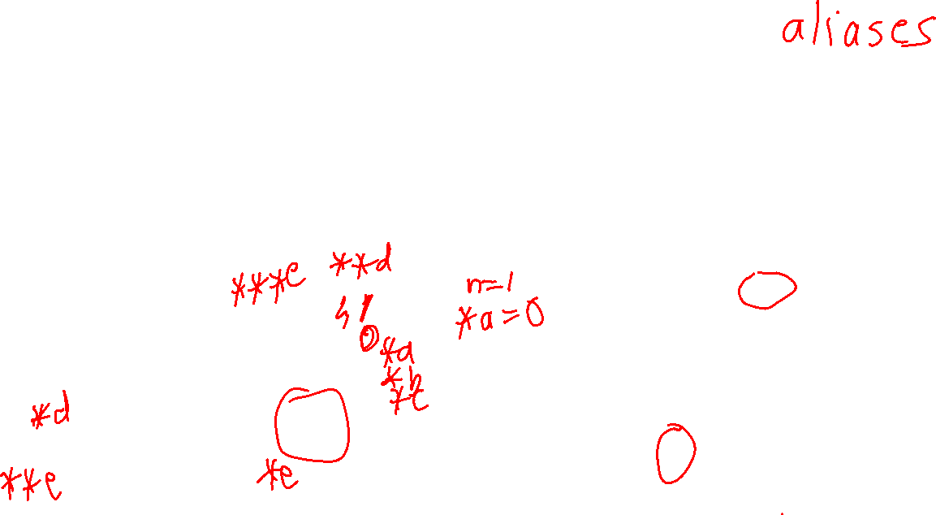
Memory of a running C++ program
int n = 5;
int* a = &n;
int* b = &n;
int* c = &n; int** d = &c; int*** e = &d;
Different names (aliases) for the int that n refers to:
n
*a *b *c **d
***e
a
int*
5
n
b
int
int*
d
Challenge
Modify the program to make memory look like this.
c
e
int*
int**

Slide 55
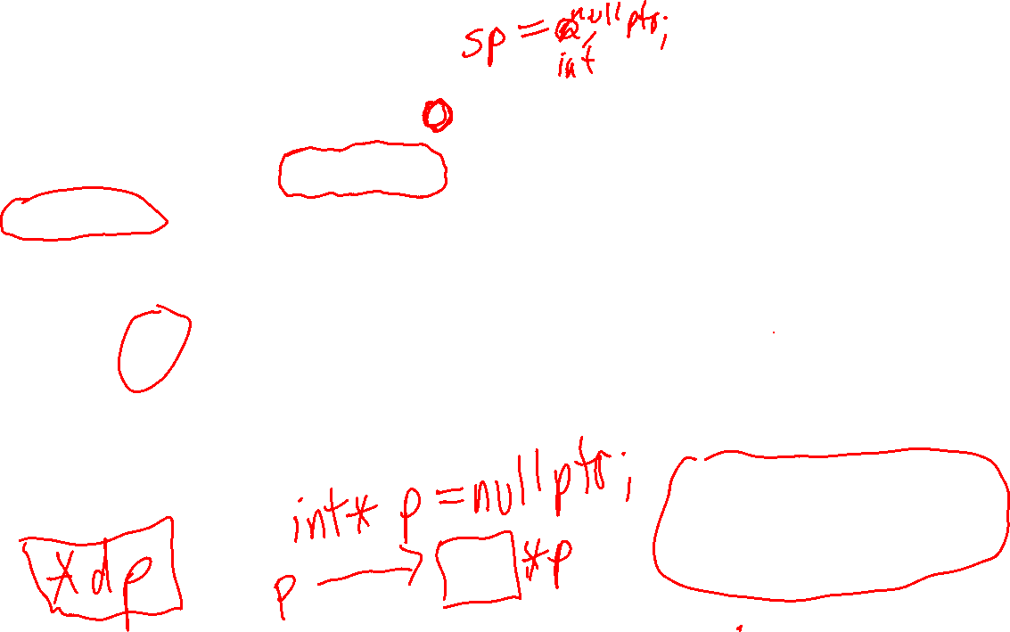
The null Pointer
nullptr is a special pointer value that means the pointer is not pointing to a valid memory location.
int* ip = nullptr; string* sp = nullptr;
double* dp = nullptr;
In earlier versions of C++, 0 is used instead of nullptr. But use nullptr instead: it’s clearer.
ip
De-referencing a nullptr is always an error, e.g. *ip is always an invalid expression.
The “ground” symbol from electronics represents a null pointer.
sp
Danger! You must always be 100% sure p is not the nullptr when you evaluate the expression *p.
dp

Slide 56

Some general rules
313782
If x is a variable, then &x is the address where the value of x is stored
x
5
&x == 313782
int
If T is a C++ type, then T* is the type of a pointer to a value of type T
9047
2055
x
val
px
9047
T
T*
If p points to a value, then *p evaluates to the value being pointed to
4473
3900
p
3900
val
X *p
T*
T
If p == nullptr, then evaluating *p is always an error
p
*p is an error!

