Slide 1

CMPT 135
Remember to finish the weekly quiz!
Assignment 2 is due next week!
Week 5
Introduction to object-oriented programming

Slide 2
Object-oriented programming: dates
Let’s look at a class called Date that represents a date as (day, month, year)
1 <= day <= 31
1 <= month <= 12
0 <= year (an int)
For example, February 15, 2024 is (15, 2, 2024)
class Date {
public:
int day; int month; int year;
};
When using object-oriented features of C++, some programmers prefer to use class since it signals OOP is being used.

Slide 3

Object-oriented programming: members
class Date {
public:
int day; int month; int year; void print() const {
cout << "(" << day
<< ", " << month
<< ", " << year
<< ")";
} void println() const {
print();
cout << "\n";
}
};
Let’s look at a class called Date that represents a date as (day, month, year)
1 <= day <= 31
1 <= month <= 12
0 <= year (an int)
For example, February 15, 2024 is (15, 2, 2024)
day, month, and year are public member variables
Date d{15, 2, 2024}; d.println(); // (15, 2, 2024)

Slide 4
Object-oriented programming: const methods
class Date {
public:
int day; int month; int year; void print() const {
cout << "(" << day
<< ", " << month
<< ", " << year
<< ")";
} void println() const {
print();
cout << "\n";
}
};
day, month, and year are public member variables
Let’s look at a class called Date that represents a date as (day, month, year)
1 <= day <= 31
1 <= month <= 12
0 <= year (an int)
For example, February 15, 2024 is (15, 2, 2024)
print() and println() are public const methods
Date d{15, 2, 2024}; d.println(); // (15, 2, 2024)

Slide 5
Object-oriented programming: const methods
class Date {
public:
int day; int month; int year; void print() const {
cout << "(" << day
<< ", " << month
<< ", " << year
<< ")";
} void println() const {
print();
cout << "\n";
}
};
If a method is declared const, it is guaranteed by the compiler that it will not change any variables in the object.
Let’s look at a class called Date that represents a date as (day, month, year)
1 <= day <= 31
1 <= month <= 12
0 <= year (an int)
For example, February 15, 2024 is (15, 2, 2024)
print() and println() are both declared const, so calling the on a Date object is guaranteed (by the compiler!) to not modify the objects.
Date d{15, 2, 2024}; d.println(); // (15, 2, 2024)

Slide 6
Object-oriented programming: const methods
A const method is also called a non-mutating method.
A non-const method is called a mutating method, or a mutator for short.
class Date {
public:
int day; int month; int year; void print() const {
cout << "(" << day
<< ", " << month
<< ", " << year
<< ")";
} void println() const {
print();
cout << "\n";
}
};
Let’s look at a class called Date that represents a date as (day, month, year)
1 <= day <= 31
1 <= month <= 12
0 <= year (an int)
For example, February 15, 2024 is (15, 2, 2024)
Date d{15, 2, 2024}; d.println(); // (15, 2, 2024)

Slide 7

What are some benefits of using const?
We will use const for parameters, read-only variables, and methods.
Consistently using const throughout your code is called const correctness: if something can be const, then make it const.

Slide 8
What are some benefits of using const?
We will use const for parameters, read-only variables, and methods.
Consistently using const throughout your code is called const correctness: if something can be const, then make it const.
Improved code readability and intent: using const makes it clear that you intend that a value should not change
Compile-type type checking: the C++ compiler can tell you at compile-time if you try to modify something that’s const
Safety for multi-threaded code: data that can’t change is much easier to use in programs that use multiple CPUs, or have multiple threads of control
“multi-threaded code” means code that does more than one thing at the same time
writing correct multi-threaded code is notoriously difficult
if an object is const, then it’s impossible for different threads to change the object at the same time (a very common source of errors)
we will not discuss anything about multi-threaded programming in this course!

Slide 9
Object-oriented programming: validity checking
Let’s look at a class called Date that represents a date as (day, month, year)
1 <= day <= 31
1 <= month <= 12
0 <= year (an int)
For example, February 15, 2024 is (15, 2, 2024)
class Date {
public:
int day; int month; int year;
bool is_valid() const
{
return 1 <= day && day <= 31
&& 1 <= month && month <= 12
&& 0 <= year;
}
// …
};
is_valid() checks that the date is always valid. Useful for debugging, and dealing with real-world data that might have errors.
Aside is_valid() is not completely correct! It ignores the fact that some months have a different numbers of days. And it also ignores leap years. How would you fix it?
Date d{15, 2, 2024}; assert(d.is_valid());

Slide 10
Object-oriented programming: constructors
Let’s look at a class called Date that represents a date as (day, month, year)
1 <= day <= 31
1 <= month <= 12
0 <= year (an int)
For example, February 15, 2024 is (15, 2, 2024)
class Date {
public:
int day; int month; int year;
Date(int d, int m, int y)
: day(d), month(m), year(y)
{ } // …
};
This is a constructor. A constructor is a special method that creates a new object.
Date d(15, 2, 2024); cout << d.day; // 15 cout << d.month; // 2 cout << d.year; // 2024

Slide 11
Object-oriented programming: constructors
class Date {
public:
int day; int month; int year;
Date(int d, int m, int y)
: day(d), month(m), year(y)
{ } // …
};
Let’s look at a class called Date that represents a date as (day, month, year)
1 <= day <= 31
1 <= month <= 12
0 <= year (an int)
For example, February 15, 2024 is (15, 2, 2024)
The constructor takes as input whatever it needs to properly initialize itself.
No explicit return type.
Same name as the class.

Slide 12
Object-oriented programming: constructors
Let’s look at a class called Date that represents a date as (day, month, year)
1 <= day <= 31
1 <= month <= 12
0 <= year (an int)
For example, February 15, 2024 is (15, 2, 2024)
class Date {
public:
int day; int month; int year;
Date(int d, int m, int y)
: day(d), month(m), year(y)
{ } // …
};
This is an initializer list. Its job is to initialize variables in the class.
starts with :
A comma-separated list of variables with initial values.
Initializer lists use the v(val) notation style to initialize variables.
This works with more kinds of objects than v=val style notation.
Not all objects work with operator=

Slide 13
Object-oriented programming: constructors
Let’s look at a class called Date that represents a date as (day, month, year)
1 <= day <= 31
1 <= month <= 12
0 <= year (an int)
For example, February 15, 2024 is (15, 2, 2024)
class Date {
public:
int day; int month; int year;
Date(int d, int m, int y)
: day(d), month(m), year(y)
{ } // …
};
In this case, the initializer list does everything we need and so the body is empty. But, in general, you can put whatever initialization code you need in the body.

Slide 14
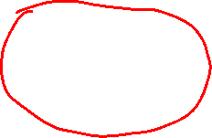
Object-oriented programming: constructors
Let’s look at a class called Date that represents a date as (day, month, year)
1 <= day <= 31
1 <= month <= 12
0 <= year (an int)
For example, February 15, 2024 is (15, 2, 2024)
class Date {
public:
int day; int month; int year;
Date(int d, int m, int y)
: day(d), month(m), year(y)
{ assert(is_valid()); } // …
};
For example, we could check that the passed-in data is valid. This way, there’s no way to construct an invalid Date.

Slide 15
Object-oriented programming: copy constructor
class Date {
public:
int day; int month; int year; // …
Date(const Date& other)
: day(other.day), month(other.month), year(other.year)
{ } // …
};
Let’s look at a class called Date that represents a date as (day, month, year)
1 <= day <= 31
1 <= month <= 12
0 <= year (an int)
For example, February 15, 2024 is (15, 2, 2024)
A class can have multiple constructors. A copy constructor makes a copy of another object of the same type.
Date d(15, 2, 2024); Date a(d); // copy constructor called cout << a.day; // 15 cout << a.month; // 2

Slide 16

Object-oriented programming: encapsulation
Encapsulation is the idea of protecting the implementation details of an object. We’ll refine it to two main ideas:

Slide 17
Object-oriented programming: encapsulation
Encapsulation is the idea of protecting the implementation details of an object. We’ll refine it to two main ideas:
Data hiding. The implementation details of an object are intentionally hidden from the programmer. Thus they don’t need to worry about those details, and it allows for changing the object’s implementation later.
Example: a std::string is typically implemented using an array of characters, and the programmer does not need to know this when they use it.
Censored!

Slide 18
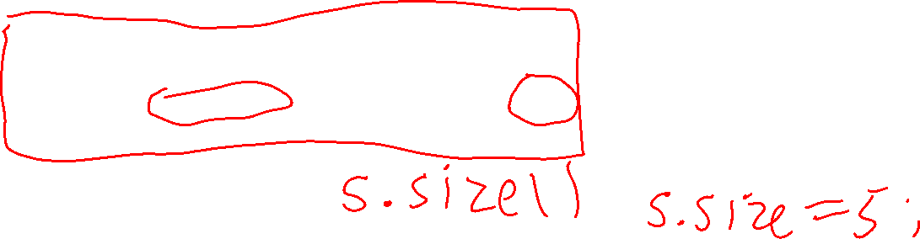
Object-oriented programming: encapsulation
Encapsulation is the idea of protecting the implementation details of an object. We’ll refine it to two main ideas:
Data hiding. The implementation details of an object are intentionally hidden from the programmer. Thus they don’t need to worry about those details, and it allows for changing the object’s implementation later.
Example: a std::string is typically implemented using an array of characters, and the programmer does not need to know this when they use it.
Access control. The object carefully controls how you can read/write its variables. This can simplify interacting with the object.
Example: in a std::string object, you can read the size of the string, but you cannot set the size of the string directly

Slide 19

Object-oriented programming: encapsulation
Let’s look at a class called Date that represents a date as (day, month, year)
1 <= day <= 31
1 <= month <= 12
0 <= year (an int)
For example, February 15, 2024 is (15, 2, 2024)
class Date {
int day; int month; int year; public:
Date(int d, int m, int y)
: day(d), month(m), year(y)
{ assert(is_valid()); } // …
};
These variables are now private, i.e. they can only be accessed by code in the Date class. Code outside of Date cannot directly access them.
Date d(15, 2, 2024); // okay cout << d.day; // compiler error! cout << d.month; // compiler error!
cout << d.year; // compiler error!

Slide 20
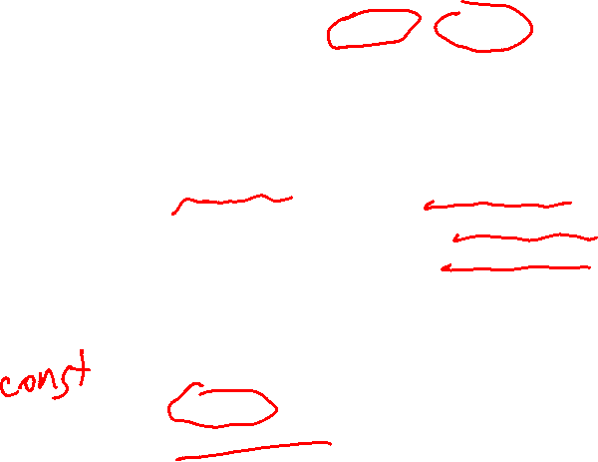
Object-oriented programming: getters
Let’s look at a class called Date that represents a date as (day, month, year)
1 <= day <= 31
1 <= month <= 12
0 <= year (an int)
For example, February 15, 2024 is (15, 2, 2024)
class Date {
int day; int month; int year; public:
// …
int get_day() const { return day; } int get_month() const { return month; } int get_year() const { return year; } // …
};
These three methods are called getters, or accessors. They return a value of an object’s variable. Getters are usually don’t modify the object, and so they are usually const.
Date d(15, 2, 2024); // okay cout << d.day; // compiler error! cout << d.get_day(); // okay

Slide 21

Object-oriented programming: getters
Let’s look at a class called Date that represents a date as (day, month, year)
1 <= day <= 31
1 <= month <= 12
0 <= year (an int)
For example, February 15, 2024 is (15, 2, 2024)
class Date {
int day; int month; int year; public:
// …
int get_day() const { return day; } int get_month() const { return month; } int get_year() const { return year; } // …
};
Important!
A getter does not need to just return a variable. It can run any necessary code.
Date d(15, 2, 2024); // okay cout << d.day; // compiler error! cout << d.get_day(); // okay

Slide 22
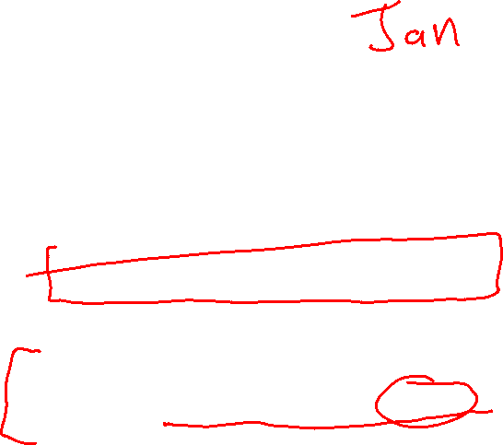
Object-oriented programming: getters
Let’s look at a class called Date that represents a date as (day, month, year)
1 <= day <= 31
1 <= month <= 12
0 <= year (an int)
For example, February 15, 2024 is (15, 2, 2024)
class Date {
int day; int month; int year; const string short_month_names[] = {"Jan", "Feb", …, "Dec"};
public:
// …
string get_short_month_name() const { return short_month_names[month-1];
}
// …
};
Note how straightforward and obvious the names are: this is an example of self-documenting code.
Date d(15, 2, 2024); // okay cout << d.get_short_month_name(); // Feb

Slide 23
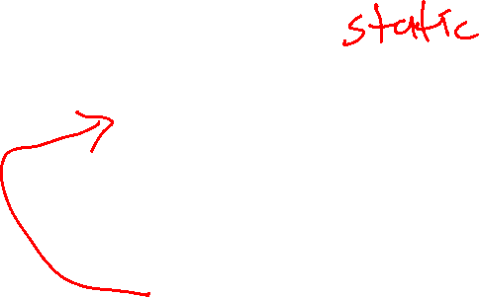
Object-oriented programming: getters
Putting a const array of all 12 months in every object wastes memory. How could you modify Date to avoid duplicating this array?
Let’s look at a class called Date that represents a date as (day, month, year)
1 <= day <= 31
1 <= month <= 12
0 <= year (an int)
For example, February 15, 2024 is (15, 2, 2024)
class Date {
int day; int month; int year; const string short_month_names[] = {"Jan", "Feb", …, "Dec"};
public:
// …
string get_short_month_name() const { return short_month_names[month-1];
}
// …
};
Date d(15, 2, 2024); // okay cout << d.get_short_month_name(); // Feb

Slide 24

Object-oriented programming: setters
Let’s look at a class called Date that represents a date as (day, month, year)
1 <= day <= 31
1 <= month <= 12
0 <= year (an int)
For example, February 15, 2024 is (15, 2, 2024)
class Date {
int day; int month; int year; public:
// …
void set_day(int d) { day = d; } void set_month(int m) { month = m; } void set_year(int y) { year = y; } // …
};
These three methods are called setters, or mutators. They change the value of on object’s variable. Setters can’t be const.
Date d(15, 2, 2024); // okay d.day = 10; // compiler error! d.set_day(10); // okay

Slide 25

Object-oriented programming: setters
class Date {
int day; int month; int year; public:
// …
void set_day(int d) { if (d < 1 || d > 31) { assert("error!"); } day = d; } // …
};
As with getters, setters can do more than just assign a value. We could, for example, do error checking.
Let’s look at a class called Date that represents a date as (day, month, year)
1 <= day <= 31
1 <= month <= 12
0 <= year (an int)
For example, February 15, 2024 is (15, 2, 2024)
Date d(15, 2, 2024); // okay d.set_day(32); // run-time error! d.set_day(10); // okay

Slide 26

Object-oriented programming: immutable objects
A common pattern in OOP is to use getters, but no setters of any kind. Once such an object is created, it can never change. This makes it easier to reason about the object, and can speed up certain operations, e.g. copying the object is just making a pointer point to it.
Let’s look at a class called Date that represents a date as (day, month, year)
1 <= day <= 31
1 <= month <= 12
0 <= year (an int)
For example, February 15, 2024 is (15, 2, 2024)
class Date {
int day; int month; int year; public:
// …
int get_day() const { return day; } int get_month() const { return month; } int get_year() const { return year; } // no getters or other mutating methods
};

Slide 27

Object-oriented programming: immutable objects
Let’s look at a class called Date that represents a date as (day, month, year)
1 <= day <= 31
1 <= month <= 12
0 <= year (an int)
For example, February 15, 2024 is (15, 2, 2024)
class Date {
int day; int month; int year; public:
// …
int get_day() const { return day; } int get_month() const { return month; } int get_year() const { return year; } // no getters or other mutating methods
Date next_year() const {
return Date{day, month, year + 1};
}
};
Since you can’t modify a Date, all you can do is create new Dates with the values you want, as next_year does.

Slide 28
Recap of main OOP ideas so far
Combine data and operations together in a single object
A class/struct is like a blueprint that describes the contents of an object
The variables in an object are called member variables or properties
The member functions in an object are called methods, and they can access any other variables or methods in the object
Constructors create objects: they initialize their variables using initializer lists
Use private to hide implementation details
Getters return values from objects
Setters change values of objects
Objects with no public variables and no setters are called immutable objects. Deciding if an object can, or should, be immutable is an important design decision.

Slide 29
Designing an (x, y) point class
Design a class for representing (x, y) points.
Before writing the solution, lets take some time to think about how we want it to work …

Slide 30
Designing an (x, y) point class
At least three different constructors.
Design a class for representing (x, y) points.
Before writing the solution, lets take some time to think about how we want it to work …
We want it to be easy to create points:
Point a(4, -5);
Point b(a); // copy constructor
Point origin; // default constructor: (0, 0)

Slide 31

Designing an (x, y) point class
Design a class for representing (x, y) points.
Before writing the solution, lets take some time to think about how we want it to work …
What should be public/private in Point? If we make x and y private then we’ll need setters/getters:
Point a(4, -5);
cout << a.get_x(); a.set_x(3);
If we made x and y public, then code will look like this:
Point a(4, -5);
cout << a.x; a.x = 3;

Slide 32
Designing an (x, y) point class
Design a class for representing (x, y) points.
Before writing the solution, lets take some time to think about how we want it to work …
What should be public/private in Point? If we make x and y private then we’ll need setters/getters:
Point a(4, -5);
cout << a.get_x(); a.set_x(3);
If we made x and y public, then code will look like this:
Point a(4, -5);
cout << a.x; a.x = 3;
Which should we choose?

Slide 33
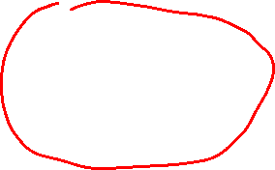
Designing an (x, y) point class
Design a class for representing (x, y) points.
Before writing the solution, lets take some time to think about how we want it to work …
What should be public/private in Point? If we make x and y private then we’ll need setters/getters:
Point a(4, -5);
cout << a.get_x(); a.set_x(3);
If we made x and y public, then code will look like this:
Point a(4, -5);
cout << a.x; a.x = 3;
Which should we choose? Since there does not seem to be any obvious restrictions on accessing x and y, lets make them public. The calling code will be simpler.

Slide 34

Designing an (x, y) point class
Design a class for representing (x, y) points.
Before writing the solution, lets take some time to think about how we want it to work …
Do we want points to be mutable or immutable? Like this:
Point a(4, -5);
cout << a.x; a.x = 3; // this is a setter: a has changed
Or like this:
Point a(4, -5);
cout << a.x;
// a.x = 3; // compiler error: // no mutations allowed
Which should we choose?

Slide 35
Designing an (x, y) point class
Design a class for representing (x, y) points.
Before writing the solution, lets take some time to think about how we want it to work …
Do we want points to be mutable or immutable? Like this:
Point a(4, -5);
cout << a.x; a.x = 3; // this is a setter: a has changed
Or like this:
Point a(4, -5);
cout << a.x;
// a.x = 3; // compiler error: // no mutations allowed
Which should we choose? Let’s make Point immutable. That’s a good default choice. We can re-visit this later if we find situations in practice where this is a bad choice.

Slide 36
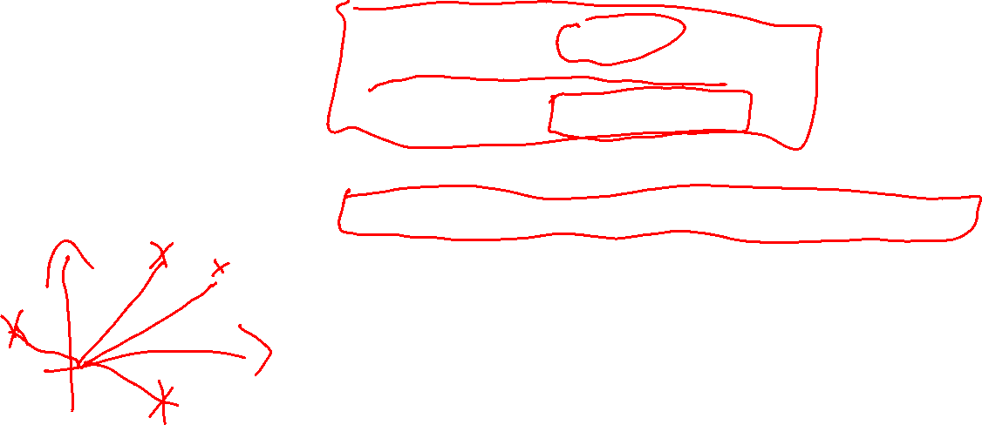
Designing an (x, y) point class
Design a class for representing (x, y) points.
Before writing the solution, lets take some time to think about how we want it to work …
What methods would be useful to add to Point? Here are some:
return a string representation of the Point, e.g. Point(2, 1) is "(2,1)"
compute the distance between two points
test if two points are the same
add two points, e.g. (1, 2) + (3, 4) = (4, 6)
In addition, write this function (not method!) to help test Point:
Point furthest_from_origin(const vector<Point> &pts)
Deciding what methods ought to be in an object can sometimes be tricky. We usually want to put the most used methods in it and leave out highly specialized methods (those can be added later as functions, or through inheritance).

Slide 37
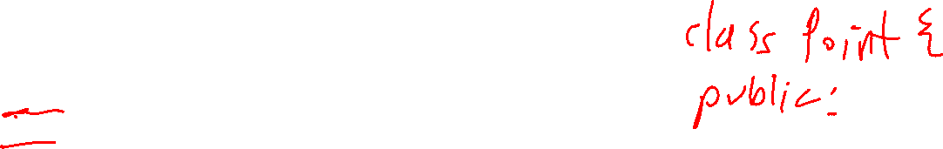
Implementing an (x, y) point class
Everything is public in Point, so let's use a struct.
struct Point
{
const int x;
const int y;
};
Our points are immutable, so we make x and y const. This will allow code to read them, but not to change them.

Slide 38
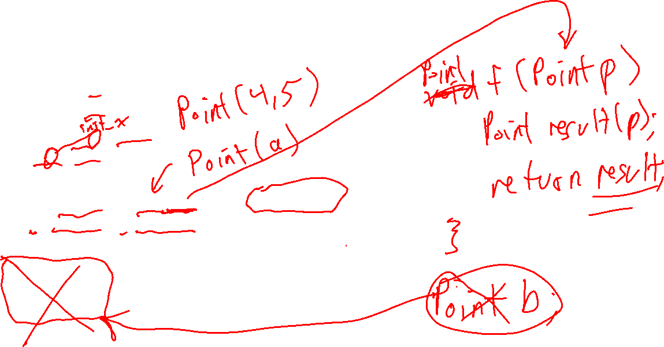
Implementing an (x, y) point class
struct Point
{
const int x;
const int y;
Point(int x, int y)
: x(x), y(y)
{}
Point(const Point &other)
: x(other.x), y(other.y)
{}
Point()
: x(0), y(0)
{}
};
A copy constructor takes another Point object as input and copies it (x, y) values.
A default constructor takes no inputs, and assigns x and y some sensible default values, in this case (0, 0).

Slide 39

Implementing an (x, y) point class
Point a(4, -5);
assert(a.x == 4);
assert(a.y == -5);
Point b(a); // copy constructor
assert(b.x == 4);
assert(b.y == -5);
Point origin; // default constructor: (0, 0)
assert(origin.x == 0);
assert(origin.y == 0);
struct Point
{
const int x;
const int y;
Point(int x, int y)
: x(x), y(y)
{}
Point(const Point &other)
: x(other.x), y(other.y)
{}
Point()
: x(0), y(0)
{}
};
A copy constructor takes another Point object as input and copies it (x, y) values.
With only some of Point implemented, we can write some useful test code. Test as you go!
A default constructor takes no inputs, and assigns x and y some sensible default values, in this case (0, 0).

Slide 40
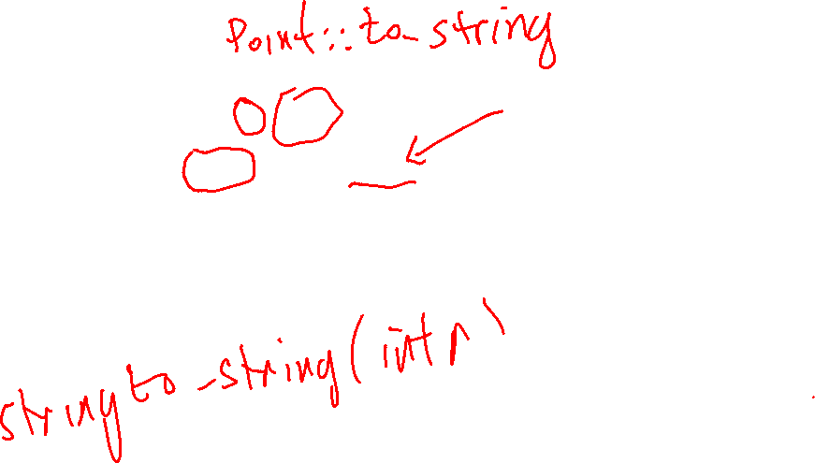
Implementing an (x, y) point class
assert(a.to_string() == "(4, -5)");
assert(b.to_string() == "(4, -5)");
assert(origin.to_string() == "(0, 0)");
struct Point
{
// ...
string to_string() const {
return "("
+ std::to_string(x)
+ ", "
+ std::to_string(y) + ")"; }
};
With only some of Point implemented, we can write some useful test code. Test as you go!

Slide 41
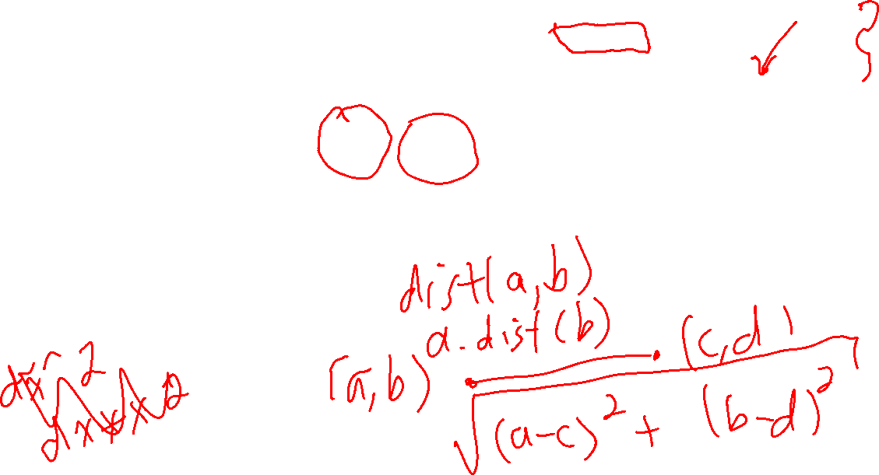
Implementing an (x, y) point class
assert(a.dist_to(b) == 0);
assert(b.dist_to(a) == 0);
assert(a.dist_to(a) == 0);
assert(a.dist_to(origin) == 6.4031242374328485);
assert(origin.dist_to(Point(3, 0)) == 3);
struct Point
{
// ...
double dist_to(const Point &other) const
{
int dx = x - other.x;
int dy = y - other.y;
return sqrt(dx * dx + dy * dy);
}
};
With only some of Point implemented, we can write some useful test code. Test as you go!
#include <cmath> to get sqrt

Slide 42
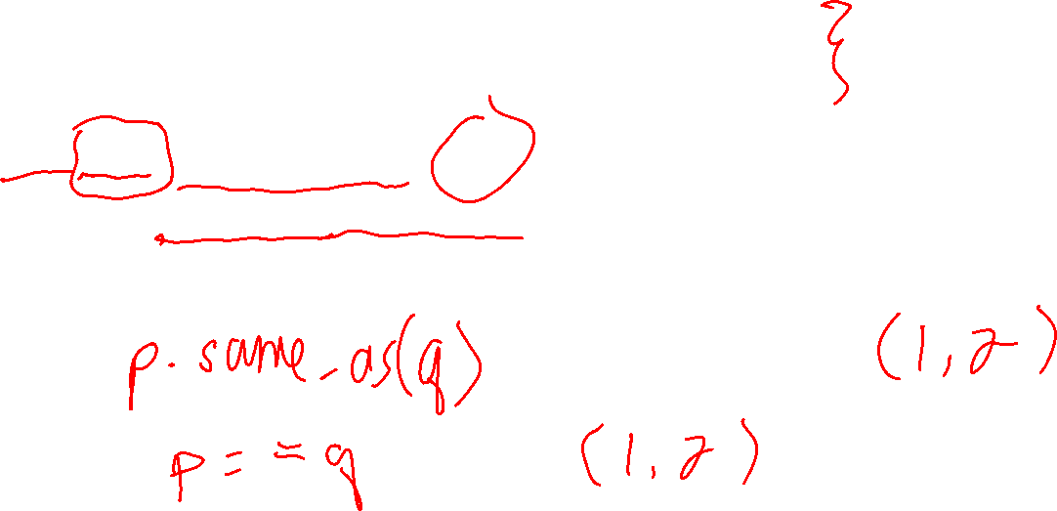
Implementing an (x, y) point class
assert(a.same_as(a));
assert(a.same_as(b));
assert(b.same_as(a));
assert(!a.same_as(origin));
assert(!origin.same_as(a));
struct Point
{
// ...
bool same_as(const Point &other) const
{
return x == other.x && y == other.y;
}
};
With only some of Point implemented, we can write some useful test code. Test as you go!

Slide 43
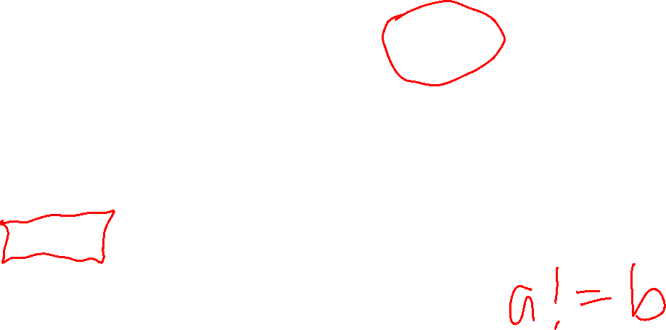
Implementing an (x, y) point class
assert(a == a);
assert(a == b);
assert(b == a);
struct Point
{
// ...
bool same_as(const Point &other) const
{
return x == other.x && y == other.y;
}
bool operator==(const Point &other) const
{
return same_as(other);
}
};
With only some of Point implemented, we can write some useful test code. Test as you go!
C++ lets you create your own versions of the == operator specific to a class. This can make it easier to read code that uses Point.

Slide 44
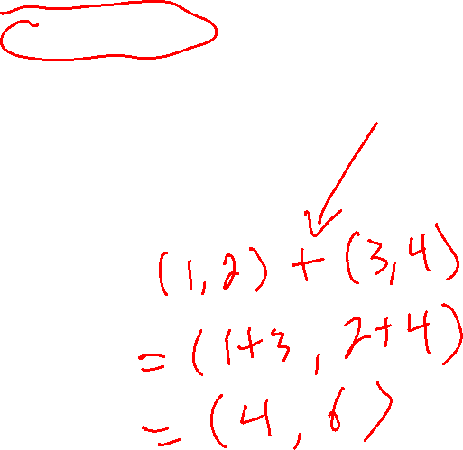
Implementing an (x, y) point class
assert(a == a);
assert(a == b);
assert(b == a); assert(a != origin);
assert(origin != a);
struct Point
{
// ...
bool same_as(const Point &other) const
{
return x == other.x && y == other.y;
}
bool operator==(const Point &other) const
{
return same_as(other);
}
bool operator!=(const Point &other) const {
return !same_as(other);
}
};
With only some of Point implemented, we can write some useful test code. Test as you go!

Slide 45
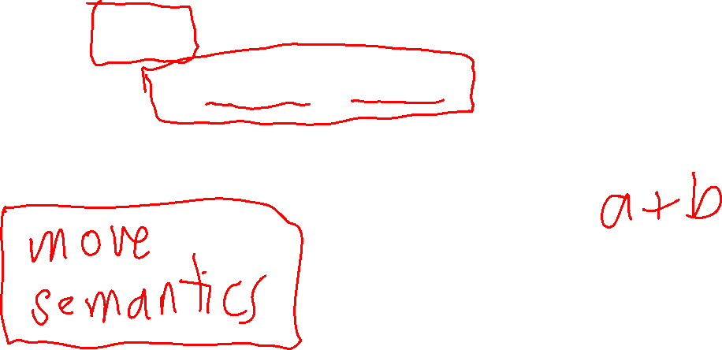
Implementing an (x, y) point class
assert(Point(1, 2) + Point(3, 4) == Point(4, 6));
assert(Point(3, 4) + Point(1, 2) == Point(4, 6));
assert(origin + a == a);
assert(a + origin == a);
assert(origin + origin == origin);
struct Point
{
// ...
Point operator+(const Point &other) const
{
return Point(x + other.x, y + other.y);
}
};
With only some of Point implemented, we can write some useful test code. Test as you go!
When you add 2 Point objects the result is a brand new third Point.

Slide 46

Implementing an (x, y) point class
vector<Point> points = {Point(1, 2), origin, Point(3, 4), Point(5, -6)};
assert(furthest_from_origin(points) == Point(5, -6));
struct Point
{
// ...
};
Point furthest_from_origin(const vector<Point> &pts)
{ assert(pts.size() > 0);
// ???
Before implementing furthest_from_origin, lets write some test code to help clarify how we want to use it, and to give us an example to work with.
How would you implement this function?

Slide 47
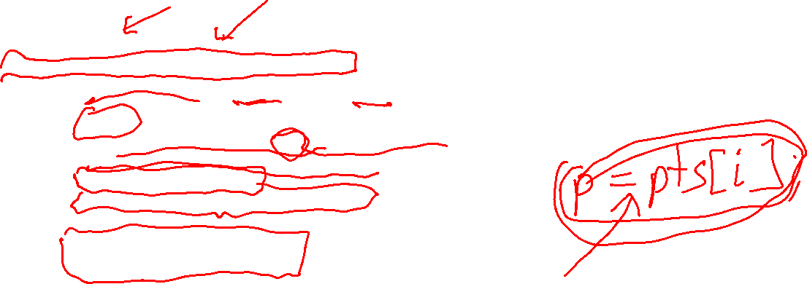
Implementing an (x, y) point class
struct Point
{
// ...
};
Point furthest_from_origin(const vector<Point> &pts) {
assert(points.size() > 0);
Point origin;
int index_of_furthest = 0;
Point first = points[index_of_furthest];
double dist_to_furthest = first.dist_to(origin);
for (int i = 1; i < points.size(); i++) {
double dist_to_current = pts[i].dist_to(origin);
if (dist_to_current > dist_to_furthest) {
index_of_furthest = i;
dist_to_furthest = dist_to_current;
}
}
return points[index_of_furthest];
}
vector<Point> points = {Point(1, 2), origin, Point(3, 4), Point(5, -6)};
assert(furthest_from_origin(points) == Point(5, -6));
Before implementing furthest_from_origin, lets write some test code to help clarify how we want to use it, and to give us an example to work with.

Slide 48
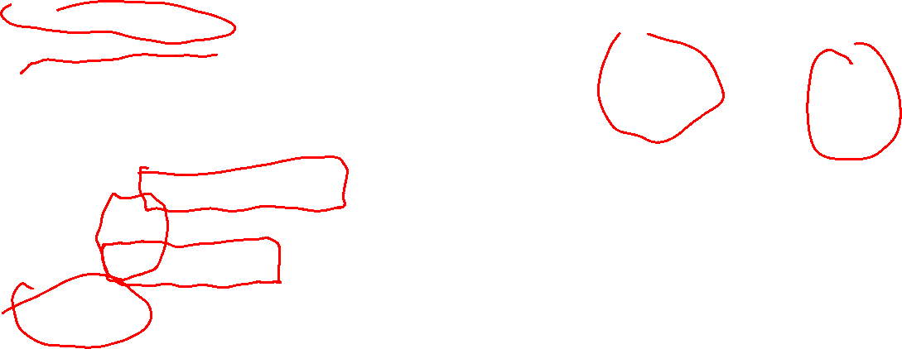
Implementing an (x, y) point class
You can use pointers with Point objects, and also allocate/de-allocate them on the free store with new/delete.
struct Point
{
// ...
};
void test_Point_pointers() {
Point a(4, -5);
Point* p = &a;
assert(p->x == 4);
assert(p->y == -5);
assert(p->to_string() == "(4, -5)");
Point* pt = new Point(1, 2);
assert(pt->x == 1);
assert(pt->y == 2);
assert(pt->to_string() == "(1, 2)");
delete pt;
}
Call stack
Free store
a
x: 4 y: 5 …
x: 1 y: 2 …
p
pt

Slide 49
Back to Free Store allocation
De-allocating free store memory is surprisingly tricky to do completely correctly in every case. There are two main problems …
Memory Leak
Dangling Pointer
A pointer that points to an invalid memory location.
value on free store
p
???
No pointer to the value, so it is unusable but takes up memory

Slide 50
Back to Free Store allocation
Call stack memory
Free store memory
new allocates memory on the free store
delete de-allocates memory on the free store
void f() { double* p = new double(6.4); cout << *p; // 6.4 delete p; }
p: 4962
f()
// …
4962
6.4
bottom of the stack

Slide 51
Back to Free Store allocation
void f() { double* p = new double(6.4);
cout << *p; // 6.4
delete p; }
new allocates memory on the store. It should be called when you need the memory
delete de-allocates memory on the free store. It should be called after you are done with the memory.

Slide 52
Back to Free Store allocation
void f() { double* p = new double(6.4);
cout << *p; // 6.4
delete p; }
allocate memory
Do stuff with the memory p points to.
de-allocate memory

Slide 53
Back to Free Store allocation
void f() { double* p = new double(6.4);
cout << *p; // 6.4
delete p; }
allocate memory
Do stuff with the memory p points to.
Solution Make delete be called automatically when } is reached.
de-allocate memory

Slide 54
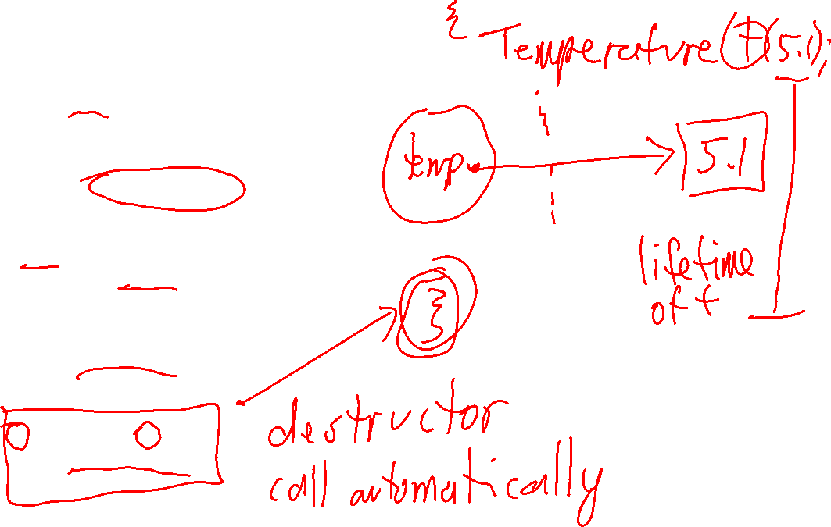
Back to Free Store allocation
class Temperature { double *temp;
public:
Temperature(double t) : temp(new double(t)) { }
double get_temp() const { return *temp; }
void set_temp(double t) { *temp = t; }
~Temperature() { delete temp; } };

Slide 55

Back to Free Store allocation
Important!
The destructor is always called automatically when the object it is associated with is de-allocated.
class Temperature { double *temp;
public:
Temperature(double t) : temp(new double(t)) { }
double get_temp() const { return *temp; }
void set_temp(double t) { *temp = t; }
~Temperature() { delete temp; } };
Constructor calls new
Since the destructor is called automatically, there is no way to call it at the wrong time.
The destructor is always the name of the class with a ~ at the start, and it always takes no inputs.
Destructor calls delete

Slide 56
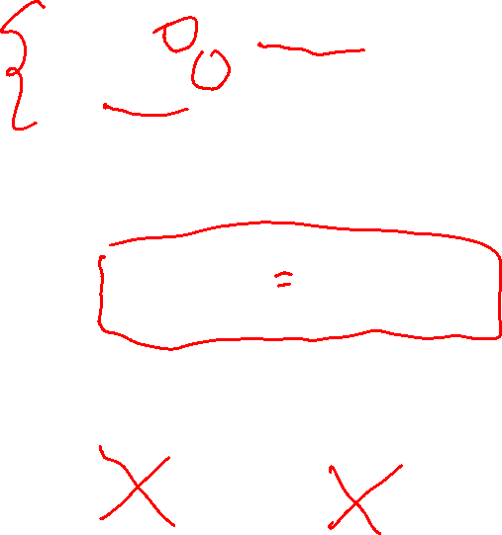
Back to Free Store allocation
class Temperature { double *temp;
public:
Temperature(double t) : temp(new double(t)) { }
double get_temp() const { return *temp; }
void set_temp(double t) { *temp = t; }
~Temperature() { delete temp; } };
void f() { double* p = new double(6.4); cout << *p; // 6.4 delete p; }
void g() { Temperature t(6.4);
cout << t.get_temp(); // 6.4 }
Call stack
Free store
t
temp: …
6.4

Slide 57
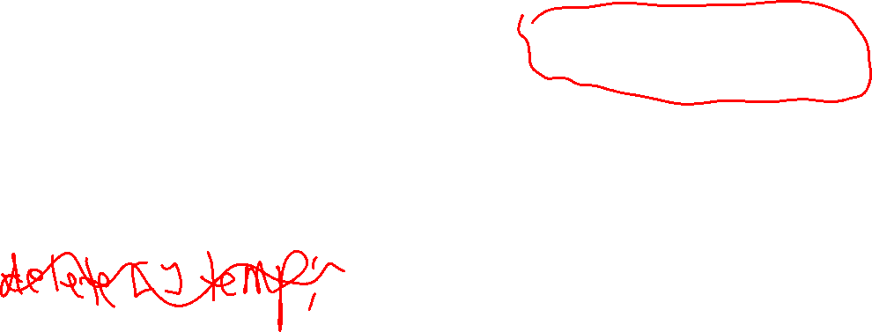
Back to Free Store allocation
class Temperature { double *temp;
public:
Temperature(double t) : temp(new double(t)) { }
double get_temp() const { return *temp; }
void set_temp(double t) { *temp = t; }
~Temperature() { delete temp; } };
void f() { double* p = new double(6.4); cout << *p; // 6.4 delete p; }
void g() { Temperature t(6.4);
cout << t.get_temp(); // 6.4 }
~Temperature() is automatically called when t goes out of scope. t is on the call stack, so it is de-allocated when it the flow of control hits }
No memory leak, no dangling pointer, no need to use pointer notation!
Call stack
Free store
t
temp: …
6.4

Slide 58
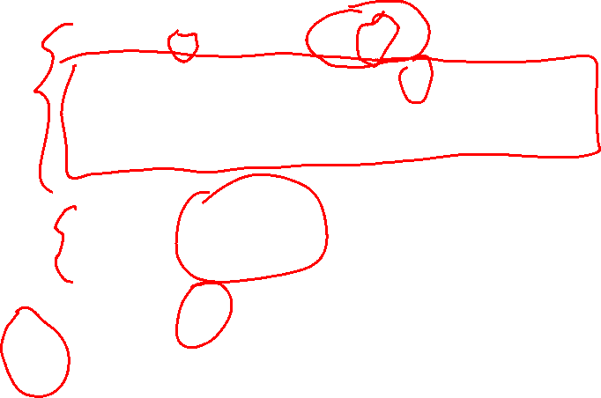
Back to Free Store allocation
void arr() {
int* a = new int[5];
for(int i = 0; i < 5; i++) {
a[i] = 0;
}
cout << a[3] << endl; // 0
delete[] a;
}
new allocates memory on the store. It should be called when you need the memory
Do stuff with the array
delete[] de-allocates memory on the free store. It should be called after you are done with the memory.

Slide 59
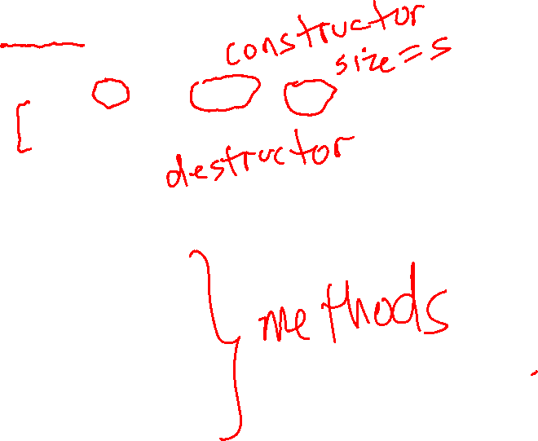
Back to Free Store allocation
class Fixed_array { int *data; int size; public: Fixed_array(int s) : data(new int[s]), size(s) { for (int i = 0; i < size; i++) { data[i] = 0; } }
~Fixed_array() { delete[] data; }
int get_size() const { return size; }
int get(int i) const { return data[i]; }
void set(int i, int value) { data[i] = value; }
}; // Fixed_array
new allocates memory on the store. It’s called when you need the memory
delete[] de-allocates memory on the free store. Since ~Fixed_array() is called automatically when the object is de-allocated, there’s no way to call it too soon, too late, or too many times.

Slide 60
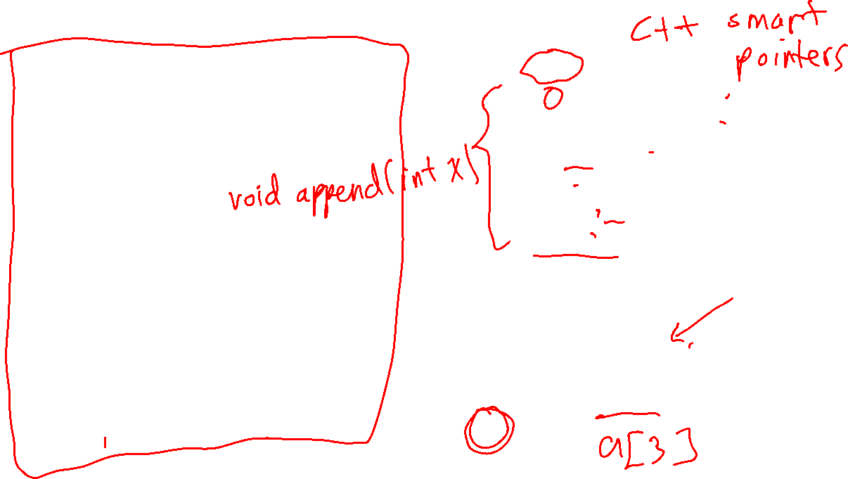
Back to Free Store allocation
class Fixed_array { int *data; int size; public: Fixed_array(int s) : data(new int[s]), size(s) { for (int i = 0; i < size; i++) { data[i] = 0; } }
~Fixed_array() { delete[] data; }
int get_size() const { return size; }
int get(int i) const { return data[i]; }
void set(int i, int value) { data[i] = value; }
}; // Fixed_array
void arr() {
int* a = new int[5];
for(int i = 0; i < 5; i++) {
a[i] = 0;
}
cout << a[3] << endl; // 0
delete[] a;
}
void fixed_arr() {
Fixed_array a(5);
cout << a.get(3) << endl; // 0
}

Slide 61

RAII: Resource Acquisition is Initialization
RAII is the idea of managing memory using objects
The memory
is allocated by the object’s constructor
exists for the life-time of the object
is automatically de-allocated when the object’s destructor is called
Allocating/de-allocating is completely handled by the object
No memory leaks, no dangling pointers!!
RAII can also be used for other resources
file handles, network connections, …

