Slide 1

CMPT 135
Week 3
Pointers and Memory Management

Slide 2
Administrative Notes
Two quizzes can still be submitted today:
Quiz 0
Academic Integrity
Assignment 1 is due this Wednesday
You should use std::sort or std::stable_sort in the assignment
Writing your own sort is likely going to be much slower, and possibly have bugs
We’ll discuss sorting later in the course

Slide 3
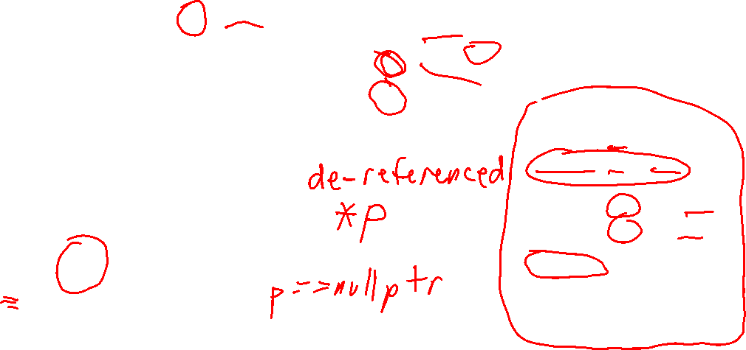
Reminder of basic pointers
Since p points to x, you can use *p as another name for x.
A pointer stores the address of another value.
4473
p
3900
3900
double*
X *p
2.6
double
If p is a pointer, then the expression *p is the de-referenced pointer, and it names the value p points to.
double x = 2.6; double* p = &x;
cout << x; // 2.6 cout << *p; // 2.6
*p = 0; cout << x; // 0 cout << *p; // 0
p
*p is an error!
Never de-reference a null pointer!

Slide 4
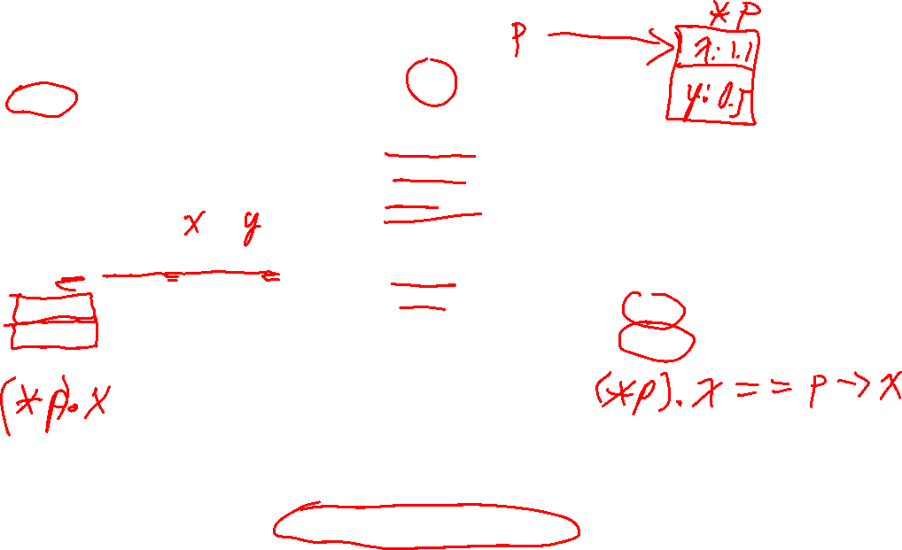
Pointers to structs
*p
struct Point {
double x; double y;
};
x: 1.1 (*p).x
p->x
y: 0.5
(*p).y
p->y
p
Point* p = new Point{1.1, 0.5};
cout << (*p).x; // 1.1
cout << (*p).y; // 0.5
Point* p = new Point{1.1, 0.5};
cout << p->x; // 1.1
cout << p->y; // 0.5
If p points to a struct with a member variable x, then p->x is a name for x.
p->x is short for (*p).x

Slide 5
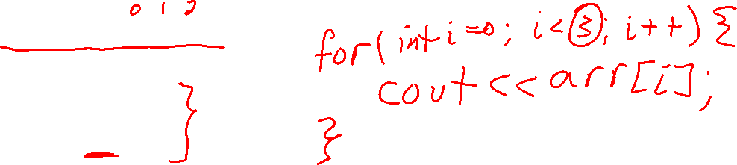
Practice with pointers: printing an array
int arr[] = {4, 1, 5};
Challenge
Write a loop that prints the elements of arr using [ ]-notation.
Write a loop that prints that elements of arr without using [ ]-notation.

Slide 6
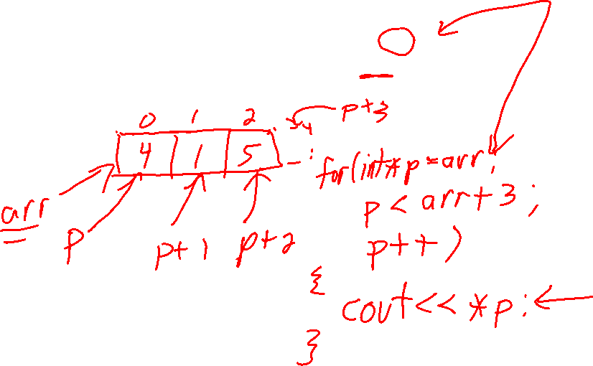
Practice with pointers: printing an array
int arr[] = {4, 1, 5};
// arr[i] style
for(int i = 0; i < 3; ++i) {
cout << arr[i] << "\n";
}
Challenge
Write a loop that prints the elements of arr using [ ]-notation.
Write a loop that prints that elements of arr without using [ ]-notation.

Slide 7
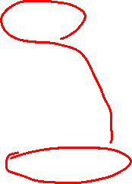
Practice with pointers: printing an array
int arr[] = {4, 1, 5};
// arr[i] style
for(int i = 0; i < 3; ++i) {
cout << arr[i] << "\n";
}
Challenge
Write a loop that prints the elements of arr using [ ]-notation.
Write a loop that prints that elements of arr without using [ ]-notation.
// *(arr + i) style
for(int i = 0; i < 3; ++i) { cout << *(arr + i) << "\n";
}

Slide 8
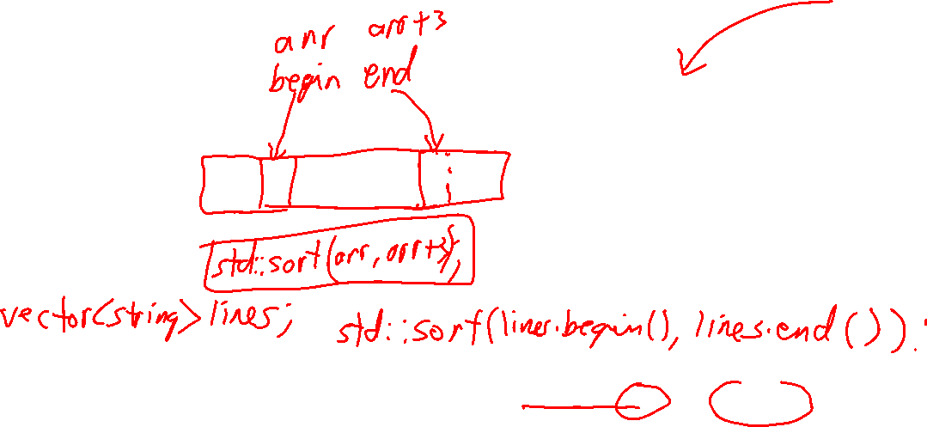
Practice with pointers: printing an array
int arr[] = {4, 1, 5};
// arr[i] style
for(int i = 0; i < 3; ++i) {
cout << arr[i] << "\n";
}
Challenge
Write a loop that prints the elements of arr using [ ]-notation.
Write a loop that prints that elements of arr without using [ ]-notation.
// *(arr + i) style
for(int i = 0; i < 3; ++i) { cout << *(arr + i) << "\n";
}
Which style do you find to be the most readable?
// direct pointer style
for(int* p = arr; p < arr + 3; p++) { cout << *p << "\n"; }

Slide 9
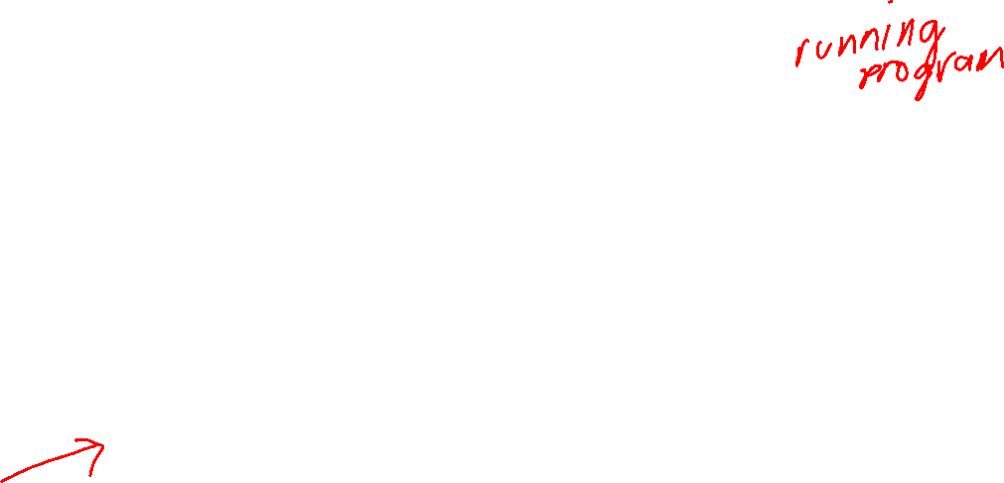
Memory of a running C++ program
456
457
458
459
460
1291
1292
1293
1294
. . .
'a'
. . .
. . .
c
We can think of the memory of a running C++ program as a long array of bytes.
static memory
call stack memory
free store memory

Slide 10
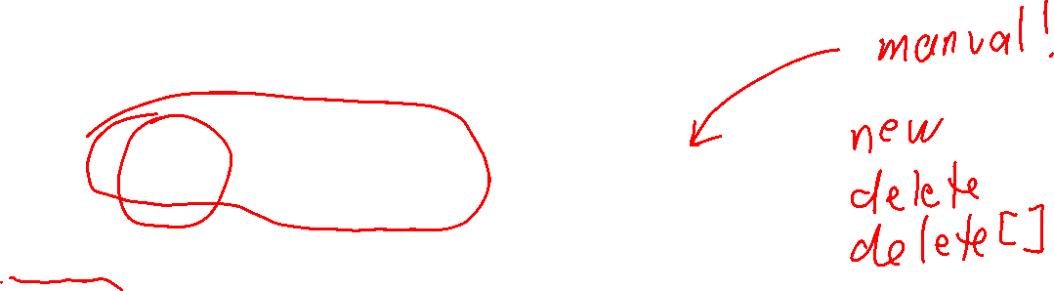
Memory of a running C++ program
456
457
458
459
460
1291
1292
1293
1294
. . .
'a'
. . .
. . .
c
We can also think of it as divided into 3 main regions
static memory
call stack memory
free store memory
Global variables go here. Size is known at compile time and never changes.
Function calls and local variables. Automatically grows/shrinks like a stack.
All other memory. Allocated manually using new, and de-allocated manually using delete/delete[].

Slide 11
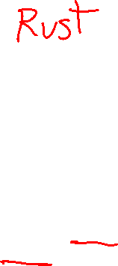
Memory of a running C++ program
456
457
458
459
460
1291
1292
1293
1294
. . .
'a'
. . .
. . .
c
Most other modern programming languages automatically manage their free store memory using a special garbage collector program.
We can also think of it as divided into 3 main regions
static memory
call stack memory
free store memory
A garbage collector periodically runs and de-allocates memory that is no longer uses. Prevents many common memory errors but is usually a little slower than manual memory management.
Global variables go here. Size is known at compile time and never changes.
Function calls and local variables. Automatically grows/shrinks like a stack.
All other memory. Allocated manually using new, and de-allocated manually using delete/delete[].

Slide 12
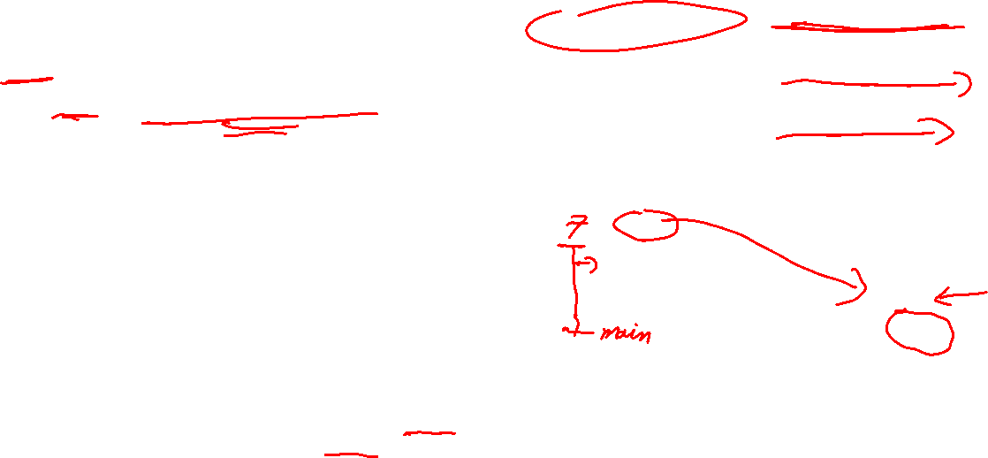
Using free store memory
Call stack memory
Free store memory
void f() { double* p = new double(6.4);
// … }
p: 4962
f()
// …
4962
6.4
bottom of the stack
When new is called the C++ free store memory allocator finds and returns a location for the requested memory.
4962 is the address of a chunk of memory that can hold a double. 4962 is returned by the new operator.

Slide 13
Using free store memory
Call stack memory
Free store memory
void f() { double* p = new double(6.4);
// … }
p: 4962
f()
// …
4962
6.4
bottom of the stack
When new is called the C++ free store memory allocator finds and returns a location for the requested memory.
4962 is the address of a chunk of memory that can hold a double. 4962 is returned by the new operator.

Slide 14
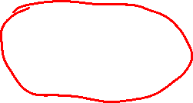
Using free store memory
Call stack memory
Free store memory
void f() { double* p = new double(6.4);
// … }
p
We don’t usually know or care about the exact address returned by new, so we use arrows instead of numbers.
f()
// …
6.4
bottom of the stack
Note that p is on the call stack, but the memory it points to is on the free store.

Slide 15
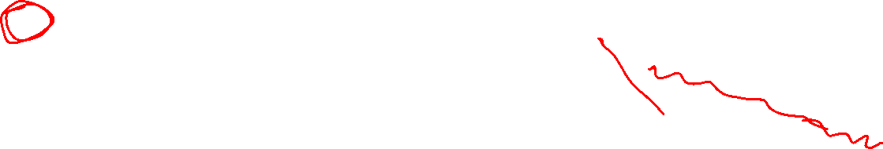
Using free store memory
Call stack memory
Free store memory
void f() { double* p = new double(6.4);
// … }
p
Question What happens if p is popped from the call stack due to function f ending?
f()
// …
6.4
bottom of the stack

Slide 16
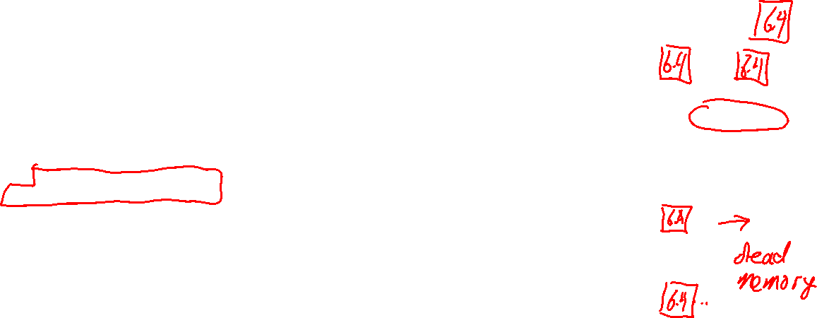
Using free store memory
Call stack memory
Free store memory
void f() { double* p = new double(6.4);
// … }
Memory leak!
6.4 takes up memory but is no longer accessible by the program.
In practice, memory leaks can be extremely difficult errors to find and fix! The valgrind tool can recognize memory leaks in a running program.
What happens if p is popped from the call stack due to function f ending?
f()
// …
6.4
bottom of the stack
There’s no way to regain access to 6.4, it is “dead” memory. It wastes a little bit of space, and over time small leaks can add up to waste lots of memory.
Now p is gone, so we no longer have the address of 6.4. This is an error called a memory leak.

Slide 17
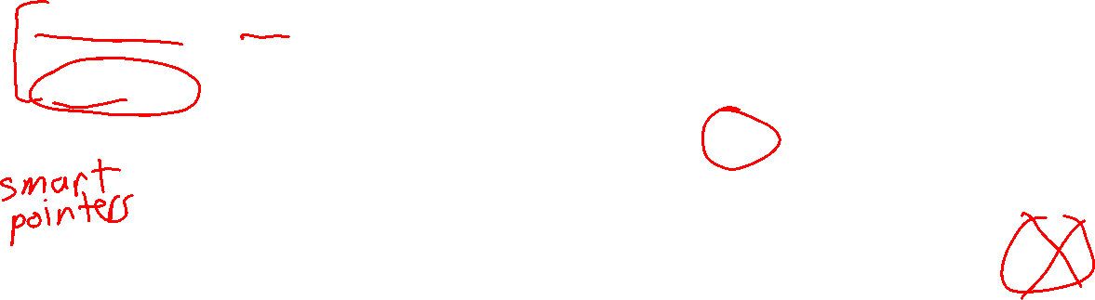
Using free store memory
Call stack memory
Free store memory
void f() { double* p = new double(6.4);
// … delete p; }
p
f()
delete p tells C++ to de-allocate the memory that p points to so that it can be re-used in another call to new.
To avoid a memory leak we must always make sure to de-allocate memory we’ve put on the free store.
// …
6.4
bottom of the stack

Slide 18
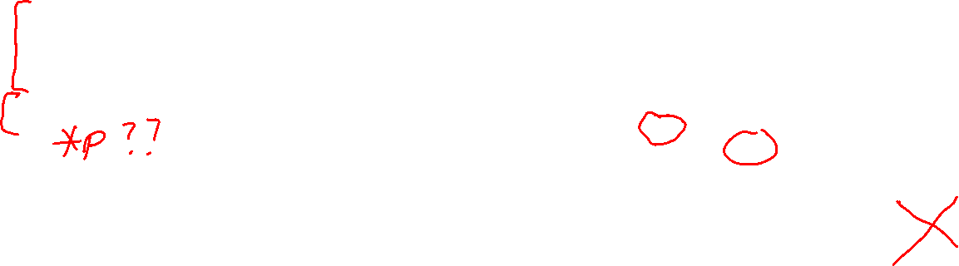
Using free store memory
Call stack memory
Free store memory
void f() { double* p = new double(6.4);
// … delete p; // p is now a dangling pointer }
Even though p still contains the address of the memory, it is no longer valid because it has been deleted.
p: 4962
This memory is now marked as no longer allocated. You cannot safely access it!
???
f()
delete p tells C++ to de-allocate the memory that p points to so that it can be re-used in another call to new.
To avoid a memory leak we must always make sure to de-allocate memory we’ve put on the free store.
// …
4962
6.4
bottom of the stack
p is now an example of a dangling pointer, i.e. a pointer that is not pointing to valid memory

Slide 19
Two common pointer errors
p
value on free store
Memory Leak
Dangling Pointer
A pointer that points to an invalid memory location.
No pointer to the value, so it is unusable but takes up memory
value on free store
p
???

Slide 20
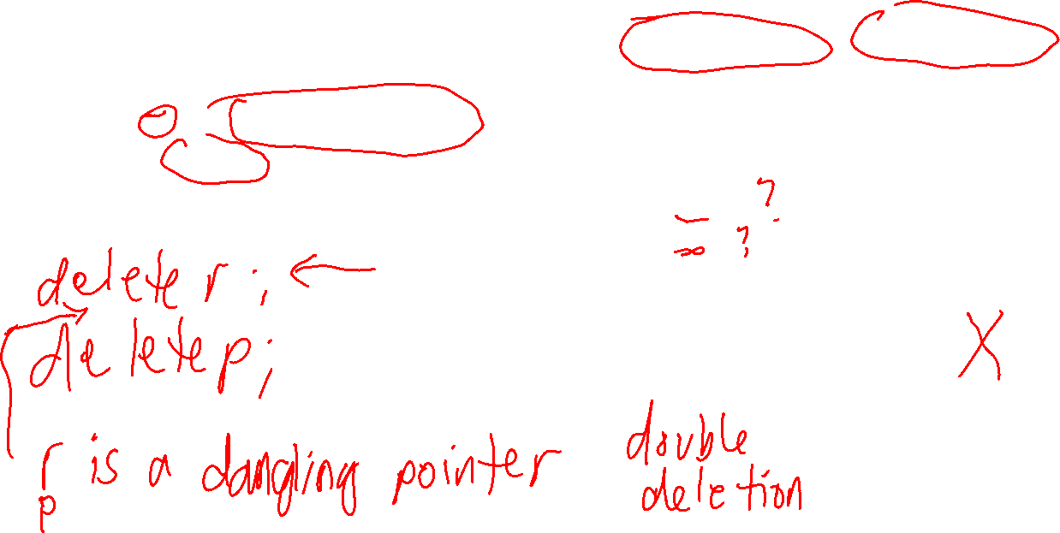
Using free store memory
Call stack memory
Free store memory
void f() { double* p = new double(6.4); double* r = p;
// … }
p and r both happen to point to the same value … no copy is made of the value 6.4
r
p
f()
// …
6.4
Question
How do we properly delete the 6.4 without causing an error?
bottom of the stack

Slide 21
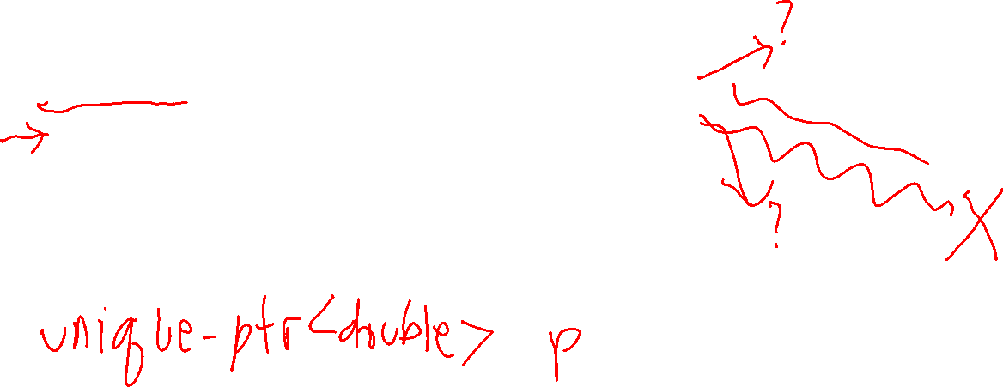
Using free store memory
Call stack memory
Free store memory
void f() { double* p = new double(6.4); double* r = p;
// … delete p; delete r; }
r
Wrong!
p
f()
// …
6.4
Question
How do we properly delete the 6.4 without causing an error?
bottom of the stack

Slide 22
Using free store memory
Call stack memory
Free store memory
void f() { double* p = new double(6.4); double* r = p;
// … delete p; delete r; }
After calling delete p, both r and p are dangling pointers!
r
???
Wrong!
p
???
f()
Calling delete on both p and r is an error called double deletion. You can only safely delete a memory location once.
// …
After 6.4 is de-allocated by delete p, r is now a dangling pointer and so cannot be used for anything.
6.4
bottom of the stack

Slide 23
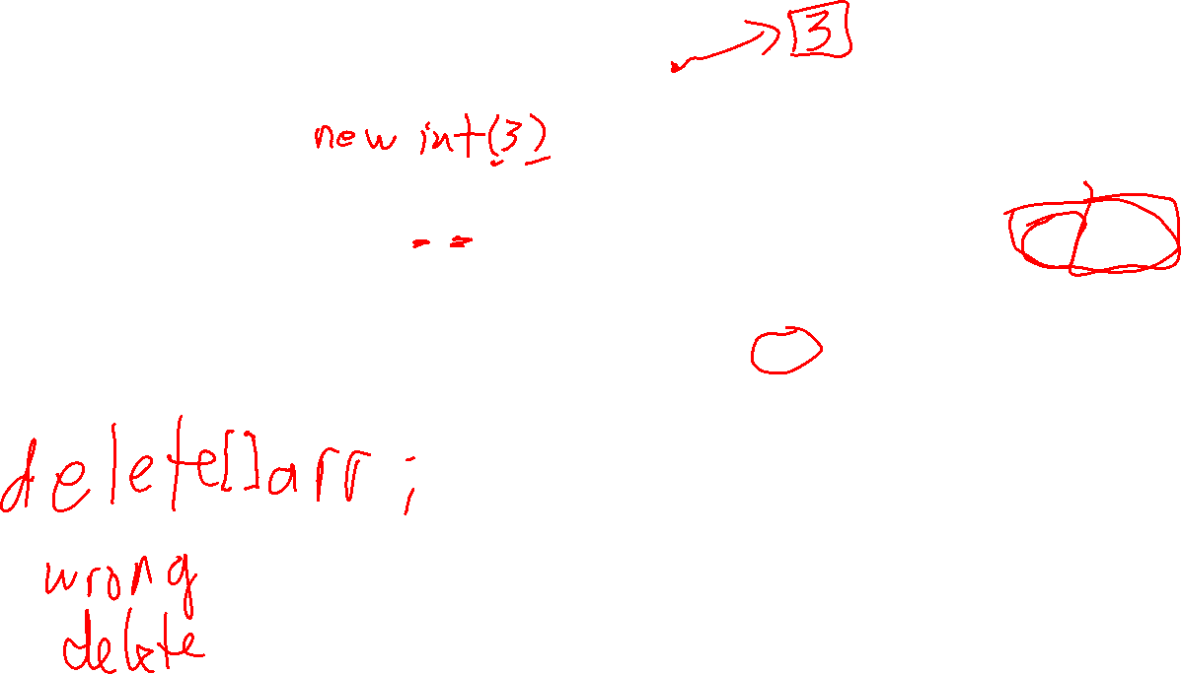
Arrays on the free store
Call stack memory
Free store memory
void g() { double* arr = new int[3];
// … }
Address of first element of the array is stored in arr
??
??
??
Important: square brackets indicate an array is being allocated
No guarantee about the initial values of the ints in the array!
arr
g()
// …
bottom of the stack

Slide 24
Arrays on the free store
Call stack memory
Free store memory
void g() { double* arr = new int[3];
// …
delete[] arr; }
Address of first element of the array is stored in arr
??
??
??
No guarantee about the initial values of the ints in the array!
arr
Important! delete[] must be used to de-allocate arrays: leaving out the [] is a mistake!
g()
// …
bottom of the stack

Slide 25
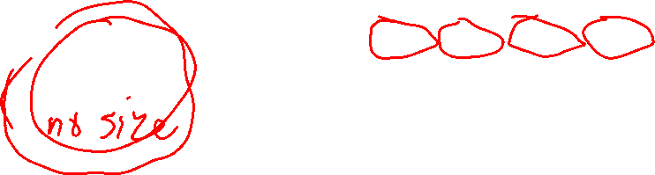
Arrays on the free store
each int in the array has an address
8241
8242
8243
8244
arr: 8241
3
7
6
-1
(arr + 0)
(arr + 1)
(arr + 2)
(arr + 3)
*(arr + 0) == 3
*(arr + 1) == 7
*(arr + 2) == 6
*(arr + 3) == -1
arr[0] == 3
arr[1] == 7
arr[2] == 6
arr[3] == -1
arr[i] means the same as *(arr + i)

Slide 26
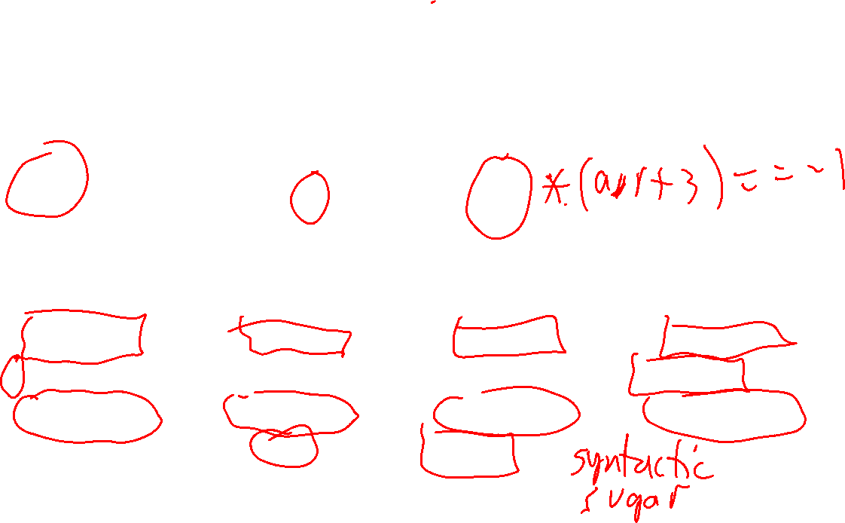
Arrays on the free store
Since we don’t usually know or care about the actual addresses, we just use the index values.
8241
8242
8243
8244
0
1
2
3
arr
3
7
6
-1
(arr + 0)
(arr + 1)
(arr + 2)
(arr + 3)
*(arr + 0) == 3
*(arr + 1) == 7
*(arr + 2) == 6
*(arr + 3) == -1
arr[0] == 3
arr[1] == 7
arr[2] == 6
arr[3] == -1
arr[i] means the same as *(arr + i)

Slide 27
Arrays on the free store
There are memory locations before and after an array.
8239
8240
8241
8242
8243
8244
8245
8246
-2
-1
0
1
2
3
4
5
arr
?
?
3
7
6
-1
?
?
(arr + 0)
(arr + 1)
(arr + 2)
(arr + 3)
*(arr + 0) == 3
*(arr + 1) == 7
*(arr + 2) == 6
*(arr + 3) == -1
arr[0] == 3
arr[1] == 7
arr[2] == 6
arr[3] == -1
arr[i] means the same as *(arr + i)

Slide 28
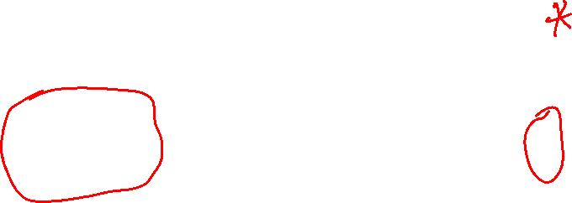
Arrays on the free store
Using pointer arithmetic, we can get the address of memory locations outside of arrays!
(arr - 2)
(arr - 1)
(arr + 4)
(arr + 5)
8239
8240
8241
8242
8243
8244
8245
8246
-2
-1
0
1
2
3
4
5
arr
?
?
3
7
6
-1
?
?
(arr + 0)
(arr + 1)
(arr + 2)
(arr + 3)
*(arr + 0) == 3
*(arr + 1) == 7
*(arr + 2) == 6
*(arr + 3) == -1
arr[0] == 3
arr[1] == 7
arr[2] == 6
arr[3] == -1
arr[i] means the same as *(arr + i)

Slide 29
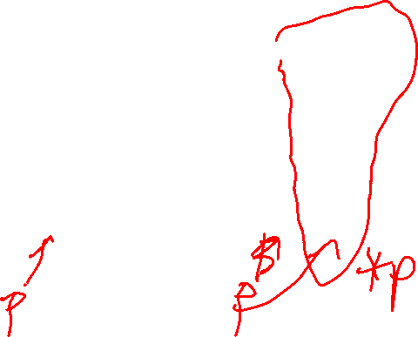
Arrays on the free store
While we can point to invalid memory locations, we don’t know what is there and so it’s not safe to access them.
arr[-2] == ?
arr[-1] == ?
arr[4] == ?
arr[5] == ?
(arr - 2)
(arr - 1)
(arr + 4)
(arr + 5)
8239
8240
8241
8242
8243
8244
8245
8246
-2
-1
0
1
2
3
4
5
Accessing an out of bounds memory location could cause unknown behaviour: maybe nothing happens, maybe your computer crashes, …
arr
?
?
3
7
6
-1
?
?
(arr + 0)
(arr + 1)
(arr + 2)
(arr + 3)
*(arr + 0) == 3
*(arr + 1) == 7
*(arr + 2) == 6
*(arr + 3) == -1
arr[0] == 3
arr[1] == 7
arr[2] == 6
arr[3] == -1
arr[i] means the same as *(arr + i)

Slide 30
Arrays on the free store
Bad! arr[4], arr[5], .., are out of the array bounds and cannot be safely accessed!
arr[-2] == ?
arr[-1] == ?
arr[4] == ?
arr[5] == ?
Bad! arr[-2], arr[-1], .., are out of the array bounds and cannot be safely accessed!
(arr - 2)
(arr - 1)
(arr + 4)
(arr + 5)
8239
8240
8241
8242
8243
8244
8245
8246
C++ pointer arithmetic lets a program access almost any memory location!
Powerful but dangerous!
Almost always an error to access out-of-bounds memory. Can also be a security risk, e.g. accessing private memory.
-2
-1
0
1
2
3
4
5
arr
?
?
3
7
6
-1
?
?
(arr + 0)
(arr + 1)
(arr + 2)
(arr + 3)
*(arr + 0) == 3
*(arr + 1) == 7
*(arr + 2) == 6
*(arr + 3) == -1
arr[0] == 3
arr[1] == 7
arr[2] == 6
arr[3] == -1
arr[i] means the same as *(arr + i)

Slide 31
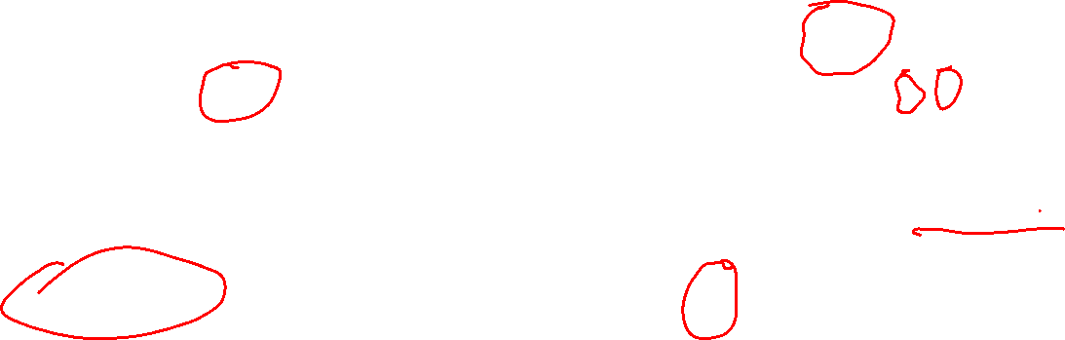
Basics of using new/delete
Allocating a single value
Allocating an array of n values
int* a = new int(3);
// ...
delete a;
int* b = new int[3];
// ...
delete[] b;
a
b
3
??
??
??

Slide 32
Example 1: a function to initialize an array
Let’s write a function that will make it easier to initialize arrays of ints on the free store. We want to write code like this:
int* a = make_array(4, 3);
int* b = make_array(3);

Slide 33
Example 1: a function to initialize an array
Let’s write a function that will make it easier to initialize arrays of ints on the free store. We want to write code like this:
int* a = make_array(4, 3);
int* b = make_array(3);
0
1
2
3
a
3
3
3
3
0
1
2
b
0
0
0

Slide 34
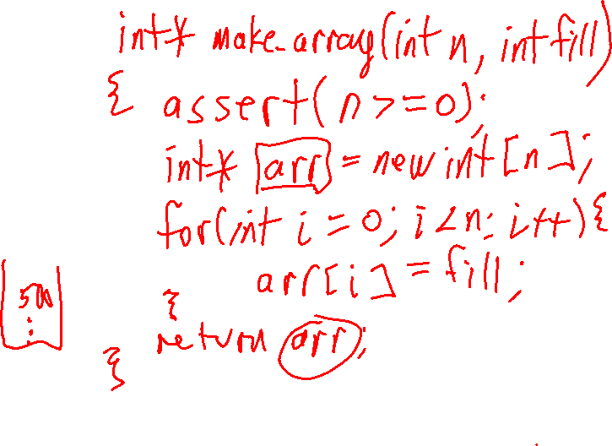
Example 1: a function to initialize an array
Let’s write a function that will make it easier to initialize arrays of ints on the free store. We want to write code like this:
int* a = make_array(4, 3);
int* b = make_array(3);
0
1
2
3
a
3
3
3
3
Important! The code that calls make_array is responsible for calling delete[] on the returned array when it’s no longer needed.
0
1
2
b
0
0
0

Slide 35
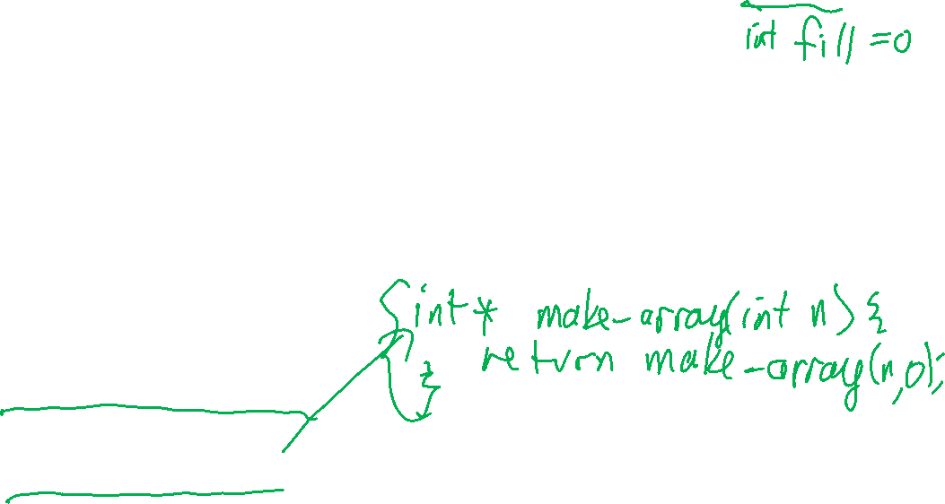
Example 1: a function to initialize an array
int* make_array(int n, int fill) {
assert(n >= 0);
int *arr = new int[n];
for (int i = 0; i < n; i++) {
arr[i] = fill;
}
return arr;
}
Let’s write a function that will make it easier to initialize arrays of ints on the free store. We want to write code like this:
int* a = make_array(4, 3);
int* b = make_array(3);
0
1
2
3
a
3
3
3
3
Important! The code that calls make_array is responsible for calling delete[] on the returned array when it’s no longer needed.
0
1
2
b
0
0
0

Slide 36
Example 1: a function to initialize an array
int* make_array(int n, int fill) {
assert(n >= 0);
int *arr = new int[n];
for (int i = 0; i < n; i++) {
arr[i] = fill;
}
return arr;
}
Let’s write a function that will make it easier to initialize arrays of ints on the free store. We want to write code like this:
int* a = make_array(4, 3);
int* b = make_array(3);
int* make_array(int n) {
return make_arr(n, 0);
}
0
1
2
3
a
3
3
3
3
Important! The code that calls make_array is responsible for calling delete[] on the returned array when it’s no longer needed.
0
1
2
b
0
0
0

Slide 37
Example 2: a function to copy an array
Let’s write a function that returns a pointer to a copy of an array. We want to write code like this:
int* a = make_array(4, 3);
int* b = make_copy(a, 4);
0
1
2
3
a
3
3
3
3
0
1
2
3
size of the new array
b
3
3
3
3

Slide 38

Example 2: a function to copy an array
int* make_copy(int* other, int n)
{
int* arr = new int[n];
for (int i = 0; i < n; i++)
{
arr[i] = other[i];
}
return arr;
}
Let’s write a function that returns a pointer to a copy of an array. We want to write code like this:
int* a = make_array(4, 3);
int* b = make_copy(a, 4);
0
1
2
3
a
3
3
3
3
Remember to de-allocate both arrays using delete[]
0
1
2
3
b
3
3
3
3

Slide 39
Example 3: filtering an array
0
1
2
3
a
-1
0
-3
2
Write a function that takes an int* to an array as input, and returns a pointer to a newly created array that is the same as the original, but all negative ints are removed.
Name the function remove_negatives. It returns an int* to the new array. You write the inputs for it!
after calling int* p = remove_negatives(???)
0
1
2
3
a
-1
0
-3
2
0
1
Constraint: don’t use a struct or class in your answer!
p
0
2

Slide 40
Example 3: filtering an array
int* remove_negatives(int* arr, int size,
int& result_size)
{ result_size = 0;
for (int i = 0; i < size; i++) {
if (arr[i] >= 0) result_size++;
}
int* result = new int[result_size];
int j = 0;
for (int i = 0; i < size; i++) {
if (arr[i] >= 0) {
result[j] = arr[i];
j++;
}
}
return result;
}
0
1
2
3
a
-1
0
-3
2
count # positive ints
after calling int* p = remove_negatives(???)
make new array
copy just positive ints into new array

Slide 41
Example 3: filtering an array
int* remove_negatives(int* arr, int size,
int& result_size)
{ result_size = 0;
for (int i = 0; i < size; i++) {
if (arr[i] >= 0) result_size++;
}
int* result = new int[result_size];
int j = 0;
for (int i = 0; i < size; i++) {
if (arr[i] >= 0) {
result[j] = arr[i];
j++;
}
}
return result;
}
0
1
2
3
a
-1
0
-3
2
count # positive ints
after calling int* p = remove_negatives(???)
make new array
0
1
copy just positive ints into new array
p
0
2
array a is still there, unchanged

Slide 42
Example 4: a function to de-allocate an array
void deallocate_array(int *arr)
{
delete[] arr;
}
Let’s write a function that will make it easier to initialize arrays of ints on the free store. We want to write code like this:
int* a = make_array(4, 3);
int* b = make_array(3);
// ...
deallocate_array(a); deallocate_array(b);
0
1
2
3
a
3
3
3
3
0
1
2
b
0
0
0

Slide 43
Example 4: a function to de-allocate an array
void deallocate_array(int *arr)
{
delete[] arr;
}
Let’s write a function that will make it easier to initialize arrays of ints on the free store. We want to write code like this:
int* a = make_array(4, 3);
int* b = make_array(3);
// ...
deallocate_array(a); deallocate_array(b);
This function isn’t very useful. It doesn’t help with common errors:
can forget to call it, so memory leaks are possible
can call it twice, so double deletion errors are possible
the pointer you pass into it becomes a dangling pointer
can pass it a non-array pointer
0
1
2
3
a
3
3
3
3
0
1
2
b
0
0
0

