Slide 1

CMPT 135
Remember to finish the weekly quiz!
Assignment 2 is due on Wednesday!
Week 6
Inheritance and Polymorphism

Slide 2
Inheritance
We can think of inheritance as a neat trick for creating new classes
For example, suppose you like the vector<int> class, but you want it to have a method called sort() that will put its elements into ascending sorted order
You can already do that with std::sort(v.begin(), v.end())
But suppose you don’t like all that typing and prefer v.sort()
With inheritance, we can easily create such a class …

Slide 3
Inheritance
class int_vec : public vector<int> {
};
Goal: Create a class called int_vec that works just like vector<int>, but also has a sort() method so we can write v.sort()
With inheritance, we can easily create such a class:
Make a new class called int_vec
int_vec inherits from vector<int>
add the sort() method to int_vec
This makes int_vec inherit all the members of vector<int>.
With the exception of constructors and assignment operator: those are not inherited.
int_vec v;
v.push_back(2);
v.push_back(1);
for (int n : v) {
cout << n << " ";
}
int_vec now works like a vector<int>

Slide 4
Inheritance
class int_vec : public vector<int> {
public: Goal: Add other useful methods
With inheritance, we can use the methods in vector<int> in any methods we add to int_vec.
sort() {
std::sort(begin(), end());
}
};
Goal: Create a class called int_vec that works just like vector<int>, but also has a sort() method so we can write v.sort()
With inheritance, we can easily create such a class:
Make a new class called int_vec
int_vec inherits from vector<int>
add the sort() method to int_vec
begin() and end() are inherited from vector<int>
int_vec v;
v.push_back(2);
v.push_back(1);
v.sort();
for (int n : v) {
cout << n << " ";
}

Slide 5
Inheritance
class int_vec : public vector<int> {
public: int sum() const {
// ...
}
};
You can add any other methods you’d like to int_vec. Let’s add a sum() method …
Goal: Add other useful methods
With inheritance, we can use the methods in vector<int> in any methods we add to int_vec.
int_vec v;
v.push_back(2);
v.push_back(1);
cout << v.sum(); // 3

Slide 6
Inheritance
class int_vec : public vector<int> {
public: int sum() const {
return std::accumulate(begin(),
end(),
0);
}
};
Goal: Add other useful methods
With inheritance, we can use the methods in vector<int> in any methods we add to int_vec.
accumulate is in #include <numeric>
0 is the initial value of the sum
int_vec v;
v.push_back(2);
v.push_back(1);
cout << v.sum(); // 3

Slide 7
Inheritance
class int_vec : public vector<int> {
public: int sum() const {
int result = 0; for(int i = 0; i < size(); i++) { result += ; } return result;
}
};
Goal: Add other useful methods
With inheritance, we can use the methods in vector<int> in any methods we add to int_vec.
What goes in here?
int_vec v;
v.push_back(2);
v.push_back(1);
cout << v.sum(); // 3

Slide 8
Inheritance
class int_vec : public vector<int> {
public: int sum() const {
int result = 0; for(int i = 0; i < size(); i++) { result += (*this)[i]; } return result;
}
};
Goal: Add other useful methods
With inheritance, we can use the methods in vector<int> in any methods we add to int_vec.
Every C++ object has a special pointer called this that points to the object itself.
v
this
…
int_vec v;
v.push_back(2);
v.push_back(1);
cout << v.sum(); // 3

Slide 9
Inheritance
class int_vec : public vector<int> {
public: int sum() const {
int result = 0; for(int i = 0; i < this->size(); i++) { result += (*this)[i]; } return result;
}
};
Goal: Add other useful methods
With inheritance, we can use the methods in vector<int> in any methods we add to int_vec.
Sometimes it might be useful to use this even when it is not strictly needed. Here it makes clear that size() is from int_vec.
v
this
…
int_vec v;
v.push_back(2);
v.push_back(1);
cout << v.sum(); // 3

Slide 10
Inheritance
class int_vec : public vector<int> {
public: int sum() const {
int result = 0; for(int n : *this) { result += n; } return result;
}
};
Using a for-each loop.
Goal: Add other useful methods
With inheritance, we can use the methods in vector<int> in any methods we add to int_vec.
v
this
…
int_vec v;
v.push_back(2);
v.push_back(1);
cout << v.sum(); // 3

Slide 11
Inheritance
class int_vec : public vector<int> {
string name;
public: int_vec(const string &name) : name(name) {
assert(name.size() > 0);
}
string get_name() const {
return "<intvec:" + name + ">";
}
void set_name(const string &name) { assert(name.size() > 0);
this->name = name;
}
// ...
};
constructor
Goal: Add a member variable
We can also add member variables to int_vec that don’t appear in vector<int>.
For example, suppose we want to give an int_vec a name …
int_vec v; // compiler error: no name
int_vec w("temps"); cout << w.get_name(); // <intvec:temps> w.set_name(""); // run-time error

Slide 12
Polymorphism
void summarize(const vector<int>& v) {
for (int i = 0; i < v.size(); i++) {
cout << "v[" << i << "] = " << v[i]
<< "\n";
}
cout << "size: " << v.size() << "\n";
}
Wherever a vector<int> can be used, we can replace it with an int_vec.
That’s because an int_vec can do everything a vector<int> can do (plus more).
vector<int> v;
v.push_back(2);
v.push_back(1);
summarize(v);
int_vec w("test");
w.push_back(2);
w.push_back(1);
summarize(w);
Which code works with summarize?

Slide 13
Polymorphism
void summarize(const vector<int>& v) {
for (int i = 0; i < v.size(); i++) {
cout << "v[" << i << "] = " << v[i]
<< "\n";
}
cout << "size: " << v.size() << "\n";
}
Wherever a vector<int> can be used, we can replace it with an int_vec.
That’s because an int_vec can do everything a vector<int> can do (plus more).
vector<int> v;
v.push_back(2);
v.push_back(1);
summarize(v);
int_vec w("test");
w.push_back(2);
w.push_back(1);
summarize(w);
summarize takes a vector<int> as input, so this code works
v[0] = 2
v[1] = 1
size: 2

Slide 14
Polymorphism
void summarize(const vector<int>& v) {
for (int i = 0; i < v.size(); i++) {
cout << "v[" << i << "] = " << v[i]
<< "\n";
}
cout << "size: " << v.size() << "\n";
}
Wherever a vector<int> can be used, we can replace it with an int_vec.
That’s because an int_vec can do everything a vector<int> can do (plus more).
vector<int> v;
v.push_back(2);
v.push_back(1);
summarize(v);
int_vec w("test");
w.push_back(2);
w.push_back(1);
summarize(w);
summarize takes a vector<int> as input, so this code works
summarize also works if you pass it an int_vec, because an int_vec can do everything a vector<int> does
v[0] = 2
v[1] = 1
size: 2
v[0] = 2
v[1] = 1
size: 2

Slide 15
Polymorphism
void summarize(const vector<int>& v) {
for (int i = 0; i < v.size(); i++) {
cout << "v[" << i << "] = " << v[i]
<< "\n";
}
cout << "size: " << v.size() << "\n";
}
Wherever a vector<int> can be used, we can replace it with an int_vec.
That’s because an int_vec can do everything a vector<int> can do (plus more).
vector<int> v;
v.push_back(2);
v.push_back(1);
summarize(v);
int_vec w("test");
w.push_back(2);
w.push_back(1);
summarize(w);
summarize takes a vector<int> as input, so this code works
summarize also works if you pass it an int_vec, because an int_vec can do everything a vector<int> does
If instead you called v.get_name() here you’d get a compiler error saying vector<int> doesn’t have a get_name method.
Summarize always prints the name v. This is because a vector<int> does not have a name.
v[0] = 2
v[1] = 1
size: 2
v[0] = 2
v[1] = 1
size: 2

Slide 16
Polymorphism
void summarize(const int_vec& v) {
for (int i = 0; i < v.size(); i++) {
cout << v.get_name() << "[" << i << "] = " << v[i] << "\n";
}
cout << "size: " << v.size() << "\n";
}
Wherever a vector<int> can be used, we can replace it with an int_vec.
That’s because an int_vec can do everything a vector<int> can do (plus more).
vector<int> v;
v.push_back(2);
v.push_back(1);
summarize(v);
int_vec w("test");
w.push_back(2);
w.push_back(1);
summarize(w);
Do these code fragments work with the above version of summarize?
Idea: Change the type of v to int_vec so we can call get_name()

Slide 17
Polymorphism
void summarize(const int_vec& v) {
for (int i = 0; i < v.size(); i++) {
cout << v.get_name() << "[" << i << "] = " << v[i] << "\n";
}
cout << "size: " << v.size() << "\n";
}
Wherever a vector<int> can be used, we can replace it with an int_vec.
That’s because an int_vec can do everything a vector<int> can do (plus more).
vector<int> v;
v.push_back(2);
v.push_back(1);
summarize(v);
int_vec w("test");
w.push_back(2);
w.push_back(1);
summarize(w);
summarize works with an int_vec,
<intvec:test>[0] = 2
<intvec:test>[1] = 1
size: 2

Slide 18
Polymorphism
void summarize(const int_vec& v) {
for (int i = 0; i < v.size(); i++) {
cout << v.get_name() << "[" << i << "] = " << v[i] << "\n";
}
cout << "size: " << v.size() << "\n";
}
Wherever a vector<int> can be used, we can replace it with an int_vec.
That’s because an int_vec can do everything a vector<int> can do (plus more).
vector<int> v;
v.push_back(2);
v.push_back(1);
summarize(v); // compile-time // error: v is // wrong type
int_vec w("test");
w.push_back(2);
w.push_back(1);
summarize(w);
summarize works with an int_vec,
Cannot call summarize with an object of type vector<int>, since it has no get_name method
<intvec:test>[0] = 2
<intvec:test>[1] = 1
size: 2

Slide 19
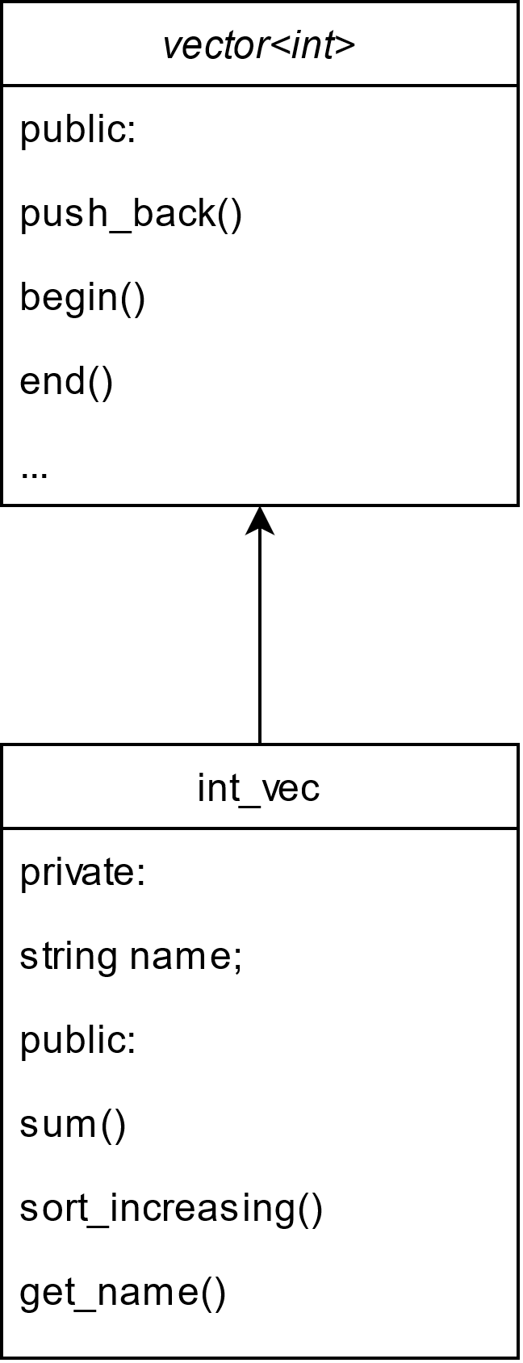
Class Diagrams
Terminology
parent class
super-class
class being inherited from
In object-oriented programs with many classes and a lot of inheritance, class diagrams can help clarify how classes are related.
Remember: in a class diagram, a child class always points to its parent class
Terminology
child class
sub-class
inheriting class
extended class
derived class

Slide 20
Class Diagrams
Terminology
This is a class hierarchy.
Arrows show when a class is inheriting from another.
Parent is called the base class of the hierarchy.
In object-oriented programs with many classes and a lot of inheritance, class diagrams can help clarify things.
Remember: in a class diagram, a child class always points to its parent class
Parent
A
B
C
Terminology
class B is a child of class Parent
Class E is a child of class B
Class B is the parent of class E
Class E is a grandchild of Parent
Class D and E are siblings
etc.
D
E
F

Slide 21
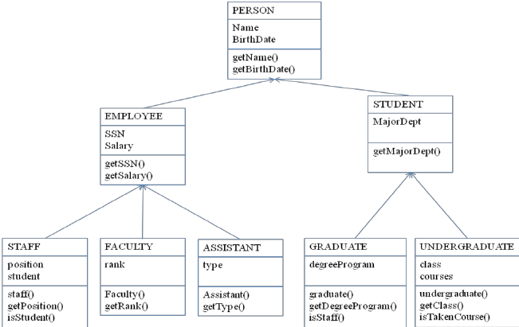
Class Diagrams
In object-oriented programs with many classes and a lot of inheritance, class diagrams can help clarify things.
Remember: in a class diagram, a child class always points to its parent class
In object-oriented programs, designing a class hierarchy is an important step that affects the entire life of the program.
Object-oriented design (OOD) is it’s own topic that we will only get into a little bit …

Slide 22
Example: Printable Objects
These three classes are not closely related, so there is no obvious class hierarchy for them. But they do have similarities: they all have print() and println(), and println() is identical in all of them.
class Point { double x, y; public: Point(double a, double b) : x(a), y(b) { } double get_x() const { return x; } double get_y() const { return y; } void print() const { cout << '(' << x << ", " << y << ')'; } void println() const { print(); cout << "\n"; } };
class Person { string name; int age; public: Person(const string& n, int a) : name{n}, age{a} { } string get_name() const { return name; } int get_age() const { return age; } void print() const { cout << "Name: '" << name << ", Age: " << age; } void println() const { print(); cout << "\n"; } };
class Reading { string loc; double temp; public: Reading(const string& l, double t) : loc{l}, temp{t} { } string get_loc() const { return loc; } double get_temp() const { return temp; } void print() const { cout << temp << " degrees at " << loc; } void println() const { print(); cout << "\n"; } };

Slide 23
Example: Printable Objects
The class diagram for these three classes has no arrows because there is no inheritance.
Point
Person
Reading

Slide 24
Example: Printable Objects
These three classes are not closely related, so there is no obvious class hierarchy for them. But they do have similarities: they all have print() and println(), and println() is identical in all of them.
class Point { double x, y; public: Point(double a, double b) : x(a), y(b) { } double get_x() const { return x; } double get_y() const { return y; } void print() const { cout << '(' << x << ", " << y << ')'; } void println() const { print(); cout << "\n"; } };
class Person { string name; int age; public: Person(const string& n, int a) : name{n}, age{a} { } string get_name() const { return name; } int get_age() const { return age; } void print() const { cout << "Name: '" << name << ", Age: " << age; } void println() const { print(); cout << "\n"; } };
class Reading { string loc; double temp; public: Reading(const string& l, double t) : loc{l}, temp{t} { } string get_loc() const { return loc; } double get_temp() const { return temp; } void print() const { cout << temp << " degrees at " << loc; } void println() const { print(); cout << "\n"; } };
v
Idea: put the common method(s) in a base class that all the classes inherit from.

Slide 25
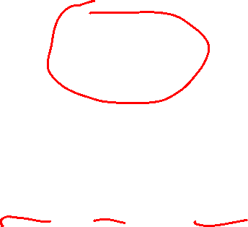
Example: Printable Objects
Printable println()
We’ll create a new class called Printable where we’ll define the common methods print() and println()
Point
Person
Reading

Slide 26
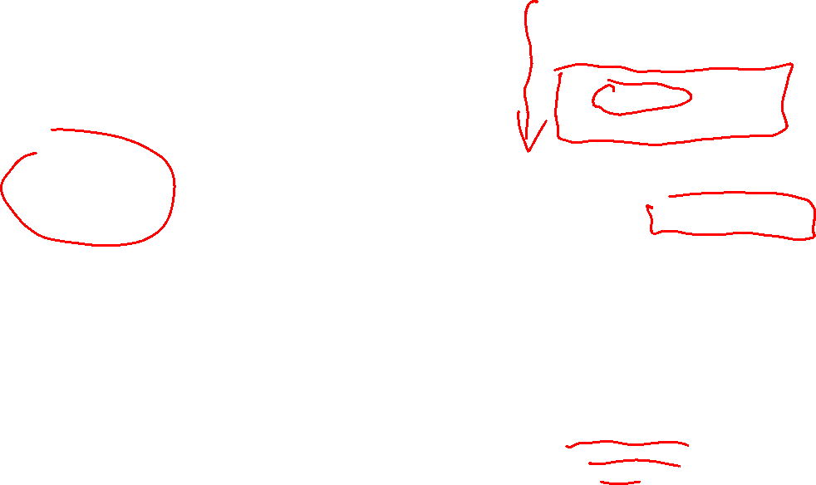
Example: Printable Objects
class Printable { public: void println() const { print(); cout << "\n"; } };
We’ll create a new class called Printable where we’ll define the common method println()
Printable println()
class Point : public Printable { double x, y; public: Point(double a, double b) : x(a), y(b) { } double get_x() const { return x; } double get_y() const { return y; } void print() const { cout << '(' << x << ", " << y << ')'; } void println() const { print(); cout << "\n"; } };
Point
Person
Reading
No need to write println(): it’s inherited from Printable

Slide 27
Example: Printable Objects
class Printable { public: void println() const { print(); cout << "\n"; } };
Printable println()
class Point : public Printable { double x, y; public: Point(double a, double b) : x(a), y(b) { } double get_x() const { return x; } double get_y() const { return y; } void print() const { cout << '(' << x << ", " << y << ')'; } void println() const { print(); cout << "\n"; } };
Problem This doesn’t work! Can you find the problem?
Point
Person
Reading
No need to write println(): it’s inherited from Printable

Slide 28
Example: Printable Objects
class Printable { public: void println() const { print(); cout << "\n"; } };
Here print() is undefined and causes a compiler error
Printable println()
class Point : public Printable { double x, y; public: Point(double a, double b) : x(a), y(b) { } double get_x() const { return x; } double get_y() const { return y; } void print() const { cout << '(' << x << ", " << y << ')'; } void println() const { print(); cout << "\n"; } };
Problem This doesn’t work! Can you find the problem?
Point
Person
Reading
No need to write println(): it’s inherited from Printable

Slide 29
Example: Printable Objects
class Printable { public: void print() const { // ??? } void println() const { print(); cout << "\n"; } };
All classes have a unique implementation of print()
So let’s add print(). Problem: what is the implementation of print()?
Printable println()
class Point : public Printable { double x, y; public: Point(double a, double b) : x(a), y(b) { } double get_x() const { return x; } double get_y() const { return y; } void print() const { cout << '(' << x << ", " << y << ')'; } void println() const { print(); cout << "\n"; } };
Problem This doesn’t work! Can you see what the problem is?
Point
Person
Reading
No need to write println(): it’s inherited from Printable

Slide 30
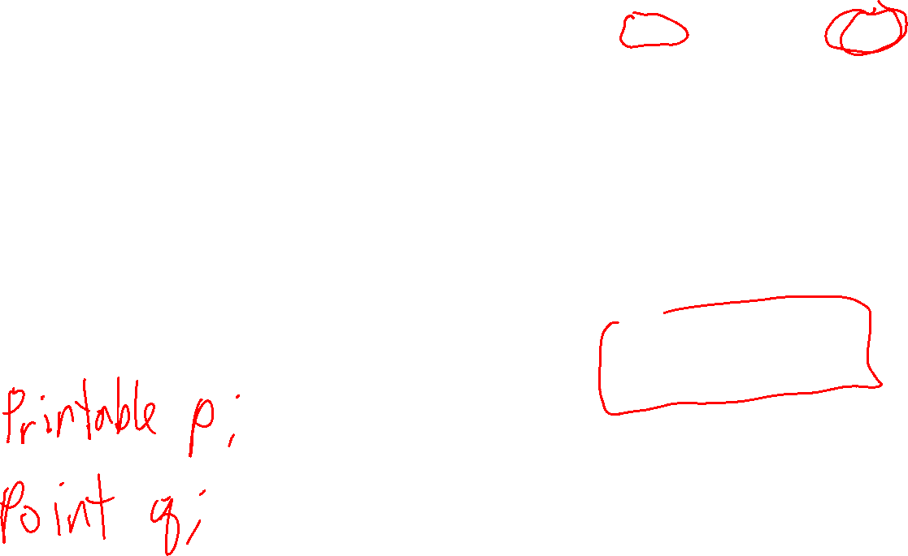
Example: Printable Objects
virtual means that inheriting classes can, if they like, provide their own implementation of this methods.
class Printable { public: virtual void print() const = 0; void println() const { print(); cout << "\n"; } };
Solution We’ll declare print() to be a virtual and abstract method, i.e. a method with no implementation that can be implemented by inheriting classes.
Printable println()
class Point : public Printable { double x, y; public: Point(double a, double b) : x(a), y(b) { } double get_x() const { return x; } double get_y() const { return y; } void print() const { cout << '(' << x << ", " << y << ')'; } void println() const { print(); cout << "\n"; } };
A class with one or more abstract methods is called an abstract class. So Printable is an abstract class. Abstract classes are often the base class for a class hierarchy.
Point
Person
Reading
print() is both virtual and abstract in Printable, and inheriting classes must provide their own implementation of print()

Slide 31
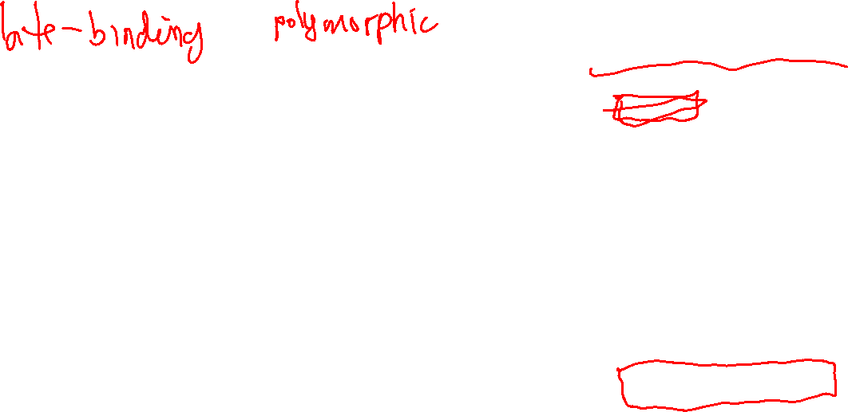
Example: Printable Objects
class Printable { public: virtual void print() const = 0; void println() const { print(); cout << "\n"; } };
This raises a question. When print() is called here, what code is actually called?
It is not known until run-time what print() code is actually called, e.g. the code from Point, Person, or Reading.
But at compile-time, C++ can check that the code is used correctly.
Printable println()
class Point : public Printable { double x, y; public: Point(double a, double b) : x(a), y(b) { } double get_x() const { return x; } double get_y() const { return y; } void print() const { cout << '(' << x << ", " << y << ')'; } void println() const { print(); cout << "\n"; } };
Point
Person
Reading
print() is both virtual and abstract in Printable, and inheriting classes must provide their own implementation of print()

Slide 32

Example: Printable Objects
class Printable { public: virtual void print() const = 0; void println() const { print(); cout << "\n"; } };
There’s still a C++-specific problem with this class: to work correctly, you must also declare the Printable destructor to be virtual.
Otherwise, if ~Printable() is not virtual, inheriting classes won’t be able to create their own customized destructors.
Printable println()
class Point : public Printable { double x, y; public: Point(double a, double b) : x(a), y(b) { } double get_x() const { return x; } double get_y() const { return y; } void print() const { cout << '(' << x << ", " << y << ')'; } void println() const { print(); cout << "\n"; } };
Point
Person
Reading

Slide 33
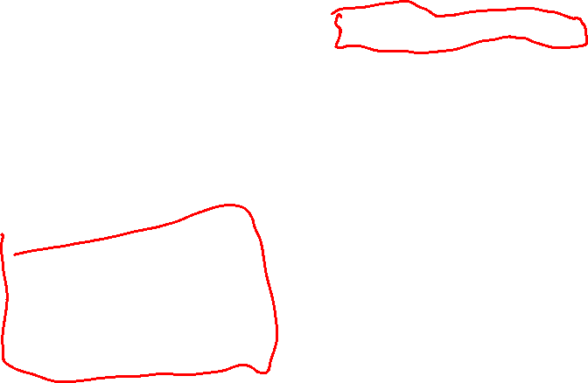
Example: Printable Objects
class Printable { public: virtual void print() const = 0; void println() const { print(); cout << "\n"; } virtual ~Printable() { } };
There’s a C++-specific problem with this class: to work correctly, you must also declare the Printable destructor to be virtual.
Otherwise, if ~Printable() is not virtual, inheriting classes won’t be able to create their own customized destructors.
Printable println()
class Point : public Printable { double x, y; public: Point(double a, double b) : x(a), y(b) { } double get_x() const { return x; } double get_y() const { return y; } void print() const { cout << '(' << x << ", " << y << ')'; } void println() const { print(); cout << "\n"; } };
Point
Person
Reading
Rule of Thumb
All classes that you inherit from in C++ should have a virtual destructor. g++ has a flag to check for this (we’ve used it since the start of the course).

Slide 34
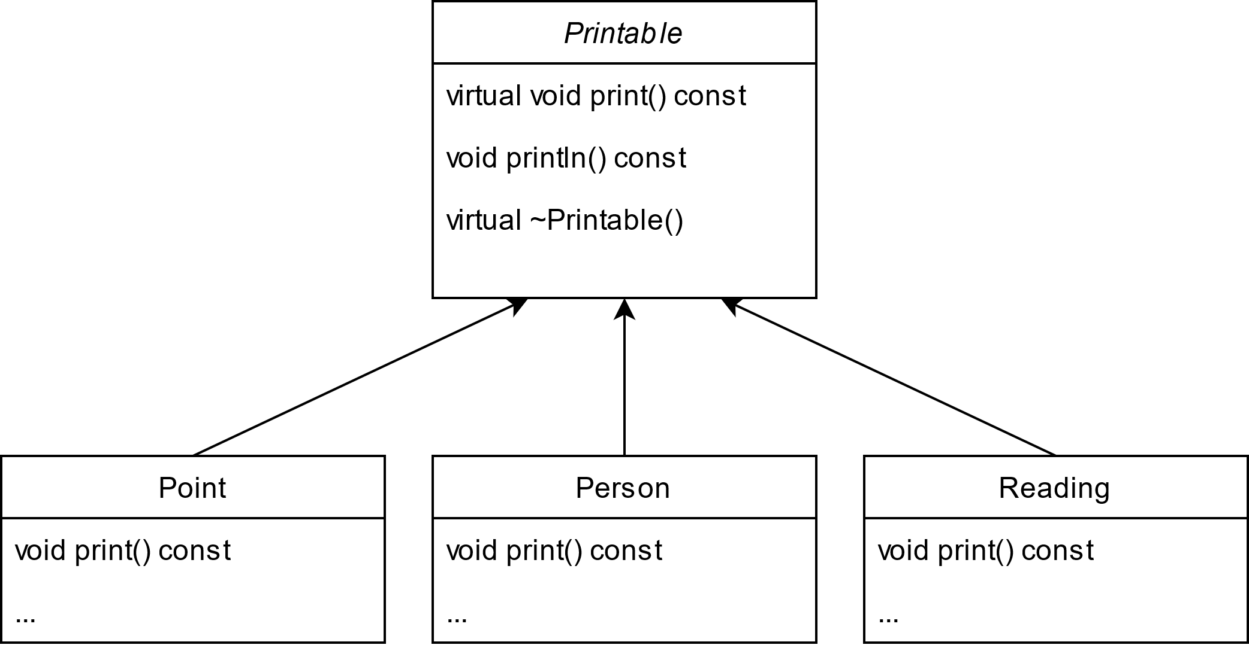
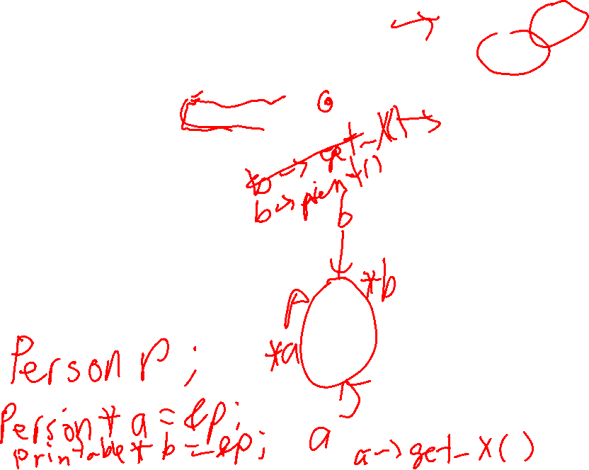
Example: Printable Objects
class Printable { public: virtual void print() const = 0; void println() const { print(); cout << "\n"; } virtual ~Printable() { } };
The class diagram for the final classes.
class Point : public Printable { double x, y; public: Point(double a, double b) : x(a), y(b) { } double get_x() const { return x; } double get_y() const { return y; } void print() const { cout << '(' << x << ", " << y << ')'; } void println() const { print(); cout << "\n"; } };

Slide 35
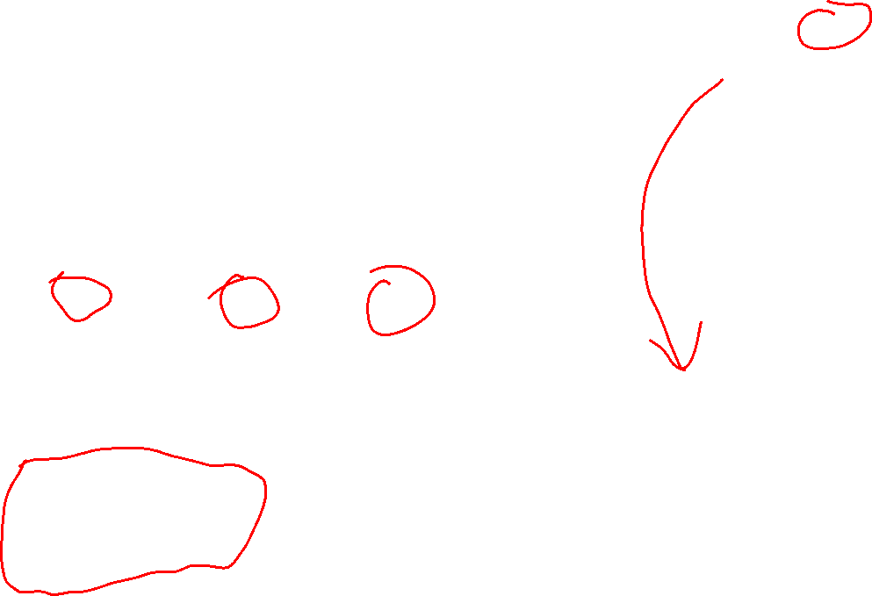
Example: Printable Objects
class Printable { public: virtual void print() const = 0; void println() const { print(); cout << "\n"; } virtual ~Printable() { } };
The class diagram for the final classes.
class Point : public Printable { double x, y; public: Point(double a, double b) : x(a), y(b) { } double get_x() const { return x; } double get_y() const { return y; } void print() const { cout << '(' << x << ", " << y << ')'; } void println() const { print(); cout << "\n"; } };
Different types of objects in the same vector!
vector<Printable*> v = { new Point{1, 2}, new Person{"Max", 2}, new Reading{"Black Rock", 41.5} }; for(Printable* p : v) { p->print(); cout << "\n"; }
The exact version of print() that’s called here isn’t known until run-time.

Slide 36
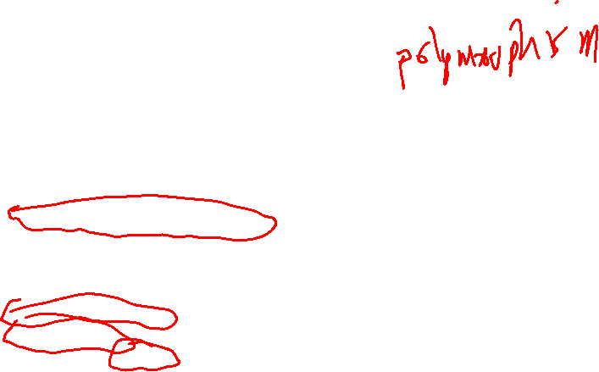
Example: Printable Objects
class Printable { public: virtual void print() const = 0; void println() const { print(); cout << "\n"; } virtual ~Printable() { } };
The class diagram for the final classes.
class Point : public Printable { double x, y; public: Point(double a, double b) : x(a), y(b) { } double get_x() const { return x; } double get_y() const { return y; } void print() const { cout << '(' << x << ", " << y << ')'; } void println() const { print(); cout << "\n"; } };
Point* r = new Point{-5, 12}; r->println(); // okay cout << r->get_x() // okay << "\n"; Printable* p = r; // okay p->println(); // okay cout << p->get_z(); // compile-time error
p is of type Printable* and so can only access members of Printable

Slide 37
Example: Printable Objects
class Printable { public: virtual void print() const = 0; void println() const { print(); cout << "\n"; } virtual ~Printable() { } };
The class diagram for the final classes.
class Point : public Printable { double x, y; public: Point(double a, double b) : x(a), y(b) { } double get_x() const { return x; } double get_y() const { return y; } void print() const { cout << '(' << x << ", " << y << ')'; } void println() const { print(); cout << "\n"; } };
void print_all(const vector<Printable*>& v) { for(Printable* p : v) { p->println(); } }
Printable lets us write polymorphic functions like this, that run on any object that inherits from Printable.

Slide 38
Abstract Base Classes
In general, abstract base classes like Printable are a useful idea
The idea is to put abstract methods in the base class, and let inheriting classes implement however they like
Then you can write general-purpose functions that run all objects that inherit from the base class
void print_all(const vector<Printable*>& v) { for(Printable* p : v) { p->println(); } }

Slide 39
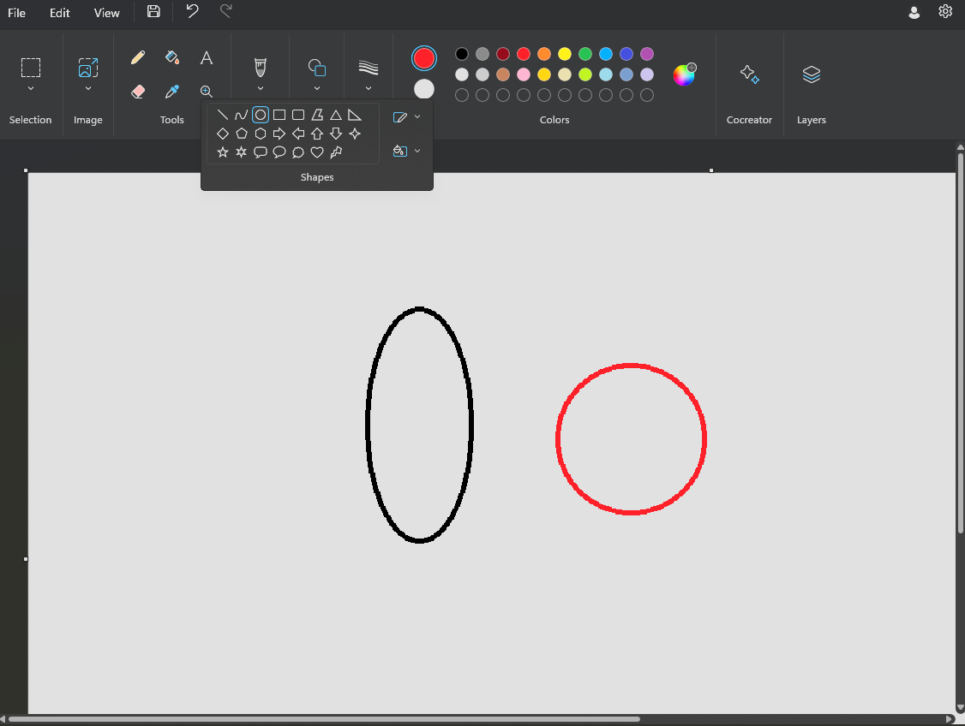


Designing Class Hierarchies
Suppose you are making a paint program, and you want a Circle class and an Ellipse class.
How should Circle and Ellipse be related?
a
r
b
Area = $πab$
Area = $πr^{2}$

Slide 40
Designing Class Hierarchies
Only two possibilities for inheritance …
Ellipse
Circle
Circle
Ellipse
Suppose you are making a paint program, and you want a Circle class and an Ellipse class.
How should Circle and Ellipse be related?
a
r
b
class Ellipse { int a; int b; public:
void get_width() const { return a; } void get_height() const { return b; }
// ...
};
class Circle { int r; public:
void get_radius() const { return r; }
// ...
};

Slide 41
Designing Class Hierarchies
Possibility: Circle inherits from Ellipse
Ellipse
Suppose you are making a paint program, and you want a Circle class and an Ellipse class.
How should Circle and Ellipse be related?
Circle
Makes sense: every circle is also an ellipse.
What could go wrong?
a
r
b
Area = $πab$
Area = $πr^{2}$

Slide 42
Designing Class Hierarchies
Possibility: Circle inherits from Ellipse
Ellipse set_width(int w) set_height(int h)
But suppose you can change the width and height of an Ellipse.
Suppose you are making a paint program, and you want a Circle class and an Ellipse class.
How should Circle and Ellipse be related?
Makes sense: every circle is also an ellipse.
Since Circle inherits from Ellipse, you set_width and set_height
Circle set_width(int w) set_height(int h)
This lets us set the width and height of a circle to be different values, which makes no sense for a circle.
Circle c(10); // a circle of radius 10 c.set_width(5); c.set_height(15); // ???: a circle's width and // height can't be different!
a
r
b
Area = $πab$
Area = $πr^{2}$

Slide 43
Designing Class Hierarchies
Possibility: Circle inherits from Ellipse
Ellipse set_width(int w) set_height(int h)
But suppose you can change the width and height of an Ellipse.
Suppose you are making a paint program, and you want a Circle class and an Ellipse class.
How should Circle and Ellipse be related?
Makes sense: every circle is also an ellipse.
Since Circle inherits from Ellipse, you set_width and set_height
Circle set_width(int w) set_height(int h)
This lets us set the width and height of a circle to be different values, which makes no sense for a circle.
Circle c(10); // a circle of radius 10 c.set_width(5); c.set_height(15); // ???: a circle's width and // height can't be different!
a
r
b
Area = $πab$
Area = $πr^{2}$

Slide 44
Designing Class Hierarchies
Possibility: Ellipse inherits from Circle
Circle
Suppose you are making a paint program, and you want a Circle class and an Ellipse class.
How should Circle and Ellipse be related?
Makes sense: Circle stores one radius, Ellipse will add another one.
Ellipse
What could go wrong?
a
r
b
Area = $πab$
Area = $πr^{2}$

Slide 45
Designing Class Hierarchies
Possibility: Ellipse inherits from Circle
Circle
Suppose you are making a paint program, and you want a Circle class and an Ellipse class.
How should Circle and Ellipse be related?
Makes sense: Circle stores one radius, Ellipse will add another one.
Ellipse
double area(Circle c) { return 3.14 * c.radius() * c.radius(); }
a
r
Ellipse e(5, 10); // an ellipse 5 wide, 10 high cout << area(e); // this can't return the correct area
// because area only calls c.radius()
b
Area = $πab$
Area = $πr^{2}$

Slide 46
Designing Class Hierarchies
Possibility: Ellipse inherits from Circle
Circle
Suppose you are making a paint program, and you want a Circle class and an Ellipse class.
How should Circle and Ellipse be related?
Makes sense: Circle stores one radius, Ellipse will add another one.
Ellipse
double area(Circle c) { return 3.14 * c.radius() * c.radius(); }
a
r
Ellipse e(5, 10); // an ellipse 5 wide, 10 high cout << area(e); // this can't return the correct area
// because area only calls c.radius()
b
Area = $πab$
Area = $πr^{2}$

Slide 47
Designing Class Hierarchies
Suppose you are making a paint program, and you want a Circle class and an Ellipse class.
How should Circle and Ellipse be related?
Ellipse
Circle
Circle
Ellipse
The example code shows that it neither of these ways of inheriting work sensibly in every case!
How do you know when inheritance is okay to use?
a
r
b
Area = $πab$
Area = $πr^{2}$

Slide 48

Designing Class Hierarchies
Suppose you are making a paint program, and you want a Circle class and an Ellipse class.
How should Circle and Ellipse be related?
Ellipse
Circle
Circle
Ellipse
Liskov Substitution Principle
It’s okay for class B to inherit from class A if objects of type A in a program may be replaced with objects of type B without altering any of the desirable properties of that program.
A
B
a
r
Barbara Liskov
b
Area = $πab$
Area = $πr^{2}$
Inheritance should always follow this principle! Otherwise, you could wind up in logically inconsistent situations.

Slide 49
Designing Class Hierarchies
Windows Paint program appears to have just an Ellipse. To make a circle, you could make the width and height the same and “lock the aspect ratio”.
Suppose you are making a paint program, and you want a Circle class and an Ellipse class.
How should Circle and Ellipse be related?
a
r
b
Area = $πab$
Area = $πr^{2}$

