Slide 1
Ensuring Perl's Viability on FreeBSD:
A NYCBUG-NY.PM Collaboration
New York City BSD Users Group (nycbug)
New York Perlmongers (ny.pm)
James E Keenan
Andrew Villano
November 7 2018

Slide 2
Ensuring Perl's Viability on FreeBSD:
A NYCBUG-NY.PM Collaboration
The Big Picture:
How NYCBUG and
New York Perlmongers
have collaborated to ensure
the continued viability of
Perl 5 on FreeBSD

Slide 3
Ensuring Perl's Viability on FreeBSD:
A NYCBUG-NY.PM Collaboration
We’ll consider:
The Perl 5 core distribution and development process
Testing the Perl 5 core distribution on various platforms
The Perl 5 ecosystem: CPAN
Testing CPAN on various platforms: CPANtesters
Testing Perl monthly development releases
against CPAN on FreeBSD
Impacts of our work

Slide 4
Ensuring Perl's Viability on FreeBSD:
A NYCBUG-NY.PM Collaboration
The Perl 5 Core Distribution and Development Process
Perl 5, created by Larry Wall - 1994
Perl 5.28.0 - June 2018 production release
Perl 5.29.4 - October 2018 development release

Slide 5
Ensuring Perl's Viability on FreeBSD:
A NYCBUG-NY.PM Collaboration
Perl 5 Core Distribution consists of:
  Source code to build perl executable
  Important libraries (modules)

Slide 6
Ensuring Perl's Viability on FreeBSD:
A NYCBUG-NY.PM Collaboration
Testing the Perl 5 Core Distribution
  Committers must run test suite
  Smoke-testing
  http://perl5.test-smoke.org

Slide 7
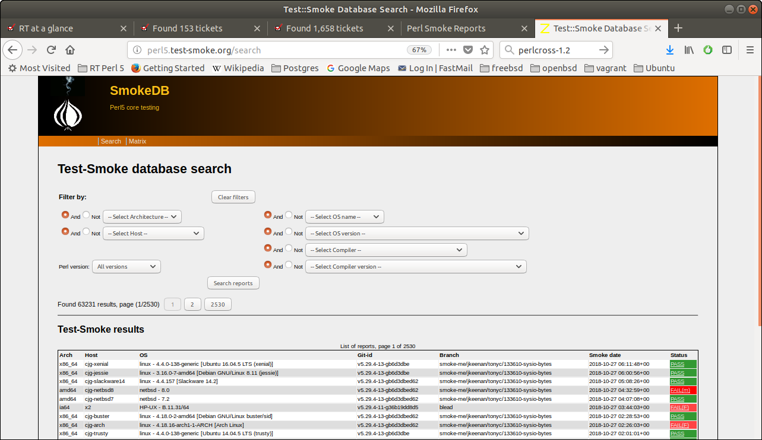

Slide 8
Ensuring Perl's Viability on FreeBSD:
A NYCBUG-NY.PM Collaboration
May 2016: No smoke-testing on FreeBSD
Set up virtual machines on this Linux laptop
Installed VirtualBox, VMware, Vagrant
August 2016: FreeBSD-10.3 first smoke test: PASS

Slide 9
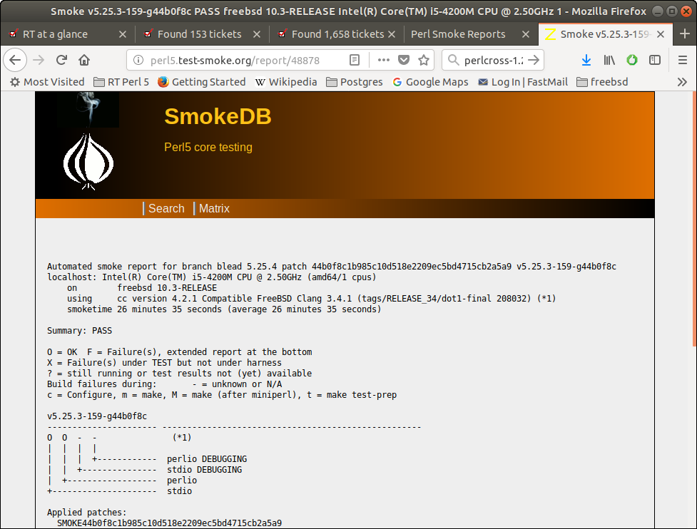

Slide 10
Ensuring Perl's Viability on FreeBSD:
A NYCBUG-NY.PM Collaboration
October 2016: FreeBSD-11.0
First smoke-test: FAIL

Slide 11
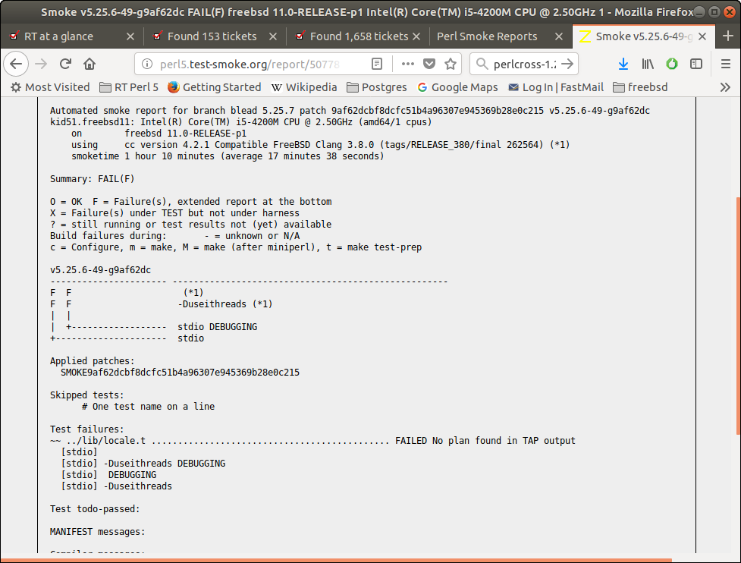

Slide 12
Ensuring Perl's Viability on FreeBSD:
A NYCBUG-NY.PM Collaboration
Failures in code added to core distribution
after May 2016 release of perl-5.24.0
Months of work to get PASS on FreeBSD-11

Slide 13
Ensuring Perl's Viability on FreeBSD:
A NYCBUG-NY.PM Collaboration
CPAN: The Perl 5 Ecosystem
Comprehensive Perl Archive Network
https://www.cpan.org/
175,000 modules
39,000 distributions
13,000 authors
Perl's killer app

Slide 14
Ensuring Perl's Viability on FreeBSD:
A NYCBUG-NY.PM Collaboration
CPANtesters
Test CPAN modules across operating systems and Perl versions
http://matrix.cpantesters.org/?dist=DateTime;os=freebsd

Slide 15
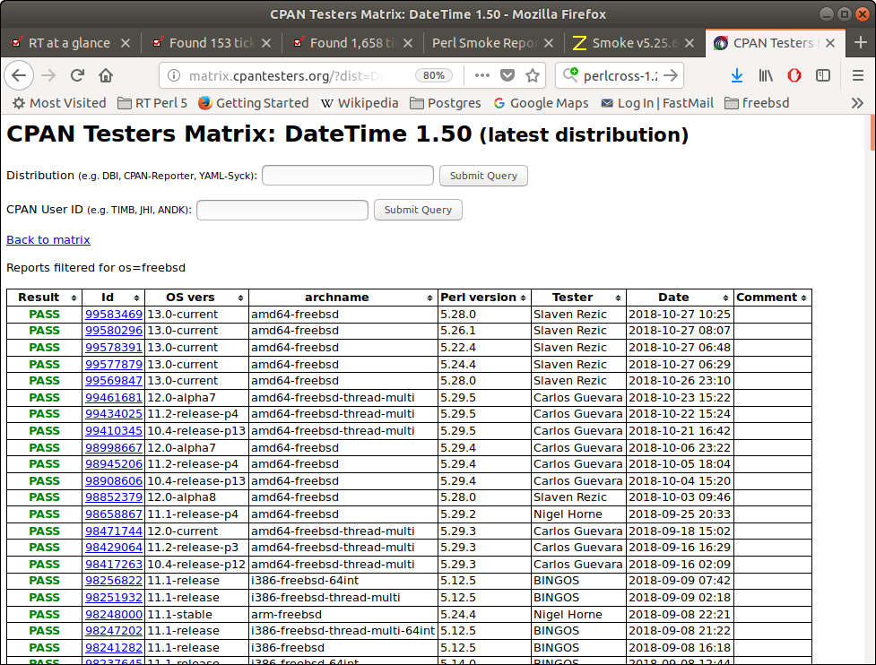

Slide 16
Ensuring Perl's Viability on FreeBSD:
A NYCBUG-NY.PM Collaboration
Do CPAN modules work with dev versions of Perl?
  Do the changes we've made in the core distribution since our last production release 'break' any CPAN modules?
  Must evaluate benefits of changes to core distribution against potential disruption to users of CPAN
  modules

Slide 17
Ensuring Perl's Viability on FreeBSD:
A NYCBUG-NY.PM Collaboration
“Blead”: master development branch in git repository
Does blead “break” CPAN?
How much?
Under what configurations?
On which versions of which OSes?
Is breakage just blead’s fault?
Or do changes to core expose sub-optimal code
on CPAN?

Slide 18
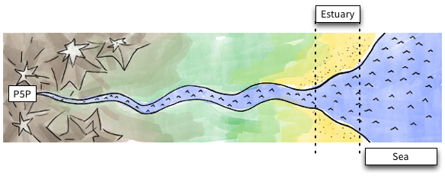
Ensuring Perl's Viability on FreeBSD:
A NYCBUG-NY.PM Collaboration
CPAN River

Slide 19
Ensuring Perl's Viability on FreeBSD:
A NYCBUG-NY.PM Collaboration
CPAN River
Chain of dependencies starting with core distribution
Flowing downstream through CPAN
Flowing into the sea of all Perl code in the world

Slide 20
Ensuring Perl's Viability on FreeBSD:
A NYCBUG-NY.PM Collaboration
CPAN River
What if there’s pollution upstream or a dam gets built?
Everything downstream suffers
For QA: test modules high on CPAN river to make sure
they work with blead

Slide 21
Ensuring Perl's Viability on FreeBSD:
A NYCBUG-NY.PM Collaboration
During Perl 5.27-5.28 development cycle (2017-2018):
Used list of 1000 CPAN modules “farthest upstream”
Tested against monthly development releases:
5.27.0, 5.27.1, ... 5.27.11
Tested on Debian Linux (Linode)
Posted to Perl 5 Porters mailing list

Slide 22
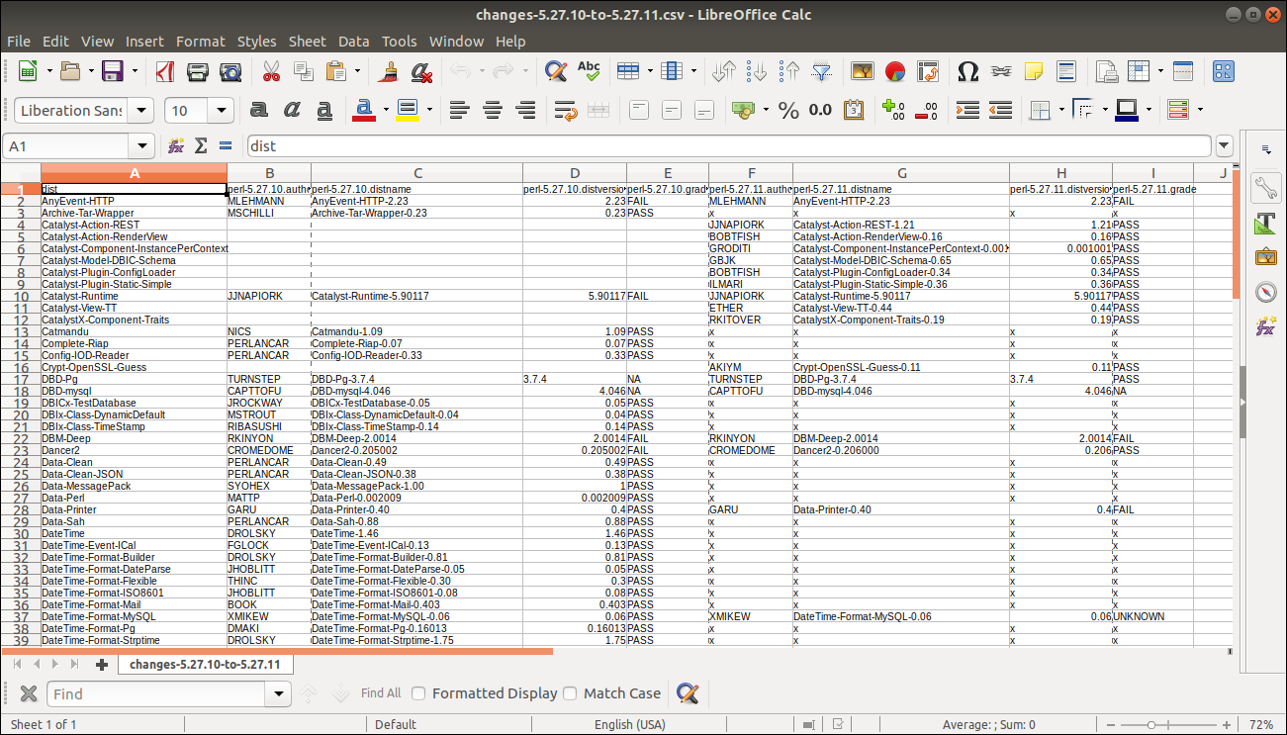

Slide 23
Ensuring Perl's Viability on FreeBSD:
A NYCBUG-NY.PM Collaboration
Preparing for 5.29-5.30 development cycle (2018-2019):
Wanted larger list of CPAN modules: 3000 vs. 1000
Wanted diversity of OSes: FreeBSD vs. Linux
Wanted better administered platform

Slide 24
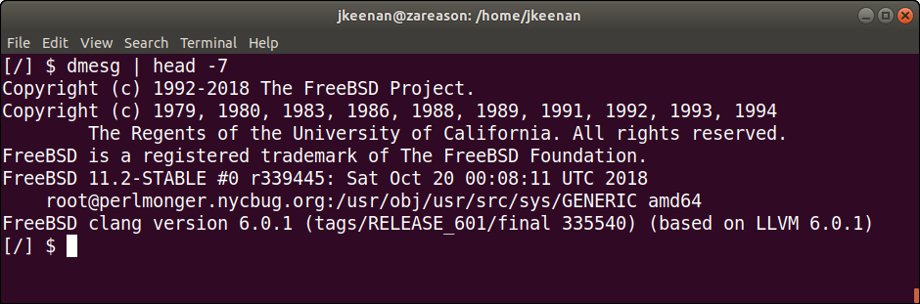
Ensuring Perl's Viability on FreeBSD:
A NYCBUG-NY.PM Collaboration
Early 2018: Approach NYCBUG admin team
Help from George Rosamond and Mark Saad

Slide 25
Ensuring Perl's Viability on FreeBSD:
A NYCBUG-NY.PM Collaboration
Andrew Villano, SysAdmin, came on board
Notes:
Most Vagrant images are purposely kept small for purposes of portability. We're going to want to enlarge our Virtual Machine so that it can accommodate more storage. First, we're going to want to login to the FreeBSD Host via ssh and su to a shared user. We created a shared user as we found that it is difficult to share Vagrantfiles among multiple users. We cd to the directory that we're keeping the Vagrantfile in. At this point we're going to have to stop the Virtual Machine as you cannot do an online resize -- issue vagrant halt to do that. Now we're going to cd to the directory of the Virtualbox VM image, let's assume the path is /home/vmuser/Virtualbox/VMs/mybox_default_12345678. You will now want to confirm the location of the Virtual Machine disk file. We'll do that with this command:
VBoxManage showvminfo mybox_default_12345678 | grep ".vmdk" Another issue we'll run into is that .vmdk files cannot be resized, they must be converted to .vdi files first. A VMDK file or VDI file is a file that contains the Virtualbox VM image used by Vagrant. It is analogous to an ISO for a CD. Staying in the same directory (and assuming your .vmdk file is named box-disk1.vmdk) run the command:
VBoxManage clonehd "box-disk1F<.vmdk>" "clone-disk1.vdi" --format vdi Let's verify the conversion was successful and the size of the new file with the command:
VBoxManage showhdinfo "clone-disk1.vdi"

Slide 26
Ensuring Perl's Viability on FreeBSD:
A NYCBUG-NY.PM Collaboration
Vagrant images by default are small for portability.
VMDK files cannot be resized. They must be converted to VDI files first.
A shared user ‘vmuser’ must be created as Vagrantfiles cannot be easily shared among users.
After converting the VMDK file to VDI we can grow the size of the container under the ‘vmuser’.
Notes:
Most Vagrant images are purposely kept small for purposes of portability. We're going to want to enlarge our Virtual Machine so that it can accommodate more storage. First, we're going to want to login to the FreeBSD Host via ssh and su to a shared user. We created a shared user as we found that it is difficult to share Vagrantfiles among multiple users. We cd to the directory that we're keeping the Vagrantfile in. At this point we're going to have to stop the Virtual Machine as you cannot do an online resize -- issue vagrant halt to do that. Now we're going to cd to the directory of the Virtualbox VM image, let's assume the path is /home/vmuser/Virtualbox/VMs/mybox_default_12345678. You will now want to confirm the location of the Virtual Machine disk file. We'll do that with this command:
VBoxManage showvminfo mybox_default_12345678 | grep ".vmdk" Another issue we'll run into is that .vmdk files cannot be resized, they must be converted to .vdi files first. A VMDK file or VDI file is a file that contains the Virtualbox VM image used by Vagrant. It is analogous to an ISO for a CD. Staying in the same directory (and assuming your .vmdk file is named box-disk1.vmdk) run the command:
VBoxManage clonehd "box-disk1F<.vmdk>" "clone-disk1.vdi" --format vdi Let's verify the conversion was successful and the size of the new file with the command:
VBoxManage showhdinfo "clone-disk1.vdi"

Slide 27
Ensuring Perl's Viability on FreeBSD:
A NYCBUG-NY.PM Collaboration
After VDI is resized we re-attach it to the VM
We will not encounter LVM on FreeBSD by default, but if we had we would have ran pvcreate,vgextend,lvextend and growfs.
We’ll install the package firstboot-growfs as we cannot go down runlevel 1 as that would terminate our network access. This will expand the filesystem before the filesystem is mounted on firstboot.
After running vagrant reload –provision , the filesystem should have expanded.
Notes:
We're finally going to resize the Virtual Machine. Keeping in mind the scale is in MegaBytes the following example will resize the disk to 100 GigaBytes:
VBoxManage modifyhd "clone-disk.vdi" --resize 102400 Let's confirm the name of the storage controller we're going to be attaching the .vdi file to with the command:
VBoxManage showvminfo mbox_default_12345678 | grep "Storage" Assuming the name of the storage controller retreived in the previous step is "SATA Controller", we will attach the new .vdi file to the VM via:
VBoxManage storageattach mybox_default_12345678 \ --storagectl "SATA Controller" \ --port 0 \ --device 0 \ --type hdd \ --medium clone-disk1.vdi Let's bring the VM back up by cd-ing back to the directory of the Vagrantfile and then issuing the command vagrant up and logging into the VM with the command vagrant ssh.

Slide 28
Ensuring Perl's Viability on FreeBSD:
A NYCBUG-NY.PM Collaboration
Testing Perl monthly development releases
against CPAN on FreeBSD
Prepare the VM: Use pkg to install many C libraries
Improve the Vagrantfile
CPAN module Test::Against::Dev
cron job

Slide 29
Ensuring Perl's Viability on FreeBSD:
A NYCBUG-NY.PM Collaboration
Download monthly development release tarball
Build and install perl-5.29.*
Install cpanm for use as CPAN installer
Install 3000 “farthest upstream” CPAN modules
Write JSON for each module
Write pipe-separated-values file summarizing results

Slide 30
Ensuring Perl's Viability on FreeBSD:
A NYCBUG-NY.PM Collaboration
Store results in git: https://github.com/nyperlmongers/nypm-nycbug-associates/tree/master/results/perl-5.29-cycle
Post results to Perl 5 Porters mailing list

Slide 31
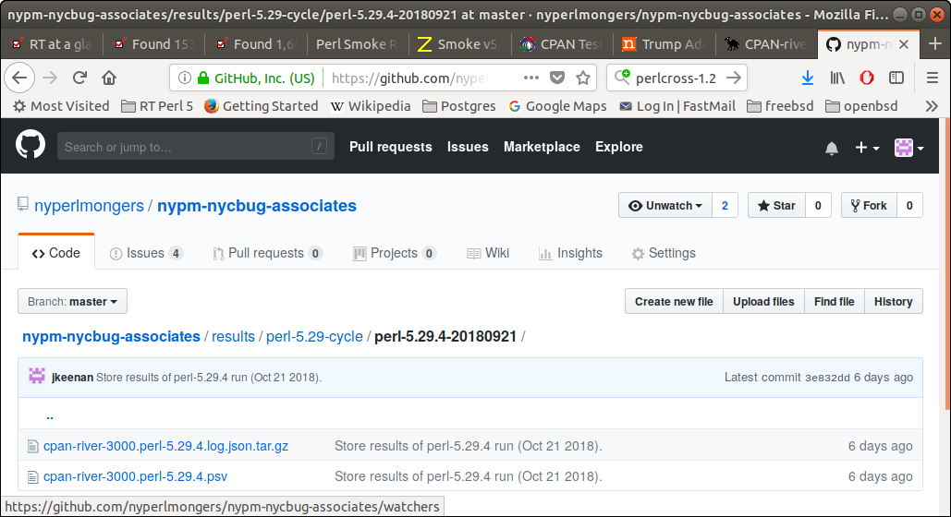

Slide 32
Ensuring Perl's Viability on FreeBSD:
A NYCBUG-NY.PM Collaboration
Impacts
Purpose of test-against-dev: Promote viability of Perl 5 and CPAN as basis for production applications
Alert core developers to impact of changes in core on CPAN
Alert CPAN developers to need to update code
Avoid excessive Linux-centricity

Slide 33
Ensuring Perl's Viability on FreeBSD:
A NYCBUG-NY.PM Collaboration
Impacts
Helps ensure Perl-based applications continue to run on FreeBSD
Helps ensure viability of FreeBSD as applications platform

Slide 34
Ensuring Perl's Viability on FreeBSD:
A NYCBUG-NY.PM Collaboration
Impacts
Hence, ensure viability of both Perl and FreeBSD
Result of NYCBUG-NY.PM collaboration

Slide 35
Ensuring Perl's Viability on FreeBSD:
A NYCBUG-NY.PM Collaboration
Thanks!

