Slide 1

Introduction to Clinical Informatics
01/28/2026

Slide 2
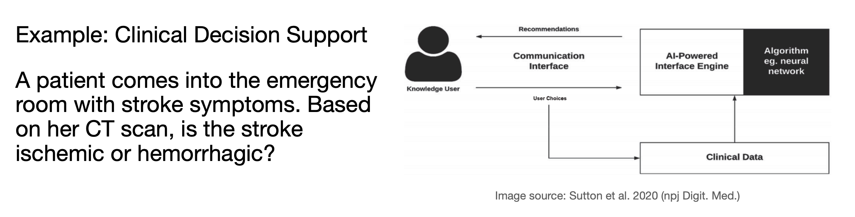
Why is informatics relevant to medicine?
Can act as an improvement to health decision-making
Expands access to care
Streamline workflows
Precision medicine
AI/ML
Data management

Slide 3
What questions can informatics help answer?
Prognostication: Is X a biomarker of Y disease?
Quality-improvement: Does adding X treatment to the standard of care improve quality-of-life?
Decision-making: Can understanding X exposure allow for risk assessment in patient populations?
Discovery: How does X treatment impact the fundamental biology of Y disease?
Discovery: Can we develop X epitope vaccine for Y disease?
Discovery: What lies on the surface of tumor cells?

Slide 4
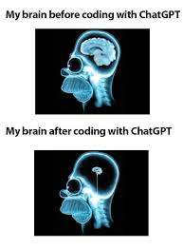
But can’t chat just do it all?
No, but it can certainly help.
ChatGPT is a great assistant for analyses but cannot replace your ability to think up real, relevant outside-the-box humanoid questions.
Statistics, biases, hallucinations
Workflow: Understand code → practice coding → understand thinking computationally + learn statistics → come up with interesting questions → answer questions → use GPT to automate this analysis

Slide 5
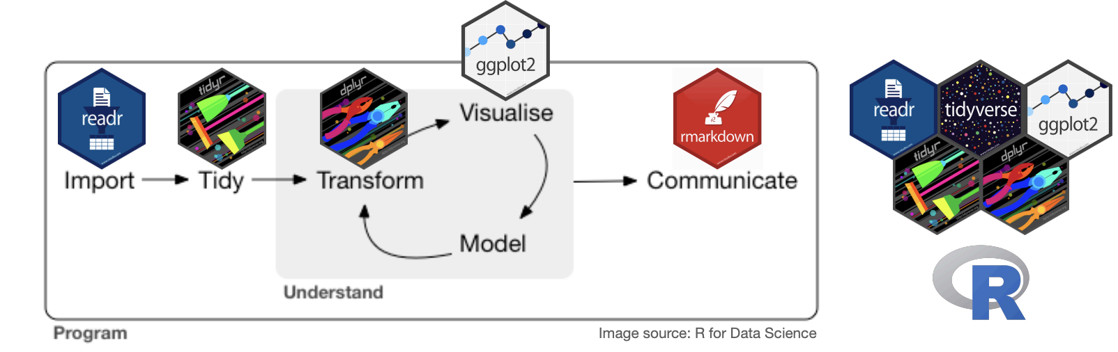
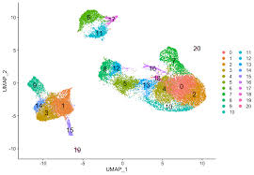
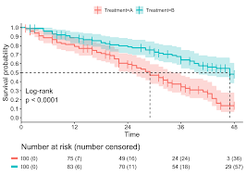
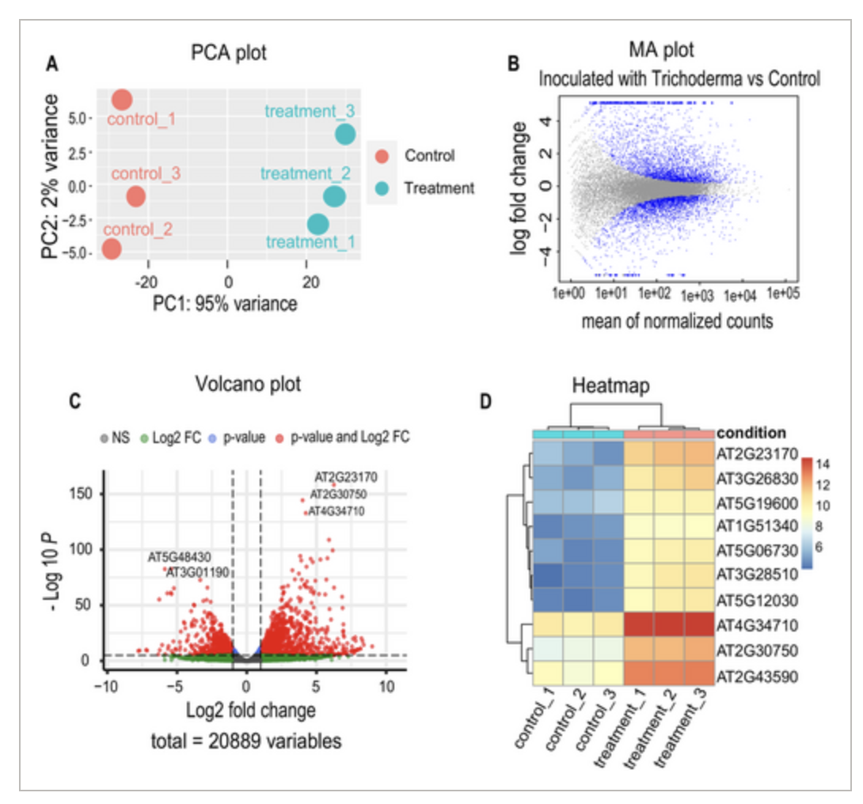
The goals of this quasi-course

Slide 6



The inspiration for this quasi-course
Dan Beiting
Eugene Katsevich
Hadley Wickham

Slide 7
Expectations
Come to the sessions that matter most to you – feel zero obligation to snuff around
Show up not only to learn, but to teach
Tell me your interests and what excites you most! I want to add that to the curriculum
Give me feedback
Disclaimer: This is a survey course, things will be missed.

Slide 8
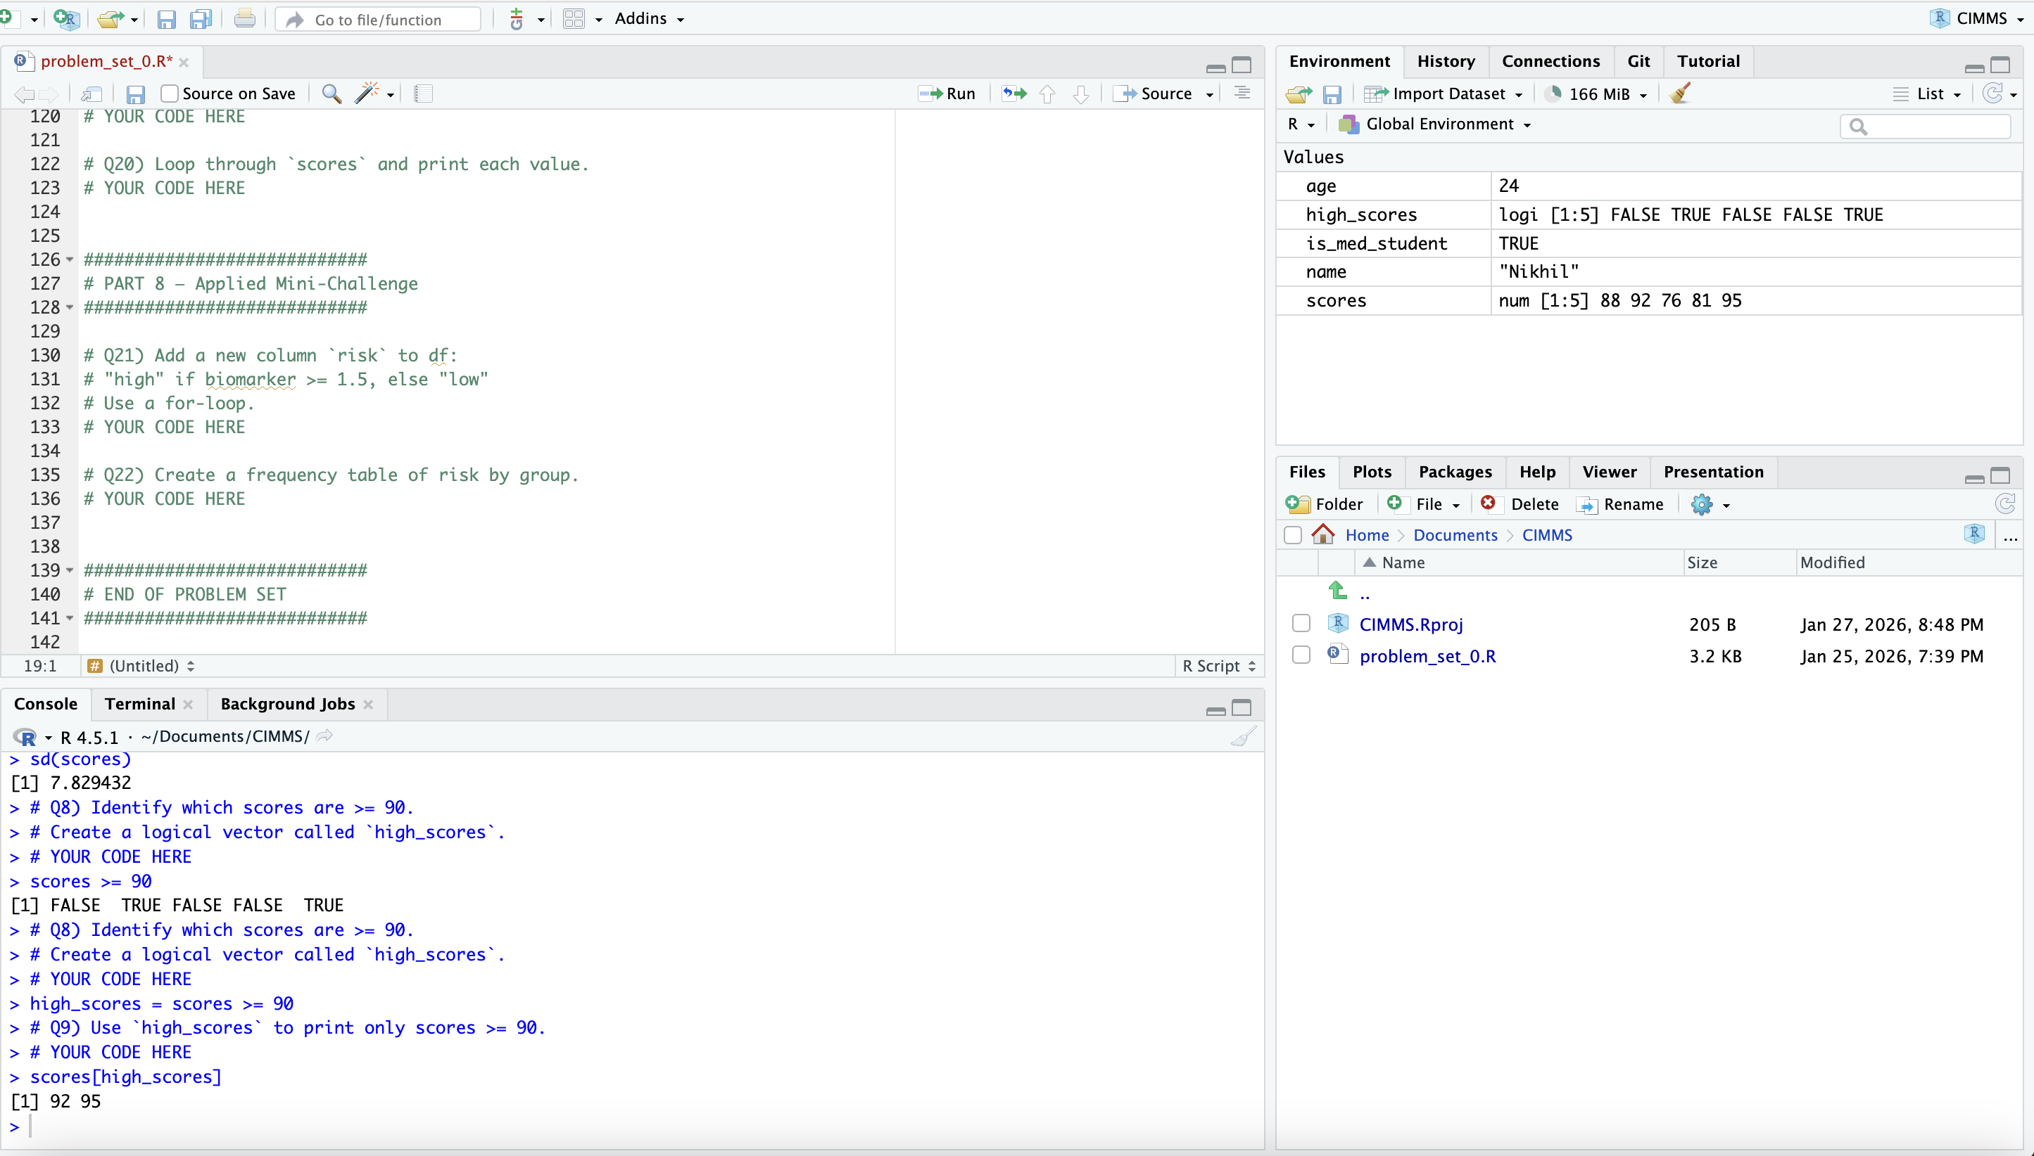
Rstudio/R Overview

Slide 9
Variables, Methods
Variables
Definition: Named objects that store data
Common Types:
  numeric → 3.14, 120, gene expression
  character → "Male", "Control"
  factor → categorical variables with levels
  logical → TRUE / FALSE
Data Structures:
  vector → single data type
  data.frame / tibble → rows = observations, columns = variables
Methods
Definition: Functions that operate on variables
Structure:
  function_name(input, options)
Examples:
  mean(x) → summarize data
  lm(y ~ x, data = df) → linear regression
  t.test(y ~ group, data = df) → compare groups
  filter(), mutate() → data manipulation (tidyverse)

Slide 10
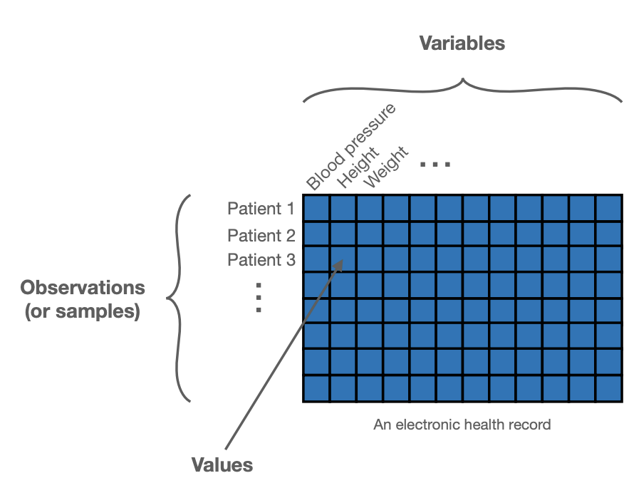
Database structures
Databases should be built with analysis in mind
  Data dictionary
Principles of tidy data:
  1. Each variable forms a column.
  2. Each observation forms a row.
  3. Each type of observational unit forms a table.

Slide 11
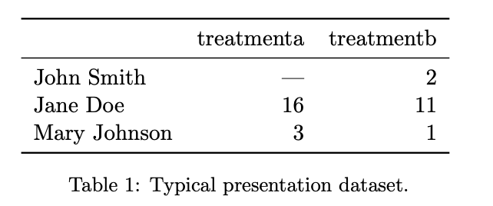
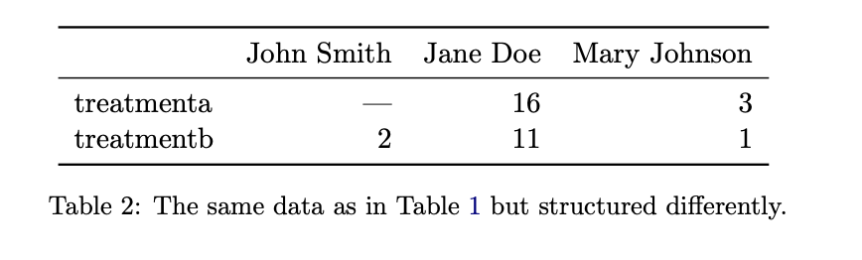
Principles of tidy data

Slide 12
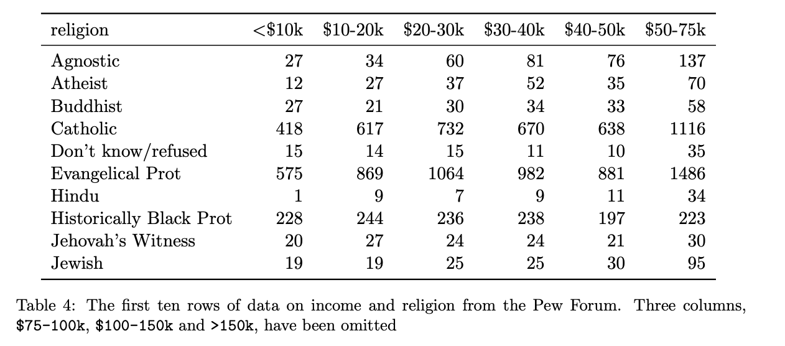
Principles of tidy data

Slide 13
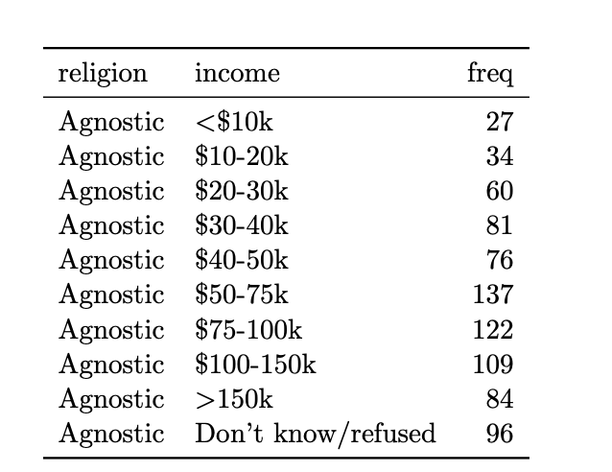
Principles of tidy data

Slide 14
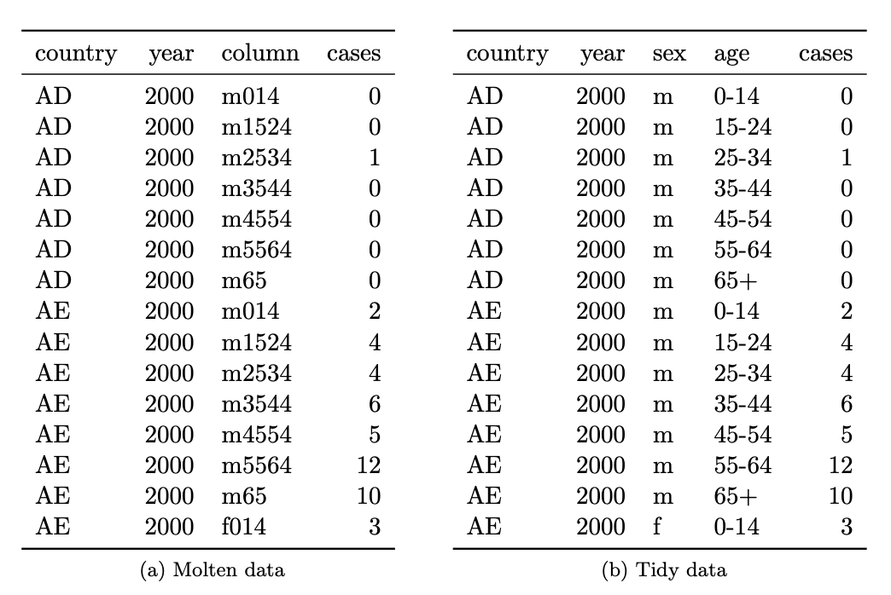
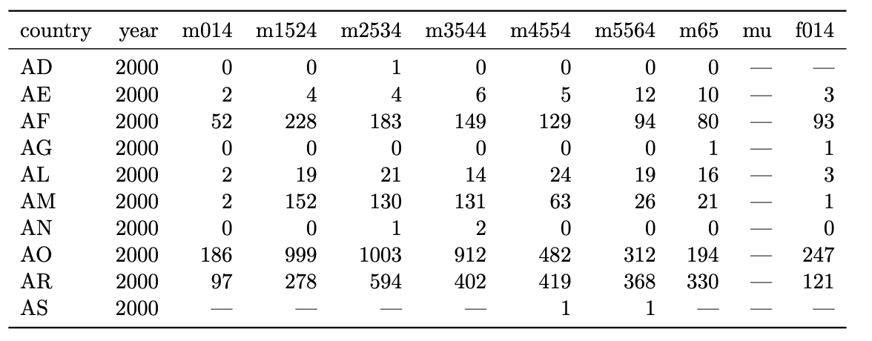
Principles of tidy data

Slide 15
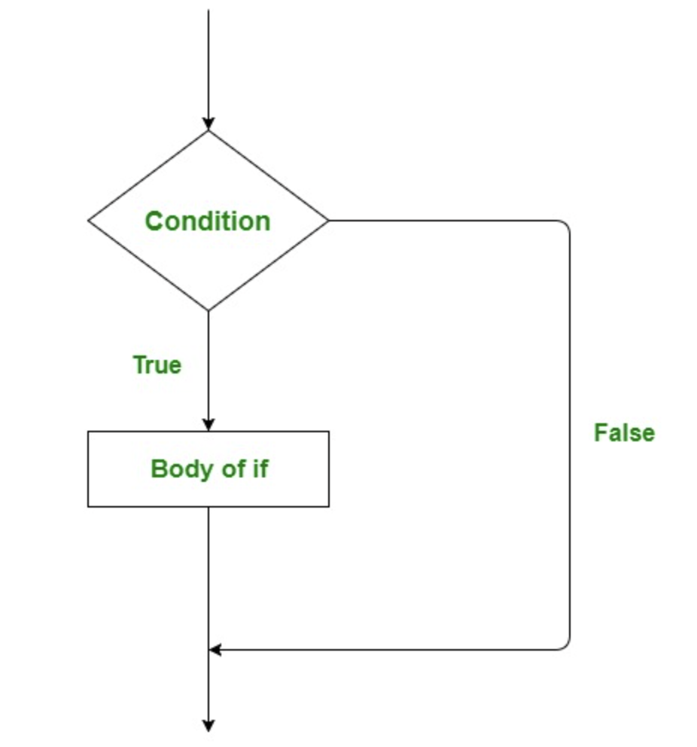
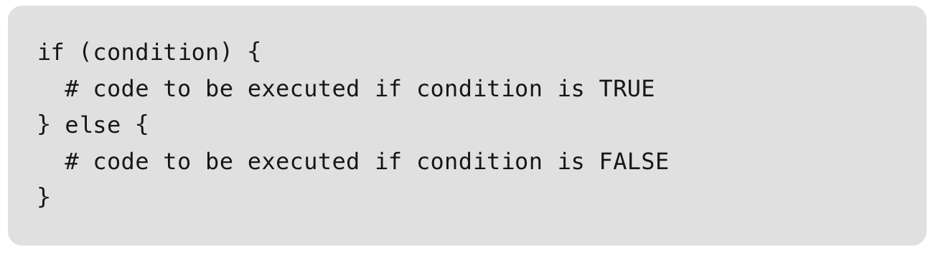
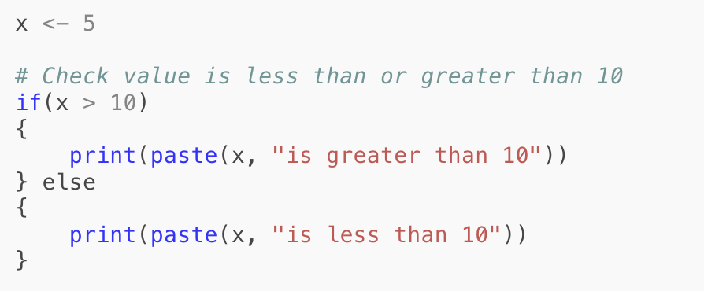
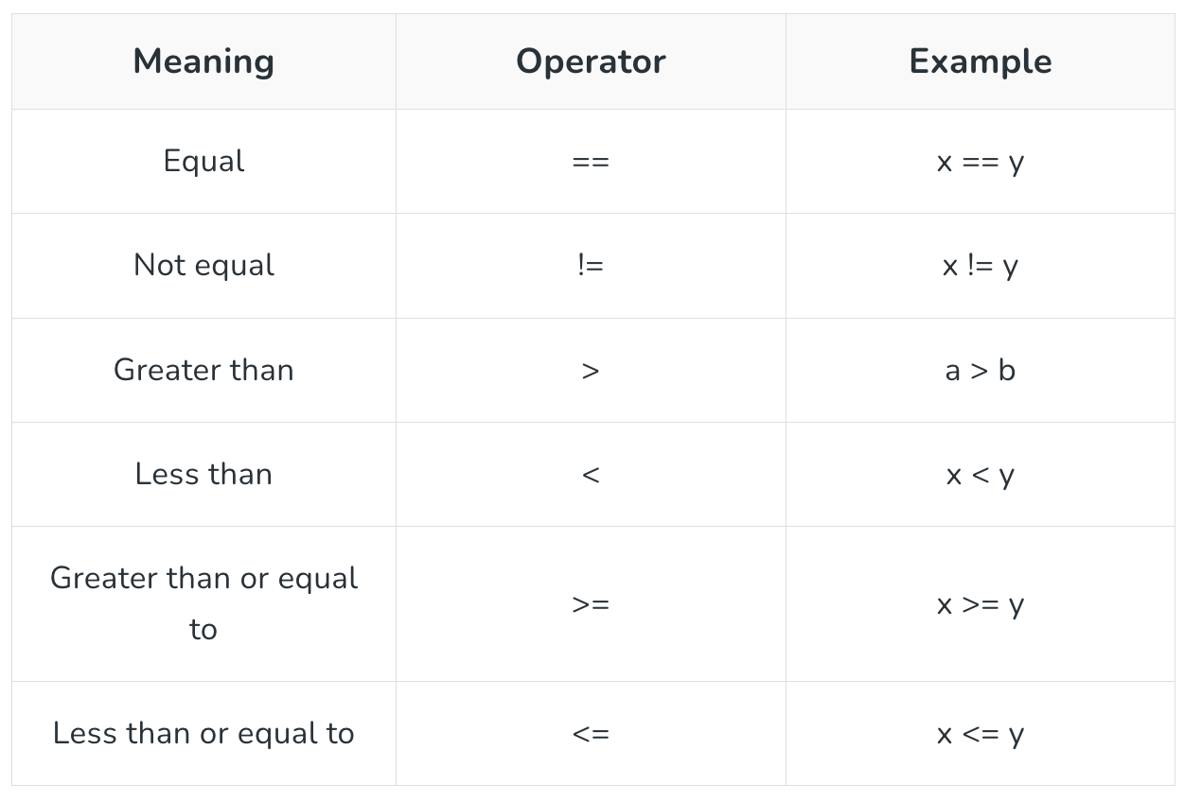
If-else

Slide 16
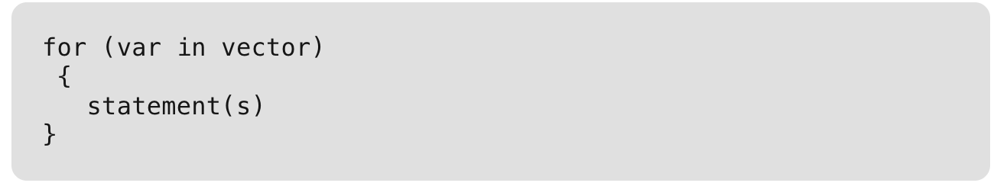
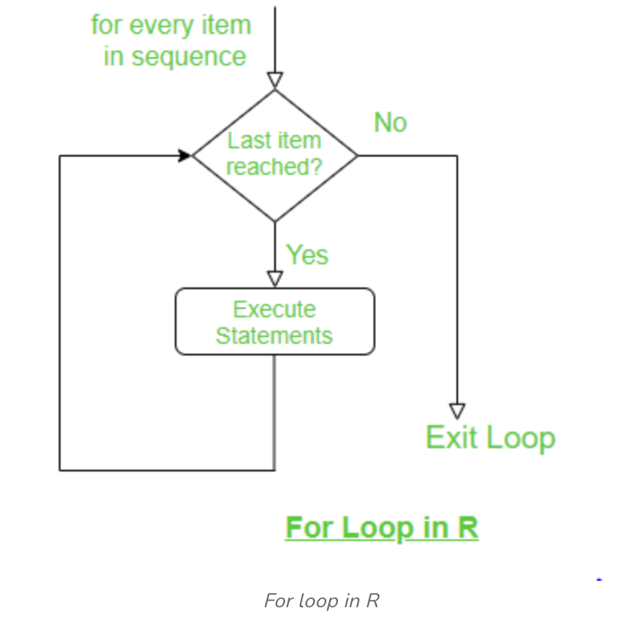
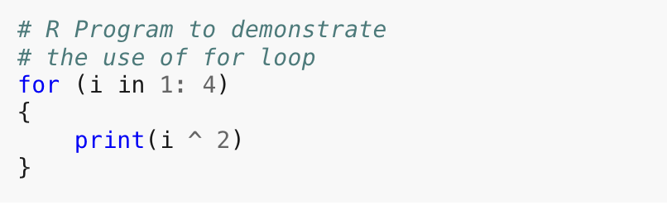
For Loops

Slide 17
Questions?

