Slide 1
Neighbor Management Policy for 6LoWPAN (focusing on the protocol change-free guidance )
https://tools.ietf.org/html/draft-jadhav-lwig-nbr-mgmt-policy-00
Rahul, Rabi@ Huawei
Simon @ INRIA Joakim @ Yanzi Networks
IETF99
History:
IETF97: Presented the problem statement, without the draft
IETF98: First presentation based on the draft, sample reservation policy described

Slide 2
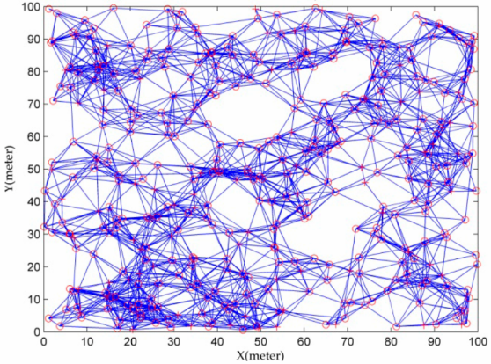
Why Neighbor Management?
Implementation dilemma:
Node density is higher than nbr cache size
Quite an implementation issue!!
Unbalanced & unstable topology
without proper nbr mgmt policy
Stable and scalable topology
with a proper policy
Notes:
Impacts scalability …
Impacts PDR and every other performance indicator

Slide 3
The problem of trivial policies
Trivial policies
LRU: Replace the least recent used entry
FCFS: First come first serve
An example given by Joakim:
50-60 smart plugs on a table
trying to switch all of them at the same time
However in this case only 10 entries in the neighbor table
Result: the network went into a continuous topology churn

Slide 4
Considerations….
Security-enabled 6LoWPAN/RPL network
Key management protocols before RPL network formation
Cases where neighbor table update happens
Relay based signaling during authentication
RPL’s parent selection using DIO messaging
RPL’s routing child node
PRE = PANA Relay Element aka Join Proxy
PaC = PANA Client aka Pledge
PAA = Auth Server aka Join Registrar/Coordinator
Notes:
Need to talk about implicit vs explicit signaling which impacts neighbor table

Slide 5
Neighbor Management Operations
Insertion
Problem with simple logic (If table space is available: insert)
RPL’s DIO storm in dense network overwhelms neighbor cache
DAO storm to the same parent
Eviction
Problems currently…
An routing child eviction may have ripple effect on all grand-childs
Good news: Evicting non-preferred parent NCE is possible without much implications!!
Reinforcement
Reinforcement allows the link quality estimation to be updated, eventually helping in eviction/retention decision
NCE = Neighbor Cache Entry
Notes:
We assume link metric estimation especially RSSI to be always good since the network is dense.
Reinforcement can be done by passive/active hearing or by explicit probing. Draft does not define how to do this.

Slide 6
Clearing unused NCEs
For storing MOP, route invalidation is important since routing entries are mapped to NCEs
For Non-storing MOP,
since there is no route invalidation procedure, the child node needs to deregister using NS(lifetime=0) …
PRE neighbors
After authentication is successful, the PRE auth entries can be removed
However there is no way of explicit identification of auth finish
Usually reachability timeout will remove such entries. For neighbors added for authentication, the reachability timer can be reduced to a lower value.
Notes:
Important that unused NCEs be reclaimed soon

Slide 7
Proposed reservation based policy
Basic principles
“Reservation”
Parent NCEs can be inserted at will and can occupy reserved entries
Because they could be evicted if necessary, unlike routing direct childs and relay element entries
Insertion reason (RPL_parent, RPL_child, Other) is attached with every NCE
Makes decision making easier when it comes to eviction

Slide 8
Issues with reactive policy
Whatever I presented as of now is reactive …
Limitations of reactive policy
Scenario: A parent whose nbr cache is full sends a DIO (a 6LR(router node) cannot avoid sending DIOs) …
A child node may still select this parent node since DIO does not signal NCE metric
Thus there would be an additional signaling to reject this parent node
Worse, in the future, the child node may again select the same parent based on new DIO from the parent node.
Notes:
Currently there are no changes to signaling or message formats … This is the best (imo) that can be achieved and it has its limitations …

Slide 9

Proactive way:
A “Parental Advisory” to signal availability
“Currently there is no standard way of signaling such neighbor cache space availability information. RPL's DIO messages carry metric information and can be augmented with neighbor cache space as an additional metric”
Out of scope for LWIG, could bring to RPL/6lo for discussion

Slide 10
Discussions
WG Adoption in LWIG
As a general protocol agnostic guidance for nbr mgmt.
Next steps:
Contiki implementation already began prior to this draft. Contiki will keep aligning with this draft…
Thank You

