Slide 1


State of protocol compression in IoT
Rahul Jadhav
Pre-IETF100 2017, Bangalore
Notes:
Can really IPv6 be used for last-mile IoT networks? Isn’t it a lot of overhead just to get IP in the last mile? Are we compromising on the last mile goodput just to fit in IPv6?
IPv6 compression is one key thing which has allowed use of IP in the last-mile and thus making end-to-end IP connectivity possible.

Slide 2
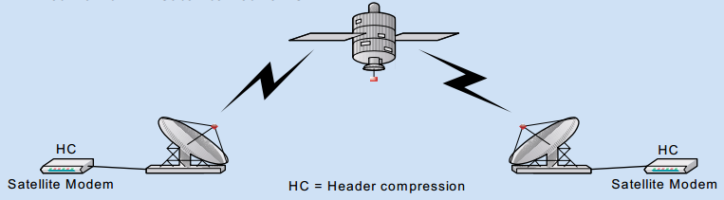
Compression Scenarios – pre-IoT era
Low-or-medium speed links such as satellite and cellular
VoIP calls
20ms audio data is ~20 octets (G.729 codec) and control overhead (RTP/UDP/IPv4) is 40 octets
Gaming applications: Small and latency critical payload
Tunneling overhead (IPv6/IPv6/TCP header = 100 octets)
Notes:
Goodput improves when you reduce header overhead.
Header compression is about link efficiency…
Support for higher node densities..

Slide 3
Protocols Compression
Header Compression Fundamentals
Usually per-link compression
Temporal Compression:
Redundancy between consecutive packets of the same flow
Robustness:
Impact of packet-loss and reordering on packet reconstruction
Increased robustness comes at an expense of lower compression efficiency
Payload Compression

Slide 4
CTCP / VJ Compression
ROHC
ROHCv2
Delta Encoding for TCP/IP compression
Robust (than IPHC)
Quick context resynchronization
Simplified
More robust
More profiles
1990
1999
2001
2003
2008
Per-flow compression context
Closed-Loop – thus feedback
Compression efficiency inversely proportional to packet loss, reordering
IPHC, CRTP
eCRTP
Arbitrary IP, TCP, UDP header compression
No use of delta encoding for non-tcp packets
Robust (than CRTP)
Quick context resynchronization

Slide 5

IoT conditions
Constraints everywhere…
Network & Device constraints
Thousands of devices may connect to a single gateway
Some characteristics to work with…
Only couple or more of flows per device
Limited traffic flow per device
Compression allows
Reduction of packet fragmentation
Improvement in good-put of last-mile constrained network
Notes:
Device Resource Constraints:
- Limited memory, thus cannot have complex compression algorithms implemented.

Slide 6
Are IPHC/ROHC/… good candidates for such conditions?
Per-flow context – An overkill for IoT
Requirement of compression at multiple hops
Cannot afford closed-loop systems
Designed for high throughput systems
Notes:
Per-flow context is too resource intensive
Compression at multiple hops
Cannot afford closed-loop systems which involves feedback
Designed for higher traffic

Slide 7
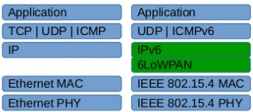
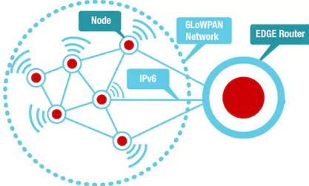
6LoWPAN Compression (RFC 6282)
Basis for header compression on 802.15.4
127 Bytes MTU (in 2.4GHz)
MAC(w/sec) + IPv6 + UDP = 46 + 40 + 8 = 94 Bytes
Multihop network
Compression
IPv6 header
Transport header
Fragmentation & Reassembly

Slide 8
6LoWPAN compression assumptions
Reuse MAC layer information…
For checksum calculation, payload length derivation
For address generation
For IPv6 compression
Use of Stateless Address Auto-configuration (SLAAC)
Derivation of IPv6 address from MAC ID
Assumptions of default traffic class & flow, hop limit and other defaults
But still allows non-default values to be carried uncompressed inline if need be…
Better UDP hdr compression, if port-range is in (0xf0b0 – 0xf0bf)
6LoRH compression
IPv6 artefacts (SRH, RPI) compression

Slide 9
An example…
Src port = 0xf0b2
Dst port = 0xf0ba
B
IP pkt
A
IP=fe80::6543
MAC IID=6543
IP=fe80::1234
MAC IID=1234
CID = Context ID
SAC = Source address compression
DAC = Destination address compression

Slide 10
Difference to Pre-IoT era header compression
Stateless compression
No state/context on per-flow basis
Shared context contains network prefix common to all flows
Packets can be decompressed individually
without referring to previous packets in the same flow.
Different packets may take different routes
Context is light-weight and easy to share (since context is not on per-flow basis)

Slide 11
Emergence of 6lo-over-foo…
Other candidate link layer technologies …
BTLE
Bluetooth Low Energy
PLC
Power Line Comm
NFC
Near Field Comm
MS/TP
Master Slave/Token Passing for RS-485 phy
DECT-ULE
Digital Enhanced Cordless Telecomms – Ultra Low Energy
Addressing (SLAAC)
MTU impact on FAR
Neighbor discovery

Slide 12
Application Protocols Redesign
Use of CoAP (RFC 7252) in place of HTTP
CBOR (RFC 7049) for payload representation in binary format
Use of YANG SIDs (Schema Item iDentifier)
NETCONF & RESTCONF use string identifiers
YANG SIDs substitute these string identifiers with unique 64bit uint.
Redesign helps reduce memory footprint as well as reduce network bandwidth usage

Slide 13

Where are we heading… LPWANs
LPWANs
Fractional bits per second network
Long range & star topology
Small MTU
Work-in-progress on IETF
RF Tech | Range | Throughput | MTU (B)
LoRa | 2-5 km urban <15km suburban | 0.3 to 50kbps | 256
SIGFOX | 10km urban 50km rural | Up: 100/600 bps Down: 600bps | Up: 12 Down: 8
802.15.4K-2013 (LECIM) | < 20km LoS < 5 km NoLoS | 1.5 bps to 128 kbps | 16/24/32
802.15.4g SUN | 2-3 km LoS | 4.8 to 800 kbps | 2047
Is 6LoWPAN compression good enough?

Slide 14
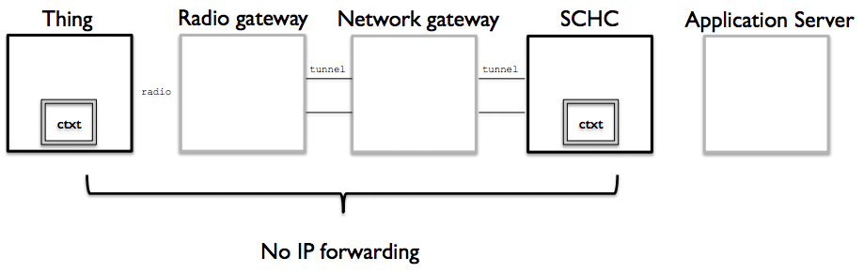
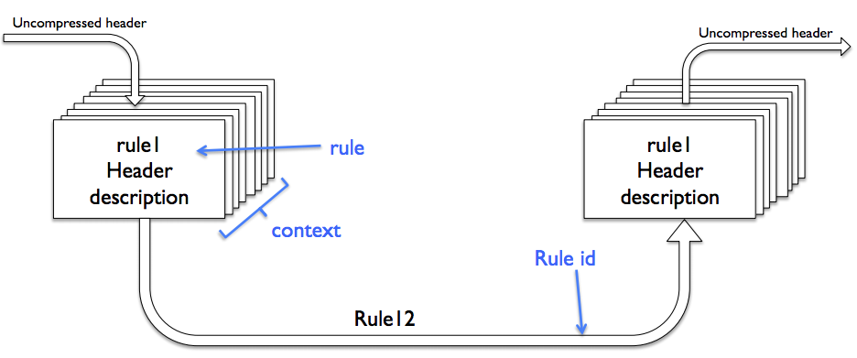
SCHC … a new compression scheme
Static Context Header Compression
Pronounced SCHiC
Currently a work-in-progress…
Optimized for
Star Topology
Predictable traffic pattern
Objective
Compress upto 0 bytes for well-known headers
Static Context stored on LPWAN device/thing and SCHC gateway

Slide 15
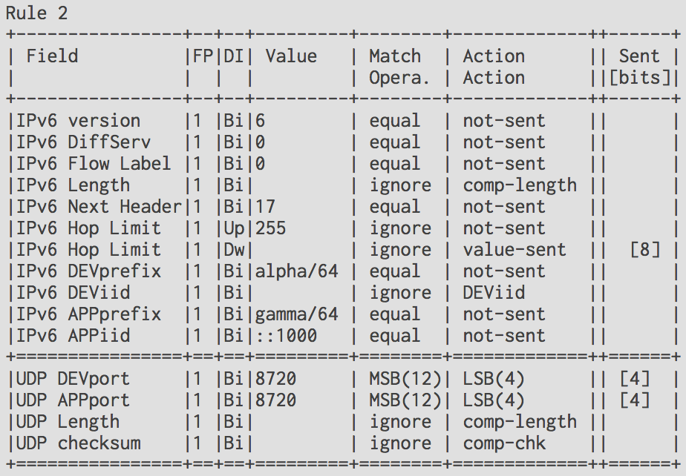
An example…
RULE: 5
Function | Target Value | Matching Operator | Comp/Decomp Factor
F1 | 0x00 | Ignore | Not-sent
F2 | 0x1230 | MSB(12) | LSB(4)
F3 | 0xABC0 | MSB(12) | LSB(4)
Compressor
De-compressor
[0x00, 0x2812, 0xE3A1]
DROPPED
[0x00, 0x1234, 0xABCD]
RULE 5 : 0x4D
[0x00, 0x1234, 0xABCD]
Notes:
https://www.ietf.org/proceedings/97/slides/slides-97-lpwan-45-ipv6udp-static-context-header-compression-coap-schc-00.pdf

Slide 16
A generic payload compression approach…
Generic header compression (RFC 7400)
LZ77-style compression for IP payload
Decompressor can be very light-weight implementation
But the compressor implementation could be non-trivial
A trivial implementation may not be able to achieve good compression ratio
Thus implications on constrained device use
Certain deployments where devices are not necessarily “extremely” constrained could benefit from such schemes.

Slide 17
Several challenges remain…
Especially with security solutions…
Especially with authentication & key management solutions
Certificate based authentication is challenging with IoT constraints
Most of the work is work-in-progress…
DICE working group
DTLS profiles which allow
Profiling DTLS for specific use-cases thus eliminating generic handshake

Slide 18
Thank You

