Slide 1
RootACK
- Roll Interim (25th May 2020)

Slide 2
Motivation for Storing-Root-ACK
End to end path establishment indication
Node can initiate app traffic
Query target node’s capabilities

Slide 3
K flag in TIO
K flag is set by the target node in the TIO
used by the root to send the RootAck
Ideally the node may set the K flag only once after startup
RootAck may be sent asyncly by the root without any K flag too
useful for cap query
Intermediate 6LRs: K flag handling
DAO is regenerated on 6LRs on behalf of target node
K flag has to be stored in context to the target. Similar to E flag.
When the intermediate nodes see the K flag disabled from the target the K flag could be reset

Slide 4
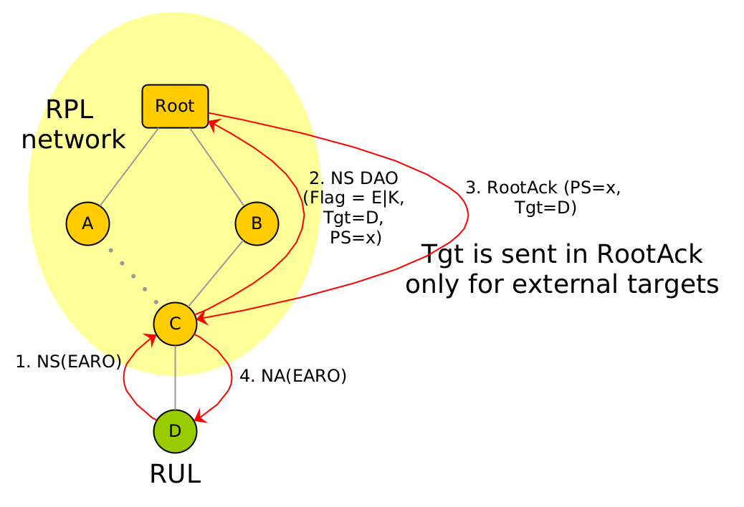
RULs with RootACK
Send NA to RUL only when E2E path is established
Send NA in response to RootACK
Note that for external targets DAO is directly addressed to Root even in storing MOP
Implies source routed data path for external targets
Similar to unaware-leaves
For external targets, the RootACK needs to carry the Target Option

Slide 5
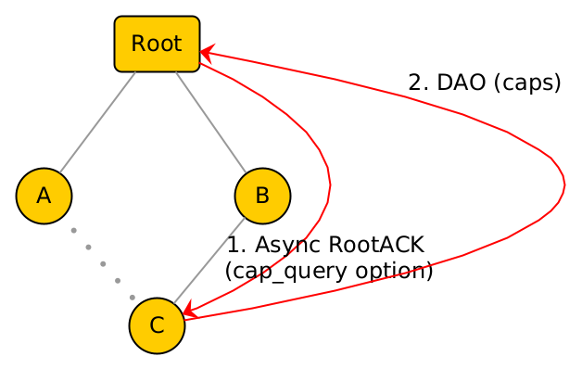
Handling Capability Query
Root sends async RootACK to query caps
Capability Query Option needed
Already pending work item in cap draft
Target responds with DAO with caps
No Target/TIO Option needed, since DAO addressed directly to Root

