Slide 1


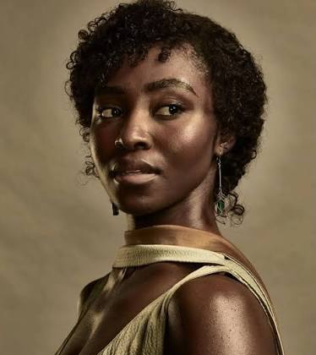




My Example Assignment:
How the movie Sinners explored the Jezebel trope with PEarline
Pearline’s story arc in Sinners is a layered approach that, at times, is a contradictory answer to the question of how Black women are represented in this film: she is granted moments of desire, agency, and heroism, yet she is also defined largely by her relationship to men, denied the same narrative recognition as her male counterpart, and ultimately sacrificed for someone else's story.

Slide 2


Sinners Background-
Media: Feature Film
Released: April 18th, 2025
Writer & Director: Ryan Coogler
Character of Interest: Pearline, played by Jayme Lawson
Setting: Jim Crow era, 1930s Mississippi Delta
Plot- https://www.imdb.com/title/tt31193180/plotsummary/
Able to view streaming HBO MAX with a subscription
https://www.rottentomatoes.com/m/sinners_2025/cast-and-crew

Slide 3
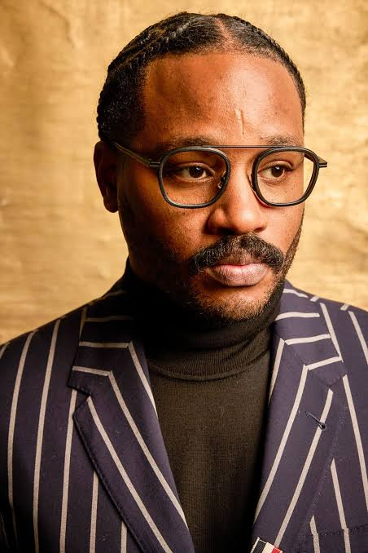
Background continued
Ryan Coogler- Writer/Director
An African American male, from the San Francisco Bay area, who has experience creating complex stories around black characters, as seen in his other movies.
Fruitvale Station, 2013
Creed, 2015
Black Panther, 2018
The background of the director/ writer is relevant to Pearline being a more well-rounded black woman character, even if she is being used in a traditional trope.

Slide 4
Jezebel Trope Description
“The Jezebel was a middle-aged or young woman governed by her libido and “matters of the flesh. She was deemed a hypersexual woman with unlimited bestial passions.” - (Mgadmi, paragraph.5)
“Historically, white women, as a category, were portrayed as models of self-respect, self-control, and modesty - even sexual purity- but black women were often portrayed as innately promiscuous, even predatory. This depiction of black women is signified by the name Jezebel.^{1”-(}(Pilgrim)
Usually characterized by suggestive outfits and a sociable personality.
Can be outspoken or brash
Associated with their connections with men

Slide 5
Quote
First Impressions and Setting
When we first meet Pearline, she is unattended at the train station, and the film does not indicate where she is going or where she has been. The first thing established about her character is that she is married, yet she is shown flirting with Sammie. This sets her up early on as a love interest for Sammie, rather than as a character with her own independent arc.
She is associated first with her relationship to another man, whom the audience never meets. Also, being unaccompanied at a train station proclaims worldliness.
It is not confirmed directly what the ages of Sammie or Pearline are. Based on the initial meeting, it is implied that Pearline is older than Sammie. They are both aware there is an age difference.
This adds to the persuasive/predatory characterization of Pearline that aligns her again with the Jezebel trope.

Slide 6
Quote
Juxtaposition with Annie
Pearline is juxtaposed against Annie, the film's other central Black woman character. Pearline is portrayed as skinny and conventionally attractive by white beauty standards, while Annie is cast in the "mammy" archetype, portrayed as loyal to a man who ultimately left her (Smoke).
This contrast raises questions about which body types are afforded desirability.
Showcasing Sexuality and Desire
Although Pearline is an adulteress, the film does not dwell on or condemn this, since every character in the story is presented as a sinner in their own right.
Pearline is also given an experience of oral sex that appears to be a first for her, a moment that suggests a Black woman can be portrayed as desirable in her own right rather than solely as an object for male satisfaction.
At the same time, Pearline's reputation as a skilled singer who frequents late-night clubs suggests she was already understood to be somewhat promiscuous before Sammie enters her story.

Slide 7
Characterization continued.
Pearline tells Sammie that she walked to the Juke Joint, alone at night, a choice that would have been dangerous for any woman in the 1930’s, and now.
It can be deduced that she has probably gone out at night alone before. Adding to the understanding of promiscuity, or the wildness of her character.
She also dances openly with Sammie, suggesting that she is unafraid of being caught by her husband or simply does not care if she is.
This concept is not explored further because it is unnecessary to showcase Pearline in this context for Sammie’s story.

Slide 8
Erasure of Black women
Erasure and Lack of Recognition
Before taking the stage, Sammie is given a formal introduction, while Pearline performs without receiving one. This absence suggests that her background and identity are treated as irrelevant to the story, even as she plays a significant role within it.
Selflessness and Sacrifice
Pearline ultimately gives up her life to help Sammie escape the vampires, positioning the Black woman as selfless in service of protecting others in her community.

Slide 9
Citations:
Holiman, Mary. “Sinners Have Souls Too: The Humanization of the Deep South in Ryan Coogler’s Southern Gothic Horror “Sinners.”” The Dig at Howard University, Office of University Communications, 15 May 2025, thedig.howard.edu/all-stories/sinners-have-souls-too-humanization-deep-south-ryan-cooglers-southern-gothic-horror-sinners.
“Key Questions to Ask When Analyzing Media Experiences.” NAMLE, The National Association for Media Literacy Education , 2026, namle.org/resources/key-questions-for-analyzing-media/.
Mgadmi, Mahassen. “Black Women’s Identity: Stereotypes, Respectability and Passionlessness (1890-1930).” Revue LISA/LISA E-Journal. Littératures, Histoire Des Idées, Images, Sociétés Du Monde Anglophone – Literature, History of Ideas, Images and Societies of the English-Speaking World, vol. 7, no. Vol. VII – n°1, 2009, pp. 40–55, journals.openedition.org/lisa/806, http://journals.openedition.org/lisa/806.
Pilgrim, David. “The Jezebel Stereotype.” Jim Crow Museum, 2012, https://jimcrowmuseum.ferris.edu/jezebel/index.htm.
Shanita Hubbard. “Black Women Stereotypes: How the Media Can Avoid Tropes.” NBCU Academy, 12 Feb. 2025, nbcuacademy.com/black-women-stereotypes/.
Wikipedia Contributors. “Ryan Coogler.” Wikipedia, Wikimedia Foundation, 10 Nov. 2019, en.wikipedia.org/wiki/Ryan_Coogler.
Use of Claude AI to create subheadings for related points and for grammar edits in the thesis statement and reflection.

