Slide 1
Signature Assignment- Being Seen-The Presentation
Nyree Brown
July 5, 2026
ENG 6813. SU26

Slide 2
Course Context Changes
Numerous Items have changed in my vision for this course.
Starting with the theme of the course “Analyzing literature, film, visual art, and music in a social/historical context to examine examples of black women in love: familiar, romantic, and community-based platonic love. ” as of May 24th 2026
I have a clearer focus and overall course goal that has a connection to what the student needs are outside of the classroom. A major change is not focusing on love as the only lens, broadening students' ability to think critically, and not guiding them to a single viewpoint.
Course name Change: “Viewing the Black Women”
Instead of being housed under the humanities, it would align with an African Diaspora studies department.
For this signature assignment, I started with the student goals, which anchor the assignment, utilizing backward design.
Course design has more of an intent on scaffolding
Modality change to be Mixed mode when originally designed based on online modality.
Previously was a supporter of a No AI use policy, but I have changed my approach to integrate AI to be specific to the assignment given.

Slide 3
Course Goal Viewing the Black Women
By the end of the semester, students will be able to construct and defend a research-supported argument about how Black women are portrayed in media (painting, text, film, photograph, song, etc.), citing credible sources to support their position. Students will build cultural awareness and compassion, which are needed to critically engage with representation and bias in the news, advertising, and entertainment media.

Slide 4
Delivery Context
At the time of this assignment, we would have previously discussed these topics:
key terms/ Influential people: “Black women, stereotype; Maya Angelou, Bell Hooks
Major stereotypes: Mammy, Jezebel, Light skin(Mulatto), Angry black women
Conducted a case study on at least one poem, TikTok, a painting, and the film Sinners.
Readings:
Key Questions to Ask when Analyzing Media Experiences: https://namle.org/resources/key-questions-for-analyzing-media/
Black Women’s Identity: Stereotypes, Respectability and Passionlessness (1890-1930): https://journals.openedition.org/lisa/806
Understanding -and avoiding- stereotypes about Black Women in the News: https://nbcuacademy.com/black-women-stereotypes/

Slide 5
Assignment goals
Students will select a piece of media (e.g., painting, text, film, photograph, song, or other artistic work) and conduct independent research to answer the question, "How are Black women being represented in this work?"
Students will produce a presentation that (a) states a clear thesis addressing this question, (b) synthesizes evidence from at least 3 sources (which may include scholarly criticism, historical context, or artist/creator background), and (c) cites all sources.
Students will also reflect on their experience creating the presentation, addressing why they chose that piece, what they learned about their chosen topic, how their research process shaped or changed their initial perspective, and what challenges they encountered.

Slide 6
Tasks
1) Choose one form of media to analyze. At least one black woman must be showcased in the piece. Cannot use a piece already discussed in the course.
Examples could include a music video, song lyrics, a movie, a television show, a book, a poem, a meme, a performance, physical art: (painting, drawing, sculpture), court case, or viral TikTok
If choosing a movie, show, or book, focus on one of the following: a specific scene, plot point, or character.
Feel free to extend beyond these examples
2) Examine the Black woman in the context of the piece
Include the creator/author/originator, identify subject matters, include background: setting, cultural relevance, historical context, identify tropes, etc.
Look at how the black woman’s presence affects or is affecting the work.
Keep a record of the sources of your research; this should be included in the reflection and should be mentioned in the presentation where applicable.
3) Create a presentation about your medium between 4 and 12 minutes. 70 points
Include a thesis statement in the first minute of the presentation addressing "How are black women being represented?“
Consider items like narrative point of view, casting, symbolism, dialogue, word choice, author/producer motivations,
Include a moving element (PowerPoint, slide deck, video, song, voice recording, graphic, etc.
In the presentation, you must provide a link to the piece or include a picture or link to a summary of the piece you have chosen for a book, television show, or movie.
4) Create a reflection 30 points
Include a separate video or written piece explaining why you chose the piece you did and why you chose to present the information in the manner you did.
Include citations for research.
No word count or time length required; both questions must be addressed for full credit.

Slide 7







Criteria
Presentation 70 points, Grading looking for the following
Addresses the question, " How are black women being presented in this work?"- 25pts
Coherent argument- 15pts
Include what tools are being used to portray perspective
Should include where the information stems from, where relevant
Clear language
Minimal errors in spelling
Includes thesis statement within the first minute -10pts
Includes moving element- 10pts
Within the time frame 4-8 minutes- 5pts
Visually interesting- 5pts
Reflection 30pts
Explains why the piece was chosen-10pts
Explains what they learned -5pts
Any challenges or perspective changes- 5pts
Includes citations for research-10pts

Slide 8
AI Integration
Disclose any AI software that you used in the citations section of the reflection and explain for what purpose.
Acceptable Uses:
Brainstorming
Clarifying concepts, terms, or historical/cultural context encountered during research
Checking grammar, spelling, and citation formatting in the final presentation and reflection
Organizing the layout for the presentation
Non-Acceptable Uses
AI should not be used in choosing your presentation piece. You should choose a piece that is already relevant or interesting to you.
Why? This will make the reflection section easier to complete when you have a connection to the material.
Using AI as a substitute for reading or viewing sources.
You are responsible for any misrepresented, misquoted, or false information presented.
Completing the reflection showcases your own perspective and process with this assignment.
If an AI grammar or spelling checker is used for the reflection, include the original and rewritten piece.

Slide 9
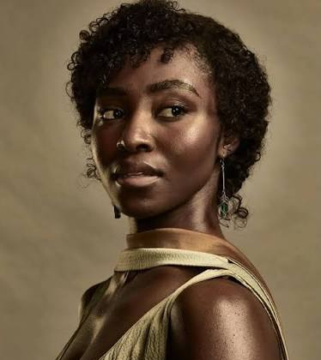
My Example Assignment:
How the movie Sinners explored the Jezebel trope with PEarline
Pearline’s story arc in Sinners is a layered approach that, at times, is a contradictory answer to the question of how Black women are represented in this film: she is granted moments of desire, agency, and heroism, yet she is also defined largely by her relationship to men, denied the same narrative recognition as her male counterpart, and ultimately sacrificed for someone else's story.

Slide 10
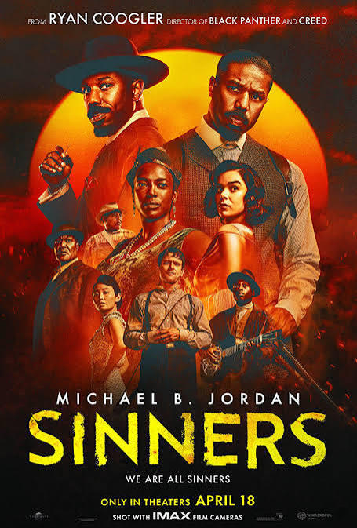

Sinners Background-
Media: Feature Film
Released: April 18th, 2025
Writer & Director: Ryan Coogler
Character of Interest: Pearline, played by Jayme Lawson
Setting: Jim Crow era, 1930s Mississippi Delta
Plot- https://www.imdb.com/title/tt31193180/plotsummary/
Able to view streaming HBO MAX with a subscription
https://www.rottentomatoes.com/m/sinners_2025/cast-and-crew

Slide 11
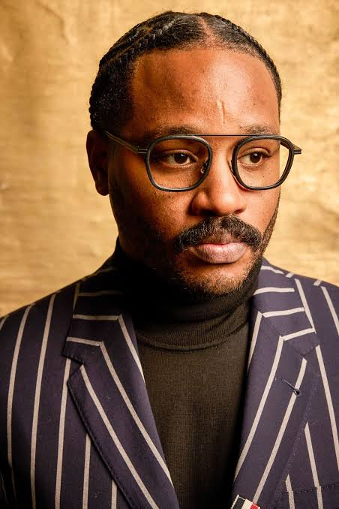
Background continued
Ryan Coogler- Writer/Director
An African American male, from the San Francisco Bay area, who has experience creating complex stories around black characters, as seen in his other movies.
Fruitvale Station, 2013
Creed, 2015
Black Panther, 2018
The background of the director/ writer is relevant to Pearline being a more well-rounded black woman character, even if she is being used in a traditional trope.

Slide 12
Jezebel Trope Description
“The Jezebel was a middle-aged or young woman governed by her libido and “matters of the flesh. She was deemed a hypersexual woman with unlimited bestial passions.” - (Mgadmi, paragraph.5)
“Historically, white women, as a category, were portrayed as models of self-respect, self-control, and modesty - even sexual purity- but black women were often portrayed as innately promiscuous, even predatory. This depiction of black women is signified by the name Jezebel.^{1”-(}(Pilgrim)
Usually characterized by suggestive outfits and a sociable personality.
Can be outspoken or brash
Associated with their connections with men

Slide 13
Quote
First Impressions and Setting
When we first meet Pearline, she is unattended at the train station, and the film does not indicate where she is going or where she has been. The first thing established about her character is that she is married, yet she is shown flirting with Sammie. This sets her up early on as a love interest for Sammie, rather than as a character with her own independent arc.
She is associated first with her relationship to another man, whom the audience never meets. Also, being unaccompanied at a train station proclaims worldliness.
It is not confirmed directly what the ages of Sammie or Pearline are. Based on the initial meeting, it is implied that Pearline is older than Sammie. They are both aware there is an age difference.
This adds to the persuasive/predatory characterization of Pearline that aligns her again with the Jezebel trope.

Slide 14
Quote
Juxtaposition with Annie
Pearline is juxtaposed against Annie, the film's other central Black woman character. Pearline is portrayed as skinny and conventionally attractive by white beauty standards, while Annie is cast in the "mammy" archetype, portrayed as loyal to a man who ultimately left her (Smoke).
This contrast raises questions about which body types are afforded desirability.
Showcasing Sexuality and Desire
Although Pearline is an adulteress, the film does not dwell on or condemn this, since every character in the story is presented as a sinner in their own right.
Pearline is also given an experience of oral sex that appears to be a first for her, a moment that suggests a Black woman can be portrayed as desirable in her own right rather than solely as an object for male satisfaction.
At the same time, Pearline's reputation as a skilled singer who frequents late-night clubs suggests she was already understood to be somewhat promiscuous before Sammie enters her story.

Slide 15
Characterization continued.
Pearline tells Sammie that she walked to the Juke Joint, alone at night, a choice that would have been dangerous for any woman in the 1930’s, and now.
It can be deduced that she has probably gone out at night alone before. Adding to the understanding of promiscuity, or the wildness of her character.
She also dances openly with Sammie, suggesting that she is unafraid of being caught by her husband or simply does not care if she is.
This concept is not explored further because it is unnecessary to showcase Pearline in this context for Sammie’s story.

Slide 16
Erasure of Black women
Erasure and Lack of Recognition
Before taking the stage, Sammie is given a formal introduction, while Pearline performs without receiving one. This absence suggests that her background and identity are treated as irrelevant to the story, even as she plays a significant role within it.
Selflessness and Sacrifice
Pearline ultimately gives up her life to help Sammie escape the vampires, positioning the Black woman as selfless in service of protecting others in her community.

Slide 17
Citations:
Holiman, Mary. “Sinners Have Souls Too: The Humanization of the Deep South in Ryan Coogler’s Southern Gothic Horror “Sinners.”” The Dig at Howard University, Office of University Communications, 15 May 2025, thedig.howard.edu/all-stories/sinners-have-souls-too-humanization-deep-south-ryan-cooglers-southern-gothic-horror-sinners.
“Key Questions to Ask When Analyzing Media Experiences.” NAMLE, The National Association for Media Literacy Education , 2026, namle.org/resources/key-questions-for-analyzing-media/.
Mgadmi, Mahassen. “Black Women’s Identity: Stereotypes, Respectability and Passionlessness (1890-1930).” Revue LISA/LISA E-Journal. Littératures, Histoire Des Idées, Images, Sociétés Du Monde Anglophone – Literature, History of Ideas, Images and Societies of the English-Speaking World, vol. 7, no. Vol. VII – n°1, 2009, pp. 40–55, journals.openedition.org/lisa/806, http://journals.openedition.org/lisa/806.
Pilgrim, David. “The Jezebel Stereotype.” Jim Crow Museum, 2012, https://jimcrowmuseum.ferris.edu/jezebel/index.htm.
Shanita Hubbard. “Black Women Stereotypes: How the Media Can Avoid Tropes.” NBCU Academy, 12 Feb. 2025, nbcuacademy.com/black-women-stereotypes/.
Wikipedia Contributors. “Ryan Coogler.” Wikipedia, Wikimedia Foundation, 10 Nov. 2019, en.wikipedia.org/wiki/Ryan_Coogler.
Use of Claude AI to create subheadings for related points and for grammar edits in the thesis statement and reflection.

