Slide 1
Employee Attrition
Final Project for the internship.
Made by:
Nysa.P.Ginu

Slide 2
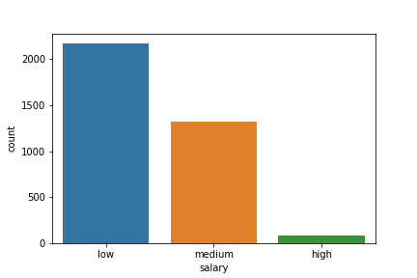
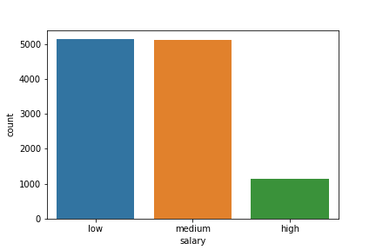
Comparing the salary of the employee who left and the existing employees.
On comparing both the graphs we can see that although both have very large number of employees with low salary but the number of employees with medium and high salary is significantly high in existing employee.
Therefore, this can be contributing factor for employees leaving the company.

Slide 3
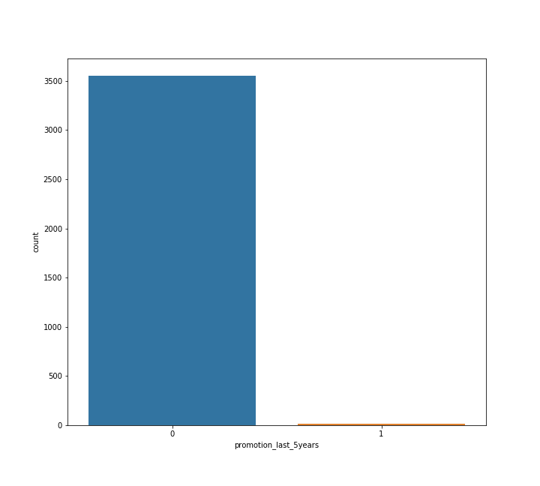
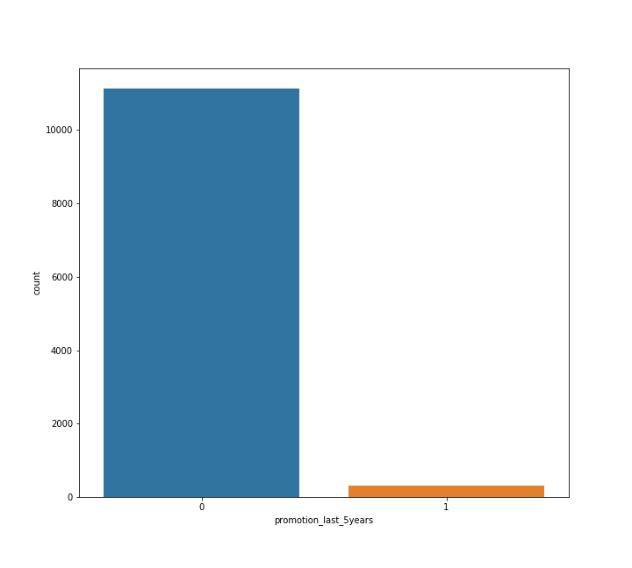
Comparing the promotions in the last 5 years of the employee who left and the existing employees.
On comparing both the graphs , both has a significant number of employees
with zero promotions in the last 5 years.
Therefore, this might not be a factor.

Slide 4
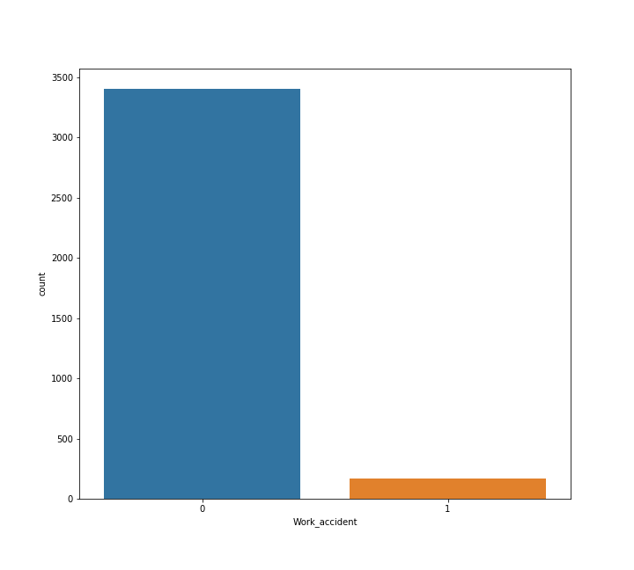
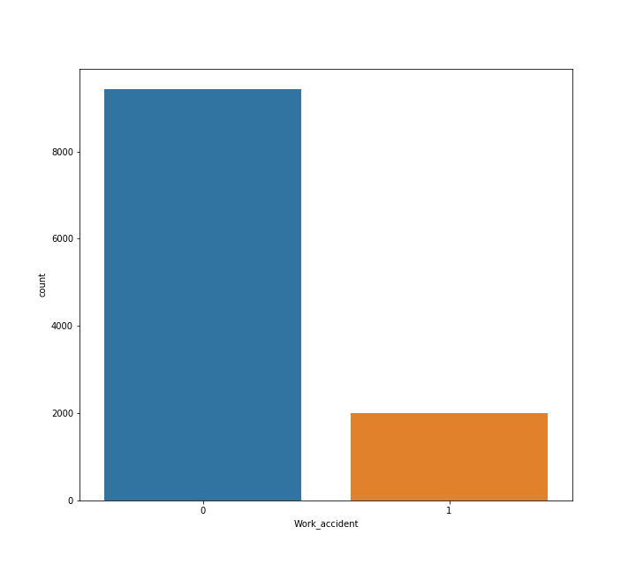
Comparing the no.of work accidents encountered by the employee who left and the existing employees.
On comparing both the graphs , we can clearly eliminate this as the factor
because there are a lot of existing employees who have encountered work
accidents when compared to the employees who left.

Slide 5
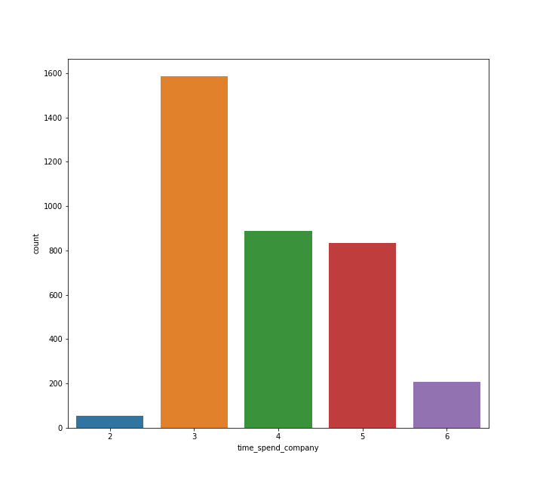
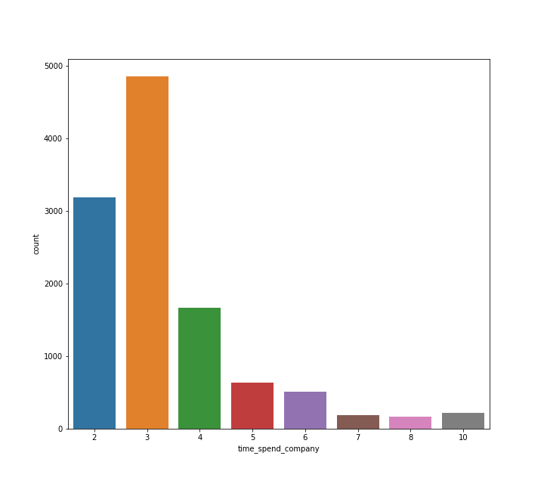
Comparing the time spent at the company by the employee who left and the existing employees.
On comparing, we can remove this as a contributing factor as there are existing
employees who clock much more hours than the employees who left.

Slide 6
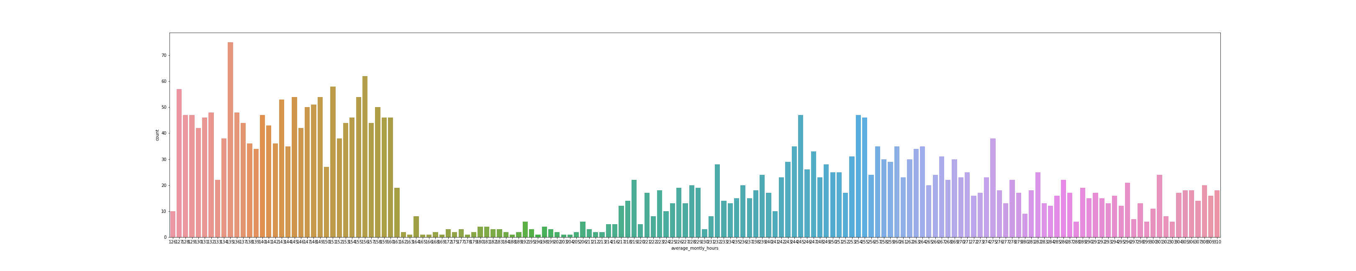
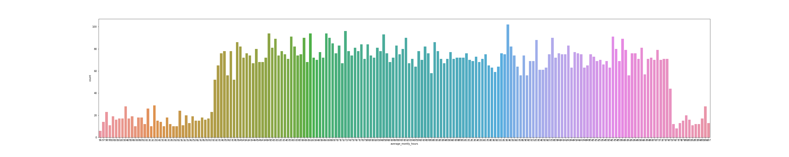
Comparing the Av. Monthly hours spent by the employee who left and the existing employees.
When Comparing we can eliminate this as a reason for employees leaving the
company because there is not much employees who worked for more hours
monthly left the Company.

Slide 7
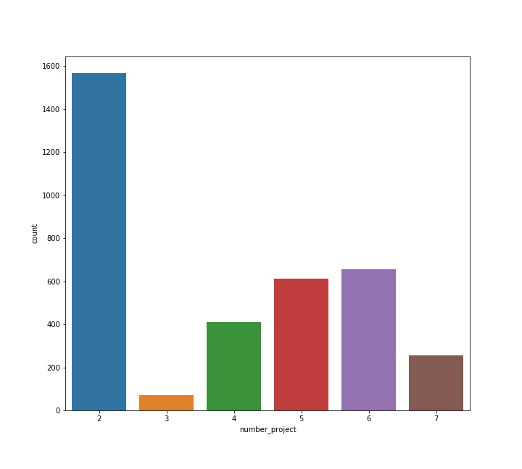
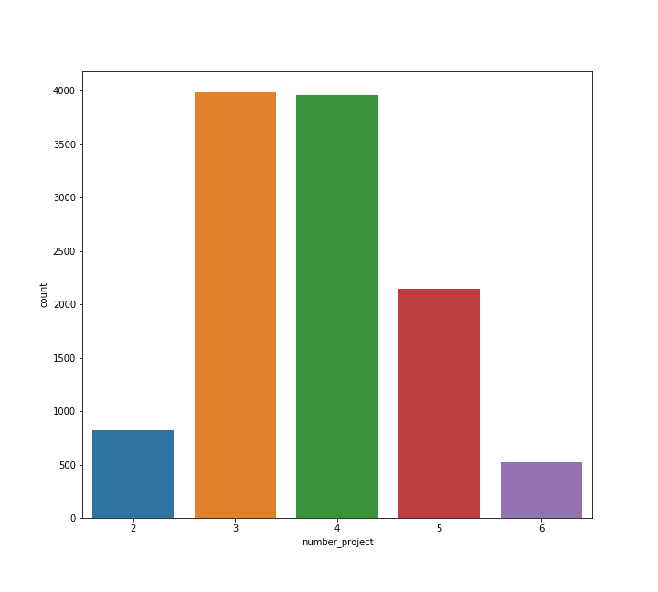
Comparing the no. of projects done by the employee who left and the existing employees.
On comparing we can see that majority of the employees who left only got 2
projects to work on while the existing employees got more than 2 projects.
This can be a very strong factor toward the employees leaving the company.

Slide 8
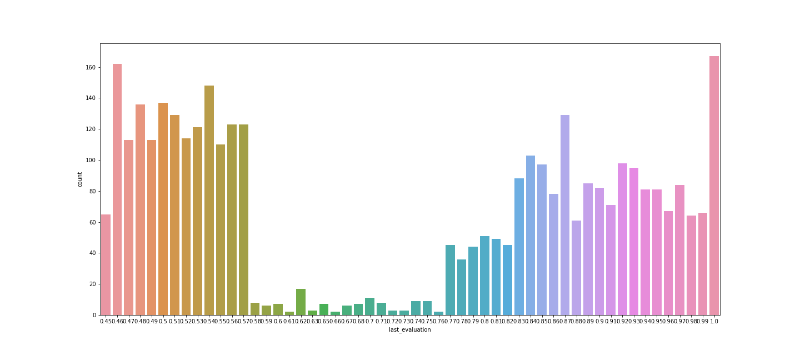
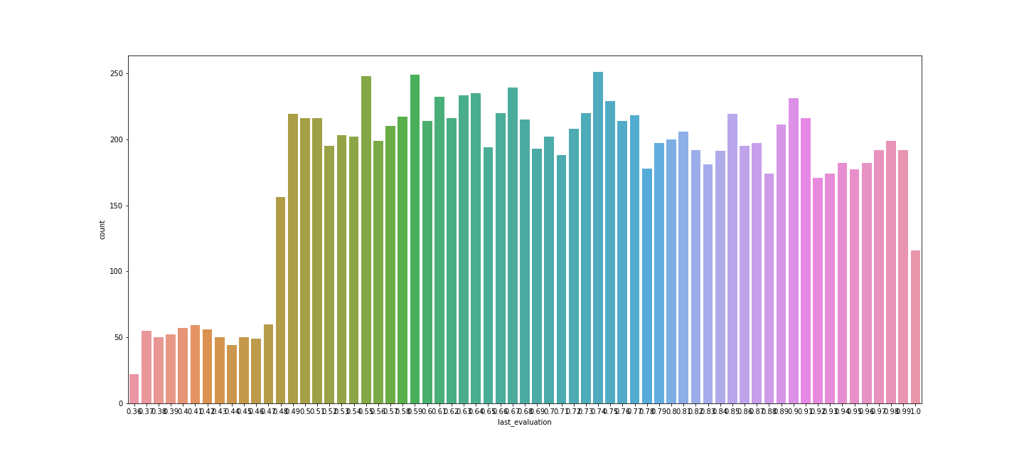
Comparing the last evaluation of the employee who left and the existing employees.
On comparing the majority of employees who left were last evaluated fairly
recently while the existing employees were last evaluated a long time back.
This can be contributing factor.

Slide 9
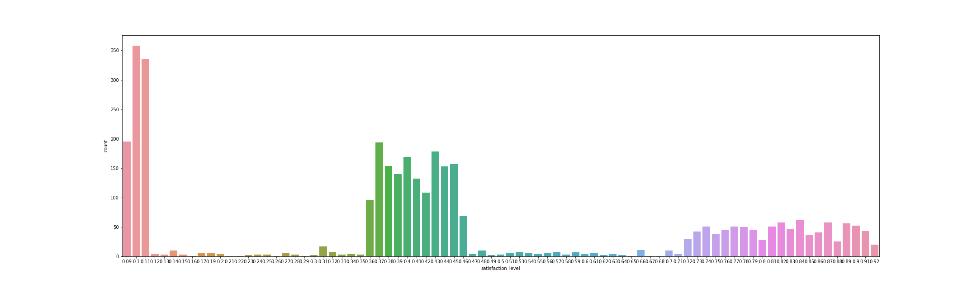
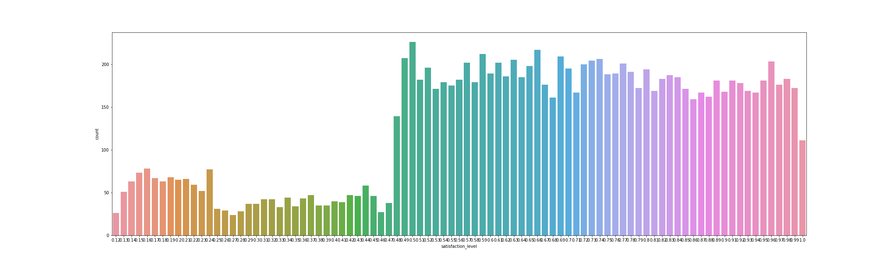
Comparing the satisfaction level of the employee who left and the existing employees.
The majority of the employees who left had very low satisfaction level while majority
of the existing employees had a very high satisfaction level.
This can be a major contributing factor for employees leaving the company.

Slide 10
Conclusion
We can conclude that the combination of the factors mentioned below can be the reason for employees deciding to leave the company. They are:
Satisfaction level
Salary
No. of projects
Last evaluation

Slide 11
Thank You!

