Slide 1
Weather Trend Analysis and Extreme Temperature Pattern Detection
Machine-learning workflow for discovering long-term temperature behavior and flagging unusual extremes.
roll1
roll2
roll3
roll4

Slide 2



Problem Statement
Problem
Daily weather records contain noise, missing values, seasonality, and station-level variation.
Need
Combine trend analysis with a repeatable detector for unusually hot or cold observations.
Project aim
Transform raw observations into interpretable trends, engineered signals, and evaluated predictions.

Slide 3
Data Foundation
Chosen dataset: NOAA Global Historical Climatology Network Daily (GHCN-Daily), a quality-reviewed archive of daily land-station climate summaries.
Available inputs: daily maximum temperature, minimum temperature, precipitation, snowfall, snow depth, station metadata, and observation dates.
Project scope: select one station or city subset and define the analysis window before model training.
Target: classify an observation as normal vs. extreme, with optional hot/cold subclasses.

Slide 4
FEATURE ENGINEERING
Feature engineering turns weather history into learnable signals
01
02
03
04
Clean
Calendar
Rolling
Anomaly
Handle missing and flagged observations; standardize units and align dates.
Create day-of-year, month, season, and cyclical sine/cosine signals.
Build 3-day and 7-day means, volatility, and lagged temperature values.
Compare observations with a seasonal baseline and apply the project threshold.
Use a time-aware train, validation, and test split so future information never leaks into the past.
Raw observations → aligned dates → temporal context → anomaly signal

Slide 5

BASELINE MODEL
A transparent baseline makes the detector easy to evaluate
Baseline: Logistic regression or random forest for extreme-event classification.
Inputs: Lagged temperature, rolling statistics, precipitation context, seasonality, and station metadata.
Output: Class label plus probability score for each observation. Interpretability: Feature importance or coefficient analysis explains which signals drive the flag.
Decision rule: Compare with one stronger model only if recall improves without sacrificing interpretability.
Engineered Weather Signals
Transparent Baseline Model
Class Label and Probability Score
Feature-Importance Interpretation

Slide 6
EVALUATION
Outputs should report more than accuracy
Classification
Trend analysis
Operational view
Accuracy, precision, recall, F1-score, ROC-AUC, and confusion matrix.
Rolling average, seasonal baseline, anomaly score, and event frequency over time.
Predicted probability, alert threshold, false-positive review, and seasonal error breakdown.
A useful detector explains what it flags, when it fails, and how stable the signal is

Slide 7
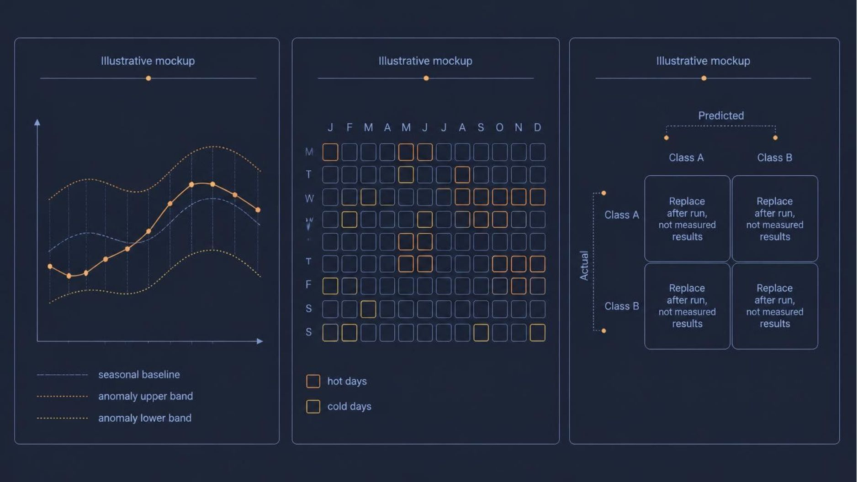
RESULTS AFTER TRAINING
Results: connect the trend line to the extreme-event signal
Metrics
Accuracy [value]
Precision [value]
Recall [value]
F1-score [value]
ROC-AUC [value]
Readout
Check whether hot or cold events are missed more often, and which seasons create the most false alarms.

Slide 8



NEXT STEPS
Future goals: move from detection to dependable forecasting
Broaden the comparison
Extend from one station to multi-station and regional comparisons.
Strengthen the detector
Test calibrated thresholds, class balancing, and stronger time-series models.
Monitor reliability
Add explainability, uncertainty bands, and drift monitoring for new observations.
Package the workflow
Turn the analysis into a reproducible dashboard or alerting tool.
Thank you

