Slide 1
Capstone Project -
Gun Violence in the US
Joshua Kim
Springboard - Data Science Career Track

Slide 2
Table of Contents
1. Cover Page 2. Table of Contents 3. Introduction 4. Clients 5. Dataset 6. Data Dictionary 7. Data Wrangling 8. Number of Casualties 9. Casualties by City 10. Casualties by Date
11. Casualties by Gender 12. Casualties by Incident Characteristics 13. Feature Selection 14. Baseline/Linear Regression 15. Decision Tree 16. Random Forest 17. Random Forest Model Visualization 18. Best Models 19. Conclusion 20. Appendix

Slide 3
Introduction - The Problem & The Goal
The Problem:
One of the biggest issues that America has faced in the past few decades has been the rise of gun violence in civilian life and it has become particularly prevalent in the past decade.
According to the U.S. Centers for Disease Control and Prevention, 33,636 Americans were killed in 2013 and that figure rose to 38,658 deaths in 2016.₁ While the official number for the total number of deaths in 2017 has yet to be released, the organization estimates it to surpass 2016 based on end-of-the-year figures.
The Goal:
To analyze and explore data on gun violence in the US over the last few years.
To create a Machine Learning model that can predict the number of people killed and injured based on features about the shooting incidents.

Slide 4
Clients - Who Cares?
Government Agencies (ex. U.S. Centers for Disease Control and Prevention)
Identify which factors can help predict the number of casualties in shooting incidents.
Determine which models are most efficient for analyzing gun violence data.
Pro - Gun Control Organizations
Inform the public where the most dangerous cities are in terms of gun violence.
Understand which factors are most important in predicting casualties even if they don’t have the data.
You!
Learn about the demographics of the most susceptible people to gun violence.
Understand the characteristics of the incident participants.

Slide 5
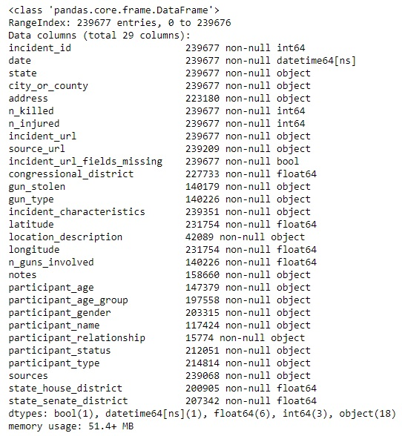
Dataset
The data was provided by James Ko: https://www.kaggle.com/jameslko/gun-violence-data
Data was web-scraped from: http://www.gunviolencearchive.org/
Contains gun-violence data in the US from 2013 - 2018.
Holds 239, 677 rows of data and 29 columns.
Missing a lot of data from 2013 and only contains incidents up until March 2018.

Slide 6
Data Dictionary
1. incident_id: ID of the crime report 2. date: Date of crime 3. state: State of crime 4. city_or_county: City/ County of crime 5. address: Address of the location of the crime 6. n_killed: Number of people killed 7. n_injured: Number of people injured 8. incident_url: URL regarding the incident 9. source_url: Reference to the reporting source 10. incident_url_fields_missing: TRUE if the incident_url is present, FALSE otherwise 11. congressional_district: Congressional district id 12. gun_stolen: Status of guns involved in the crime (i.e. Unknown, Stolen, etc...) 13. gun_type: Typification of guns used in the crime 14. incident_characteristics: Characteristics of the incidence 15. latitude: Location of the incident
16. location_description: Location description 17. longitude: Location of the incident 18. n_guns_involved: Number of guns involved in incident 19. notes: Additional information of the crime 20. participant_age: Age of participant(s) at the time of crime 21. participant_age_group: Age group of participant(s) at the time crime 22. participant_gender: Gender of participant(s) 23. participant_name: Name of participant(s) involved in crime 24. participant_relationship: Relationship of participant to other participant(s) 25. participant_status: Extent of harm done to the participant 26. participant_type: Type of participant 27. sources: Participants source 28. state_house_district: Voting house district 29. state_senate_district: Territorial district from which a senator to a state legislature is elected.

Slide 7
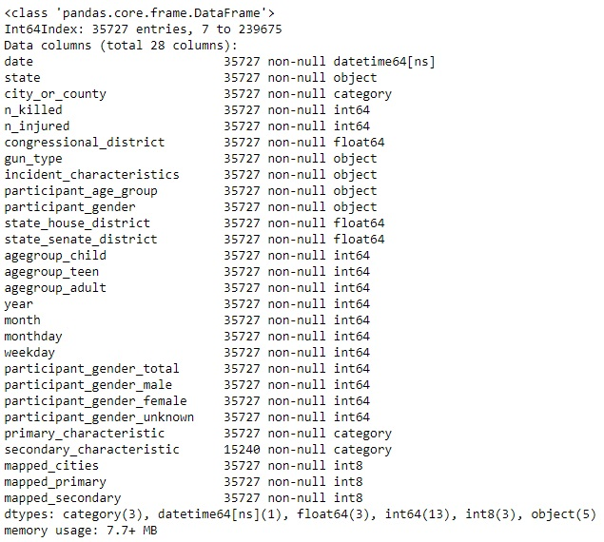
Data Wrangling
Drop columns that are irrelevant to the project
Remove columns/rows with excessive amount of missing data
Choose age-group column over age column for better prediction
Create pseudo-dummy columns that counts the number of genders/age-groups in a single row
Include only the top 15 cities with most incidents for better prediction
Add new date columns (year, month, weekday)
Create 2 columns for the first 2 incident characteristics from each row
Create new numerical columns for Categorical columns (ex. mapped_cities)
Nearly 200,000 rows of data were dropped as a result

Slide 8
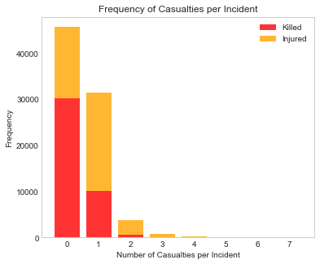
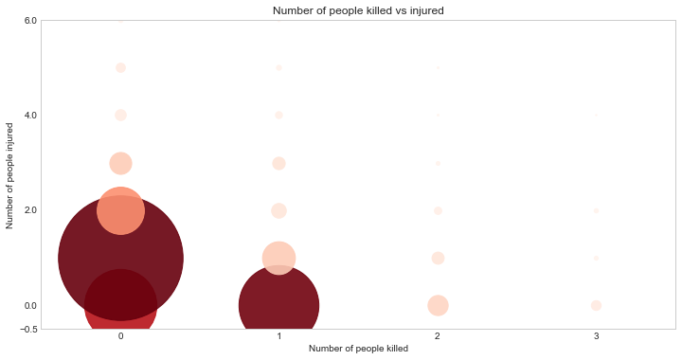
Number of Casualties (Deaths and Injuries)
Most shooting incidents resulted in no deaths but there were still nearly 10,000 incidents where 1 person died.
There were more incidents that resulted in an injury than incidents without an injury.
The most frequent casualty scenario was when there were 0 deaths and 1 injury.
Very few incidents that had more than 2 people killed or more than 3 people injured.

Slide 9
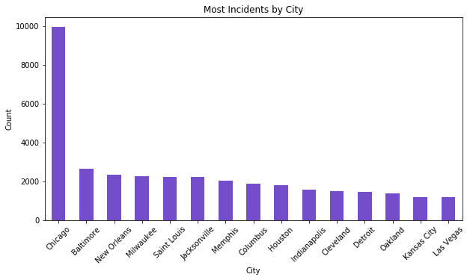
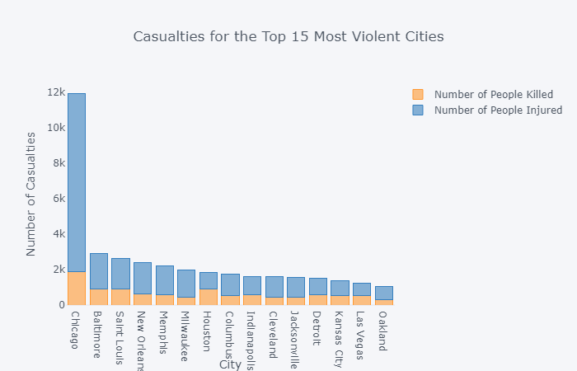
Casualties by City
Chicago by far had the most number of shooting incidents based on the dataset.
Other violent cities included Baltimore, New Orleans and Milwaukee.
Chicago also had the most deaths and injuries.
Houston had the 2nd most deaths but was only 7th in overall casualties.

Slide 10
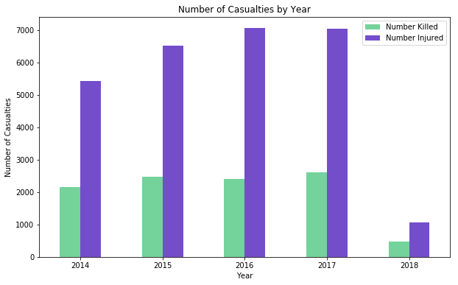
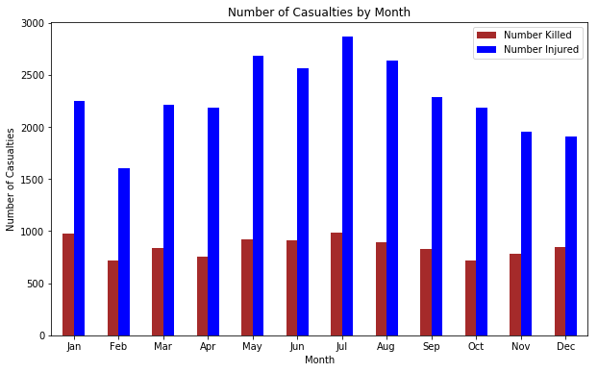
Casualties by Date
Number of casualties has overall been growing each year from 2014 - 2017 for the top 15 cities.
There were slightly more injuries in 2016 than 2017, but fewer deaths.
Casualties are at their highest in the summer months, with the peak being in July for both deaths and injuries.

Slide 11
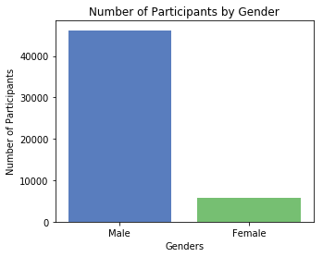
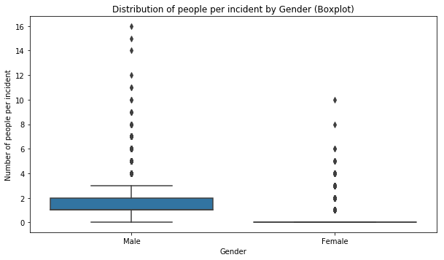
Casualties by Gender
There were over 40,000 male participants compared to less than 6,000 female participants.
Most incidents had at least 1 male involved.
There were so few females that it skews the bulk of the distribution to nearly 0.
Even having 1 female is considered an outlier.

Slide 12
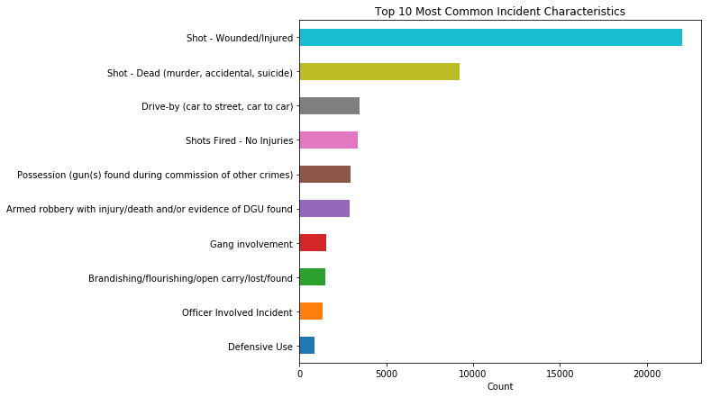
Casualties by Incident Characteristics
The two most common incident characteristics were ‘Shot - Wounded’ and ‘Shot - Dead’.
‘Shots Fired - No Injuries’ came up less frequently than ‘Drive-by’, indicating there were more incidents with casualties than none.

Slide 13
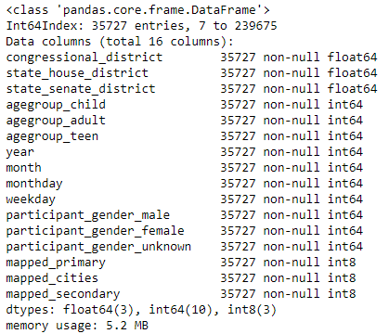
Feature Selection
Using the Chi-Square Test for Independence and previously creating numerical columns for the Categorical data, features were selected for the machine learning models.
Two types of feature sets were created: one for predicting the number of people killed (n_killed) and the other for predicting the number of people injured (n_injured).
Both feature sets included the same features shown on the right, except the set for predicting the number of people killed included n_injured as a feature and vice versa.

Slide 14
Baseline/Linear Regression
A simple baseline was created using the DummyRegressor regressor to compare with the results of the models.
2 primary metrics were used:
RMSE (Root Mean Squared Error)
R-Squared
3 different Linear Regression Models were used:
Linear Regression without Regularization
Lasso Regularization
Ridge Regularization
Application: The number of people injured had the highest coefficient value for predicting the number of people killed, and vice versa.
For every person injured in a shooting incident, there was a decrease of 0.3 deaths. In other words, there was a negative correlation between the 2 variables.
Baseline | n_killed | n_injured
RMSE | 0.5067 | 0.7654
R-Squared | -0.0001 | 0
Linear Regression | n_killed | n_injured
RMSE | 0.3924 | 0.5719
R-Squared | 0.3835 | 0.4747

Slide 15
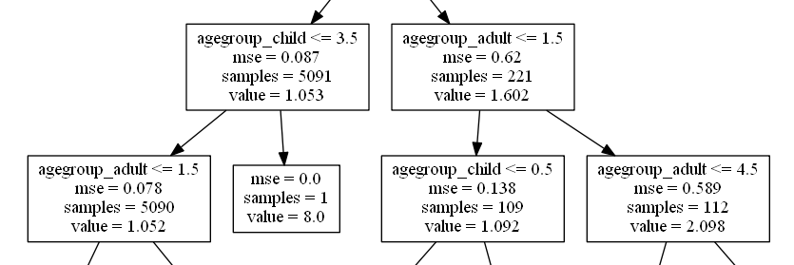
Decision Tree
Optimized Decision Tree | n_killed | n_injured
RMSE | 0.1258 | 0.3143
R-Squared | 0.9325 | 0.7776
Models were run using RandomSearchCV to obtain the optimal hyper-parameters.
Using Decision Tree model had better results than using Linear Regression due to its nature of asking sequential questions and ability to handle large datasets well.
The model was further optimized by removing “noisy” features (little impact on the response variables) and outliers (ex. Incidents with more than 2 people killed).
Application: The decision tree splits at each node based on a characteristic. Ex. One branch made its decisions based on how many adults or children were part of a shooting incident.

Slide 16
Random Forest
Random forest uses a collection of decision trees so that results are aggregated into a final result.
This is done to reduce the risk of overfitting the model by averaging the results of multiple decision trees.
Application: The most important features for predicting the number of people killed were the primary characteristics, secondary characteristics, the number of female participants and number of adults.
There were several more important features for predicting the number of people injured such as the year and the city.
Random Forest | n_killed | n_injured
RMSE | 0.1566 | 0.3589
R-Squared | 0.9023 | 0.7822
Optimized Random Forest | n_killed | n_injured
RMSE | 0.1205 | 0.2919
R-Squared | 0.9368 | 0.8149

Slide 17
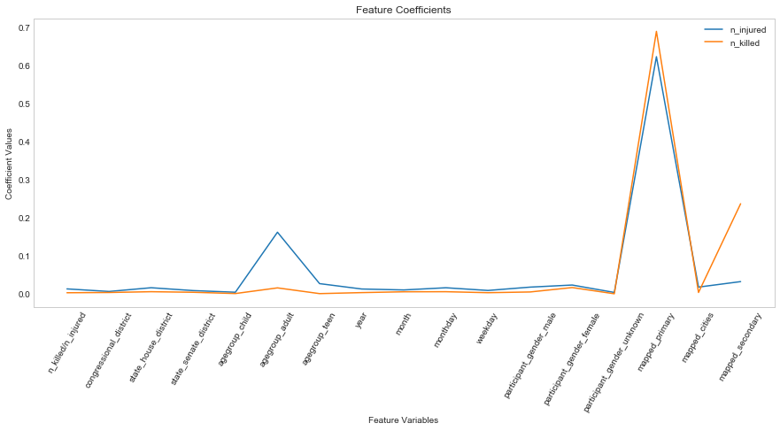
Random Forest Model Visualization
The most important feature for both response variables was the primary incident characteristic.

Slide 18
Best Models
The 3 best performing models in this project were:
Random Forest with optimization
Decision Tree with optimization
Random Forest without optimization
Random Forest with optimization came out on top for predicting both the number of people killed and number of people injured.
 | n_killed |  | n_injured
 | RMSE | R-Squared | RMSE | R-Squared
Random Forest with Optimization | 0.1205 | 0.9368 | 0.2919 | 0.8149
Decision Tree with Optimization | 0.1258 | 0.9325 | 0.3143 | 0.7776
Random Forest | 0.1566 | 0.9023 | 0.3589 | 0.7822

Slide 19
Conclusion
Main factors in predicting the number of people killed or injured:
Incident characteristics (ex. ‘Shot - Dead’, ‘Shot - Wounded’, ‘Drive-by’, ‘Armed Robbery’)
Number of adults involved (ages 18 and over)
Number of females involved
Recommendations:
Use incident characteristics to identify patterns regarding the shooting incidents.
Females are involved significantly less in shooting incidents than males but their presence correlates to higher injury and death counts.
Next Steps:
Use classification models (ex. Logistic Regression) to classify incidents based on thresholds (ex. Incidents with 2+ deaths vs incidents with 0 or 1 deaths)
Find other datasets that contain more information regarding the gun types that were used by shooters.
Analyze other big cities such as New York and Los Angeles.

Slide 20
Appendix
1. https://www.thetrace.org/rounds/gun-deaths-increase-2017/

