Slide 1
Capstone Project -
Topic Modeling with /r/PersonalFinance
Joshua Kim
Springboard - Data Science Career Track

Slide 2
Table of Contents
Cover Page
Table of Contents
Introduction
Project Goal
Data Acquisition
Data Dictionary
Data Wrangling
Most Common Topics
Most Common Tokens (Words)
Feature Engineering
11. Latent Dirichlet Allocation - Topic Modeling 12. Labeling the Topics and Posts 13. Evaluating the Topics 14. Baseline 15. Linear SVC 16. Logistic Regression 17. Model Results 18. Conclusion - Recommendations 19. Conclusion - Limitations 20. Appendix

Slide 3

Introduction - The Problems
The Problem:
/r/personalfinance is a subreddit where many people are able to ask for help regarding their financial situations (examples: debt, budgeting, insurance, student loans).
One of the important features is tagging each post with a flair (topic) in order to categorize and organize different posts by subject. These are usually done manually when you first create the post but you can also do it afterwards.
Problem #1: Some people do not tag their post with a flair, resulting in a default ‘Other’ topic. ‘Other’ is a category for posts whose topics do not fit into one of the 12 main topics. This can result in confusion since some posts can qualify for one of the main topics but are defaulted into ‘Other’. Can we build a model that categorizes posts automatically?
Problem #2: How do we know that the 12 main topics are the best set of topics?
Problem #3: If a post can fit under multiple topics, how do we decide which topic to use?

Slide 4
Project Goal
The Goal:
To create a topic model that produces a good variety of topics for /r/PersonalFinance.
To evaluate how well the new topics fit the posts.
Clients:
1) /r/PersonalFinance users: This will help users who don’t know which topic to choose as well as those who forget to pick one.
2) /r/PersonalFinance moderators: This will result in fewer ‘Other’ posts, which will create better organization for posts. This means that more people can easily search for older and similar questions, which will reduce the number of frequently asked questions on the subreddit.

Slide 5
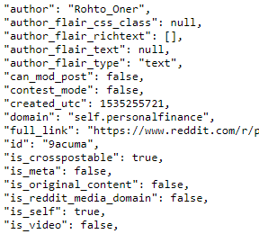
Data Acquisition
The data was extracted from pushshift.io Reddit API, using sqlite to store the data.
The data was scraped using the request module’s built-in JSON decoder.
Many pulls were done to extract the data; each pull obtained 500 posts from /r/personalfinance.
The official Reddit API (PRAW) was used to extract information that is not provided through the pushshift.io Reddit API.
Total of 25,000 rows of data and 7 columns.
Data was extracted between October 10th and August 10th.

Slide 6
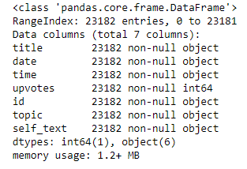
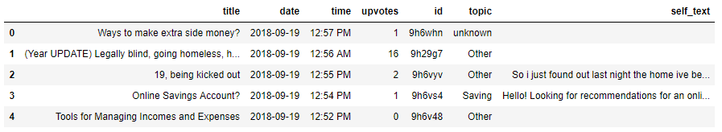
Data Dictionary
Title: Title of each post
Date: Date of post submission
Time: Time of post submission
Upvotes: Number of upvotes (popularity metric)
Submission ID: An alphanumeric ID automatically assigned to each Reddit post
Flair: The topic (or tag) assigned to each post
Self-text: The text information within each post

Slide 7
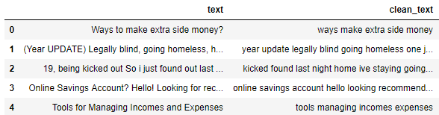
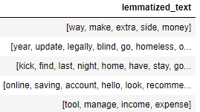
Data Wrangling
Create a new text column by concatenating title and self-text for each post.
Convert dates and times into datetime format.
Replace missing flairs with ‘unknown’.
Text Pre-processing:
Lowercase the words.
Remove numbers/digits.
Remove punctuation.
Strip whitespace.
Remove stopwords (common vocab in the English dictionary).
Remove noise.
Check for missing text after pre-processing.
Set the word limit for each row’s text to 150 words.
Tokenize the words (turn them into token objects).
Lemmatize the words (ex. Studying -> Study).

Slide 8
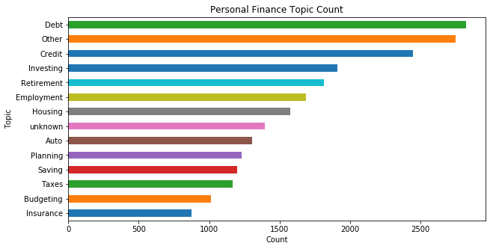
Most Common Topics
Debt is the most common topic in the personal finance subreddit, followed by Other and Credit. This indicates that debt is a major concern for many of the redditors (users) and they make submissions in order to seek advice.
Other includes posts that either haven't been given a topic or didn't match the main topics. With more data, it could be possible that Other is the most frequent topic instead of Debt.
Investment and Retirement are similar in their counts while also being similar in their functions.

Slide 9
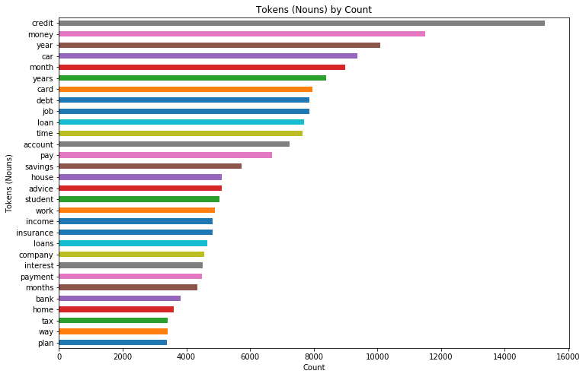
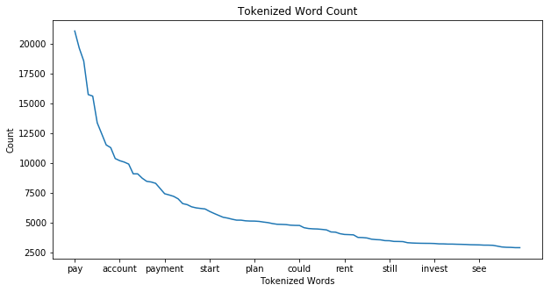
Most Common Tokens (Words)
The word 'pay' has been used over 20,000 times in the corpus of text.
After the first 10 tokens, the frequency that a word is used decreases very quickly.
The words 'account' and 'payment' are also fairly common and transferable among many different topics which is why it is logical for them to have high counts. Towards the end of the graph, we can start to see more topic-specific words such as 'rent' and 'invest'.

Slide 10
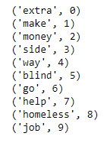

Feature Engineering
Before using the Latent Dirichlet Allocation model to create topics, we need to first transform the data so that it appropriately fits into the model.
Create a dictionary using all the text from each row (this maps each word to a numeric value).
Create a bag-of-words using the dictionary to count the number of times a word appears in a row

Slide 11
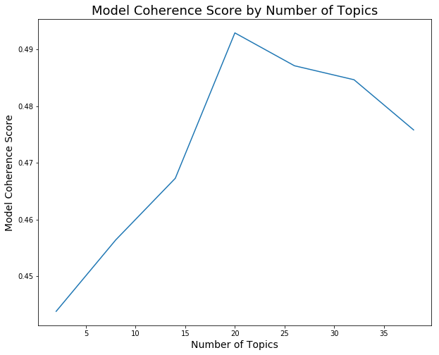
Latent Dirichlet Allocation - Topic Modeling
A corpus (large set of different texts) is represented in matrix form with documents as the rows and the words as the columns.
The LDA algorithm creates 2 smaller matrices: mapping topics by words and documents by topics.
The most important parameters for hyper-parameter tuning are the number of topics (K) and alpha (a).
Coherence (how much a text makes sense given the context of the words) is used to evaluate how “good” the topics are at representing the corpus.
Since K=20 provides the highest Coherence Score (0.4929), we will be creating 20 different topics.

Slide 12
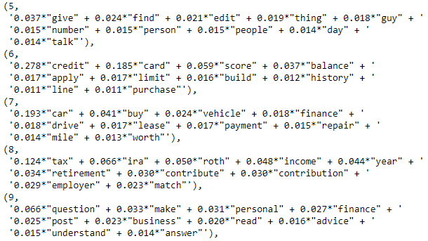
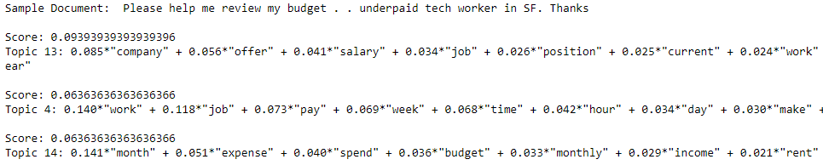
Labeling the Topics and Posts
Each topic is represented by a number and contains keywords with their respective weights.
By doing an eye-test, discernable topics were named by their most common keywords (ex. 7 - ‘Auto’)
Ambiguous topics were labeled ‘Other’ (ex. 5 - ‘Other’).
Each document is represented by a few topics and their respective weights.
We label each document by the topic with the most weight. In the example below, we would label the text with topic 13 (which would be Employment).

Slide 13
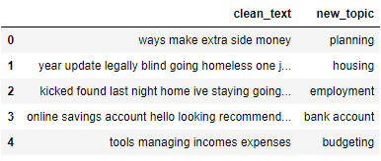
Evaluating the Topics
To evaluate how well the topics behave, we performed a classification task and predicted the topics for each row.
We intentionally made a bad model assumption: “Most labels accurately represent the post’s subject.” This is to later verify whether the labels work well.
Feature Selection: The clean_text column is the only feature. The topic column is the response variable.
Pipeline: CountVectorizer transforms the text into a bag-of-words. TF-IDF Vectorizer transforms the word frequencies into a probability that reflects the relative importance of a word in the document.

Slide 14
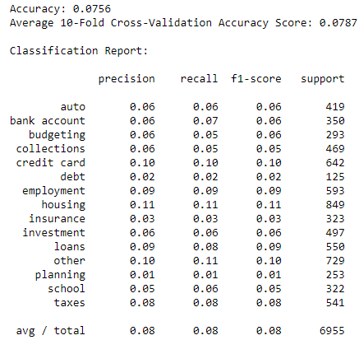
Baseline
A simple baseline was created using the DummyClassifier classifier to compare with the results of the models.
2 primary metrics were used:
Overall Accuracy: How accurate was the model in predicting the correct topic?
Recall of the ‘Other’ topic: How accurate was the model in predicting ‘Other’ for actual ‘Other’ posts?
The models were run using Grid Search CV for hyper-parameter tuning to improve results.
Baseline accuracy score: 0.0787
Baseline ‘Other’ recall score: 0.10

Slide 15
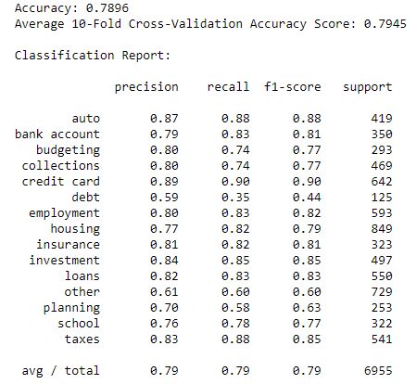
Linear SVC
Linear SVC is great for text classification due to its effective nature in high dimensional spaces (lots of words).
We can incorporate bigrams (2-word phrases) and trigrams (3-word phrases) without resulting in overfitting due to this feature.
79.45% of the topics were correctly predicted, which is 10x better than the 7.87% from the baseline!
… however, the predictions show that there was an inconsistency in the original topic labeling for ‘Other’. Some ‘Other’ posts did not belong in ‘Other’!
These are examples where ‘Other’ posts were falsely predicted as ‘Auto’ but they are better suited for ‘Auto’.

Slide 16
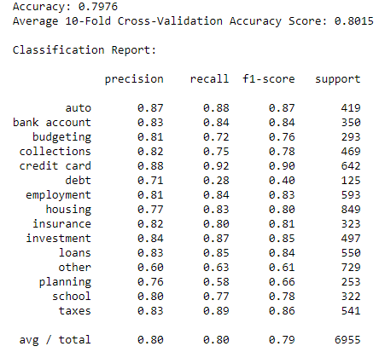
Logistic Regression
Logistic Regression performed the best with an accuracy of 80.15%! It also had the best precision (80%) and recall (80%).
It did well in predicting the main topics, since documents which were labeled with main topics were likely to have had the right label.
When we observe the predictions for ‘Other’, we again see the same problem as with the Linear SVC model: ambiguous words resulted in posts having ‘Other’ as their topic despite having more in common with one of the main topics.
These are examples where ‘Other’ posts were falsely predicted as ‘Loans’ despite the subject being about loans.

Slide 17
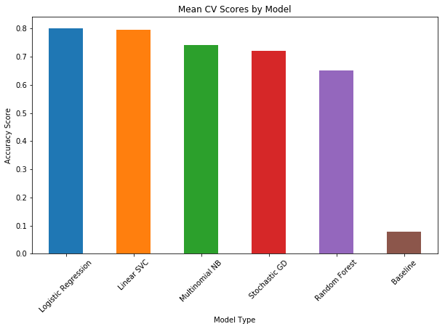
Model Results
The best performing model was Logistic Regression with a 0.8015 accuracy score. It also had the highest overall precision and recall scores.
While Naive Bayes is heralded as being one of the better models for text classification tasks, it did not do as well as Logistic Regression.
This is because Naive Bayes optimizes a generative objective function which makes it better for dealing with less training data.
Most models had high precision and recall rates for their main topics. The eye-test also confirms that the main topics generally fit their respective posts.
However, models suffered in the ‘Other’ topic because it contains posts that overlap with the main topics.

Slide 18
Conclusion - Recommendations
1) Split the Debt topic into multiple categories: It is a vast topic that can have better search results for users if it were segmented into sub-topics like ‘Loans’, ‘Collections’ and ‘Credit Card’.
2) Differentiate Credit and Credit Card: Most posts under the original ‘Credit’ topic were about credit card debts. The other ‘Credit’ posts were more geared towards other topics like ‘Loans’ and ‘Housing’, so it could be better to simply use ‘Credit Card’ as a topic.
3) Consider introducing a new School/Student topic: Reddit is dominated by teens and young adults. 5% of the total posts were clustered under the ‘School’ topic, which is a sizeable amount. This can also simplify the process of manually flairing for the younger users, since they won’t have to worry about which topic to pick.
4) Use Machine Learning to assign topics to untagged posts using a similarity percentage threshold: Rather than solely labeling posts by whichever topic has the most weight, we can also add a minimum weight percentage. For example, let’s use a threshold of 40%. If a post does not have any topics with at least 40% weight, the post will simply be labeled as ‘Other’. This is done to maximize subject accuracy.

Slide 19
Conclusion - Limitations
Ambiguous topics/words result in mislabeling: The most obvious limitation is the fact that some of the topics generated by the LDA model were ambiguous.
These were labeled as ‘Other’, which resulted in some posts having ‘Other’ as their topic despite being better suited for a different topic such as ‘Auto’ or ‘Loans’.
This is because those posts had many words with strong weights towards the ‘Other’ topics.
For example, if a post about credit cards contained more words from topic #5 (‘Other’) than from topic #6 (‘Credit Cards’), it would be categorized under topic #5 and labeled as ‘Other’.

Slide 20
Appendix
https://www.reddit.com/r/personalfinance/
https://github.com/pushshift/api
https://praw.readthedocs.io/en/latest/
http://pages.cs.wisc.edu/~jerryzhu/cs838/LR.pdf
https://www.statista.com/statistics/261766/share-of-us-internet-users-who-use-reddit-by-age-group/

