Slide 1

Can supplier stocks predict Maruti Suzuki?
Forecasting Indian stock returns with machine learning
Nyssa · Yathindra
UE24CS352A Machine Learning · Mini-Project
Notes:
Our question: carmakers depend on their suppliers, so do the suppliers' stock moves help predict the carmaker's stock? We test this for Maruti Suzuki, following a Stanford CS229 project that did the same for Volkswagen.

Slide 2



The Stanford paper we built on
Volkswagen + 30 suppliers
Gaps we address
Each supplier's daily returns over the past 28 days, plus German macro data
No baseline — its own footnote: guessing 0 is almost as accurate
Missing prices set to 0 — adds fake “flat” days
No trading costs — real trades cost money
No risk measures — how bad could it get?
Best of 96 settings reported — only 18 beat buy-and-hold
Four models compared
Elastic Net, Decision Tree, XGBoost, LightGBM; Elastic Net won at every horizon
Trading test
Buy or short VW on the forecast; best setting made 21.49% vs 7.98% buy-and-hold
Notes:
Glawion (2021) predicted VW from 30 suppliers. Elastic Net was best, and the headline was 21.49% vs 7.98% buy-and-hold. But that was the best of 96 model/horizon/threshold combinations, with no costs, and the paper's footnote admits that always predicting zero gives almost the same error. We set out to repeat the idea for India and fix these gaps.

Slide 3

Problem and data
Question: do the last few days of supplier returns predict Maruti's return over the next 5 trading days better than guessing “no change”?
2,415
10
61
trading days
Dec 2016 – Oct 2026
supplier & market
stocks
features
per day
MARUTI.NS (target)
Auto components
MOTHERSON
BOSCHLTD
UNOMINDA
ENDURANCE
Source: Yahoo Finance via yfinance, daily prices adjusted for splits and dividends.
Tyres & batteries
MRF
APOLLOTYRE
EXIDEIND
Peers with too little history would be dropped (≥ 90% coverage needed); short holiday gaps filled from past prices only. Nothing filled with zero.
Steel & market
TATASTEEL
JSWSTEEL
NIFTY 50
Notes:
We used 10 years of daily data from Yahoo Finance. The target is Maruti Suzuki. The peers are nine listed suppliers — parts makers, tyre and battery makers, and steel — plus the NIFTY 50 index. All ten had enough history, so none were dropped. 2,415 usable days after we remove the warm-up period and the last five days, which have no future price.

Slide 4






How the pipeline works
1
2
3
4
5
6
Download
Build features
Split by time
Tune & select
Test once
Backtest
Maruti + 10 peers from Yahoo Finance
61 clues per day, using only past data
Train → validate → test, with a gap
Best settings per model on validation
Score every model on unseen data
Trade on forecasts, pay 0.05% per trade
Target: Maruti's return over the next 5 trading days = Close[t+5] / Close[t] − 1. Also tested at 1 and 20 days.
Everything is reproducible: run_experiment.py rebuilds every table and chart; 11 automated tests check for future-data leakage.
Notes:
Six steps. The key rule in feature building: a row for day t only uses information available at the close of day t. The target is the 5-day forward return. Then a time-ordered split, tuning on the validation period, one final test, and a backtest with transaction costs.

Slide 5



Features and models
61 features for each day
Six models compared
11
Maruti's own history
1/5/20-day returns, price vs 5/20/50-day averages, 10/20-day volatility, volume change, day's range, where it closed in the range
Elastic Net
best-fit line with a penalty that stops it chasing noise
Decision Tree
a small yes/no flowchart (depth ≤ 8)
50
Supplier & market returns
each of the 10 peers' daily return on each of the last 5 days (the paper used 28 days)
Random Forest
150 trees that vote; averaging cuts noise
Gradient Boosting
trees built one after another, each fixing the last (like LightGBM)
Baselines
predict 0 (“no change”) and the historical average
Notes:
Two groups of features: 11 from Maruti's own prices and volume, and 50 from the peers — ten stocks times their last five daily returns. We compare four models, plus two baselines. The baselines matter: any model has to beat simply guessing zero to be useful.

Slide 6

Testing without peeking at the future
Train
1,444 days
Validate
478 days
Test
483 days
gap
gap
Dec 2016 – Oct 2022
Nov 2022 – Oct 2024
Oct 2024 – Oct 2026
No shuffling
5-day gap at each boundary
Test set used once
Shuffled data would let the model learn from 2025 to “predict” 2020.
The last training targets look 5 days ahead, so those rows are dropped.
Settings chosen on validation; the test period is only scored at the end.
Extra checks
With vs without suppliers
same model, same test period
Walk-forward
5 separate test years, retrained each time
Horizons
1, 5 and 20 days ahead
Notes:
Stock data is a time series, so we never shuffle. We train on 2016 to 2022, choose settings on 2022 to 2024, and score once on the last two years. A 5-day gap at each boundary stops training targets overlapping the next period. We also re-ran everything over five separate years (walk-forward), and at three horizons.

Slide 7
Only one model beat guessing “no change”
3.356%
Random Forest with suppliers: the only model below predict-0 (3.375%), about 1% better
2 of 4
models improved with supplier data (Random Forest, Gradient Boosting). Elastic Net and the tree ignored it.
Worst
on test: the Decision Tree, which won on validation by 0.004 pts. Small gaps are noise.
Axis starts at 3.30% to make small gaps visible.
Notes:
This is the main result. Grey is each model with Maruti's own features, teal is with the supplier features added. The first pair is the predict-zero baseline. Only Random Forest with suppliers gets below it, by about one percent. Suppliers helped the two tree ensembles, which can pick up conditional patterns; Elastic Net and the single tree ignored them. And the model that won on validation was the worst on test — the validation scores were nearly tied, so that win was mostly luck.

Slide 8
Does it hold up over time?
Walk-forward: 5 separate test years
Error by forecast horizon (RMSE %)
Years where the model beat predict-0
Model | 1 day | 5 days | 20 days
Predict 0 | 1.440 | 3.375 | 7.544
Random Forest | 1.448 | 3.356 | 7.359
Gradient Boosting | 1.485 | 3.385 | 7.314
Elastic Net | 1.441 | 3.387 | 7.594
Decision Tree | 1.496 | 3.470 | 8.283
Random Forest
2 / 5
Gradient Boosting
2 / 5
Elastic Net
1 / 5
Decision Tree
0 / 5
Teal = beats predict-0. Error grows with the horizon, as in the paper. At 20 days both ensembles beat predict-0 with supplier data; without it, only Gradient Boosting does, barely (7.51%).
On average, the simple historical-average baseline had the lowest error (3.335%).
Notes:
One test period can be lucky, so we re-ran everything over five separate years. No model beat the zero baseline consistently — the best managed two years out of five. Across horizons, error grows the further ahead we predict, exactly as the paper found. Interestingly, at 20 days the supplier features help more: both ensembles beat zero there.

Slide 9
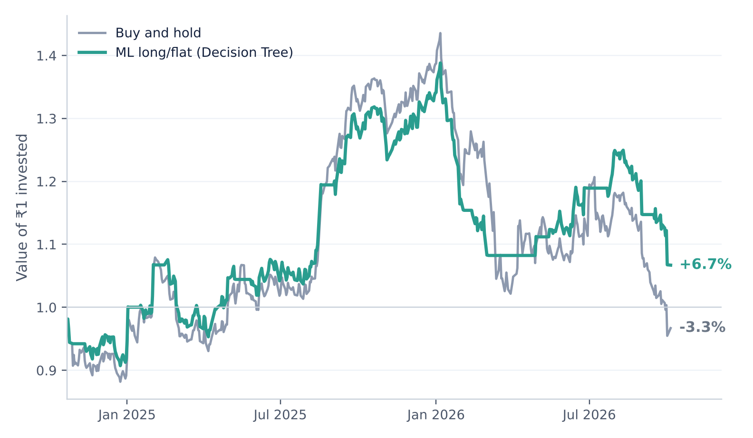

The trading test: a win that needs a caveat
+6.7%
strategy return
vs −3.3% buy-and-hold
−23%
worst drop
vs −33% buy-and-hold
32
trades
in market 71% of days
Mostly from sitting in cash during the late-2026 fall. With own features only, the result swings from −3% to +25% just by changing the threshold.
Rule: hold Maruti on a day only if yesterday's forecast was above 0.25%, otherwise cash. 0.05% cost per trade. Test period Oct 2024 – Oct 2026.
Notes:
The strategy made 6.7% while the stock fell 3.3%, with a smaller worst drop. But look at the chart: it tracks buy-and-hold closely and pulls ahead mainly by being out of the market during the final fall. Since the forecasts themselves don't beat zero, we don't claim an edge. This is the same trap as the paper's 21% figure.

Slide 10


What we learned
A small signal
Limitations
Supplier returns help the tree ensembles a little, but not enough to reliably beat guessing “no change” — the paper's own footnote says the same.
Hand-picked supplier list
One validation period, small tuning grids
No slippage or taxes
One target stock
Backtests can mislead
Our strategy beat buy-and-hold, yet the forecasts have no reliable edge and the result swings with the threshold.
Next steps
Baselines are essential
Verified supply-chain data
Macro data (bond yields, INR/USD)
Re-tune in every walk-forward year
Other Indian automakers
Without a predict-0 row, a 3.36% error looks meaningless. With it, the honest answer is clear.
Nyssa
Data pipeline & supplier selection, features, backtest & risk metrics, dashboard, write-up & slides
Yathindra
Models & tuning, evaluation (baselines, ablation, walk-forward, horizons), tests, experiments & analysis
Notes:
Three takeaways. Suppliers carry a small signal, usable only by the tree ensembles. Backtest profits can mislead when the forecasts underneath don't beat a baseline. And including baselines is what makes the results interpretable. Then limitations, next steps, and who did what.

Slide 11
Live demo & questions
1
Load MARUTI.NS + suppliers
2
Train and compare with predict-0
3
With vs without suppliers
Streamlit dashboard · Yahoo Finance data · code on GitHub
4
Move the cost and threshold sliders
5
Walk-forward check
Notes:
Switch to the app. Load Maruti with suppliers from Yahoo (or upload the saved CSVs if the network fails). Train, point at whether the selected model beats predict-0, show the with/without-suppliers table, move the cost slider to show the strategy change instantly, then run walk-forward.

