Slide 1



Development of a face recognition system using Subspace Methods
ST40 - Internship
Tony DUONG
Department of Computer Science
Tutor : Kazuhiro Fukui
Suiveur UTBM : Alexandre Caminada
www.utbm.fr

Slide 2
I. Presentation of the environment II. Project III. Reflections and Difficulties IV. Conclusionprésentation Titre suite
Outline
2
ST40 – Development of face recognition system using Subspace Methods – Tony DUONG
www.utbm.fr

Slide 3
Presentation of the environment

Slide 4
Titre de la présentation Titre suite
IA – University of Tsukuba
One of the oldest national universities and one of the most comprehensive research universities in Japan
A lot of international partnerships with foreign universities (more than 100 countries)
In Tsukuba, more than 300 research institutes
Also called « Tsukuba Science City »
Nearly half of Japan’s public R&D budget has been spent in Tsukuba
Leads scientific and technological research in Japan
4
ST40 – Development of face recognition system using Subspace Methods – Tony DUONG
www.utbm.fr

Slide 5
IB – Computer Vision Laboratory
Many aspects of computer vision are studied (protein structure classification, face recognition by small features, gesture recognition…)
17 members, most of them are students
6 foreigners (China, Brazil, Indonesia)
Communication in English mainly
Seminars held once a week to report the work progress
Computer, camera and software provided by the laboratory
All the projects conducted by the students revolve around the « Subspace Methods »
5
ST40 – Development of face recognition system using Subspace Methods – Tony DUONG
www.utbm.fr

Slide 6
Internship project

Slide 7
Titre de la présentation Titre suite
IIA – Working method
Autonomous work
No experience at all : research papers, courses on the Internet, help from colleagues
Before starting the development of the project, learning of the classification and shape detection techniques
Research papers → Implementation → Testing → Accuracy measurement
Monthly report to be submitted to my tutor (work progress, check if my understanding is correct… )
Software used : Matlab R2014b with Kinect camera
7
ST40 – Development of face recognition system using Subspace Methods – Tony DUONG
www.utbm.fr

Slide 8


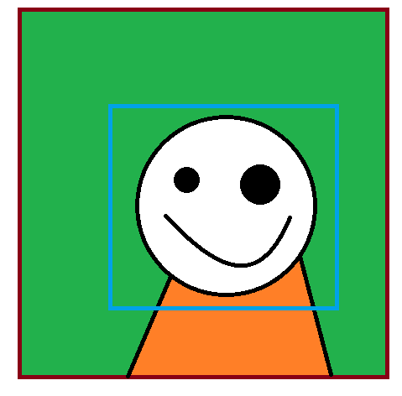





Titre de la présentation Titre suite
IIB – Project and Results : Description of the project
Development of a face recognition system using Subspace Methods
Detect a face from the camera and recognize that face from a database.
Detection part and Recognition part
FRAMEWORK
Recognition
Snapshot
Detection
“Database”
8
ST40 – Development of face recognition system using Subspace Methods – Tony DUONG
www.utbm.fr

Slide 9
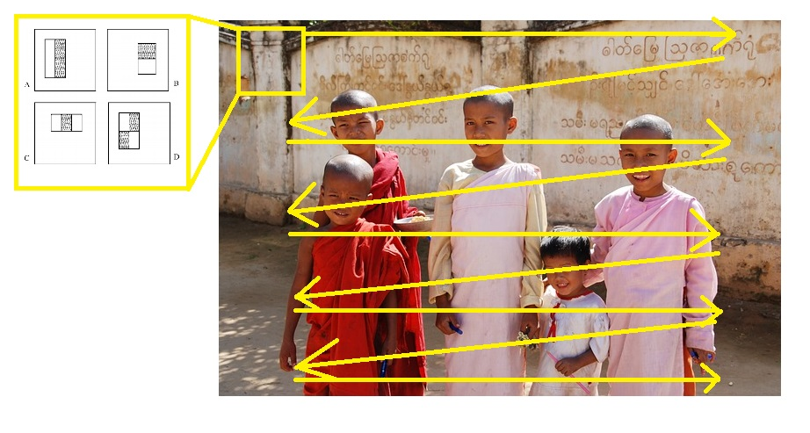
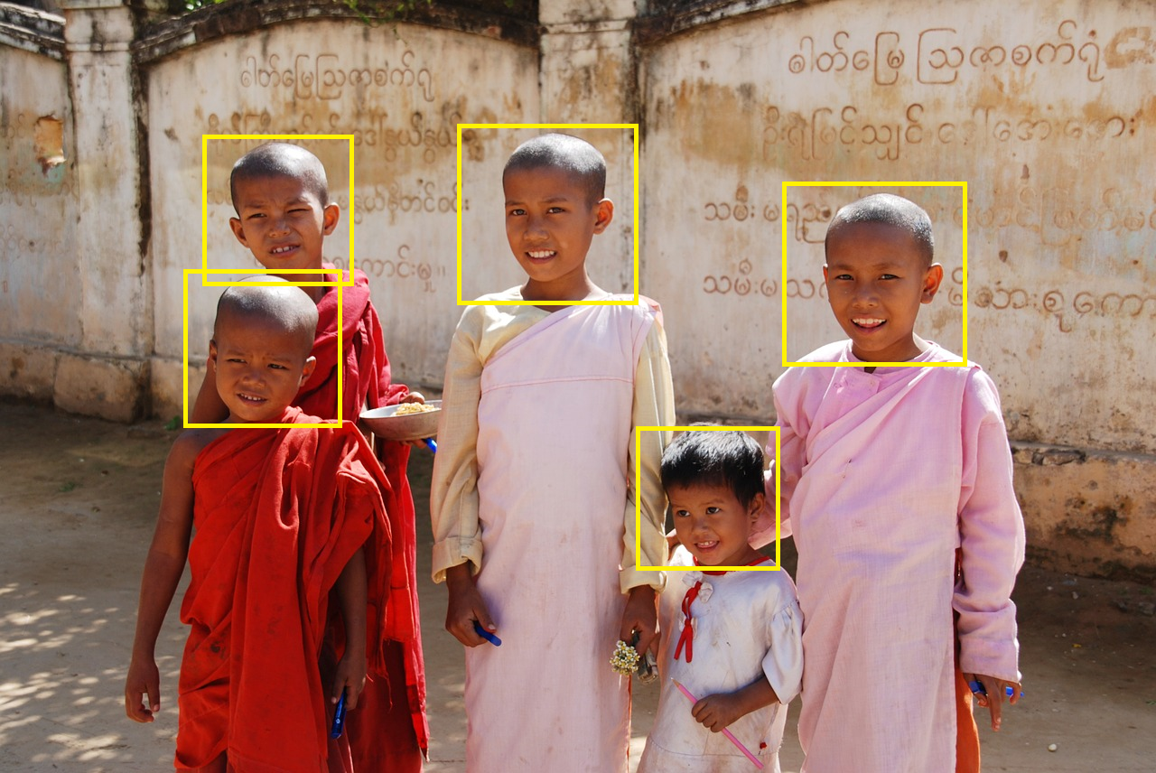
Titre de la présentation Titre suite
IIB – Project and Results : Face Detection
I have used Viola-Jones shape detection algorithm (fast → suited for real-time application, high detection rate)
Method proposed by Paul Viola and Michael Jones in 2001
The idea is to slide a window across the entire image and evaluate if a frontal face can be detected in that window
9
ST40 – Development of face recognition system using Subspace Methods – Tony DUONG
www.utbm.fr

Slide 10
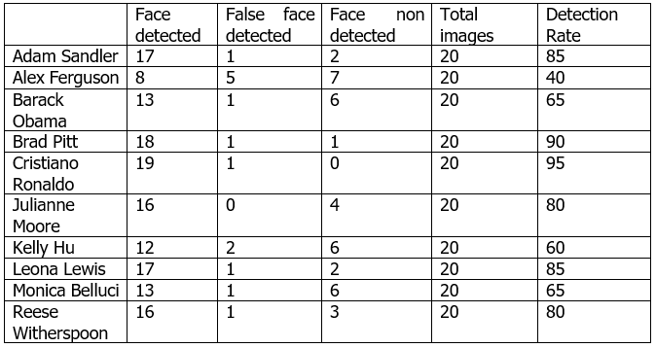




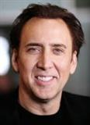
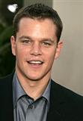
Titre de la présentation Titre suite
IIB – Project and Results : Experiment of Viola-Jones algorithm
Measurement of the detection accuracy
Database used : MSRA-CFW, data set of celebrity face images collected from the web
Results of the experiment
Samples of the MSRA-CFW
10
ST40 – Development of face recognition system using Subspace Methods – Tony DUONG
www.utbm.fr

Slide 11
Titre de la présentation Titre suite
IIB – Project and Results : Face recognition
First step : train the system
Second step : give to the system
an unknown face image
Subspace 1
Subspace 2
Subspace 3
Subspace
Reference subspaces
Input subspace
Similarity S-S1 = 0.98
Third step : calculate the similarity between each
ref. subspaces and the input subspace
Similarity S-S2 = 0.45
Similarity S-S3 = 0.24
11
ST40 – Development of face recognition system using Subspace Methods – Tony DUONG
www.utbm.fr

Slide 12
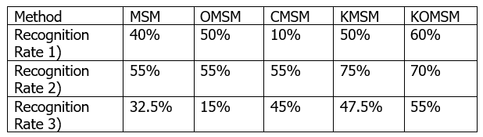
Titre de la présentation Titre suite
IIB – Project and Results : Face recognition and Experiment
Many subspace methods exist so I have performed an experiment to check which one was the most suited for face recognition task
Cropped images containing only the face part from the previous face detection experiment were used for this experiment.
Kernel Orthogonal Mutual Subspace Method
11
ST40 – Development of face recognition system using Subspace Methods – Tony DUONG
www.utbm.fr

Slide 13
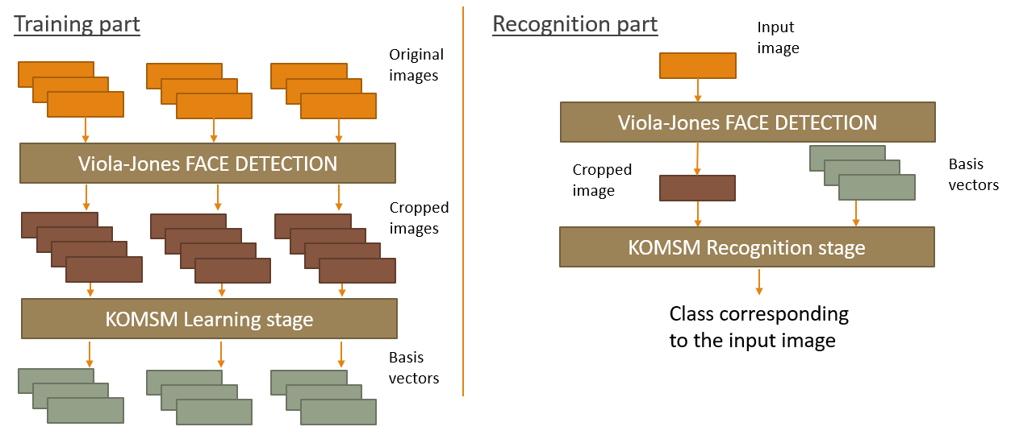
Titre de la présentation Titre suite
IIB – Project and Results : Application
Framework of the application
12
ST40 – Development of face recognition system using Subspace Methods – Tony DUONG
www.utbm.fr

Slide 14
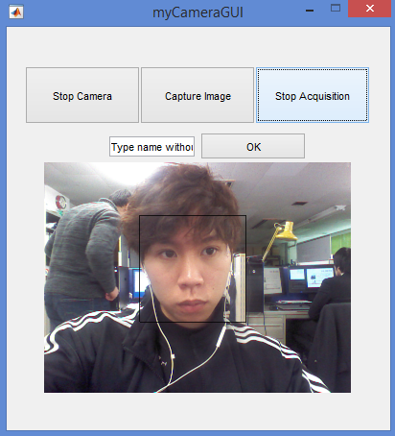
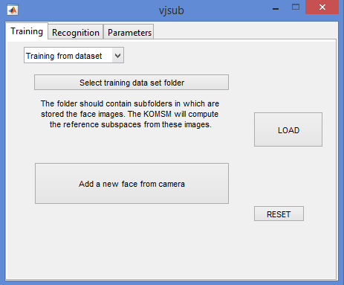
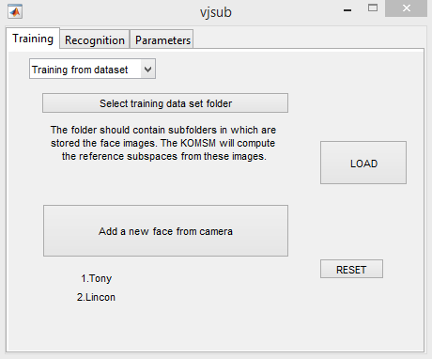
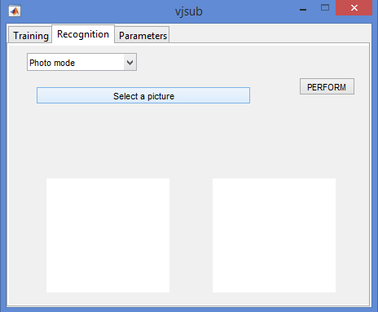
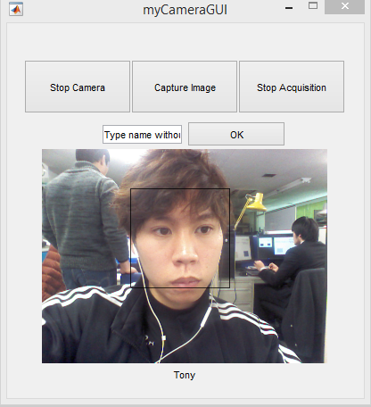
IIB – Project and Results : Application
Training part
Recognition part
13
ST40 – Development of face recognition system using Subspace Methods – Tony DUONG
www.utbm.fr

Slide 15
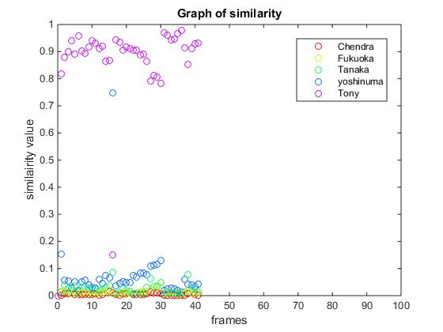
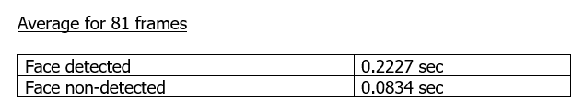
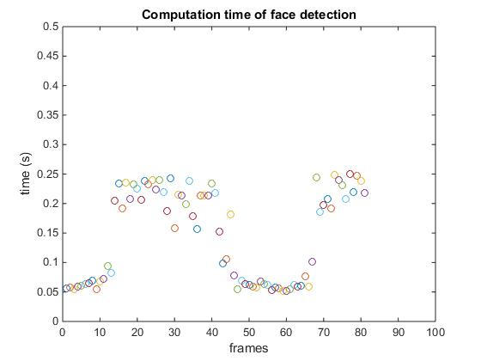
Titre de la présentation Titre suite
IIB – Project and Results : Experiment
The application is able to detect faces and to recognize them.
Nevertheless, its real-time ability is not good enough. VJ algorithm is taking too much time.
14
ST40 – Development of face recognition system using Subspace Methods – Tony DUONG
www.utbm.fr

Slide 16
Reflection and Difficulties

Slide 17
Titre de la présentation Titre suite
III – Reflection and Difficulties
Being inexperienced in the field of computer vision, it was difficult at first to know how to start
Mathematical knowledge was necessary and the mathematical courses (MT45, MT44) I took at UTBM were very useful
Working alone was difficult and sometimes discouraging
First experience in research laboratory : participating in seminars, watching the presentations of the other members…
Language barrier
16
ST40 – Development of face recognition system using Subspace Methods – Tony DUONG
www.utbm.fr

Slide 18
Conclusion

Slide 19
Titre de la présentation Titre suite
Conclusion
The application works fine from a functional point of view
In order for it to work in real-time, it needs to be developed in another environment suited for real-time applications.
First overview of Computer Vision
English as well as Japanese skills have improved considerably
I have experienced working and socializing with foreigners in a country with a different culture
17
ST40 – Development of face recognition system using Subspace Methods – Tony DUONG
www.utbm.fr

Slide 20
Merci de votre attention
www.utbm.fr

