Slide 1

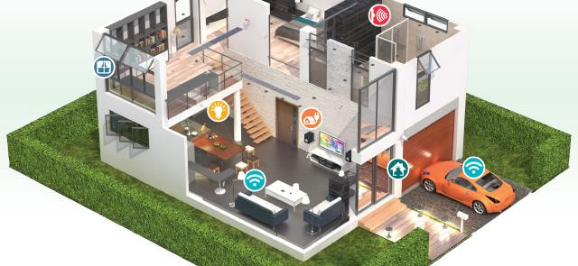
OpenHAB Smart home

Slide 2

Philips Hub

Slide 3
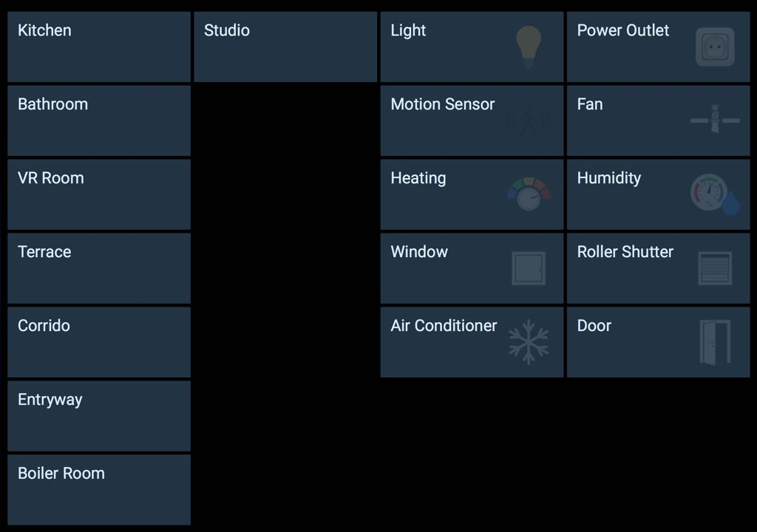
Interface

Slide 4
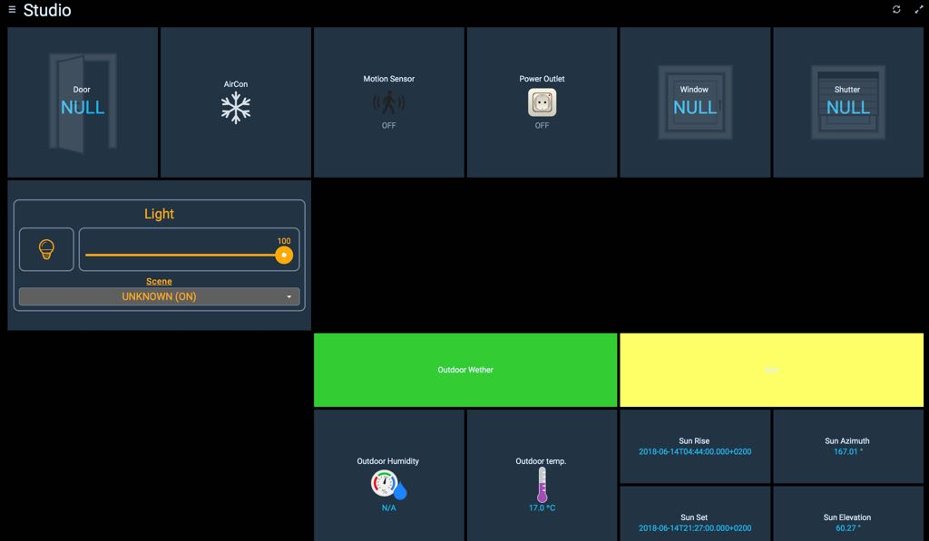
Interface

Slide 5
Mode
Study mode
Turn on all light of studio
100% brightness
Teaching mode
Turn on one third lights of studio
100% brightness
Sleep mode
Turn off all brightness
( Can set a 10% brightness night-light )
TV mode
Turn on all light of VR room
60% brightness
Cooking mode
Turn on one third lights of Kitchen
60% brightness

Slide 6
Video demonstration
A short video will be placed here

Slide 7
Discussion about Collaboration_issue
Collect data from measurement campaign (CO2 conc., Number of people, HVAC,…) & make rules in OpenHAB
Display the control HABPanel on the Magic Mirror

Slide 8
Discussion about Future_issue
Configuration with text script & UIs
Tweak or Make custom widgets for rooftop
# Edit modes on the existed widgets and API
# Create a specific widget (Energy Management purpose) for rooftop
Integrate voice assistant application, ex. Google voice assistant

Slide 9
Ask for recommendation
Secure remote access with VPN / private cloud server / private domain/ etc.
After merger to Microsoft, transplant from GitHub to GitLab. Cause it is not a open source anymore

