Slide 1
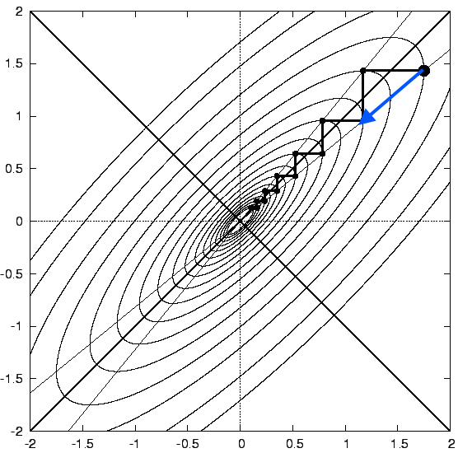
Small Step Size
Large Step Size

Slide 2

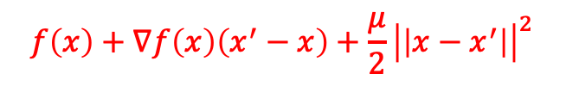


$μ$-strongly convex
$$f\left(x\right)+∇f\left(x\right)\left(x^{′}−x\right)+\frac{μ}{2}{\left|\left|x−x^{′}\right|\right|}^{2}$$
$$f\left(x\right)$$
convex
$$f\left(x\right)+∇f\left(x\right)\left(x^{′}−x\right)$$

Slide 3












$$x_{1}$$
$$θ$$
$$1−θ$$
$$x_{2}$$
$$1−θ$$
$$θ$$
$$x_{1}$$
$$θ$$
$$1−θ$$
$$x_{2}$$

